Slide 1
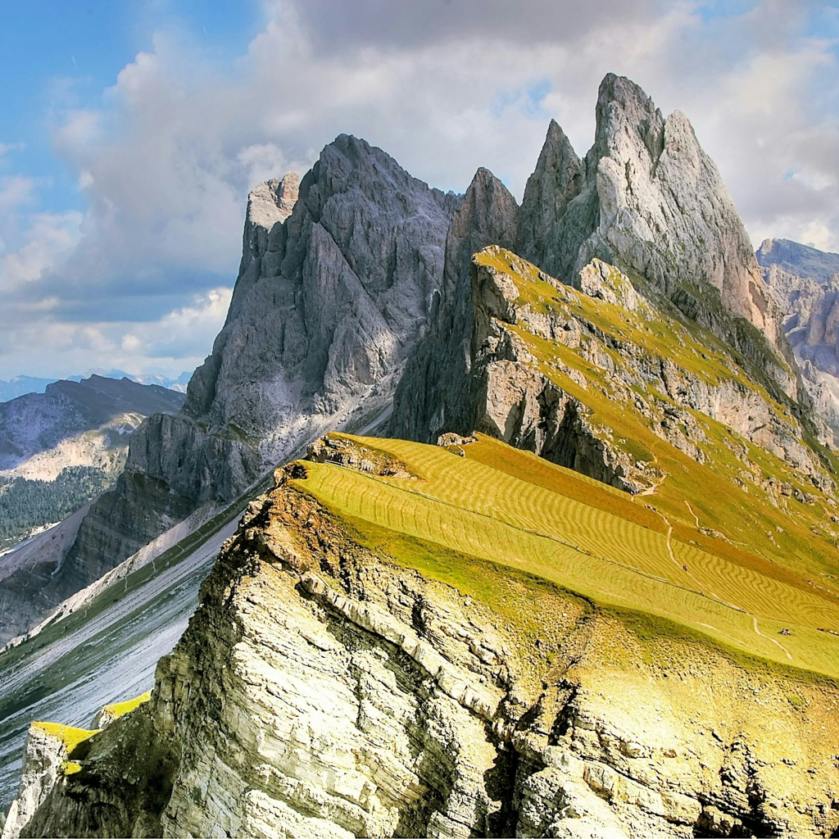
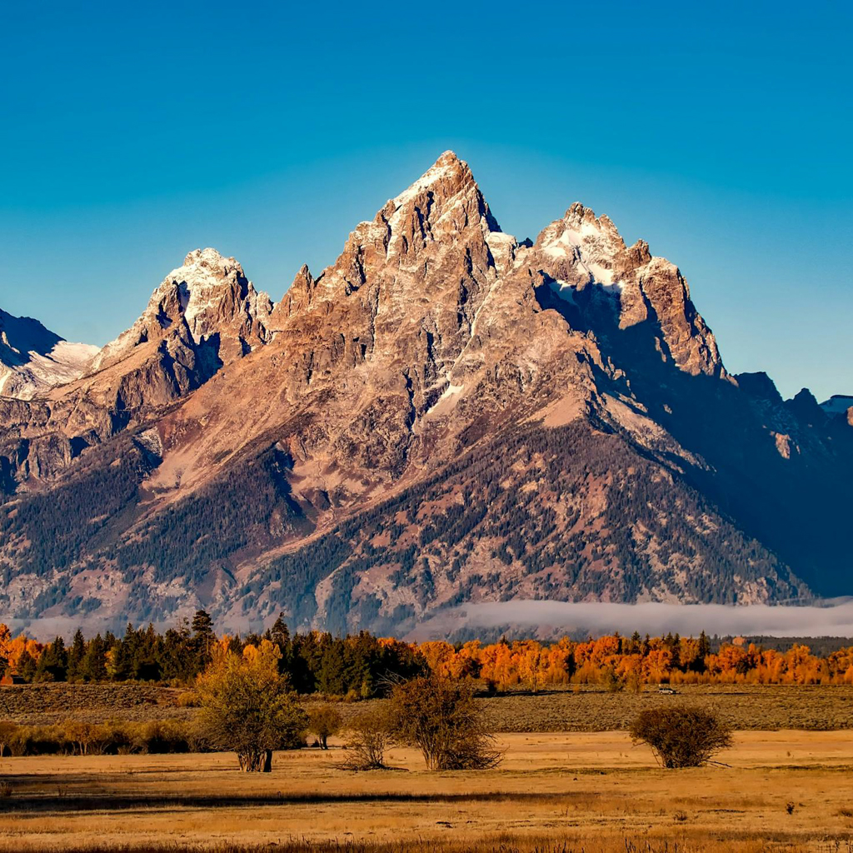
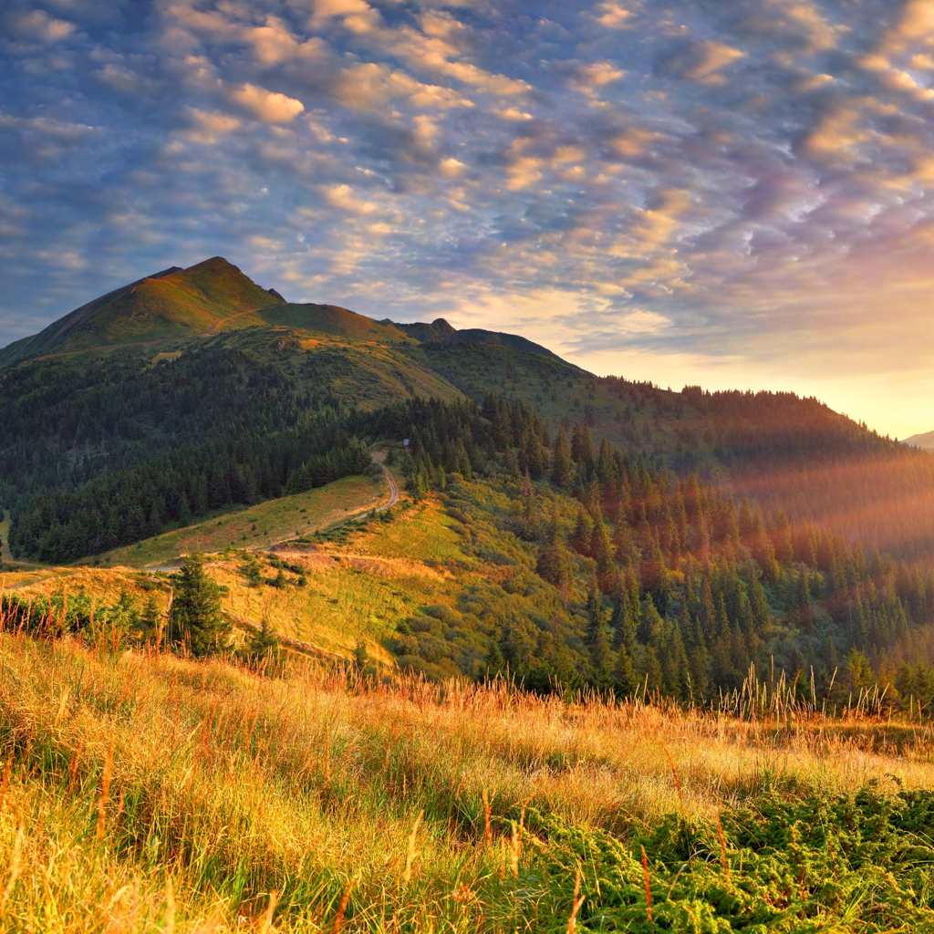
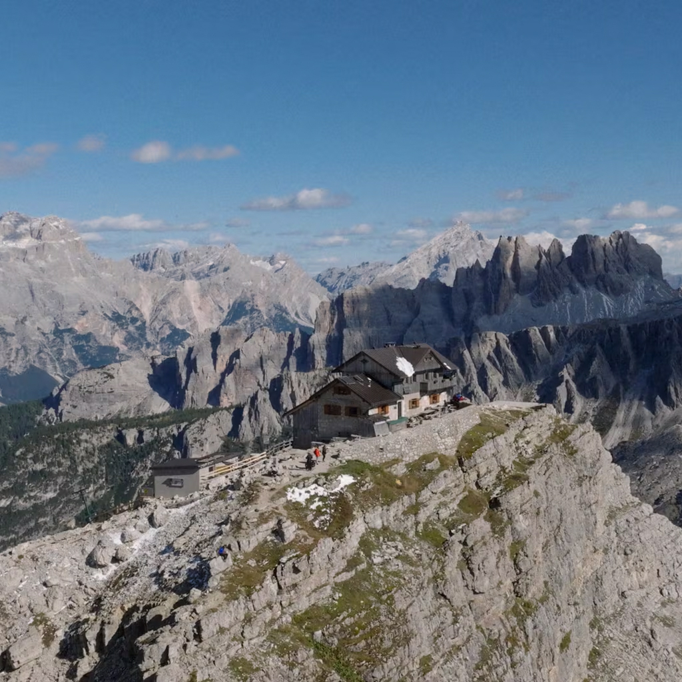
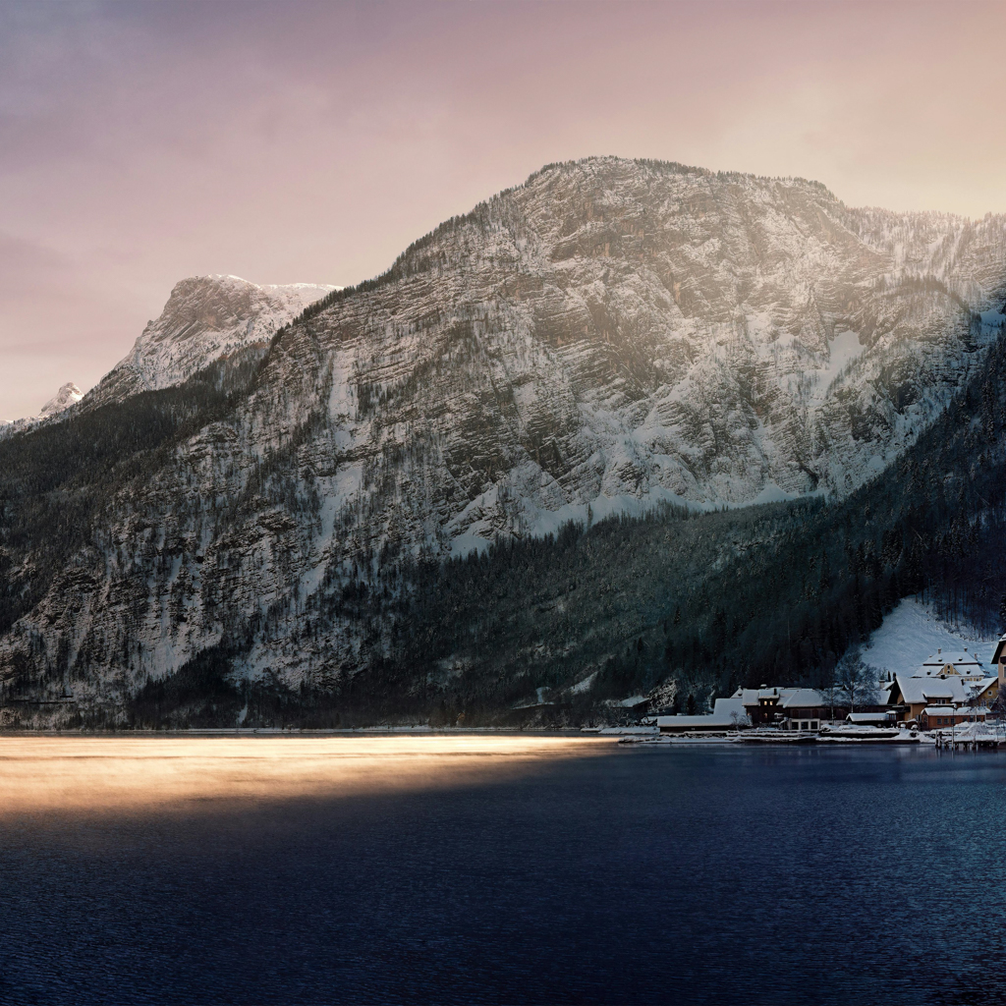
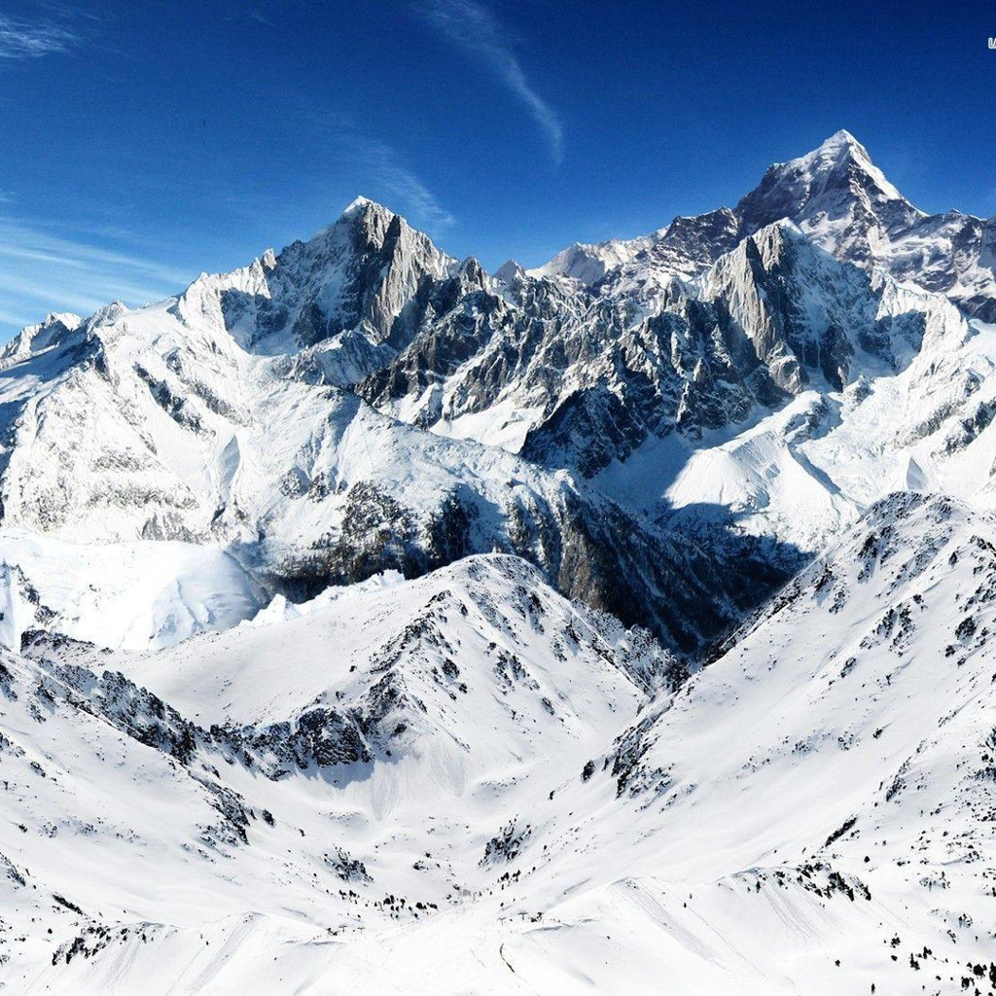

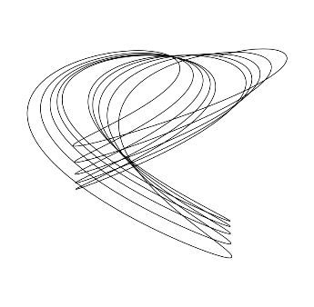
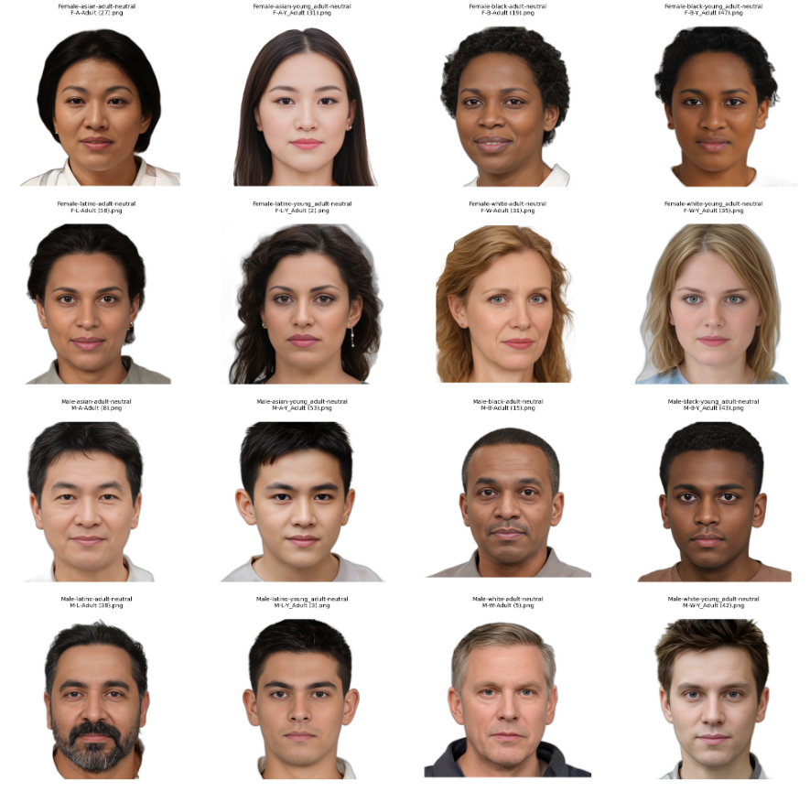
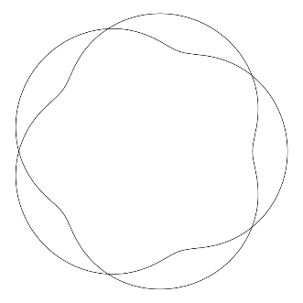


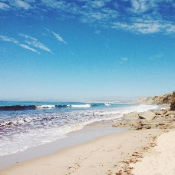
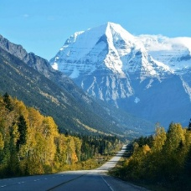
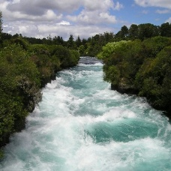
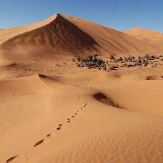
a
Task sequence
Preview
Attractiveness rating
Preference judgment
Median-ranked image: familiar stimuli
+
+
+
+
+
-3
-2
-1
0
1
2
-3
-2
-1
0
1
2
3
-3
-2
-1
0
1
2
3
-3
-2
-1
0
1
2
3
3
…..
…..
…..
1.0 s
0.5 s for each image
0.7 s
until response
0.7 s
until response
0.7 s
until response
0.7 s
until response
b
Visual stimulus categories
c
Questionnaires
1
Daily Life Familiarity/Novelty Preference
Preferences across 8 domains: food, activities, movies,
restaurants, clothes, games, books, and snacks
2
Autism-Spectrum Quotient (AQ)
Adult autistic traits; total score 0–50
Geometric figures
3
“Maemuki” Attitude
Resilience-related traits: trust, coping, social skills, perspective,
discipline, community, growth, and self-worth
4
Flow Propensity
Frequency and attitude toward deep, focused engagement
5
Negative capability
Capacity to respond adaptively in uncertain or
challenging situations
Faces
Natural scenes

