Slide 1


Safety and Financial Outlook North American Airlines United Airlines
View in Power BI
Last data refresh:
4/11/2024 8:01:04 PM UTC
Downloaded at:
4/11/2024 8:15:59 PM UTC

Slide 2
Neighbors Safety

Slide 3
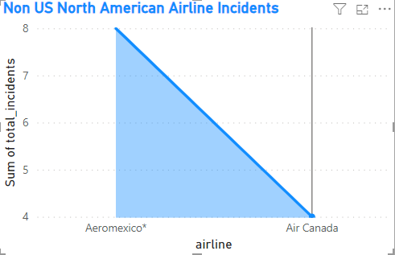
Neighbors Incidents are Low
Canada experienced 4 major Incidents
Mexico experienced 8 major incidents

Slide 4
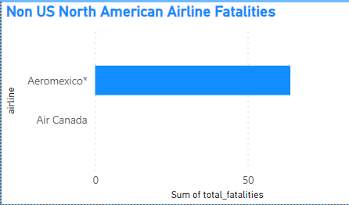
Neighbors Fatalities are Low
Canada experienced 0 fatalities
Mexico experienced 64 fatalities

Slide 5
U.S. safety

Slide 6
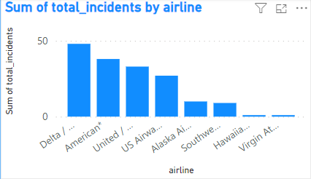
United Safety standards are working but need improvement
United sits as the 3rd major airline with major incidents
United has experienced 33 major incidents
Other airlines with better records are smaller airlines

Slide 7
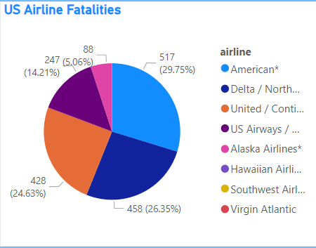
U.S airlines have experienced 1,738 fatalities
United owns 24.63% of all fatalities
American Airlines leads in fatalities 517 recorded

Slide 8
Financial indicators

Slide 9
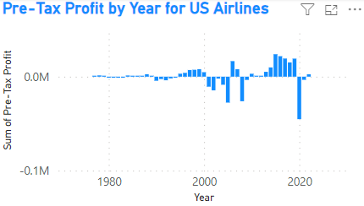
Profit
Profit is increasing for airlines
COVID recovery is progressing
Way down from pre-COVID
Expect a slow burn

Slide 10
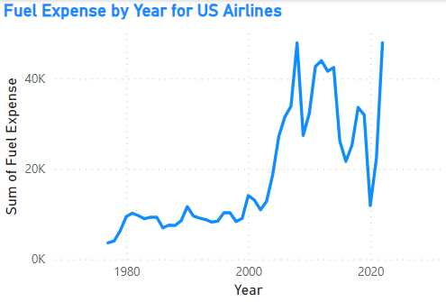
Fuel expense is all time high
U.S. airlines are experiencing fuel expenses at all time highs
This will drive ticket prices way up
Will affect recovery speeds
May hinder recovery

Slide 11
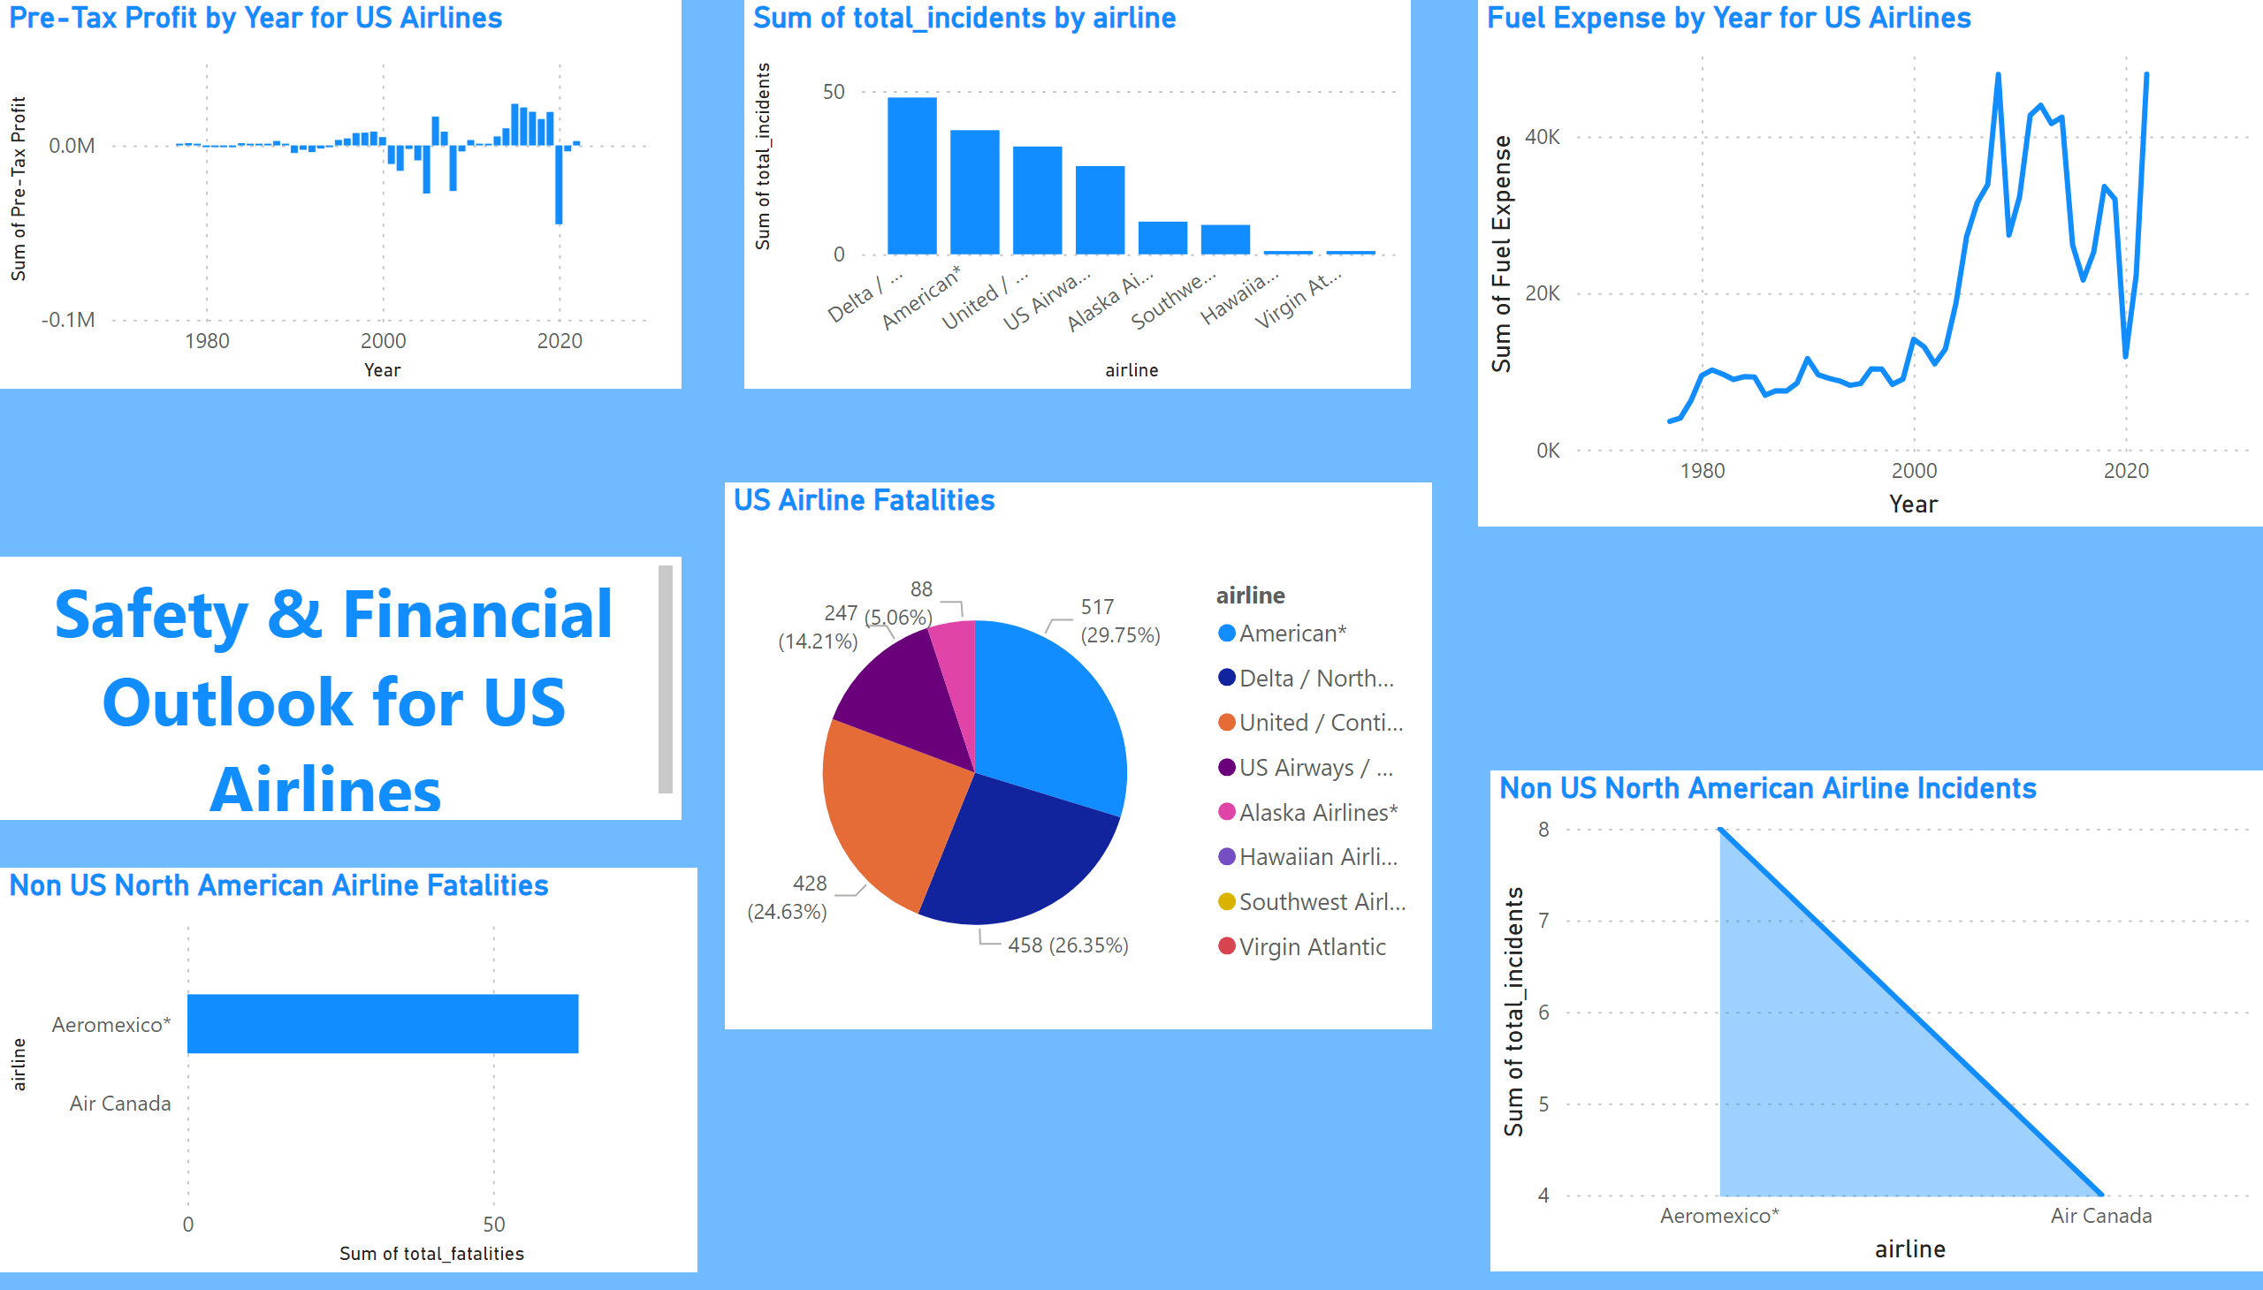
Page 1
Outlook
Notes:
Pre-Tax Profit by Year for US Airlines
No alt text provided
Fuel Expense by Year for US Airlines
No alt text provided
Non US North American Airline Fatalities
No alt text provided
Non US North American Airline Incidents
No alt text provided
US Airline Fatalities
No alt text provided
columnChart
No alt text provided
textbox
No alt text provided

