Slide 1

CBOS:
SHARED
TECHNICAL
SERVICES
OVERVIEW
SHARED SERVICES
GLOBAL MARKET SUPERVISION
SHARED FUNCTIONS
2026

Slide 2

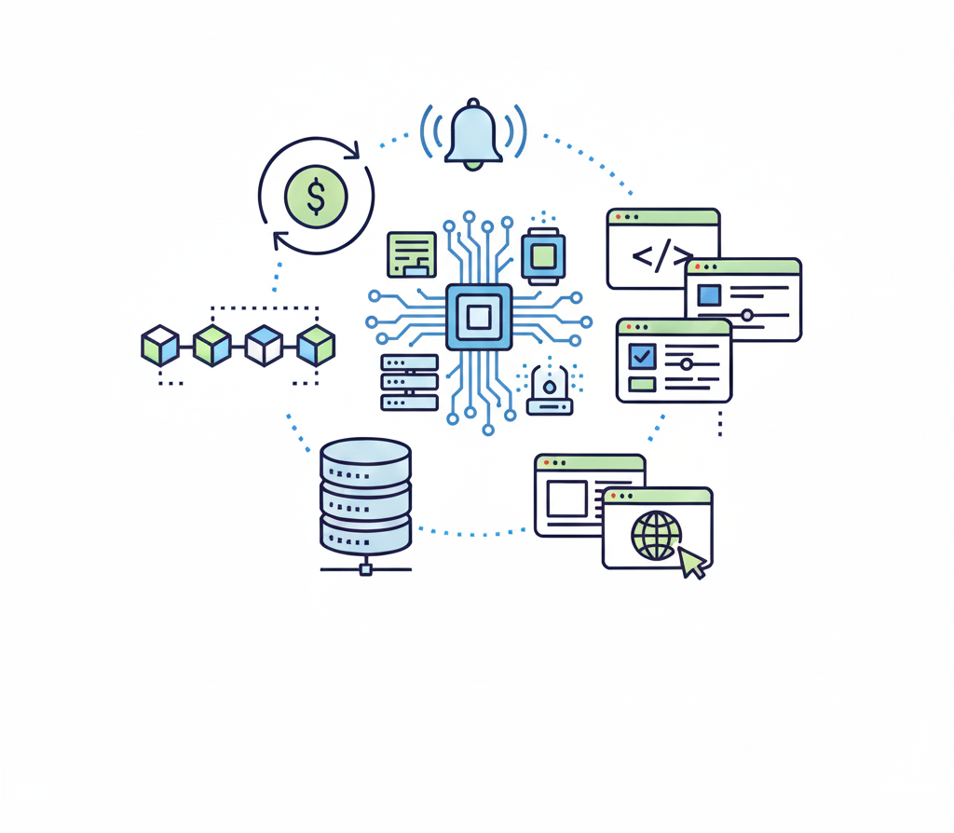
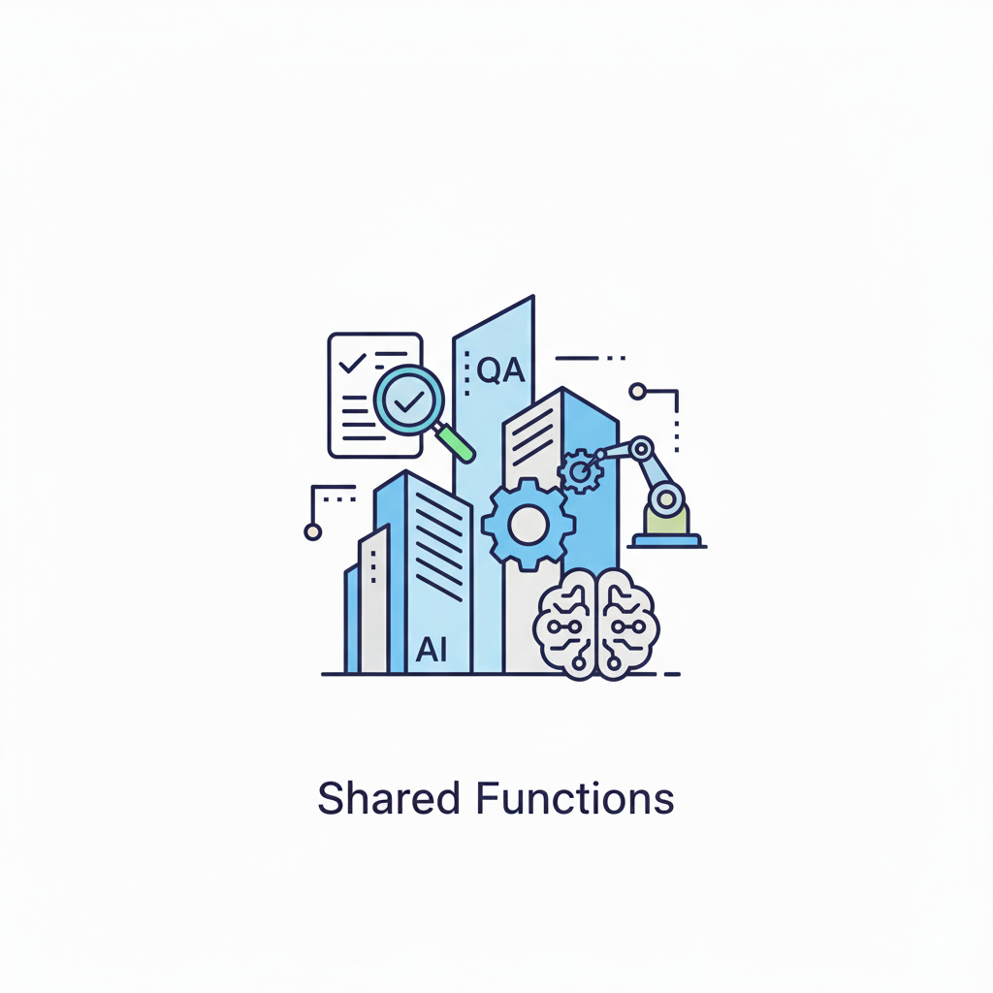
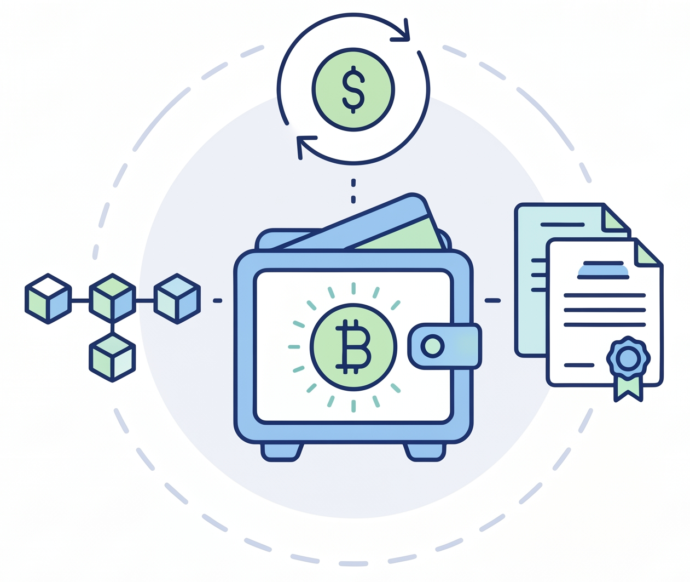
SHARED TECHNICAL SERVICES
ESTATE COVERAGE
GLOBAL MARKET
SUPERVISION
SHARED
SERVICES
SHARED
FUNCTIONS
Builds and maintains the 1LOD Supervision Framework that covers Global Markets (including Global Investment Banking and Corporate Banking)
Maintains and Develops Services to be re-used across CBOS and various domains across RBC.
Supports the wider CBOS through AI, Architecture, Automation, Development and QA. CM Technical Lead on Digital Assets.

Slide 3
TECHNICAL APPLICATIONS
GLOBAL MARKET SUPERVISION
SHARED SERVICES
HUB GUIs
ROAR
RESOURCE ONBOARDING
ATS
ABSENCE TRACKING
JAMS
JOB MANDATE
SNS
SIMPLE NOTIFICATION SERVICE
Apheleia
ADMIN AS A SERVICE
HPDS
HIGH PERFORMANCE DATA SETS (LARGE DATA REPORTING)
Workspaces
CONFIGURATION SERVICE
OpsHub
Venue Tool
EXCHANGE/BROKER APPROVAL
EDS
PAR WORKFLOW
OSFI
GOVERNANCE & INTERNAL CONTROLS
IDOL
FAAS
SQS
SIMPLE QUEUING SERVICE
CQS
CENTRAL QUEUING SERVICE
AiDirect
ModelOps
Longterm Goal: Single stop for Operations to perform, monitor and analyze all business functions.
ARMS
CANCEL, AMENDS, HOLDS< LATES REPORTING
SuperDash
Reports
SuperDash
ToDos
AiDirect
Jobs (Airflow)
RDF
REAL-TIME DATA FABRIC
SDI
SINGLE DATA INTERFACE (SDKs)
End of Day
Contract
SuperDash
Widgets
Trade Expense
Management
EAC
EMPLOYEE CLASSIFICATIONS
FR2004
FR2024
RECS
(iMatch / Xceptor)
RDH
REALTIME DATA HYDRATION (RT REFERENCE DATA)
SDS
STATIC DATA SERVICE
(BATCH REFERENCE DATA)
SuperDash
ControlHub
File
Gateways
Db Tables
Gateways
Longterm Goal: Enable all users to adhere to control standards. Single stop for all Supervision to perform, monitor and analyze all supervisory procedures.
CPMS
PROGRAM/PROJECT TRACKING & REPORTING
NBC
NEW BUSINESS COMMITTEE (PROGRAM GENESIS)
Role
Attestation
DVaaS
(OMNI)
Queue
Gateways
SOD/BABO
Attestation
ATARI
ALGORITHM REGISTRY
CLM
CREDIT/CP LIMIT MANAGEMENT
Email Resolver
CTC
COST TO CARRY
(FUNDING EUC)
Rabacus
Reporting
MatchSet
Capital Markets
Finance
Wealth Management
Technology and Operations
Portfolio Management
Human Resources
Market Supervision
Access Controls
Regulatory
Credit
Multiple Domains

Slide 4




SHARED FUNCTIONS
Inner-source
UM30
Founded inner-source community for agentic building (UM30) and repurposed Hackthon project (FastTrack) into Agent UI. Supporting Mythos (now cross-functional) w/ Jack B.
Dev/Automation
Currently support peer portfolio through Automation and Shared Services. This extends to executing on PoCs, providing lacking technical expertise.
QA (Mythos Testing Pillar)
Provide support to large scale initiatives and high-visibility / highly complex applications that require systematized approaching to testing. (Split with Jack B.)

Slide 5
CM Digital Assets
Fiscal 2026 Calendar
OCT
MAR
JUN
JUL
31
6
4
25
EDUCATION
INITIAL CMDASC
DIGITAL ASSET LEAD
COMPREHENSIVE APPROACH
Provided technical / business education to leads across CM and other LoB (Sessions w/ CTO, Strategy)
Ran informal SteerCo. (became CMDASC)
Coached and provided support to the initial committee / answer any technical and business questions.
Received PoC approvals.
Began working with Brian Mulcahy on supporting a variety of initiatives (including all the custody / stablecoin / risk / compliance / legal conversations in flight)
Work cross QTS and external Risk teams in order to make sure that RBC CM can participate w/ Digital Assets without punitive treatment.
Response sent to OSFI.

Slide 6
SELECT 2025/26 PLATFORM ACHIEVEMENTS
Completed in 2024/25 as a foundation to the delivery of all other T+1 components. Re-used across data movement programs – includes RDF/RDH.
T+1 (Strategic Data Layer)
Reconconciliations Modernization
Single Data Interface
MatchSet
Completed in 2024/25 as a foundation to the delivery of all other T+1 components. Re-used across data movement programs – includes RDF/RDH.
Built proprietary reconciliations system and matching engine (distance based) and won against external RFPs.
Credit Limit Modernization /Supervision Transformation
Front 2 Back
SuperDash
Group Mail Management
Delivered on record search, conduct scorecard, re-factored credit limit management, ROAR modernization (ControlHub).
Leveraging central ticketing / workflow and previously created shared tools – Ingest, Classify and add governance to group mailboxes.

Slide 7
GLOBAL FOOTPRINT
1
Facilitated build-out the Malaysian office (including 60+ interviews)
2
Prior to re-org had largest presence in
Halifax/Montreal.
3
Consolidated India footprint
Mixed
Contractor / SOW
Full Time Employee(s)

Slide 8
SHARED TECHNICAL SERVICES TEAM
KEY RELATIONSHIPS
EXECUTED
Ananya Mohata
Sheik Hoque
Nayana Balakuduru
ANGUS RIGBY (departed)
CHRISTIAN ALIBERT
BILL TIERNEY
MICHAEL POISSON (COO Cross)
CRAIG MITTLER (QTS)
Kicked off expansion of SuperDash across the bank. Started at ~1500 users → 7500. Expanded tool usage to CNB, WM, IS and other teams with gaps. Supported Avocado (secured modernization funding)
Liron Shimrony
Fathei Ali
LORI MESSER
KEVIN SWEENEY
ANDRES ORANGES
QTS (USERS of SERVICES)
2025/2026 – Delivered Email Resolver, TaskSet/ExceptionAi, Internal ETH chain for PoCs. Took over development on Confirmations for an internal build.
Sheik Hoque
Robert Wilbarg
Michael Sun
Onboarded 800+ users to initial Ai platform (including training). Supported various CBOS teams through QA efforts / Architecture and pattern oversight. Active: AidenGCB / AidenCOO (change management)
SIMON FUNG
AIDEN AI TEAM (BOBBY GRUBERT / ENDRI MANI)
INTERNAL CBOS LEADS
HITESH KAMDAR (QTS)
Nayana Balakuduru
Liron Shimrony
BRIAN MULCAHY
ANGUS RIGBY (departed)
LINDSAY PATRICK
ALLISON SZMULEWICZ
JONATHAN HUNTER
Worked with Sean Stanzak / Angus Rigby to help found Capital Market Digital Asset Committee (serve as QTS representative). Oversee Technical Delivery of 2 PoCs; working through Digital Asset Platform build-out (in alignement w/ other LoBs).

Slide 9
PROGRAM ALIGNMENTS
SUPPORTED BY SHARED TECHNICAL SERVICES
FULL STACK
STRATEGIC
SHARED SERVICE
DEVELPOMENT
DATA SOURCING
PLATFORM USE
Confirmations – Front End and Back End development
Payment Controls – Front End
TradeX* – Front End / Back-End
*used to be my program
USTC – includes transforms
T1 – Gateways
Business Works – Gateways
Spire Phase 2 – Gateways
AML – Airflow // Supporting
Business Works – CQS (Events)
TIC SLT – Airflow / CQS
IG – End of Day Contract
None of these programs are officially owned or managed by my group, however am responsible for various degrees of work.

