Slide 1

QTS:
SHARED
TECHNICAL
SERVICES
OVERVIEW
DIGITAL ASSETS
AUG 2026

Slide 2
AGENDA
DIGITAL ASSETS & PORTFOLIO UPDATES
Digital Assets @ RBC – 3 Pillars
Steerco & Around the Firm
Digital Asset by Geography -- Unlocks
Comprehensive Approach
Digital Asset Platform
Ongoing Work

Slide 3
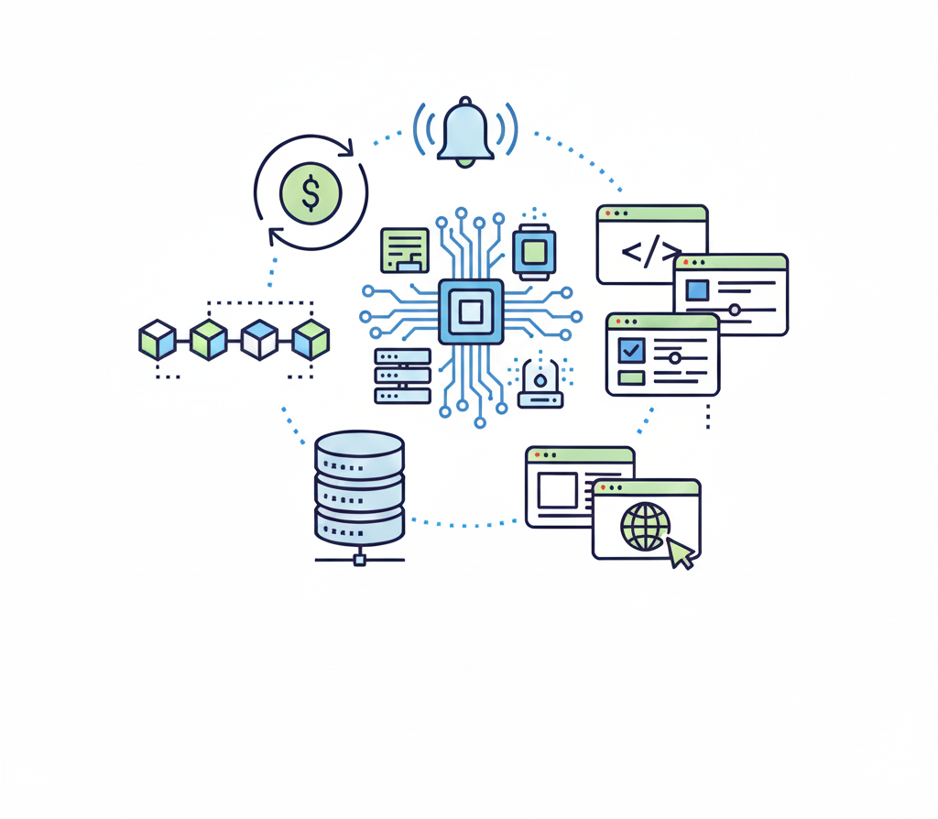

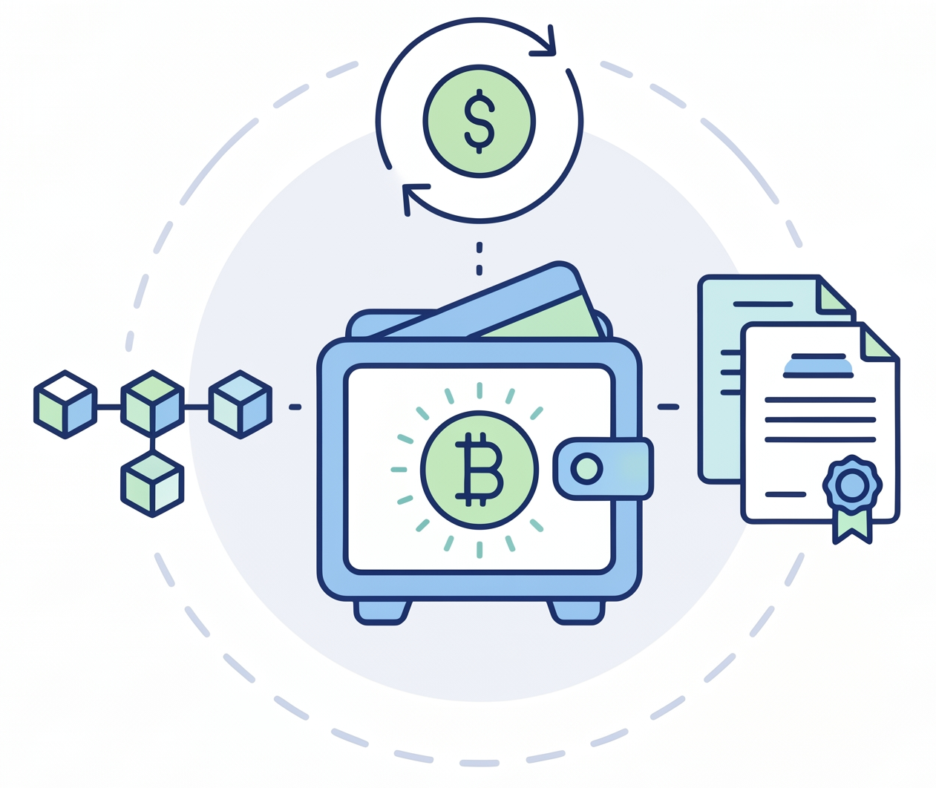
DIGITAL ASSETS
PILLARS
DIGITAL ASSET
PLATFORM
TRADFI INTEGRATIONS
INDUSTRY
PARTICIPATION
Building a define the platform on which CM will be able to do business as it comes to Digital Assets on a whole. This is cross functional – Front Office, Middle Office and Back Office (though technology merges these)
Adherence to requirements for capital treatment will require across multiple geography’s additional data to be created / stored and additional limit and supervisory controls to be created.
Currently representing RBC as part of CanDeal (also being evaluated as subject matter expert lead for one or more technical stream) and participating in DTCC working stream.

Slide 4
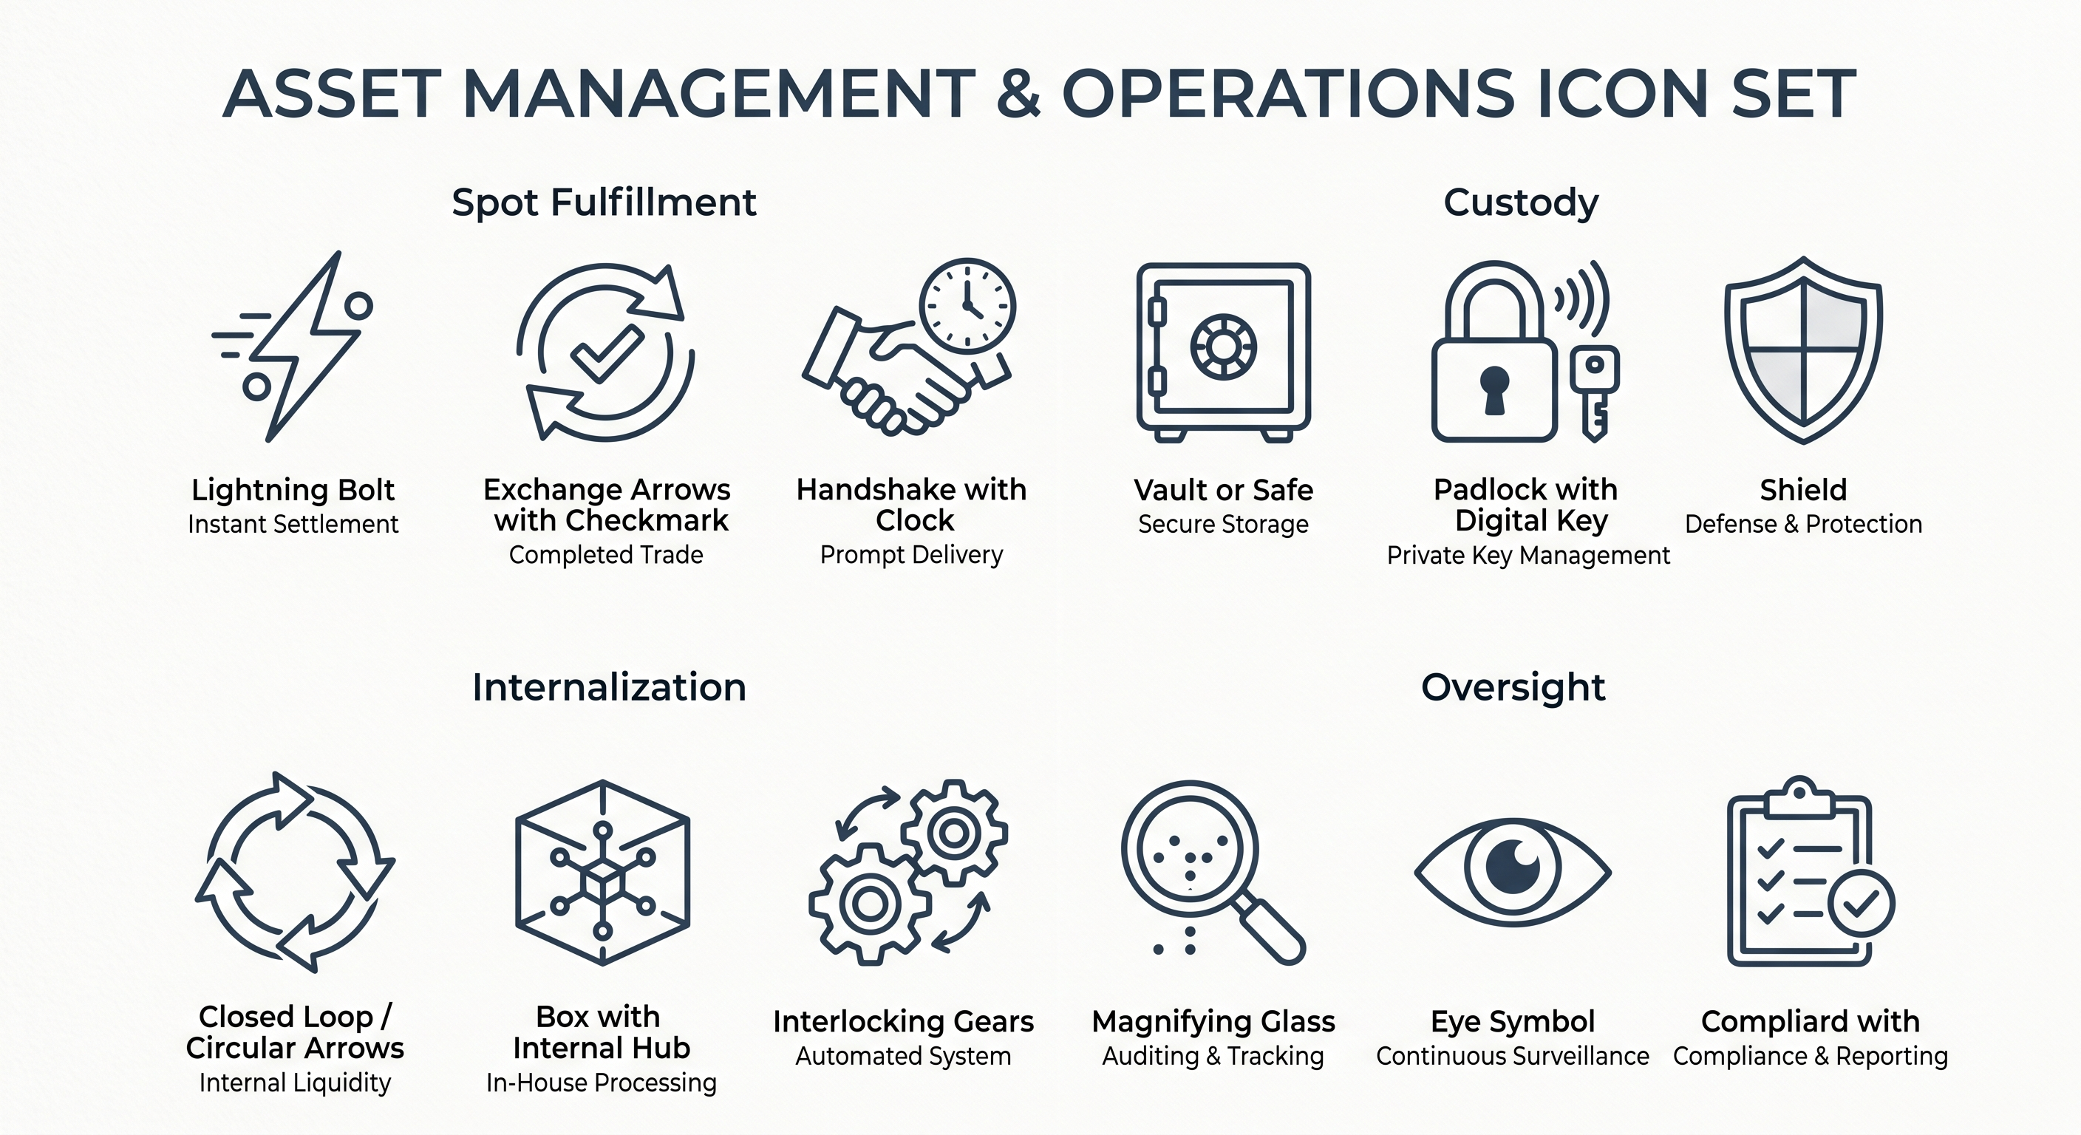
DIGITAL ASSET FIRM UPDATES
CM STEERCO
1/ Approved PoCs for Commerical Paper / Tokenized Structured Notes.
2/ Approved engagements with Industry Participation (CanDeal // Agora // DTCC)
What’s Next:
3/ Foundations PAR – including Comprehensive Approach (addressing punitive treatment by OSFI) – Enterprise also pursuing PAR (complimentary not competitive)
4/ Review next set of PoCs – Captured in opportunity tracker (Monetization of N/S corridor on Canton – socialized with Lindsay)
Direct Investing (Wealth Management)
Investor Services
SPOT FULFILLMENT
CUSTODY
Exploring multiple relationships within Digital Asset space (Coinbase, Anchorage, Paxos, BitGo, Zerohash, Standard Chartered). Deck Attached.
Upsell / Cross-sell (mapped existing fund movement)
Exploring build-out of Custody services for RBC – my analogy is this is our fort knox… but we still have branches we keep money in.
Support Longterm holdings
RBC Clear
CAOC and Center of Excellence
PLATFORM PROPOSAL / INTERNALIZATION
OVERSIGHT
Created a holistic view on what an RBC platform could look like. Clear really makes sense for Payments / Internalization.
Op Efficiency (requires legal guidance)
CoE being re-purposed as running RFI process and developing guidance for different groups. CAOC also will play a new role in the organization.
Oversight / Guidance

Slide 5
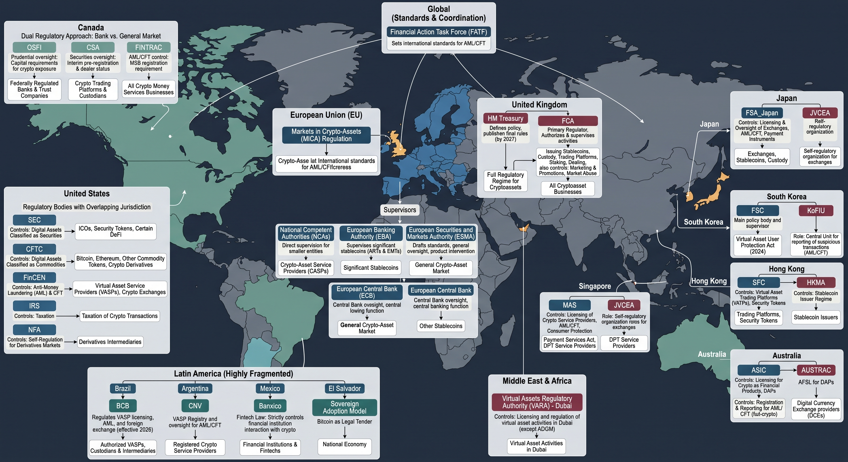
GLOBAL FOOTPRINT
1
RBC has seat of engagement on OSFI – Market remains immature.
1
2
USA passed Genius Act – missed the recess cut-off on Clarity ACT.
4
3
3
As we do Europa, incremental cost will be relatively negligible to get MiCA license – however need to ensure meet all requirements.
Opportunity Unlock
2
4
UK’s FCA published rules on June 2026 - -authorization window is Sept – Feb 26/27. Law takes effect on Oct 27.
5
5
Business would like to consider exploring purchasing a licensed entity.
APAC Unlock
6
6
Derek has been exploring with CEO of Halo Investing.
Expansion of TAM

Slide 6
COMPREHENSIVE APPROACH 1
Reference Data & Taxonomy
Assets must be classified into four OSFI prudential groups:
Group 1a – Tokenized Traditional Assets: link token to non-tokenized equivalent; track legal rights parity, settlement finality, smart contract address
Group 1b – Stablecoins: monitor reserve composition, redemption SLA, overcollateralization ratio, and audit attestations
Group 2a – Hedging-Eligible Crypto: track regulated venues, clearing status, and cross-exchange eligibility
Group 2b – Other Crypto-Assets: default fallback; strictest capital treatment (1,250% risk weight)
Indirect exposures via ETFs, mutual funds, or derivatives must be transparently mapped to underlying crypto-assets.
Limit Monitoring and Supervisory Controls
OSFI imposes strict exposure caps on Group 2 crypto-assets that require real-time or near-real-time aggregation across the enterprise.
Hard Thresholds: Systems must monitor when net short positions of Group 2 assets approach 1% of Net Tier 1 capital, and prevent total gross exposures from breaching the 5% threshold.
Supervisory Frameworks: Operational compliance applications, such as Apex Oversight, will need updated tracking modules. Because OSFI dictates that breaches of the Group 2 limit should rapidly be rectified, your supervisory tools must automatically trigger escalation workflows to management and compliance the moment a desk approaches these ceilings.
Valuation Spreads: Systems must independently price both the tokenized asset and the Traditional_ISIN_Link. If the system detects a persistent valuation spread between the two (indicating the market perceives higher risk in the token wrapper), it must flag the asset for potential downgrade to Group 2.
Network Risk Tracking: A traditional bond doesn't have "network risk." A tokenized bond does. Risk systems must map the token to its specific distributed ledger technology (DLT) and track outage events.
Peg Deviation Monitoring: Trading systems must consume real-time market data to monitor the token against its peg currency. You will need to build alert thresholds (e.g., a drop of >10 basis points) that instantly notify risk managers, as severe de-pegging revokes 1b eligibility.
Reserve Ingestion: You cannot rely on static data. The middle office must build integrations with external auditors or custodians to ingest daily or weekly reserve attestations. If the reserve composition shifts into riskier assets (e.g., commercial paper instead of short-term government debt), the system must automatically recalculate the asset's risk-weighted density.
System Requirement | Action Required
Portfolio Ingestion | Systems must ingest daily portfolio composition files (PCFs) for all ETFs and mutual funds to identify any crypto holdings.
Constituent Mapping | The database must map the fund's ISIN/CUSIP directly to the underlying crypto-asset identifiers (e.g., mapping a Bitcoin ETF to BTC).
Eligibility Tagging | The system must calculate the percentage of the fund holding eligible vs. ineligible crypto to enforce the 75% threshold rule dynamically.
Consolidated Limit Monitoring | Middle office systems must aggregate the delta-adjusted exposure of the ETF with your direct holdings of the underlying crypto to track against the enterprise Group 2 limits.

Slide 7
COMPREHENSIVE APPROACH 2
1. Regulated Venue & Product Availability
The underlying crypto-asset must be actively traded on regulated markets through specific approved structures. Specifically, the exposure must be one of the following:
  A direct spot holding where a derivative or ETF/ETN referencing the asset trades on a regulated exchange.
  A derivative or ETF/ETN referencing the crypto-asset that is explicitly approved by a jurisdictional market regulator or cleared through a qualifying central counterparty (QCCP).
System impact: Your reference data must track which specific crypto-assets have regulator-approved derivatives or ETFs linked to them. (For example, Bitcoin and Ethereum pass this because of CME futures and SEC/CSA approved ETFs; a smaller altcoin without regulated futures would fail instantly).
2. Extreme Liquidity Thresholds
  OSFI requires mathematical proof that the underlying asset is highly liquid and can be exited rapidly. Your data pipelines must calculate the following metrics over the preceding 1-year period:
  Market Capitalization: The average market capitalization of the crypto-asset must have been at least $10 billion USD over the previous year.
  Trading Volume: The 10% trimmed mean of daily trading volume against major fiat currencies must be at least $50 million USD over the previous year.
System impact: You cannot hardcode 2a eligibility. The middle office must continuously ingest 365-day rolling market cap and volume data. If an asset’s rolling average market cap drops to $9.9 billion, the system must trigger an automatic downgrade to Group 2b.
3. Data Sufficiency
The market data used to prove the liquidity thresholds above cannot be sparse or drawn from unreliable offshore exchanges.
  There must be at least 100 "real" price observations over the previous year. "Real" is defined under strict market risk criteria (MAR31.12), meaning actual executed trades on recognized platforms, not just quoted spreads or automated wash-trading volume.
System impact: Your pricing feeds must filter out volume from unregulated or suspect exchanges. If the system cannot verify 100 days of verifiable fiat-to-crypto trading volume, the asset cannot qualify for 2a.
The ETF Rule of Thumb: If an ETF holds Bitcoin (which passes the $10B market cap and $50M volume tests), it can be classed as 2a. If a Web3 fund holds a basket of smaller governance tokens that fail the $10B threshold, the entire fund defaults to 2b unless the eligible assets (like BTC/ETH) make up at least 75% of the fund's total weight.
1. The Dedicated Crypto Schedule (Schedule 10.100)
OSFI has introduced Schedule 10.100 – Summary of Crypto-asset Exposures.
The reporting layer must aggregate all the direct and indirect exposures (including the look-through ETF data you mentioned) and populate this summary schedule. It acts as the primary supervisory dashboard for OSFI to view your enterprise-wide crypto footprint.
2. Pervasive Integration Across Standard Schedules
Crypto-asset data doesn't just live in the summary schedule; it bleeds into your standard capital and risk reporting:
  Schedule 20.010 (Capital Deductions): Group 2b assets (the most punitive fallback bucket) essentially require dollar-for-dollar capital backing (a 1,250% risk weight). Your system must calculate this and feed the resulting CET1 deductions directly into this schedule.
  Schedule 90.010 (Market Risk): Your middle office risk engines must calculate sensitivities for the eligible Group 2a assets. OSFI has explicitly added a "Crypto risk (Group 2a)" category under the Sensitivities-based method in this schedule.

Slide 8
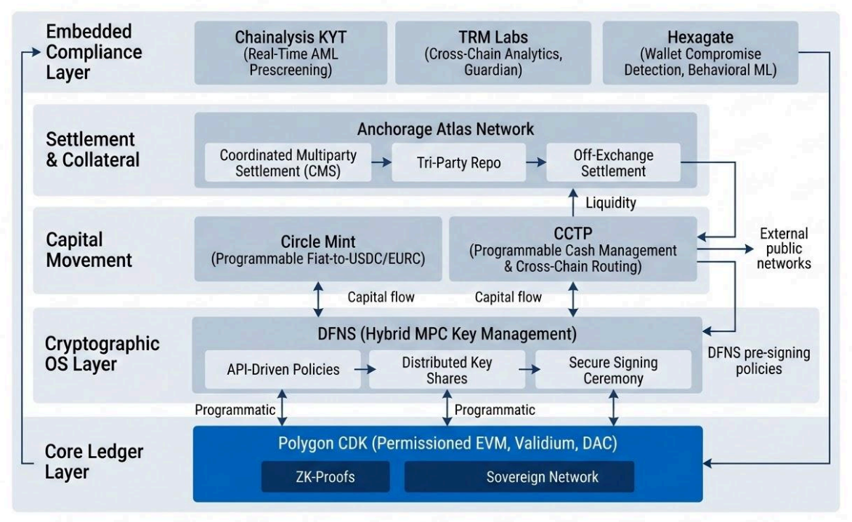

DIGITAL ASSET PLATFORM
Node Operation
Interactions with various blockchains require traffic to be routed through RPC nodes (broadcast transactions to the network). Certain networks like Canton – require a permissioned node to participate at all.
Omni Layer
All chain connectivity whether with custodians, stablecoin partners, cold storage (IS) require key management and a governance / policy layer (remains true for even an internalized blockchain). DFNS offers this as one of the best in class offerings (used by Zodia Custody and numerous other participants in the ecosystem: Circle).
All blockchain interactions should be centralized to one platform for RBC CM and have the flexibility (in case of issue) to go to the individual platforms (but not the requirement).
*Indicative architecture
Given finality of public chains – and potentially the $ amounts moving through them. Operations and RTB model must be weighed heavily.

Slide 9
SUPPORTING INITIATIVES
ONGOING WORK
Supporting PoCs:
Smart Contracts
  Deployed and tested (audited – have made 2 rounds of suggestions)
  Validating operational flows
Subject Matter Expert
  Act as SME in front of Legal, Compliance and Risk.
  Validate / conceptualize flows
  Suggest operating model for COO group
Technical Liaison
  Setup test environment for Circle Sandbox
  Setup test environment for Anchorage
  Working w/ App team to make Anchorage available via RBC App Store
  Support Athena process
Platform / Industry:
Setup App Code
Canton Node
  Exploring multiple deployment paths
  Walkthrough w/ Cloud Engineering
  Review w/ Enterprise Architecture
Deployed Private Ethereum
Created multiple PoCs on chain
  NFTs
  Internal Money Movements

