Slide 1
Program Assignment Triple Matching
Dian Chen & Yixuan Cao
@AI-Fundamental Course
Last Updated at 2018/12/03

Slide 2
Problem Definition
Given a sentence that describes the financial situation of a company in the past few years.
e.g.
sentence1:
2013年度、2014年度和2015年1-6月，发行人应付账款余额分别为2306万元、635万元和70118万元。
We extract some entities , include time, attribute, and value.
times: 2013年度、2014年度、2015年1-6月
attributes: 应收账款 (attributes might be not complete)
values: 2306万元、635万元、70118万元
We define a triple is consisted of three ordered components: [time, attribute, value].
If the sentence states that at time t, the value of attribute a was v, we say triple [t, a, v] is a correct triple.
e.g. all correct triples in sentence1:
【2013年度、应付账款、2306万元】 【2014年度、应付账款、635万元】 【2015年1-6月、应付账款、70118万元】

Slide 3
Problem Definition (cont.)
The problem is:
given a sentence and entities in that sentence,
extract all correct triples.

Slide 4
Training Data 1: vocabulary
Idx | word
0 | $TIME$
1 | $ATTRIBUTE$
2 | $VALUE$
3 | $UNKNOWN$
4 | $DIGIT$
5 | $EOS$
6 | 、
7 | ，
8 | 为
9 | 和
10 | 。
11 | 分别
… | …
There is a table that map word to a unique index
And according to that table, we can generate
two dicts (js object / java HashTable )
word2idx: word2idx[‘为’] returns 8
idx2word: idx2word[8] returns ‘为’
Notice:
We convert
any word that we think is a Attribute like ‘收入’, ‘销售额’ to ‘$ATTRIBUTE$’
any word that we think is a time like ‘2015年末’, ‘2015年12月31’ to $TIME$,
any word that we think is a value like ‘200万’, ’10%’, ‘1.21’ to $VALUE$,
any word that is a digit but not a value to $DIGIT$
any word that do not show in this vocabulary to ‘$UNKNOWN$’
The vocabulary is sorted by word frequency in descending order except the first six special words.
Words whose indexes are larger than 1500 may only appear once in our corpus.

Slide 5
Training Data 2: sentences
A list of dict (js object / java HashTable ). Each dict contains one sentence
Here is a example of a dict.
sentence_dict = {
"sentenceId": "eadf4c4d7eaa6cb767fa6d8c02555f5-eb85e9fb6ec57b2dd9ba53a8cc4b1625b18",
"sentence": "2013年度、2014年度、2015年度，公司融资租赁业务收入分别为58,821.17万元、
104,388.84万元和147,579.60万元，分别占发行人营业收入的59.21%、66.59%和66.78%。",
"words": ["2013年度", "、", "2014年度", "、", "2015年度", "，", "公司", "融资", "租赁", "业务", "收入",
"分别", "为", "58,821.17万元", "、", "104,388.84万元", "和", "147,579.60万元", "，", "分别",
"占", "发行", "人", "营业收入", "的", "59.21%", "、", "66.59%", "和", "66.78%", "。"],
"indexes": [0, 6, 0, 6, 0, 7, 13, 104, 146, 33, 1, 11, 8, 2, 6, 2, 9, 2, 7, 11, 14, 17, 18, 1, 12, 2, 6, 2, 9, 2, 10 ],
"times": [0, 2, 4 ], // that is ["2013年度", "2014年度", "2015年度"]
"attributes": [23, 10 ], // that is ["收入", "营业收入"]
"values": [13, 15, 17, 25, 27, 29 ], // that is ["58,821.17万元", "104,388.84万元", "147,579.60万元",
"59.21%", "66.59%", "66.78%"]
"results": [
[0, 10, 13 ], // ["2013年度", "收入", "58,821.17万元"]
[2, 10, 15 ], // ["2014年度", "收入", " 104,388.84万元"]
[4, 10, 17 ]], // ["2015年度", "收入", " 147,579.60万元"]
}

Slide 6
Training Data 2: sentences
Every string is Unicode string.
"sentenceId": unique id,
"sentence": A Unicode string,
"words": A list, that is the result of word segmentation of the sentence,
"indexes": convert each word in “words” to an index in vocabulary, notice that all times are converted to the same index, same as attributes and values.
“times”: which words might representing time,
"attributes": which words might representing attribute,
"values": which words might representing value,
"results": correct triples in this sentence that can be composed by words in “times”, “attributes” and “values”.

Slide 7
Training Data
How to load training data in Python:
import json
sentence_list_fname = ‘xxx’ # ‘assignment_training_data_word_segment.json’ here
sentence_list = json.load(open(sentence_list_fname , ‘r’))
How to load vocabulary in Python:
import cPickle as pickle # in py3 is ‘import pickle’ only
voc_fname = ‘xxx’ # provided file is ‘voc.pkl’ here
a = pickle.load(open(voc_fname, ‘rb’))
idx2word, word2idx = a[‘idx2word’, ‘word2idx’]

Slide 8
Test Data
like training data
[
{
"sentenceId": "eadf4c4d7eaa6cb767fa6d8c02555f5-eb85e9fb6ec57b2dd9ba53a8cc4b1625b18",
"indexes": [0, 6, 0, 6, 0, 7, 13, 104, 146, 33, 1, 11, 8, 2, 6, 2, 9, 2, 7, 11, 14, 17, 18, 1, 12, 2, 6, 2, 9, 2, 10 ],
"times": [0, 2, 4 ],
"attributes": [23, 10 ],
"values": [13, 15, 17, 25, 27, 29 ],
},
{ ... },
...
]

Slide 9
What should you do?
Use the training data to ——
build a model that can extract correct triples from a sentence.
Your code should be runnable under Python 2.7 or Python 3.6
Complete the `predict` method in `model.py` (for implement checking).

Slide 10
What should you submit?
You need to submit your model source file along with the parameters you trained from training data, and any other supplement that make your program runnable.
You should declare your dependencies in requirements.txt. You can generate that use pipreqs*.
Therefore you should upload a 2016xxxxxx.zip file, which after decompression should get a folder like this:
2016xxxxxxxxxx/
- requirements.txt (pip install –r requirements.txt)
- model.py (for calling predict)
- your parameter files (my_model.ckpt)
- any other source files (train.py)
- description about your model (mainly PPT)
* https://github.com/bndr/pipreqs

Slide 11
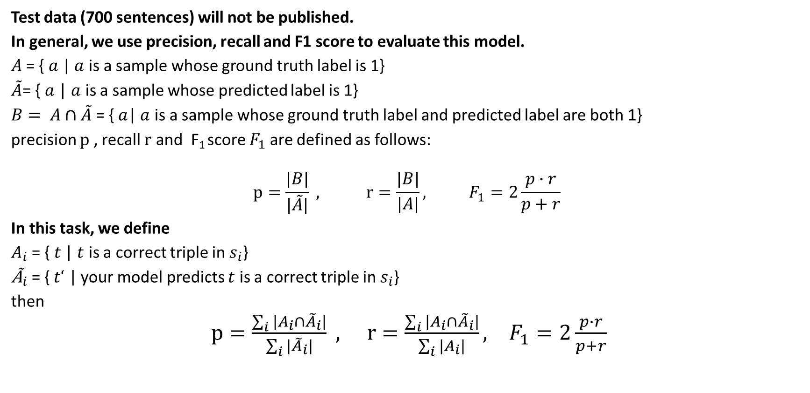
Evaluation Measures
Test data (700 sentences) will not be published.
In general, we use precision, recall and F1 score to evaluate this model.
$A$= {$a$ | $a$ is a sample whose ground truth label is 1}
$\tilde{A}$= { $a$ | $a$ is a sample whose predicted label is 1}
$B= A∩\tilde{A}$ = {$a$| $a$ is a sample whose ground truth label and predicted label are both 1}
precision $p$ , recall $r$ and F₁ score $F_{1}$ are defined as follows:
$$p=\frac{|B|}{|\tilde{A}|} , r=\frac{|B|}{|A|}, F_{1}=2\frac{p∙r}{p+r}$$
In this task, we define
$A_{i}$= {$t$| $t$ is a correct triple in $s_{i}$}
${\text{Ã}}_{i}$= {$t‘$ | your model predicts $t$ is a correct triple in $s_{i}$}
then
$p=\frac{\sum_{i}{|A_{i}∩{\tilde{A}}_{i}|}}{\sum_{i}{|{\tilde{A}}_{i}|}} , r=\frac{\sum_{i}{|A_{i}∩{\tilde{A}}_{i}|}}{\sum_{i}{|A_{i}|}}, F_{1}=2\frac{p∙r}{p+r}$

Slide 12
Something about training and cross validation
When you want to evaluate your model and choose hyper-parameters,
cross validation is usually useful.
K-fold CV:
Split all data you have into k folds.
If you set a hyper-parameter, to evaluate your model, you should do something like this:
for i in range(k):
model = train on all folds except the i^{th} fold.
errors[i] = model prediction error on the i^{th} fold (use measures like F1, precision, cost)
error=mean(errors)
And you can try many hyper-parameter settings and choose the best one.

Slide 13
Train / Valid / Test Dataset
D
Test
B
C
A
A
B
C
C
A
B
Valid
Valid
Valid
Train
Train
Train

Slide 14
Some useful links
There is a example code about LSTM: http://deeplearning.net/tutorial/lstm.html
If you want to watch the data (Unicode json file), you can search online about ‘Unicode 中文转换’, or, by encoding it in python.

Slide 15
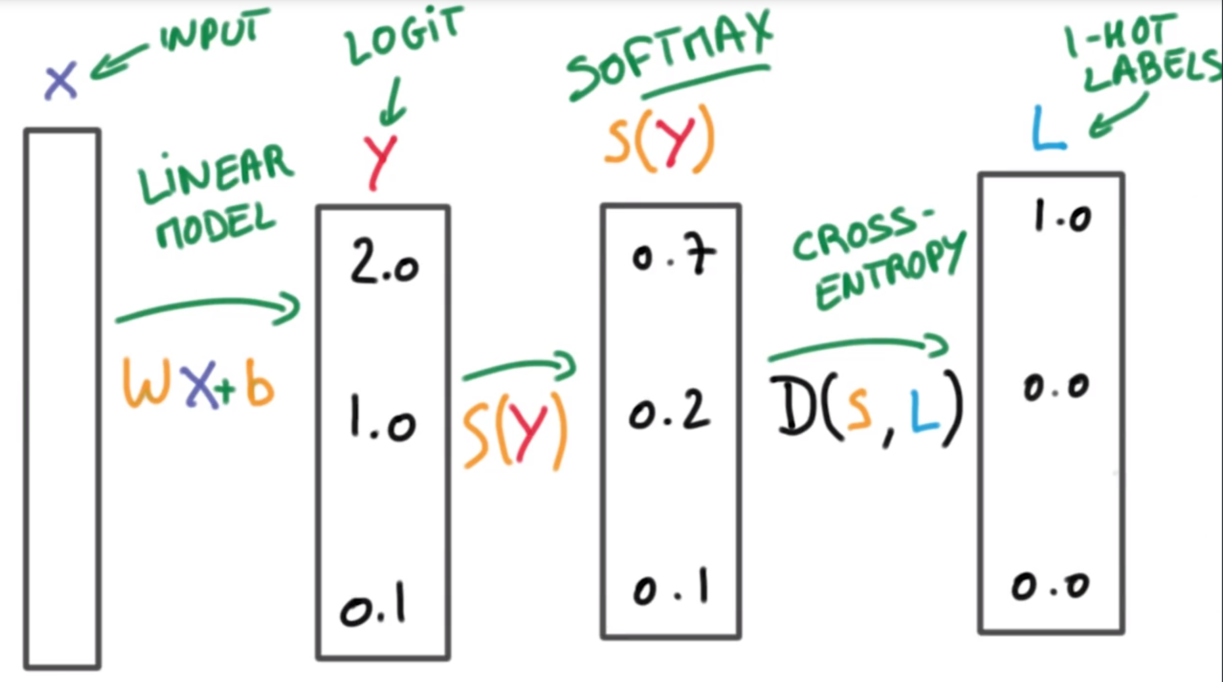
About the terms
Notes:
logits: 一个事件发生与该事件不发生的比值的对数 (统计学习方法-李航 p78)

Slide 16
思路和问题
1) 基于规则的方法
2) 基于训练的方法
3) 兼而有之
规则：三元组的组合规律是否存在哪些固定的模式？
训练：如何构建网络可以更好的学到组合规律？(as Playground)
兼而有之：
在模型预测前如何提供更多输入信息？
从模型预测出的结果中如何总结规律？

Slide 17
分组和考核安排
一共12组（分组情况见excel文件）
两阶段考核 （均通过SEP平台提交）
1) 1月10日，组长提交设计方案PPT
2) 1月24日，组长提交最终代码及模型文件

Slide 18
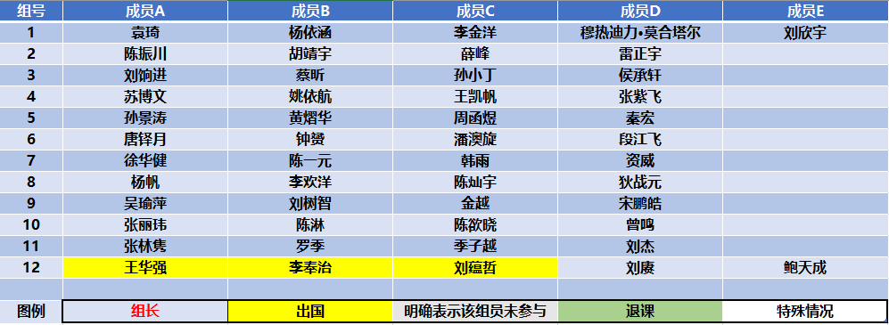
分组情况

Slide 19
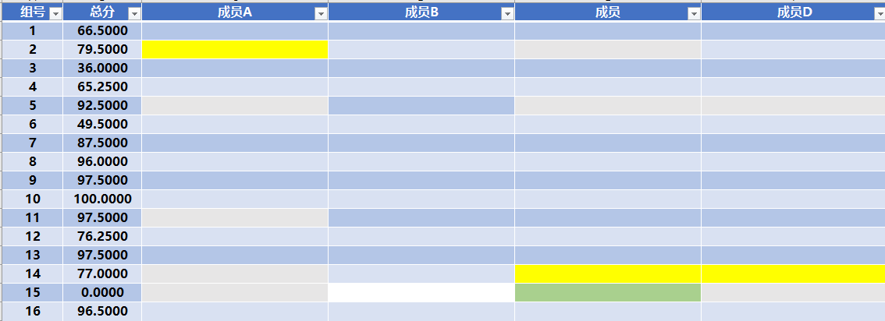
关于分组与得分制
组长
负责自己小组的代码以及PPT的提交；
负责联络自己小组的其他成员；
得分制：(小组成果得分 + PPT表达得分) x 个人工作量比率
小组成果得分：
效果(P/R/F1)
想法(创新/实用)
PPT表达得分：
思路表达清晰
分工明确真实
个人工作量：
项目中完成情况
比率取值0.5 ~ 1.5

Slide 20
分工情况（需要体现在PPT中）
组员A
查阅资料：
编写代码：
组员B（组长）
提出方案：
PPT制作：
组员C
编写代码：
后期调参：
组员D
编写代码：
规则处理：
1）不要写百分比，做了多少事情写多少事情即可，
2）每件细节的事情最多写一位同学（例如查资料解决了某个特定问题）
3）难度较大的任务，多人合作的情况，最多写贡献最大的两名同学
（即鼓励分工明确独立，各司其职，任务可以分的很细尽量都参与进来）
4）查阅的资料只有在程序编写中确实使用到了才需要写上
（即使是错误的尝试也可以放在注释里，但要求是可运行的代码片）
5）代码编写过程必然会包括该部分的查阅资料，所以不要重复写上查阅资料
6）组长联络同学、提交PPT和代码的工作，这部分计入工作量但不用写在这里

Slide 21
张三（组长）
查阅资料：有关Tensorflow程序编写中的optimizer
编写代码：Train和Test的实现，采用10-Fold交叉验证
李四
方案提出：尝试双向LSTM的模型方案
王五
PPT制作：模型网络的讲解部分
后期调参：尝试了Adam, SGD 两种Loss函数，最终选择效果好的Adam
赵六
方案提出：尝试CRF的模型方案
代码编写：用LSTM 实现network部分
PPT制作：模型网络以外的设计方案
查阅资料：CRF的实现与测试
代码编写：用CRF实现Network部分（最终未采用，代码见注释部分）
代码编写：预测前的数据预处理工作
（感谢第7组周七同学在tf.session方面提供的答疑与帮助）
代码编写：实现model部分
后期调参：尝试了0.001, 0.01, 0.1三种学习率，最终选择效果最好的0.001
实验进展：多次跑实验，解决session初始化问题导致的loss不下降的bug
数据整理：记录与总结实验中的各项数据进行对比实验。
示例A

Slide 22
张三（组长）
PPT制作：PPT设计方案的全部
李四
方案提出：尝试双向LSTM的模型方案
王五
赵六
代码编写：基于规则的预测全部代码
代码编写：模型训练与预测的全部代码
（王五出国了，我们组少个人，然后我联系不到赵六）
（我联系不到他们，就自己写了一版）
方案提出：基于关键字的规则方案
（代码写的好累，都没人帮忙，我一人一组就好了……）
资料查阅：关于optimizer的调用
示例B
Notes:
1）

Slide 23
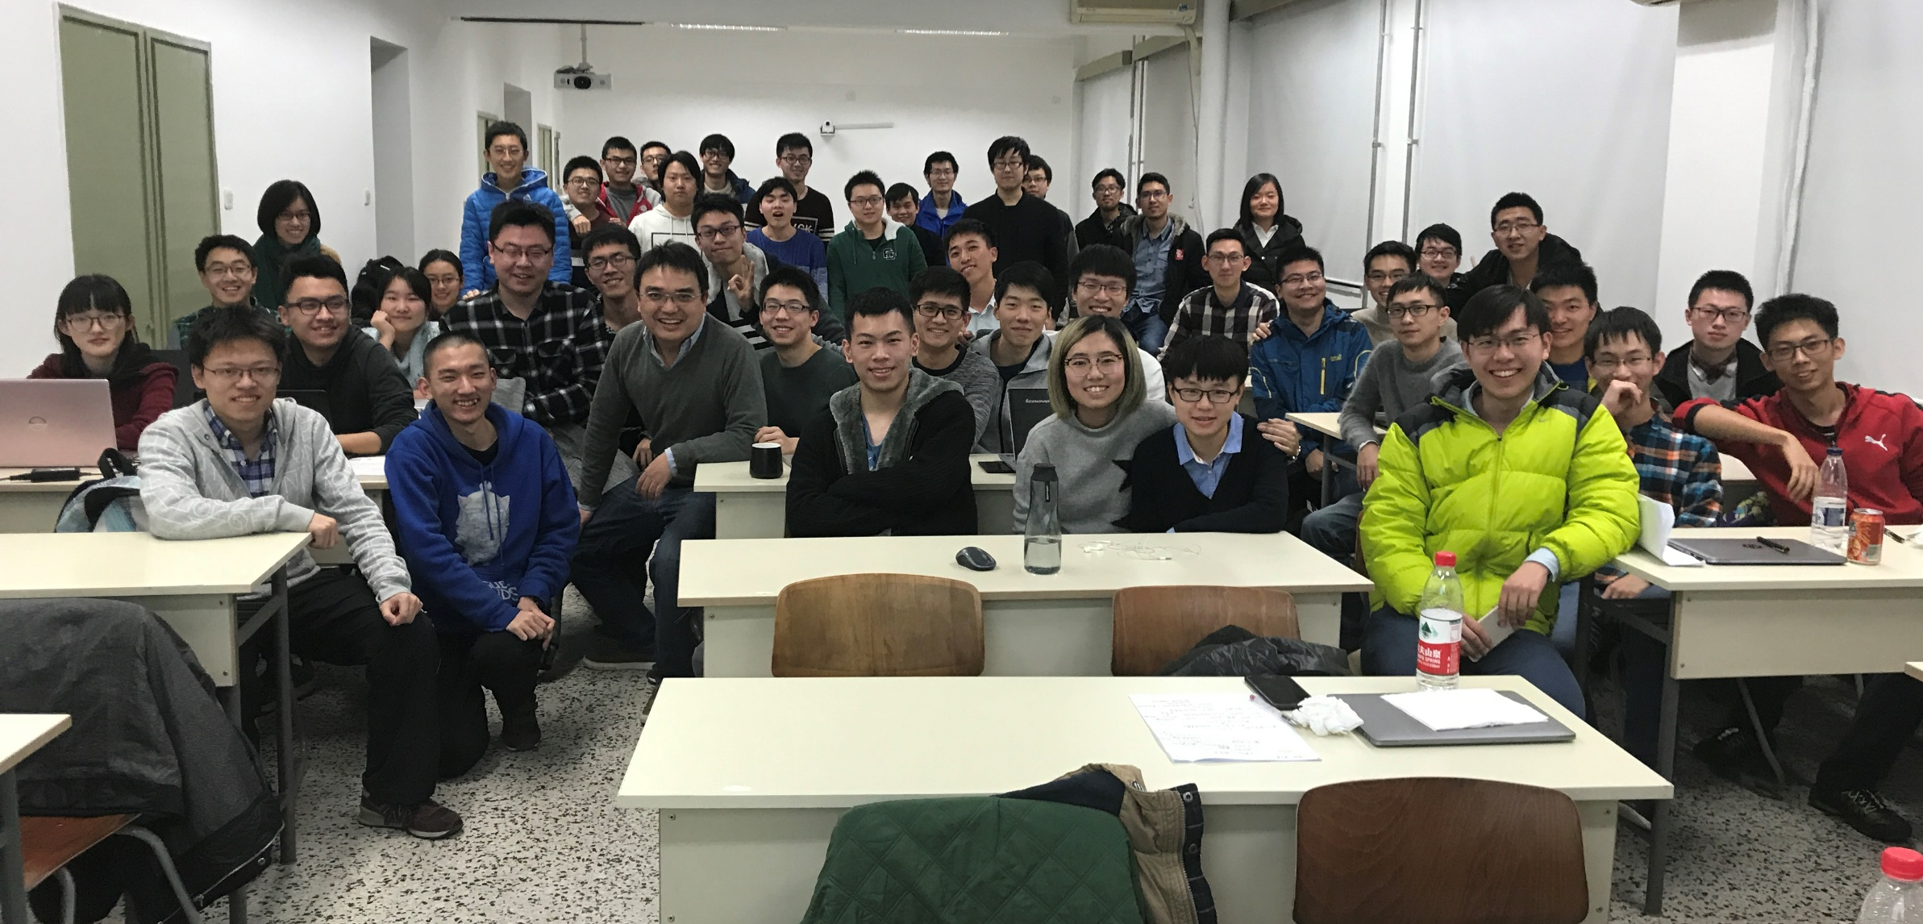
祝大家前程似锦！
AI-Fundamental Course 2017

Slide 24

祝大家前程似锦！
AI-Fundamental Course 2018
<Placeholder for picture>

