Slide 1
Supernova Cosmology
Jacky Cao
Notes:
- My talk will be on supernova cosmology, it will be an overview of what I will be doing.

Slide 2
Summary
Supernovae
Type Ia supernovae
Constraining cosmological parameters
Notes:
The different topics that I would like to cover
Basic theory of supernovae
The important of Type Ia SNe
Usage of SNe data in trying to find the cosmological parameters of the Universe

Slide 3
Supernovae
Type I
Binary system with a white dwarf and a donor star
An absence of the Balmer series of Hydrogen in it’s spectrum
Type II
A massive star which features a core-collapse
Balmer series of Hydrogen present
More sub-classifications within Type I and Type II
S. E. Woosley and T. A. Weaver. The Physics of Supernova Explosions. Annual Review of Astronomy and Astrophysics, 24:205–253, 1986.
Notes:
These are the basic distinctions between the two main groups of supernovae explosions, detail this, then go into more detail with Type Ia
Type I
Binary system: this is the most accepted theory on how Type I’s are formed, more discussion about this in Type Ia. Mass accretes onto the main white dwarf until it reaches a point where a mechanism can trigger the supernova explosion.
The Hydrogen line is not there as it is related to the initial system, the binary system leads to the absence as it is the heavier elements that are being fused and then the disruption causes an explosion
Type II
Core collapse due to the temperature from nuclear fusion burning increasing to a point where photodisintegration can occur, this leads to a runaway effect, and a loss of electron degeneracy pressure, thus the star explodes in a supernova
Balmer series present as there is still hydrogen when it explodes
Sub-classifications
Type Ia
This is the most important type for our cosmology as Type I SNe are ’standardised’ in the way they explode, they produce standard light curves when their magnitude is measured over a period of time
Type IIP, Type IIL
Type IIP has a plateau in it’s light curve after it’s peak
Type IIL has a line in it’s light curve as it trails off after peak

Slide 4
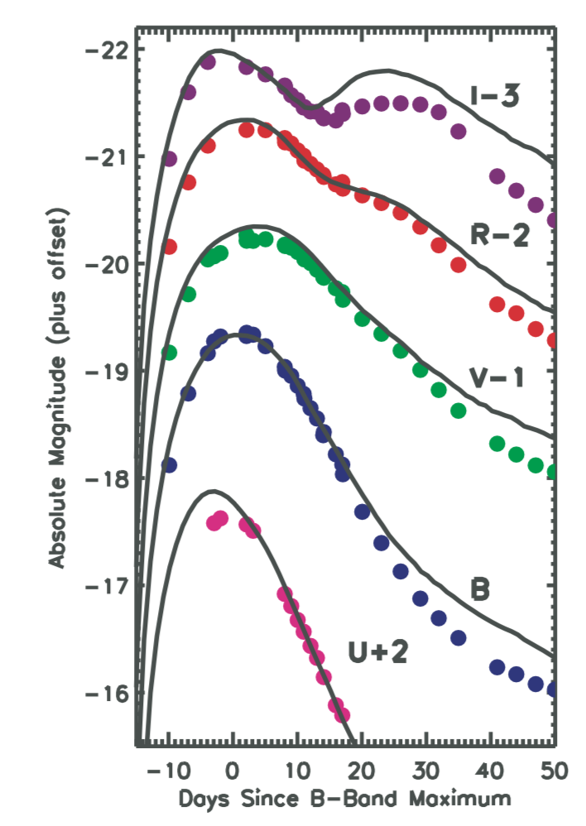

Type Ia Supernovae
Standardised explosion mechanism
Usage in finding cosmological parameters
The Friedman equation¹ ${\left(\frac{\dot{a}(t)}{a(t)}\right)}^{2}= \frac{8πG}{3}ρ\left(t\right)−\frac{kc^{2}}{a^{2}(t)}$
¹ C. R. Genovese et al. Inference for the dark energy equation of state using Type Ia supernova data. The Annals of Statistics, 3:144-178, 2009.
Figure 1. Type Ia SN light curves in five different bands.
Data and model offset to produce a clearer image.
S. E. Woosley and T. A. Weaver. The Physics of Supernova Explosions. Annual Review of Astronomy and Astrophysics, 24:205–253, 1986.
Figure 1. Adapted from S. E. Woosley et al. Type Ia Supernova Light Curves. The Astrophysical Journal, 662:487-503, 2007.
Notes:
The standardised way is due to the white dwarf accreting matter until it reaches the Chandrasekhar limit, 1.4M_solar, but it’s not the mass that’s the mechanism, it’s the fact there is extra thermonuclear energy being produced because of the fusion of the carbon and oxygen core, this creates a disruption and prevents a core-collapse into a neutron star
Observing the magnitude of Type Ia SNe over an extended period allows us to plot light curves
For multiple Type Ia’s we find that for the majority of SNe the standard curve is seen
There are some other classes of SNe, e.g. Type Ia-91bg – these are the faintest class of SNe
Figure 1 is an example of the different light curves that can observed when using different image filters, same SN but each band has different information associated with it
Use in finding cosmological parameters:
Type Ia SNe can be used as standard candles to calculate distances
Through spectroscopic observations we can obtain the redshift of the SN, and it’s host galaxy
We can also find the peak magnitude of the SNe from the light curves
Using this information we can use the Friedman equation to calculate cosmological parameters such as Omega_Lambda to determine the dark energy content of the universe.
We can use the Friedman equation to work out the expansion rate of the universe
Relating the rate of change of the scale factor to the energy density of the universe, solving for rho we can calculate the dark energy density of the universe
There are different variations but this allows us to see the link between them both.
The equation can be approximated to Hubble’s constant and then we can
When using the Friedman equation we make assumptions such as
The Universe is flat for local distances so we can assume that the comoving distance can be approximated by a linear term

Slide 5

Constraining cosmological parameters
Uncertainties in data sets
Larger data sets of SNe – investigating the uncertainties on $Ω_{Λ}$
Obtaining another measure for the quality of fit for the models to the data, $χ^{2}$ to MCMC.
T. A. Ottosen. A Bayesian Approach to Statistical Mechanics. arXiv, 2012.
Notes:
With data that is provided we must always be sceptical of how they obtained their
One of the key issues is trying to find the uncertainties in our values
There is no point having values for cosmological parameters if we cannot say to what uncertainty it is in, it provides no reasonable amount of information. It could be an extremely bad value
Using larger data sets we can produce a smoother set of data so that when finding the uncertainties in our values for $Ω_{Λ}$, so that we can be more certain that our uncertainties found are more accurate than if we have a less complete data set (???) is that correct?
Plus we could investigate how SN type affects the uncertainties, or how galaxy type/host galaxy morphology affects it as well – a form of ‘jack knife’ method in trying to see what range of uncertainties we can obtain
Investigate another method as opposed to the $χ^{2}$ method which determines the error bars on the model parameters as well as the best fit values
Using the Markov Chain Monte Carlo method we can explore the fit of the data to other general cosmological models – other cosmological methods will need to be researched but with the MCMC method, it is a method which is as follows:
We have a dataset, and we can calculate the probability of the dataset given the values of the parameters of our model, then from this we can then find a distribution function.
The advantage of MCMC is that it automatically puts the sample points where the distribution function is large
MCMC uses the principle of random walks to sample the data – state of the chain after a number of steps is then used as a sample of the desired distribution – quality of sample improves as a function of the number of steps
Exploring Bayesian statistics, we find a result from Bayes’ theorem that data changes probability
We want to improve our best fit parameters and using the MCMC method will allow us to do that

Slide 6
Conclusions
Type Ia Supernova Explosions as Standard Candles
Constraining cosmological parameters
Using larger data sets
Obtaining another measure for the quality of fit for the data to the model
Notes:
Using Type Ia SNe as standard candles allows us to collect data and then produce distance information
With this we can then calculate cosmological parameters using the Friedman equation as a simple model, and also using $χ^{2}$ method/tests
Through using larger data sets we can constrain what parameters are affecting what – separate into SN type, galaxy types. It is important how the uncertainties are being affected as we want to be as accurate as possible!
Then we can try and obtain another measure for the quality of fit for the data to the model as opposed to the $χ^{2}$ approach – MCMC approach will allow us to sample the parameter space with a probability that depends on the likelihood that the model is a good fit to the data

