Slide 1
Light from
distant object
F
Secondary Mirror
Primary
Mirror

Slide 3
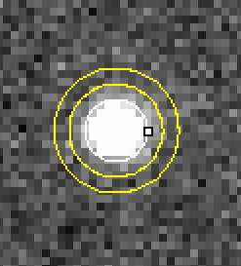

Slide 4
(a)
(b)
512-002598

