Slide 1
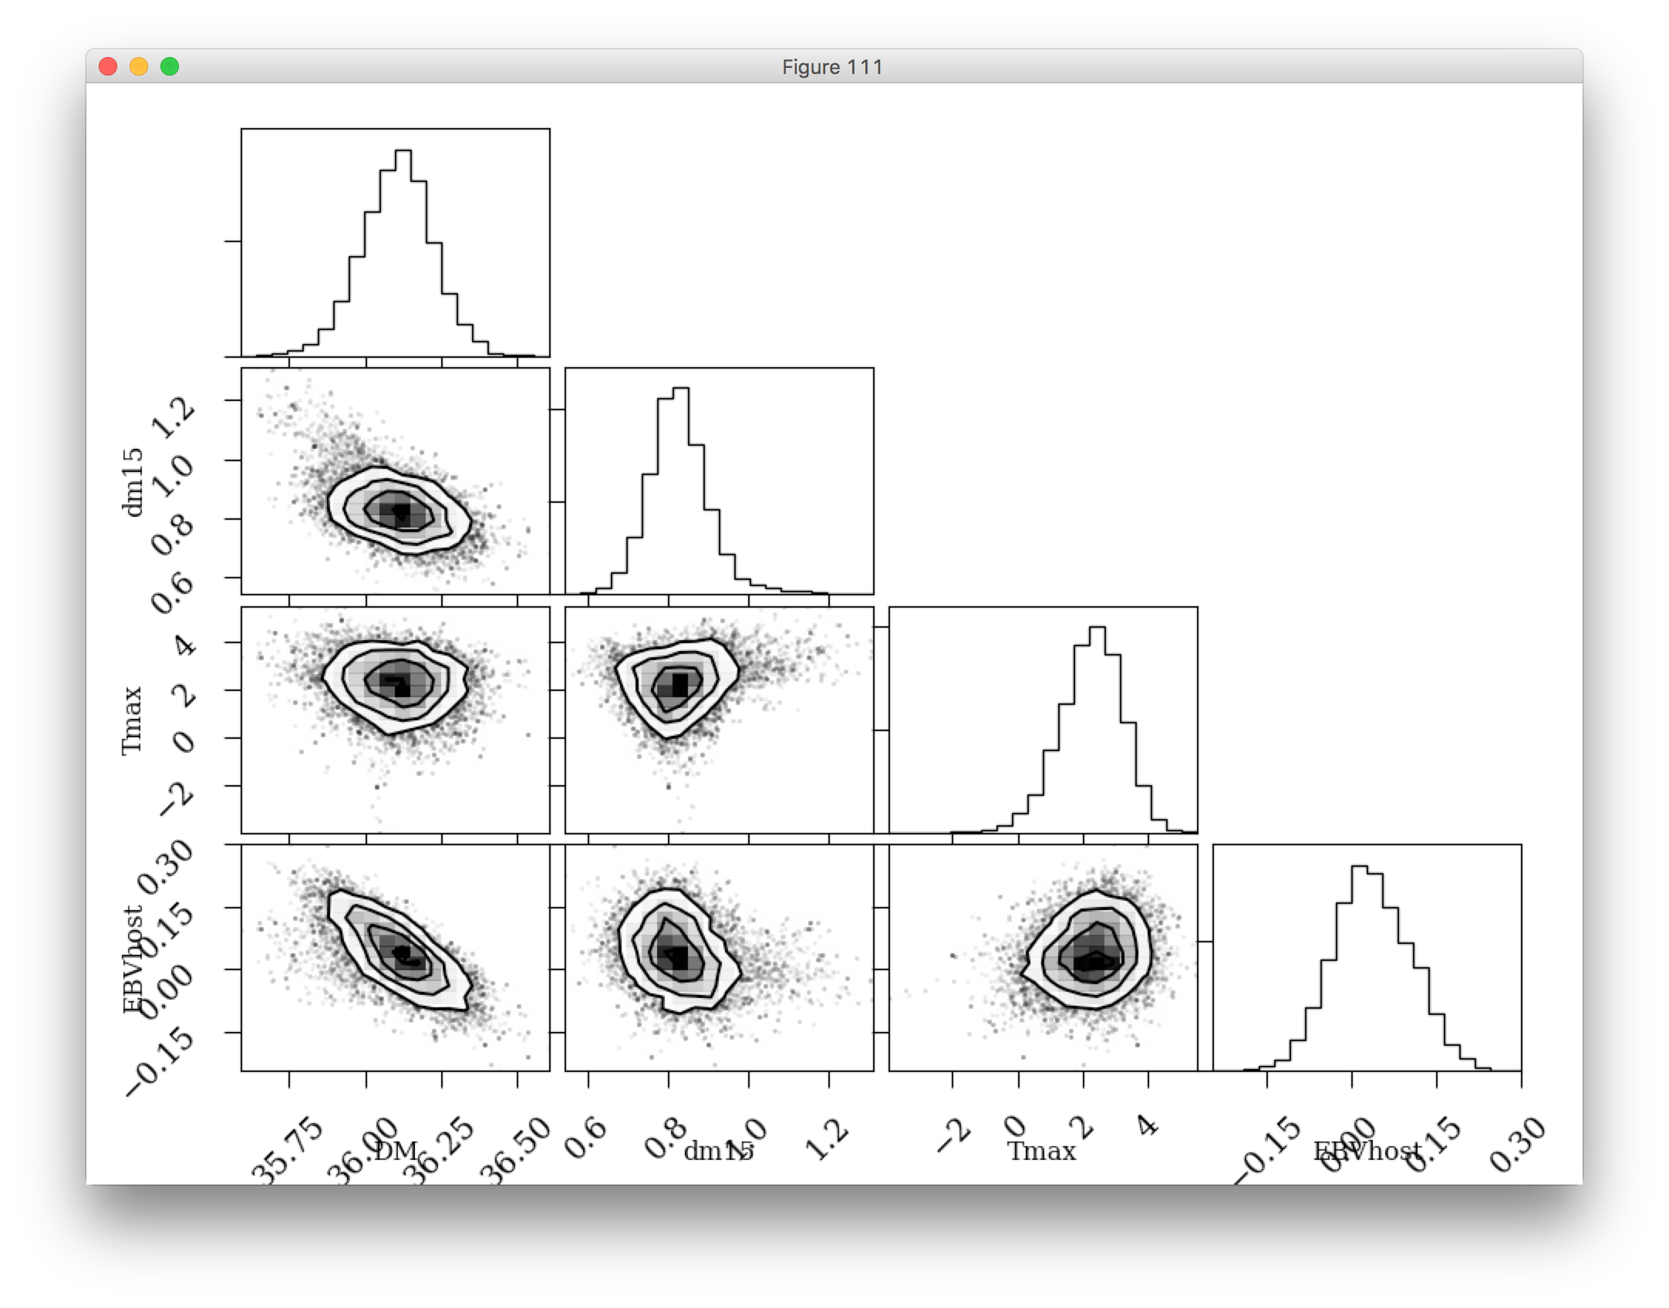
4
2
Tmax (days)
0
-2
0.30
0.15
EBVhost (mag)
0.00
-0.15
35.75
36.00
36.25
36.50
0.6
0.8
1.0
1.2
DM (mag)
dm15

Slide 2
1.2
1.0
dm15
0.8
0.6
4
2
Tmax
0
-2
0.30
0.15
EBVhost
0.00
-0.15
35.75
36.00
36.25
36.50
0.6
0.8
1.0
1.2
-2
0
2
4
DM (mag)
dm15
Tmax

