Slide 1

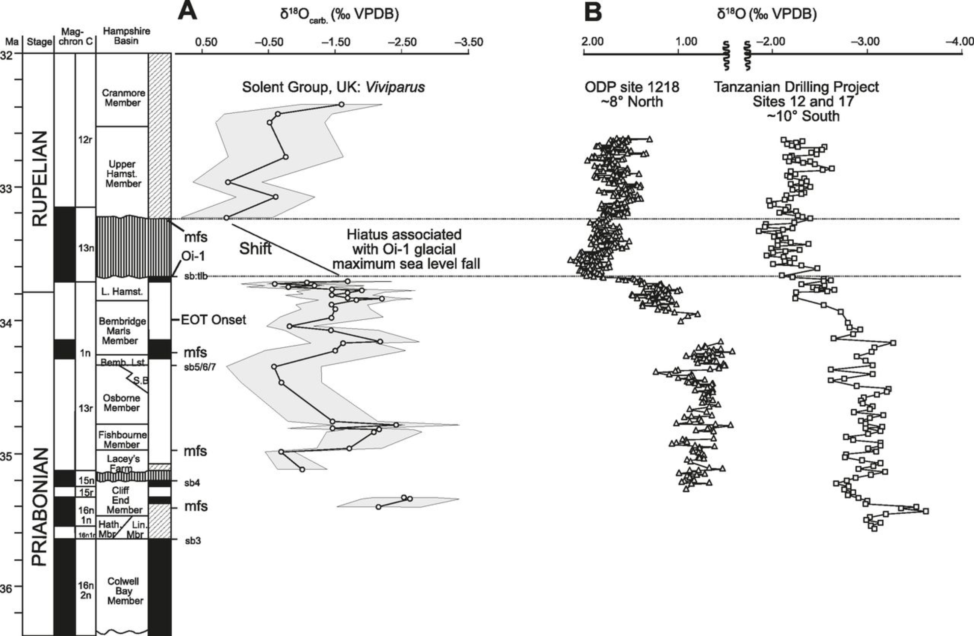

Oxygen isotope evidence for Antarctic glaciation
Jacky Cao
Abstract
Through ice-core studies
Introduction
Conclusions
The dynamic evolution of Antarctic glaciation can be established through the $δ^{18}$O ratio in sedimented foraminifera. Emiliani (1955) demonstrates that this oxygen signal is a result of changes in the isotopic composition and temperature of seawater. The most prominent climatic shift due to glacial-interglacial transition occurred ca. 33.8 Ma
Through
References
Emiliani, C. (1955). Pleistocene temperatures. The Journal of Geology, 63(6), 538-578.
Kennett, J. P. (1977). Cenozoic evolution of Antarctic glaciation, the circum‐Antarctic Ocean, and their impact on global paleoceanography. Journal of Geophysical Research, 82(27), 3843-3860.

