Slide 1

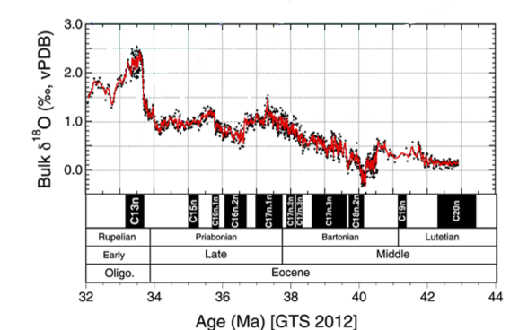
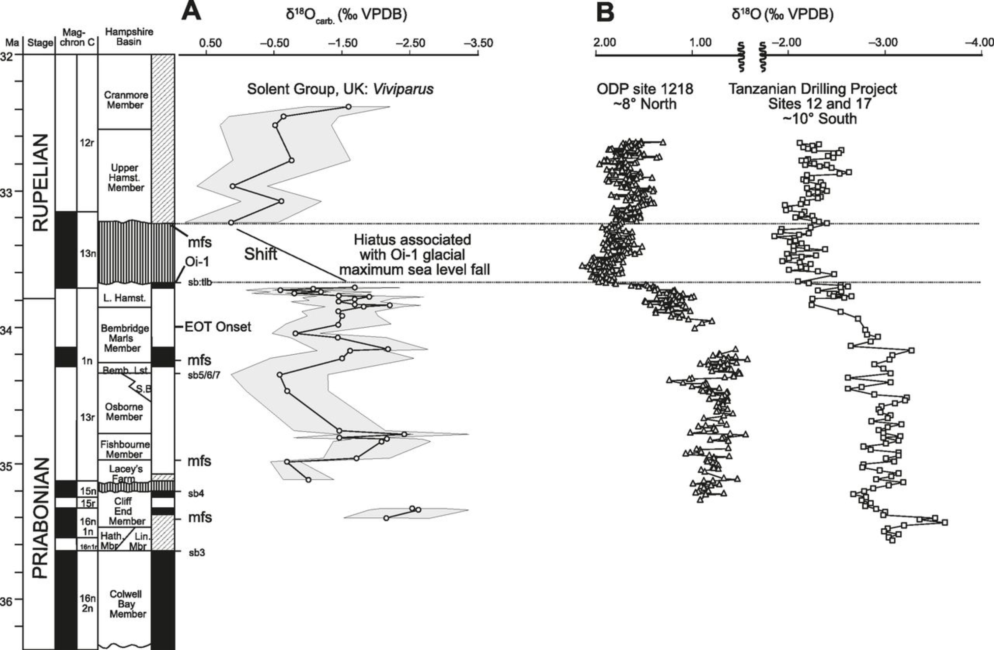
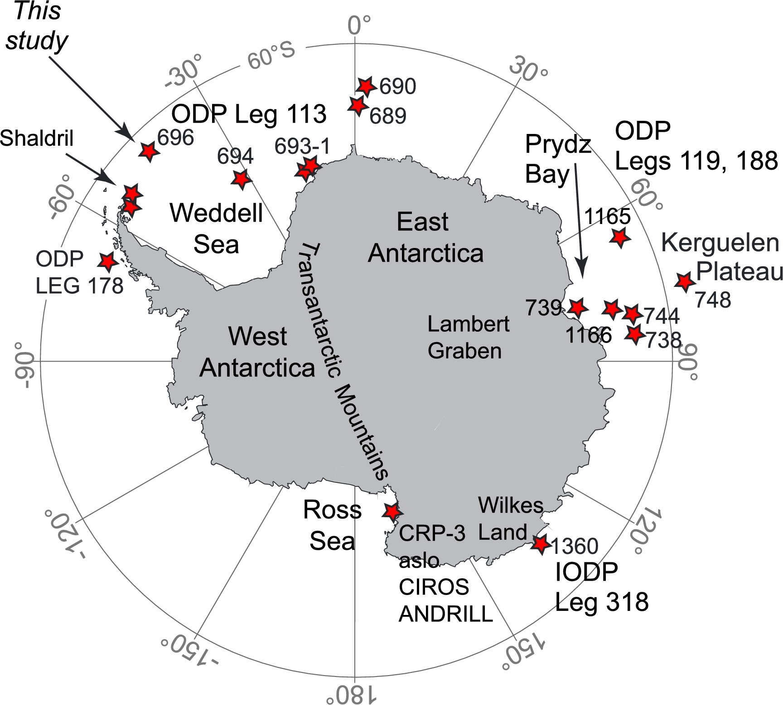

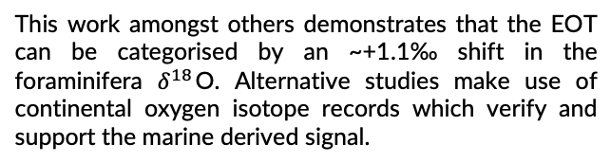




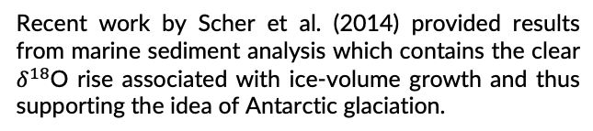

Oxygen isotope evidence for Antarctic glaciation
Jacky Cao
Abstract
Eocene-Oligocene glaciation
This higher magnitude could be attributed to the change in isotopic composition of the source meteoric water where the gastropods grew. As Antarctic ice sheets developed, the marine source waters would tend towards more enriched $δ^{18}$O values.
Proxy indicators could also be employed, for example, Zachos et al. 2008 uses ${\text{CO}}_{2}$ records to suggests that changes in atmospheric ${\text{CO}}_{2}$ could be the driver in Antarctic glaciation at the Eocene-Oligocene period. On the other hand, there are some suggestions that orbital forcing may have contributed to global cooling (Liu et al. 2009).
Modern-day Antarctica is a continent which is frozen over. The formation of permanent ice-sheets occurred approximately 34 Ma at the Eocene-Oligocene boundary. This glaciation can be studied through obtaining sedimentary cores, isolating the fossilised foraminifera, and then reconstructing the chronology by using the oxygen isotope ratio $δ^{18}$O as a tracer. Comparing marine-based and continental-based cores shows that a glaciation did occur in the Cenozoic and that it can be traced using oxygen isotopes.
Recent work by Scher et al. (2014) provided results from marine sediment analysis which contains the clear $δ^{18}$O rise associated with ice-volume growth and thus supporting the idea of Antarctic glaciation.
EOT
Introduction
One of the most prominent climatic changes in Earth’s history occurred in the Cenozoic near to the Eocene-Oligocene transition (EOT), ca. 33.8 Ma. At this boundary the decrease in global temperatures lead to effects such as permanent ice-sheet formation on Antarctica. Through studying the $δ^{18}$O ratio in sedimented foraminifera from ice-core samples, this glaciation can be placed into a long history of glacial-interglacial shifts. Changes in the isotopic composition and temperature of seawater results in variations in the oxygen ratio (Emiliani 1955), thus the larger climate picture can be reconstructed.
The following should therefore be investigated:
Is there oxygen isotopic evidence which demonstrates Antarctic glaciation?
Conclusions
Through the analysis of sedimentary cores around the Antarctic, evidence for continental glaciation can be obtained by studying oxygen isotopes within fossilised foraminifera. Marine and continental cores show an approximate ~+1.3‰ shift in the $δ^{18}$O which signifies the glaciation of Antarctica. Possible drivers for this shift could be due to changes in atmospheric ${\text{CO}}_{2}$, or even potentially due to global cooling as a result of orbital forcing.
Fig. 2. Varying $δ^{18}$O ratio across the Eocene and Oligocene (Scher et al. 2014).
This work amongst others demonstrates that the EOT can be categorised by an ~+1.1‰ shift in the foraminifera $δ^{18}$O. Alternative studies make use of continental oxygen isotope records which verify and support the marine derived signal.
This topic returns to the idea of how isotopes such as oxygen can be used to reconstruct paleotemperatures and climates, this in turn could provide potential evidence and support for hypotheses such as the “over-chill”, “over-kill”, or “over-ill” theories.
EOT
Sediment cores and Antarctic drilling
Sediment cores are key in reassembling past Antarctic climate chronology. Projects such as the Deep-Sea Drilling Project in the 1970s (Kennett 1977) utilised the $δ^{18}$O tracer for paleotemperature calculations across the early and mid Cenozoic.
References
Carter, A., Riley, T. R., Hillenbrand, C. D., & Rittner, M. (2017). Widespread Antarctic glaciation during the late Eocene. Earth and Planetary Science Letters, 458, 49-57.
Emiliani, C. (1955). Pleistocene temperatures. J Geol, 63(6), 538-578.
Kennett, J. P. (1977). Cenozoic evolution of Antarctic glaciation, the circum‐Antarctic Ocean, and their impact on global paleoceanography. Journal of Geophysical Research, 82(27), 3843-3860.
Liu, Z., Pagani, M., Zinniker, D., DeConto, & others (2009). Global cooling during the Eocene-Oligocene climate transition. Science, 323(5918), 1187-1190.
Scher, H. D., Bohaty, S. M., Smith, & others. (2014). Isotopic interrogation of a suspected late Eocene glaciation. Paleoceanography, 29(6), 628-644.
Sheldon, N. D., & others (2016). Coupling of marine and continental oxygen isotope records during the Eocene-Oligocene transition. Bulletin, 128(3-4), 502-510.
Zachos, J. C., Dickens, G. R., & Zeebe, R. E. (2008). An early Cenozoic perspective on greenhouse warming and carbon-cycle dynamics. Nature, 451(7176), 279.
Fig. 3. $δ^{18}$O records derived from continental records compared to those derived from marine foraminifera (Sheldon et al. 2016): (A) The continental isotope records. (B) Data derived from marine foraminifera.
Sheldon et al. (2016) makes use of freshwater gastropods as the source of the oxygen tracer. They conclude a higher magnitude shift of >+1.4 ‰ in the isotope ratio than when compared to the marine data.
Fig. 1. Locations of major studies of Antarctic marine sediment (Carter et al. 2017) .

