Slide 1
41.1 ka
96.3 ka
23.7 ka

Slide 2
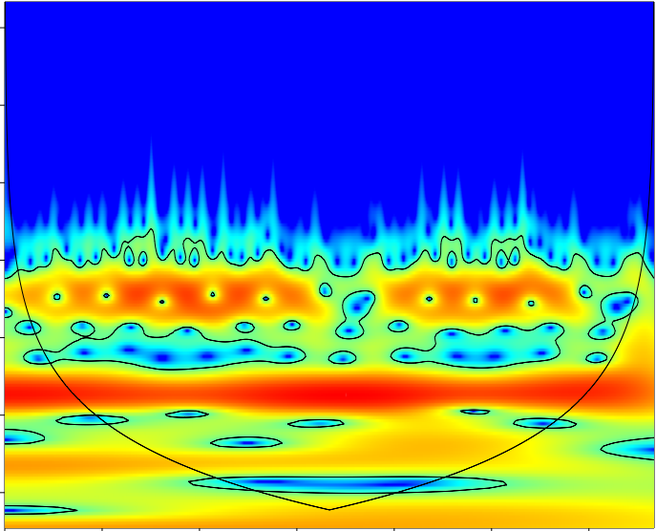
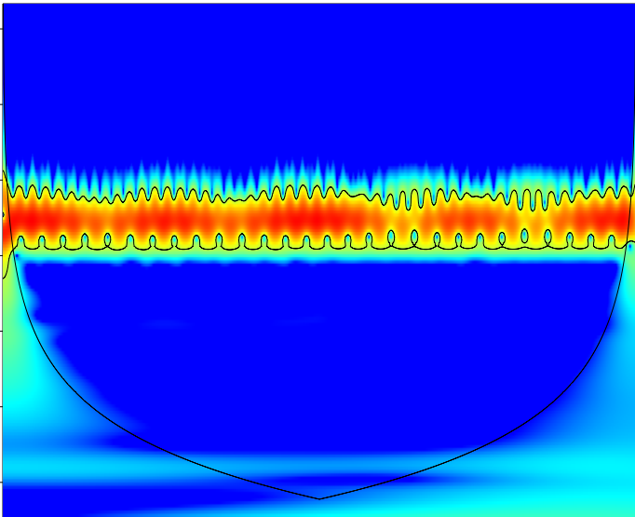
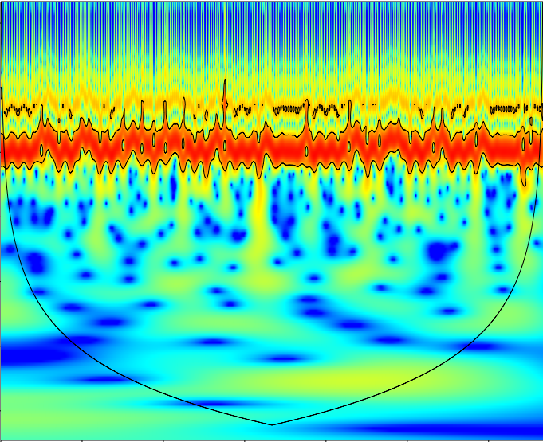
1.5
(a)
Eccentricity
(b)
Obliquity
(c)
Perihelion longitude
3.0
4.5
log2 scale
6.0
7.5
9.0
10.5
3750
4500
1500
2250
3000
3750
4500
0
750
1500
2250
3000
3750
4500
0
750
1500
2250
3000
0
750
Row number
Row number
Row number

Slide 3
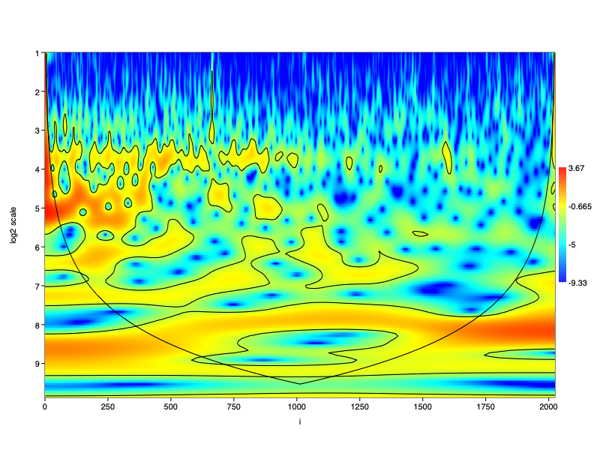
1
2
3.67
3
4
-0.665
5
log2 scale
6
-5
7
8
9
-9.33
0
250
500
750
1000
1250
1500
1750
2000
Row number

