Slide 1
41.1 ka
96.3 ka
23.7 ka

Slide 2
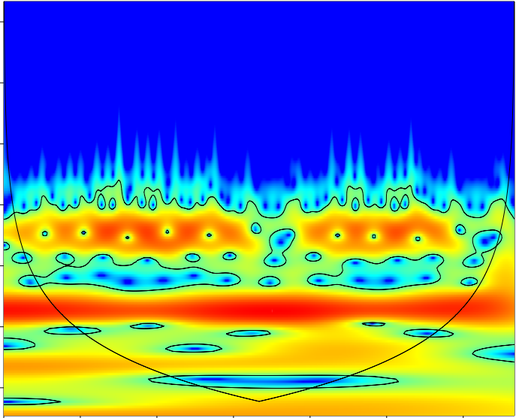
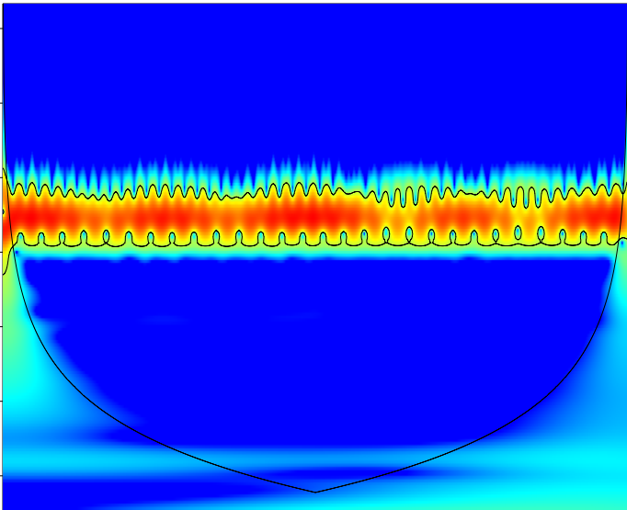
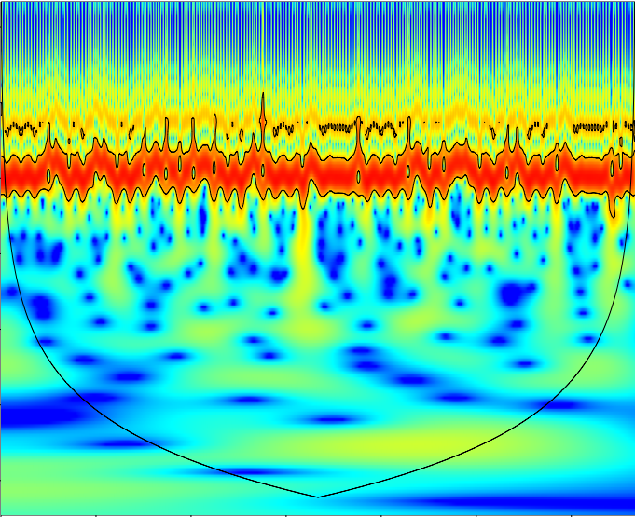
2.8
(a)
Eccentricity
(b)
Obliquity
(c)
Perihelion longitude
8.0
21.1 ka
22.6
64.0
Periodicity Wavelength (ka)
89.1 ka
39.4 ka
181.0
100.4 ka
512.0
1448.2
401.7 ka
3.75
4.50
1..50
2.25
3.00
3.75
4.50
0
0.75
1.50
2.25
3.00
3.75
4.50
0
0.75
1.50
2.25
3.00
0
0.75
Age (Myr BP)
Age (Myr BP)
Age (Myr BP)

Slide 3
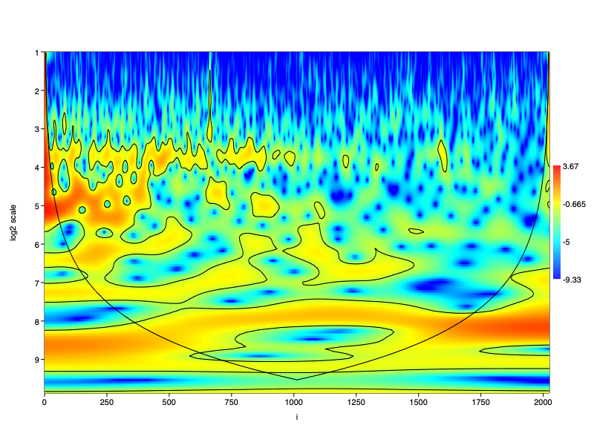
6.0
12.0
3.67
24.0
48.0
38.9 ka
-0.665
96.0
96.0 ka
Periodicity Wavelength (ka)
192.0
271.4 ka
-5
384.0
768.0
945.5 ka
1274.6 ka
1536.0
-9.33
0.00
0.75
1.50
2.25
3.00
3.75
4.50
5.25
6.00
Age (Myr BP)

