Slide 1

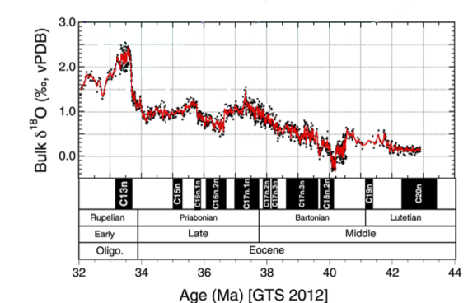
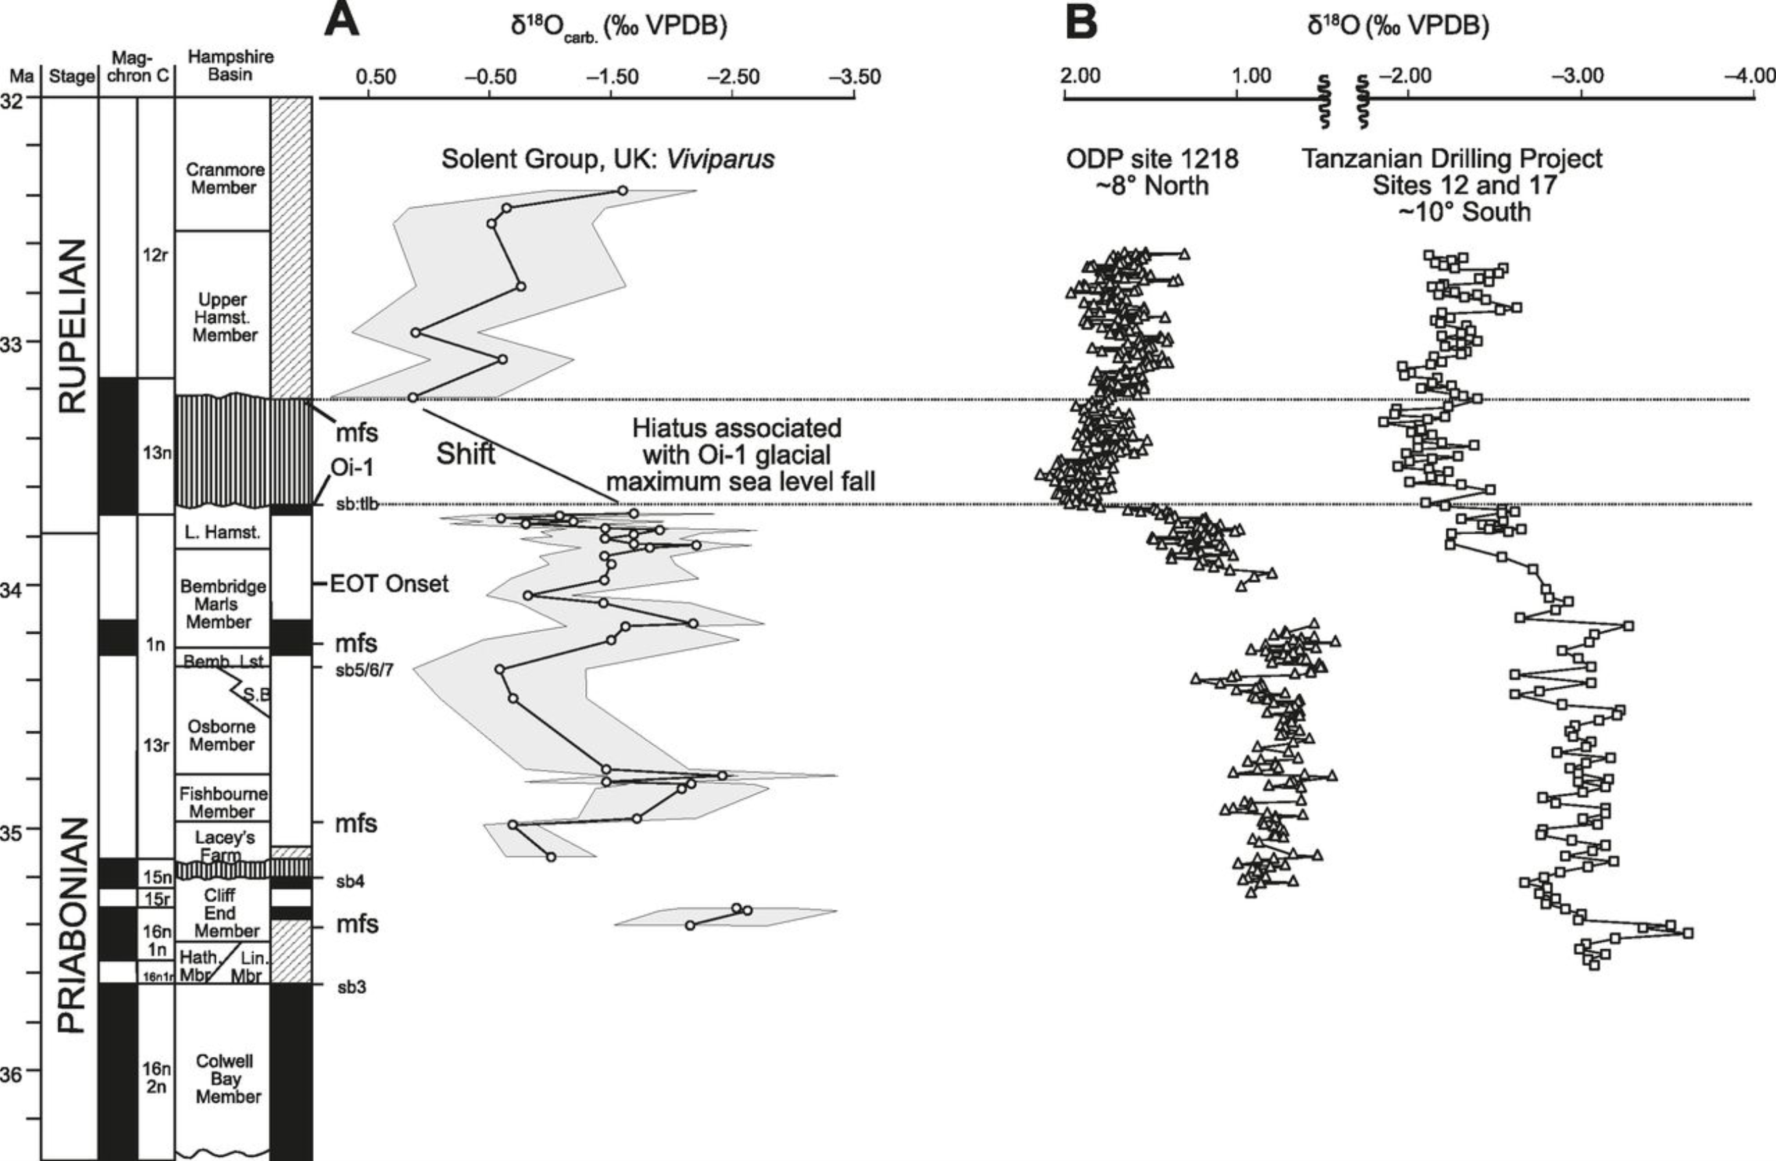
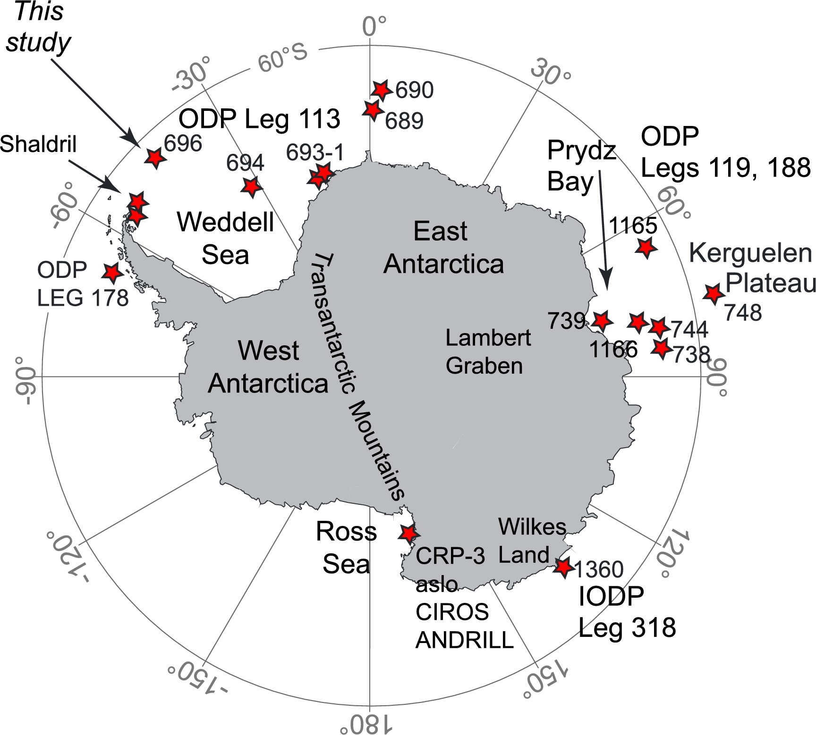
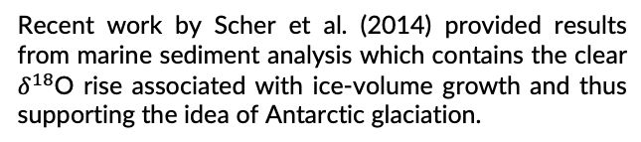

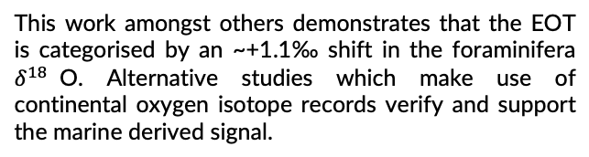

Oxygen isotope evidence for Antarctic glaciation
Jacky Cao
Abstract
Eocene-Oligocene glaciation
Through ice-core studies
Recent work by Scher et al. (2014) provided results from marine sediment analysis which contains the clear $δ^{18}$O rise associated with ice-volume growth and thus supporting the idea of Antarctic glaciation.
EOT
Introduction
One of the most prominent climatic changes in Earth’s history occurred in the Cenozoic near to the Eocene-Oligocene transition (EOT), ca. 33.8 Ma. At this boundary the decrease in global temperatures lead to effects such as permanent ice-sheet formation on Antarctica. Through studying the $δ^{18}$O ratio in sedimented foraminifera from ice-core samples, this glaciation can be placed into a long history of glacial-interglacial shifts. Changes in the isotopic composition and temperature of seawater results in variations in the oxygen ratio (Emiliani 1955), thus the larger climate picture can be reconstructed.
The following should therefore be investigated:
Is there oxygen isotopic evidence which demonstrates Antarctic glaciation?
Conclusions
Fig. 2. Varying $δ^{18}$O ratio across the Eocene and Oligocene (Scher et al. 2014).
Through
This work amongst others demonstrates that the EOT is categorised by an ~+1.1‰ shift in the foraminifera $δ^{18}$O. Alternative studies which make use of continental oxygen isotope records verify and support the marine derived signal.
EOT
This topic returns to the idea of how isotopes such as oxygen can be used to reconstruct paleotemperatures and climates, this in turn could provide potential evidence and support for hypotheses such as the “over-chill”, “over-kill”, or “over-ill” theories.
Sediment cores and Antarctic drilling
Sediment cores are key in reassembling past Antarctic climate chronology. Projects such as the Deep-Sea Drilling Project in the 1970s (Kennett 1977) utilised the $δ^{18}$O tracer for paleotemperature calculations across the early and mid Cenozoic.
References
Carter, A., Riley, T. R., Hillenbrand, C. D., & Rittner, M. (2017). Widespread Antarctic glaciation during the late Eocene. Earth and Planetary Science Letters, 458, 49-57.
Emiliani, C. (1955). Pleistocene temperatures. J Geol, 63(6), 538-578.
Kennett, J. P. (1977). Cenozoic evolution of Antarctic glaciation, the circum‐Antarctic Ocean, and their impact on global paleoceanography. Journal of Geophysical Research, 82(27), 3843-3860.
Scher, H. D., Bohaty, S. M., Smith, & others. (2014). Isotopic interrogation of a suspected late Eocene glaciation. Paleoceanography, 29(6), 628-644.
Sheldon, N. D., Grimes, S. T., Hooker, J. J., Collinson, M. E., Bugler, M. J., Hren, M. T., ... & Sutton, P. A. (2016). Coupling of marine and continental oxygen isotope records during the Eocene-Oligocene transition. Bulletin, 128(3-4), 502-510.
Fig. 3. $δ^{18}$O records derived from continental records compared to those derived from marine foraminifera (Sheldon et al. 2016).
Fig. 1. Locations of major studies of Antarctic marine sediment (Carter et al. 2017) .

