Slide 1
41.1 ka
96.3 ka
23.7 ka

Slide 2
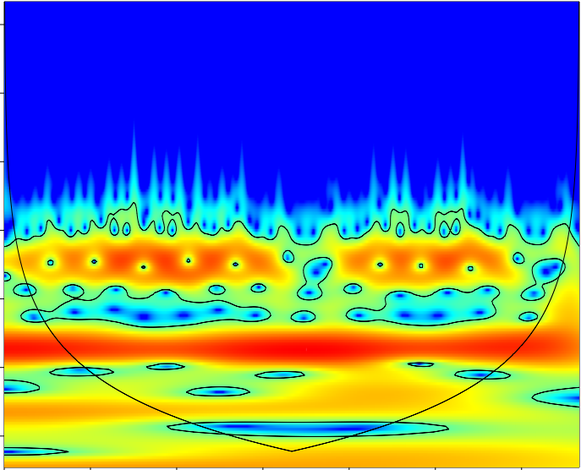
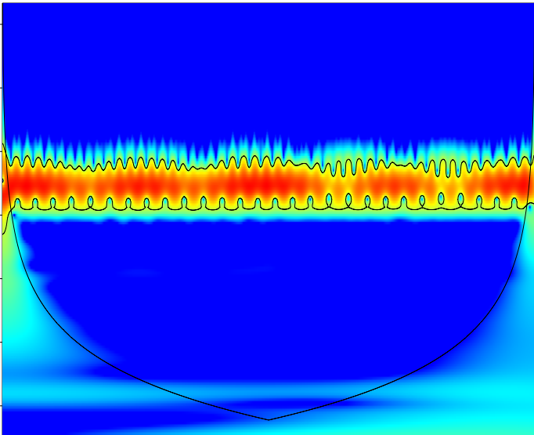
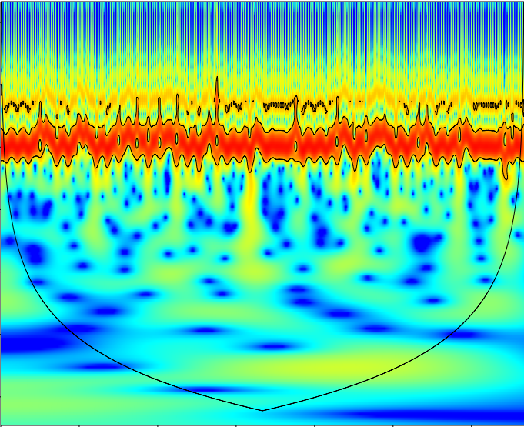
1.5
(a)
Eccentricity
(b)
Obliquity
(c)
Perihelion longitude
3.0
4.5
log2 scale
6.0
7.5
9.0
10.5
3750
4500
1500
2250
3000
3750
4500
0
750
1500
2250
3000
3750
4500
0
750
1500
2250
3000
0
750
Row number
Row number
Row number

