Slide 1
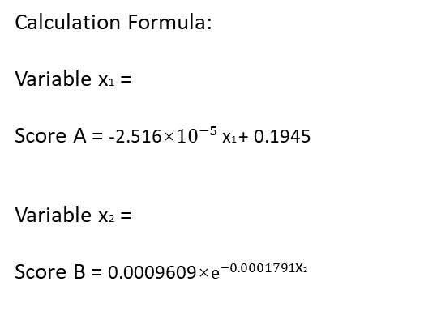
Summary Report
Trainee:
Bed:
Mentor: Date:
Phase:
marking
injection
dissection
idle
Training status:
independent
with help
take over
Trainee:
Trainee A
Trainee B
Trainee C
Phase Name | Duration | Proportion
Marking
Injection
Dissection
Idle
Total |  | /
Calculation Formula:
Variable х1 =
Score A = -2.516×${10}^{−5}$ х1 + 0.1945
Variable х2 =
Score B = 0.0009609×$e^{−0.0001791\text{х}\text{2}}$
Marking
Injection
Dissection
Idle
Injection Proportion
Marking
Dissection Proportion
Injection
Continues Dissection Period
Dissection
Dissection Duration
Idle
 | Score A | Score B
Score

