Slide 1
Post Silicon Validation
Introduction

Slide 2
Silicon Validation
Validation is the activity of ensuring
a product satisfies its specifications
compatible with related software and hardware
meets user expectations.

Slide 3
Silicon Validation
Silicon Validation is needed because:
Numbers of processor bug are growing
Bugs are becoming more diverse and complex.

Slide 4
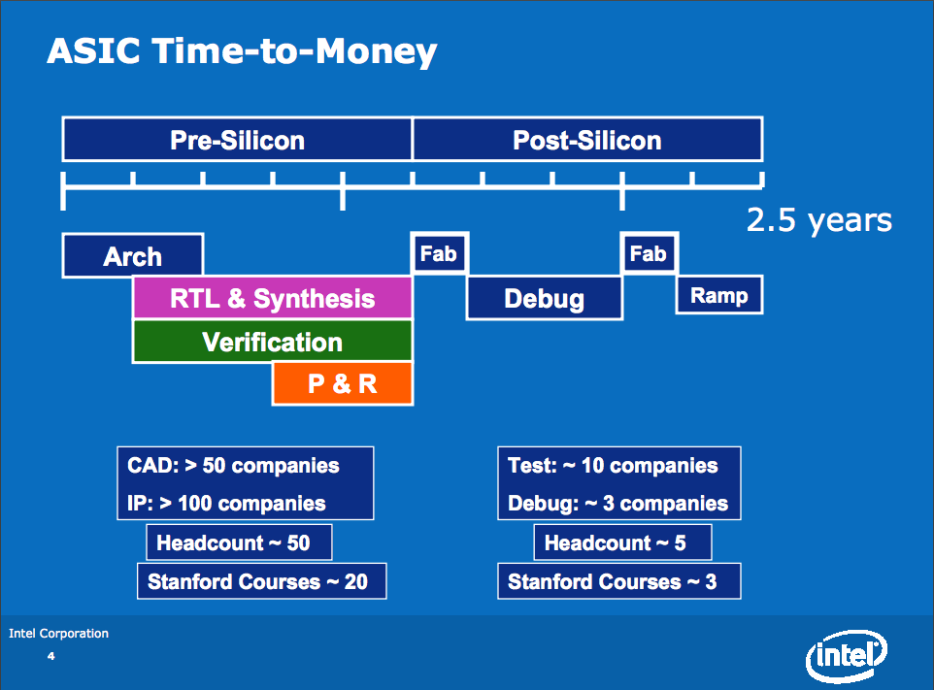
product development cycle

Slide 5
Pre silicon verification
Pre Silicon validation starts after planning and architecture build.
Verify design through simulation
Methods: software based simulation, formal verification, FPGA based hardware emulation.
Usually run at low speed (tens of hertz)

Slide 6
Post silicon validation
Start after the first silicon arrives
Validate design through silicon testing.
Very fast (gigahertz)

Slide 7
Pre vs. Post Silicon Verification
Pre Silicon Verification
Slow speed with limited amount of information
Easy to control and debug
Automated
Full observability
Post Silicon Validation
Fast execution speed leads to high information coverage.
Very hard to control and debugging is very expensive
Less automated, need manual help
Limitted observability

Slide 8
Why is Post-silicon validation needed
Because of simulation is much slower than actual system in hardware, not enough cycles can be simulated to gather enough information. Some bug may not be recorded.

Slide 9
Why is Post-silicon validation needed
Bugs caused by physical effect to the system can’t be detected by simulation. Need the actual chip.
Physical effects includes: crosstalk, thermal, process variation and so on.

Slide 10
Aspect of Post-silicon validation
Debug infrastructure
Reuse scan chain, trace buffers to output state information.
On-chip logic control
Focus on system centric solutions

Slide 11
Aspect of Post-silicon validation
Coverage
Make sure test cases cover whole area.

Slide 12
Aspect of Post-silicon validation
Coverage
To reduce overhead created loading software form memory, insert exerciser into the system
Continuously generate, execute test cases.
Check the correctness of the result.

Slide 13
Current problems
Limited observability
Only a small amount of signals can be selected to represent the current state
It’s very important and difficult to select signals that can reveal essential state of the
System.
Use State Restoration Ratio (SRR) as standard

Slide 14
My research area
Focus on communication centric validation.
By monitoring signals and translate them into system level flow activities, try to map them into different flows and detect any event that can’t be mapped to any existing flow.

Slide 15
Conclusion

