Slide 1
Quick Clips for Multiple Cameras
Instructor: Dr R.Thamas
Student: Bofeng Cao

Slide 2
Purpose
Realize a fast editing technique that can be used in sports competitions.
Input:
camera parameters (The height and angle of the camera)
Two videos captured by cameras from different perspectives
Target
Algorithm
Output: Automatically cut video

Slide 3
Implementation
To implement this technique, several steps are required:
1. Camera calibration
2. Target recognition and event detection
3. Compare the quality of different video frames

Slide 4
Camera calibration
In order to determine the relationship between the three-dimensional geometric position of a certain point on the surface of a space object and its corresponding point in the image, a geometric model of camera imaging must be established, and these geometric model parameters are camera parameters.
world coordinate
camera coordinate
Pixel coordinate

Slide 5
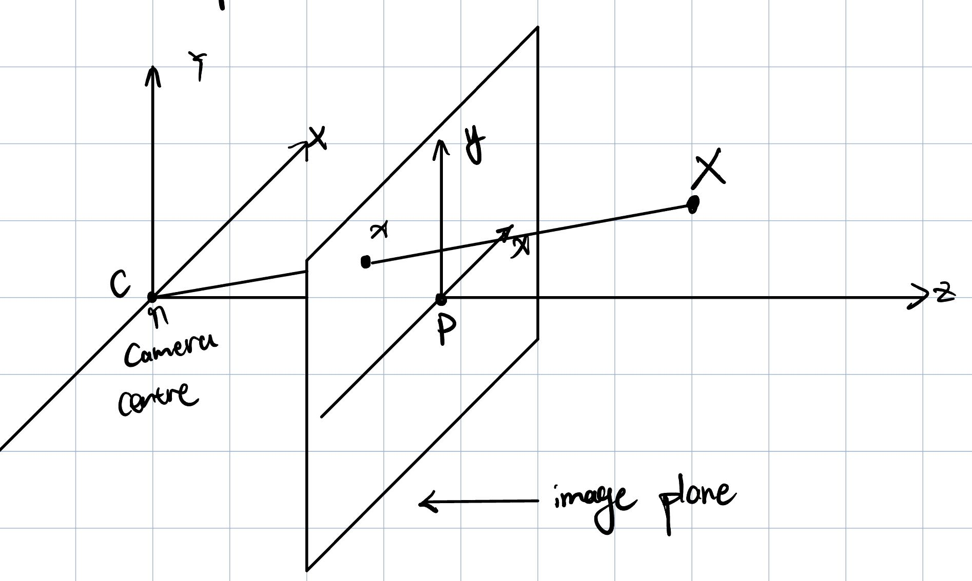

Slide 6
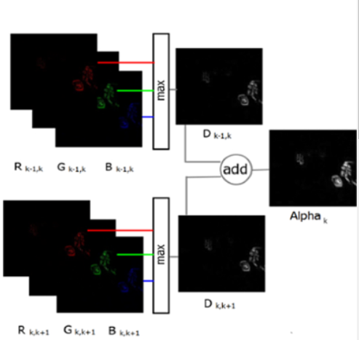
Object Recognition and Event Detection
At present, I mainly use the frame difference method for target detection:
Frame difference method is a simple and widely used technique for motion detection in video sequences. The main idea behind the frame difference method is to compare consecutive frames in a video to identify the changes or differences between them. These differences usually correspond to the moving objects in the scene.

Slide 7

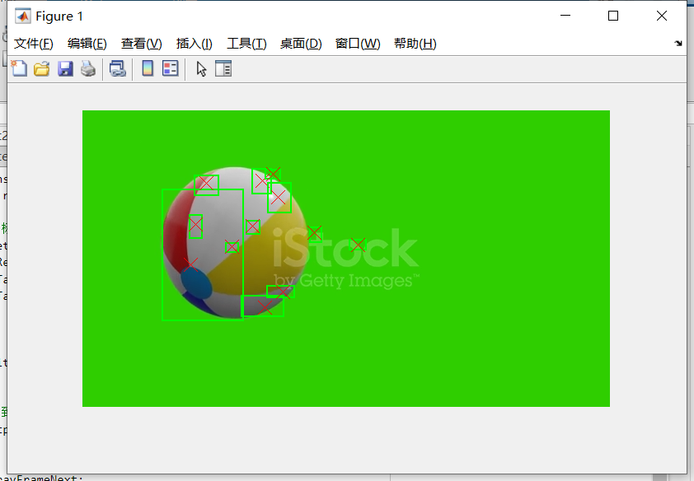
Problem
However, it is not ideal to detect moving objects only by frame difference method.
I did histogram statistics on them after doing video frame difference and binarize the histogram projection result to better determine the outline of moving objects.

Slide 8
Combine frame difference with histogram projection:
First, the frame difference method is used to find the area where there may be moving objects. This can be achieved by analyzing binary images, for example, using connected component labels or region attributes.
Determine the bounding boxes of these moving regions, which can be used as ROIs in the histogram projection.
A histogram projection method is applied in these ROIs to find more precise contours of objects. This will allow us to better track objects and estimate their position.

Slide 9
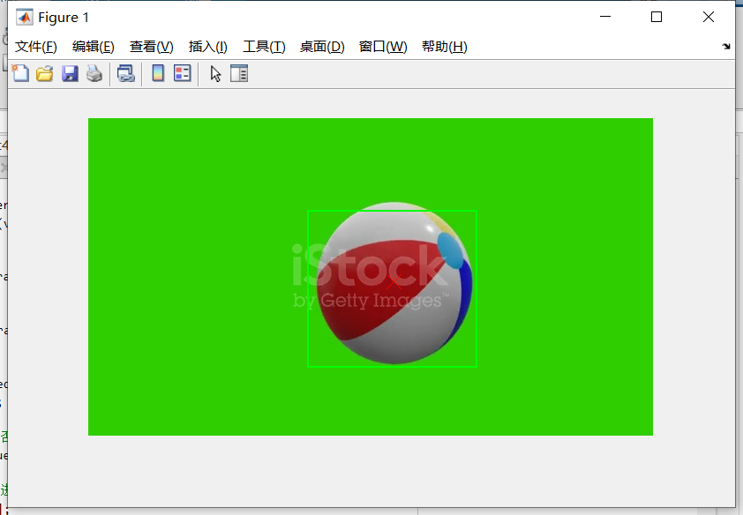
But sometimes such tracking doesn't work well with a single target. So I took the maximum value for the bounds produced by the trace.

