Slide 1
Register Allocation: A Historical Perspective
University of Science and Technology of China
Baojian Hua
bjhua@ustc.edu.cn

Slide 2
Content
Register Allocation: the Problem
Graph coloring
Linear Scan
Chordal graph
SSA allocation
Constraint-based allocation
Conclusion

Slide 3
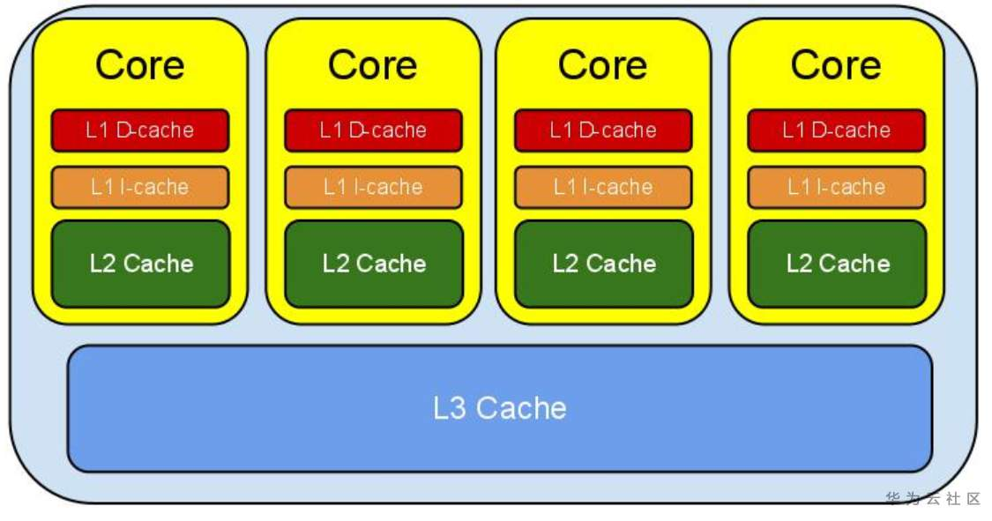
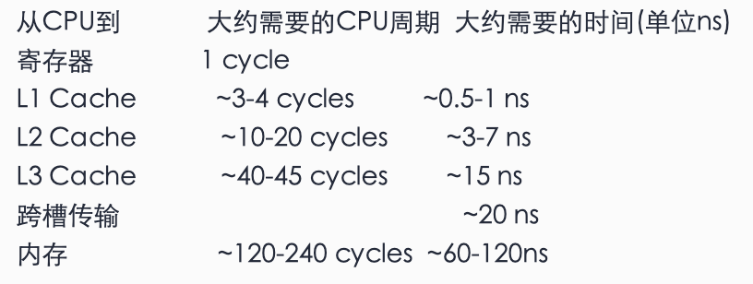
Register Allocation
The gap between accessing registers and memory may be huge
~100X on modern CPUs
Register allocation goal:
Allocate as many as programs variables to machine regs.
Tens of thousands program variables
Dozens of physical registers
To:
Improve program performance, and
Reduce binary size

Slide 4
Brief History (in CS)
Local register allocation (before 1980)
Graph coloring RA (1980, Chaitin, IBM PL.8)
Linear scan (1999, Poletto, MIT)
Chordal graph (2005, Pereira, UCLA)
SSA allocation (2006, Hack)
Constraint-based allocation (1996 Goodwin; 2001 Appel; 2002 Scholz)
…

Slide 5
What makes RA attractive and important?
A very hard problem, in theory
NP hard
Not only for allocation, but also for optimal spilling and coalesce
Many amazing solutions, in practice
Must address different application scenarios
Static compilation, JIT compilation, etc.
Heuristics
Satisfying results
Long history:
Underpinning theories date back at least to 19th century
Still active today
Considered the most important (thus a must-have) compiler optimization
[Hennessy & Patterson]
Widely used in production compilers
E.g., LLVM compiler:
Basic, Fast, Greedy, PBQP, etc.

Slide 6
Content
Register Allocation: the Problem
Graph coloring
Linear Scan
Chordal graph
SSA allocation
Constraint-based allocation
Conclusion

Slide 7
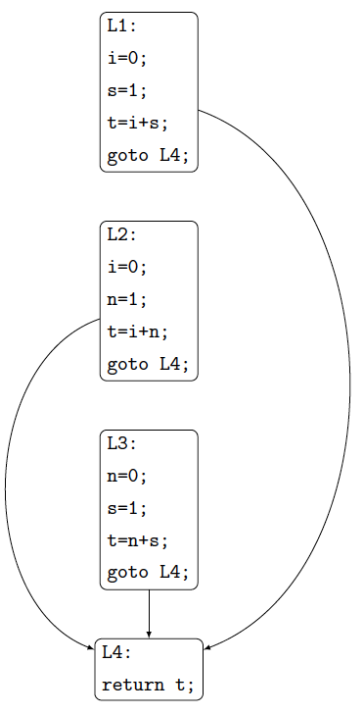
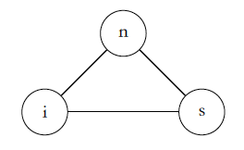
Graph coloring
定理1：对于任意程序P，都可以基于对P进行的活跃分析，构建其干涉图G=(V, E).
定理2 [Chaitin]：对于任意给定的无向图G = (V,E), 都存在一个程序P，使得对P进行活跃分析、并构造对应的干涉图后，该干涉图正好是图G。
核心结论：对一个程序P的寄存器分配问题，等价于对一个相应无向图G的着色问题。

Slide 8
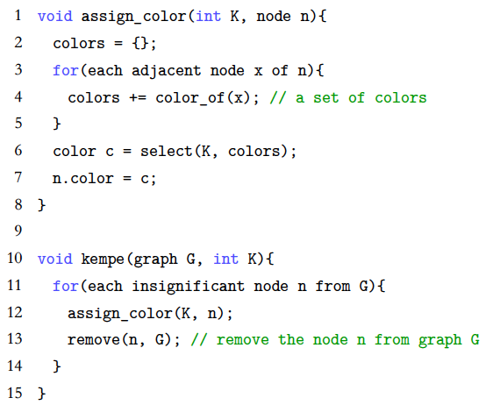
Kempe定理与乐观着色
Kempe定理：如果图G = (V,E)中存在某个小度节点p，
把节点p及其关联的边都从图G中移除后，得到的图记为G′；如果图G′是K可着色的，则原来的图G同样是K 可着色的。
【1879年，基于对“四色定理”的研究。】
启发式算法：基于小度节点移除的迭代式算法。
degree(p)<K
p
…

Slide 9
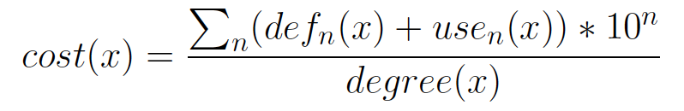
Spilling
Spilling:
Allocate variables into memory, instead of into registers
Rewrite the programs to introduce extra load/stores
Typical architecture for spilling:
Problematic from an algorithmic point of view
But 2-3 iterations are typically enough
Spilling heuristics:
build
simplify
select
spill
rewrite

Slide 10
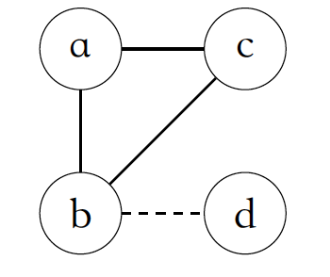
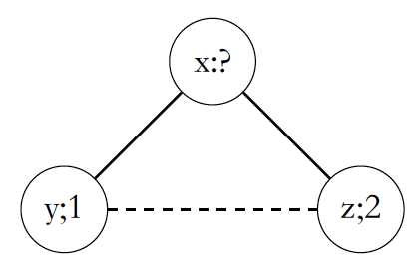
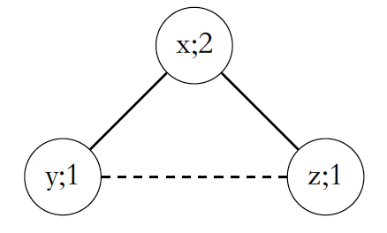
Coalescing
Coalescing:
Allocate move-related variables into the same registers, thus eliminating the move
Advantages:
Reduce useless data movement (thus improve performance)
Reduce spilling
Strategies for coalescing:
Aggressive [Chaitin], Conservative [Briggs, George], Iterated [Appel]
And many other variants
Typical architecture (aggressive):
Profitable on architecture like Kunpeng
build
Coalesce
build
select
spill
rewrite

Slide 11
Content
Register Allocation: the Problem
Graph coloring
Linear Scan
Chordal graph
SSA allocation
Constraint-based allocation
Conclusion

Slide 12
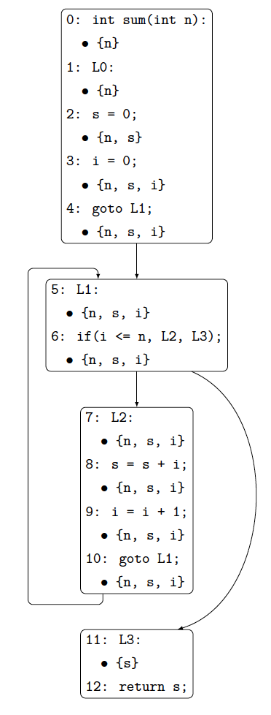
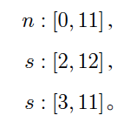
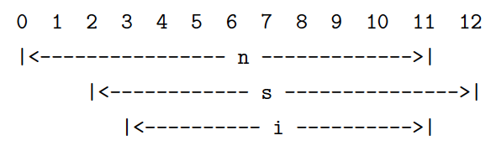
Linear Scan
Live interval:
Linearize the control-flow graph (e.g., reverse post-order)
Interval = [first-use, last-use]
Allocate each interval to a register
Nice properties:
No need to build IG
Space efficient
One-pass scanning
Very fast
Suitable for JIT or online compilations
Spilling and coalesce:
Challenging in one-pass allocators like LS
General strategies: reserve R regs
R = max(liveVars)
Complexity:
O(N*V)
Time to perform liveness analysis dominates

Slide 13
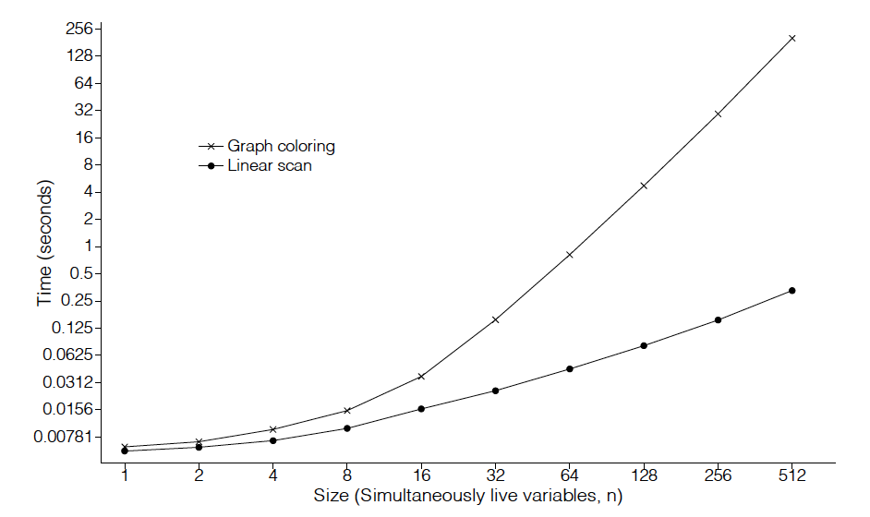
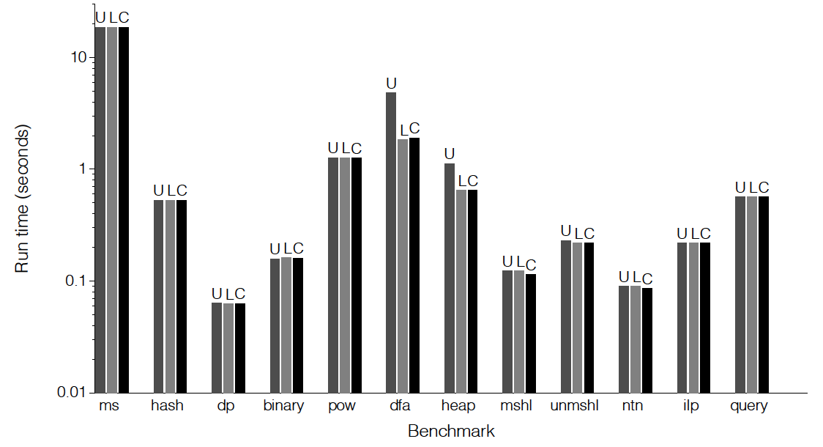
Linear Scan Performance
Compared with graph coloring:
Allocation time
Running time

Slide 14
Content
Register Allocation: the Problem
Graph coloring
Linear Scan
Chordal graph
SSA allocation
Constraint-based allocation
Conclusion

Slide 15
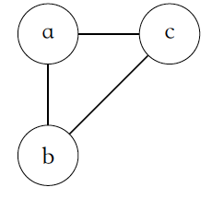
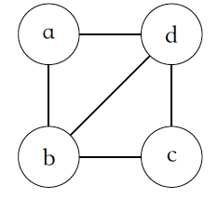
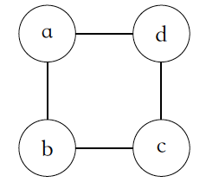
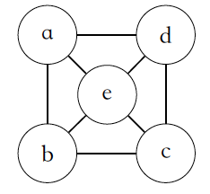
Chordal Graph
Chordal graph:
Intuitively: NO large (>=4) cycles
Nice properties:
Many hard problems are polynomial on chordal graphs
Including graph coloring
Typical architecture for Chordal allocation:
Spilling:
Post spilling in a one-pass compilation
Similar to spilling in linear scan
Coalesce:
Peephole optimization to eliminate trivial ones
Recoloring
Complexity: O(V+E)
build
PEO
color
spill
coalesce

Slide 16
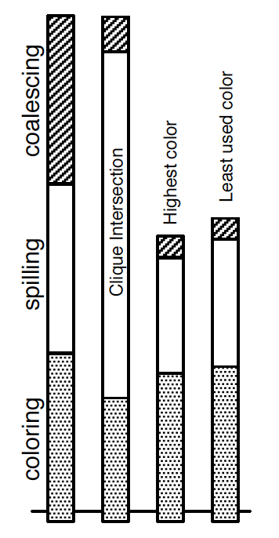
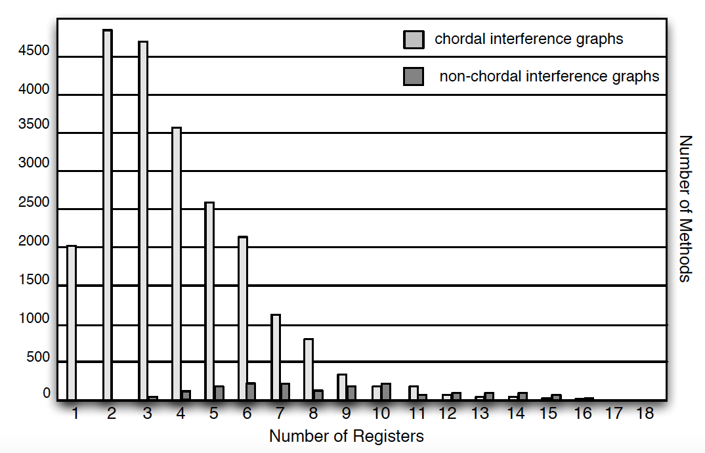
Chordal Allocation Performance
23681 methods in rt.jar from Java 1.5
91.0% graphs are chordal
95.5%, if to SSA then back

Slide 17
Content
Register Allocation: the Problem
Graph coloring
Linear Scan
Chordal graph
SSA allocation
Constraint-based allocation
Conclusion

Slide 18
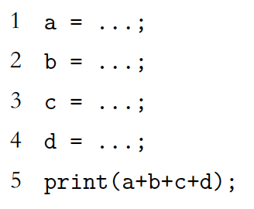
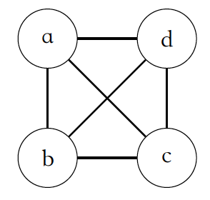
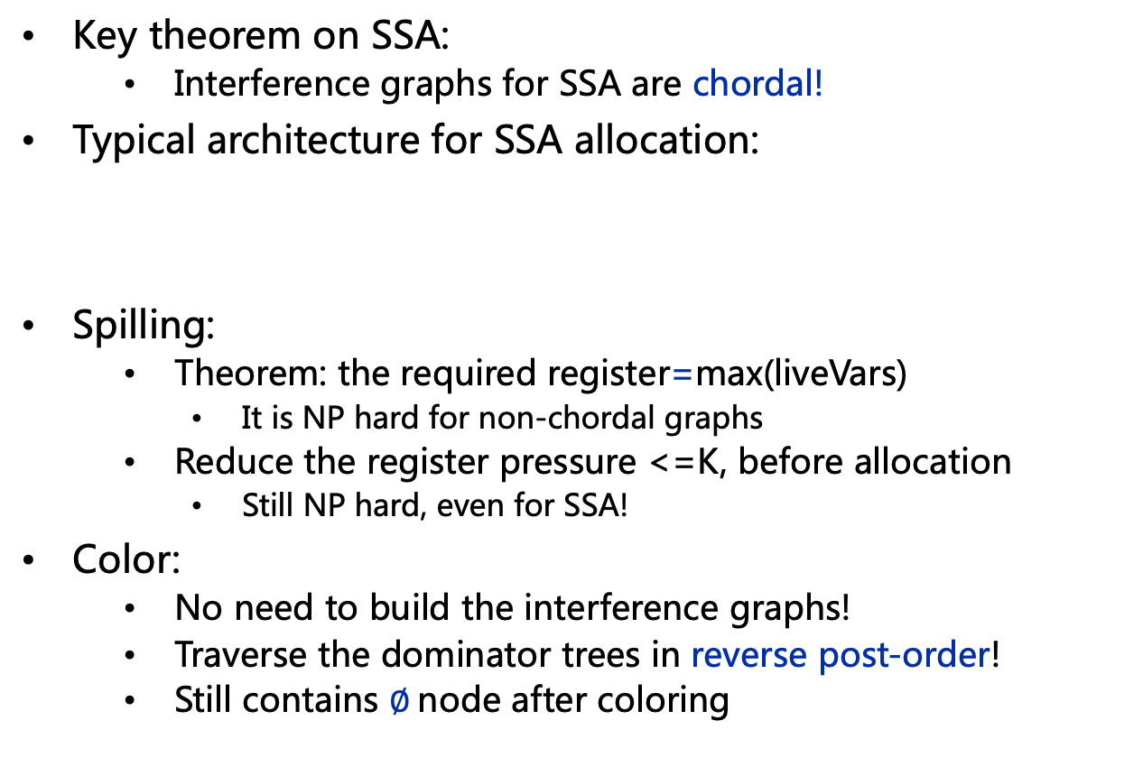
SSA Allocation
Key theorem on SSA:
Interference graphs for SSA are chordal!
Typical architecture for SSA allocation:
Spilling:
Theorem: the required register=max(liveVars)
It is NP hard for non-chordal graphs
Reduce the register pressure <=K, before allocation
Still NP hard, even for SSA!
Color:
No need to build the interference graphs!
Traverse the dominator trees in reverse post-order!
Still contains $∅$node after coloring
Build
SSA
spilling
color
coalesce
Out
SSA

Slide 19
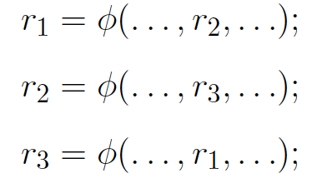
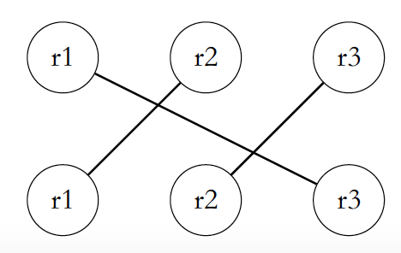
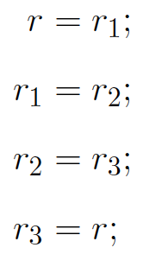
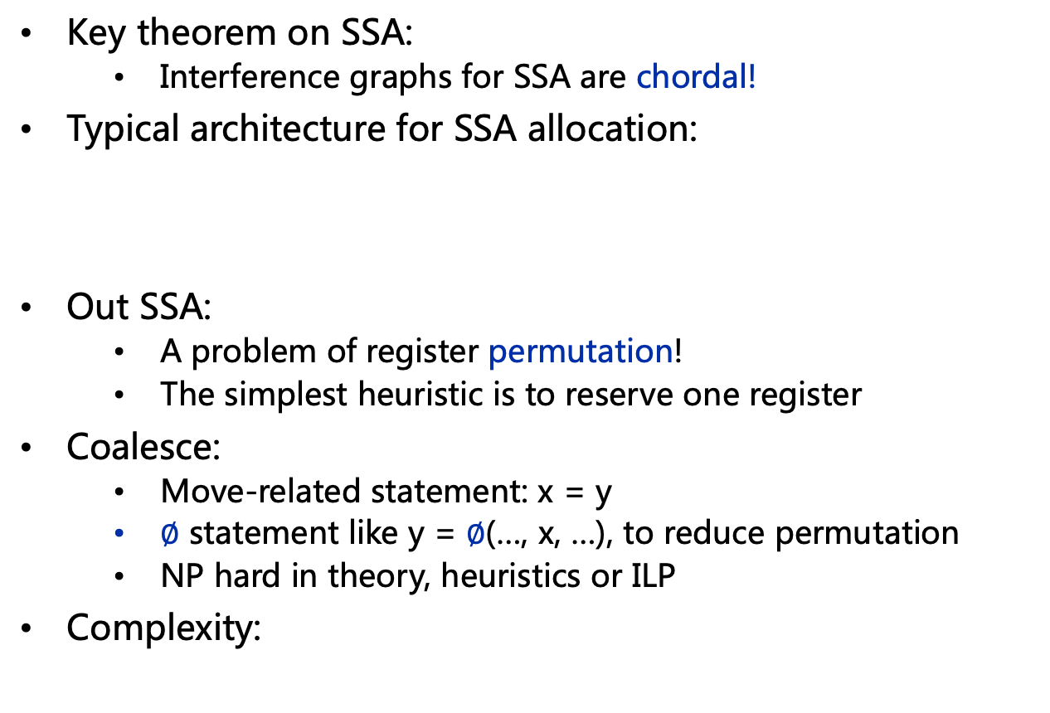
SSA Allocation, Cont’
Key theorem on SSA:
Interference graphs for SSA are chordal!
Typical architecture for SSA allocation:
Out SSA:
A problem of register permutation!
The simplest heuristic is to reserve one register
Coalesce:
Move-related statement: x = y
$∅$ statement like y = $∅$(…, x, …), to reduce permutation
NP hard in theory, heuristics or ILP
Complexity:
Build
SSA
spilling
color
coalesce
Out
SSA
Phase | Color | Spill | Coalesce
Complexity | O(V+E) | NP hard | NP hard

Slide 20
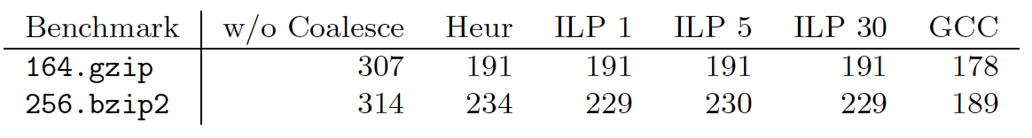
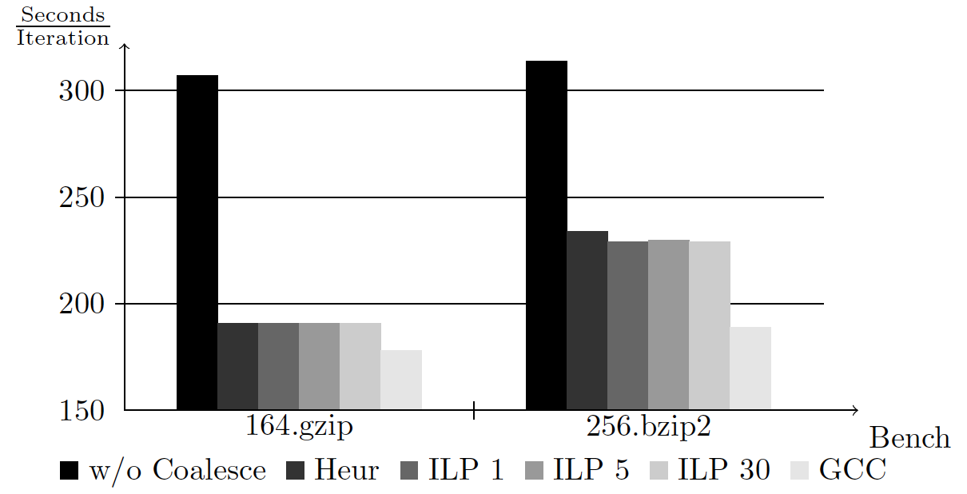
SSA Allocation Performance
The runtime performance for raw, SSA coalescing, ILP, and gcc

Slide 21
Content
Register Allocation: the Problem
Graph coloring
Linear Scan
Chordal graph
SSA allocation
Constraint-based allocation
Conclusion

Slide 22
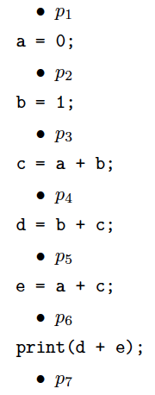
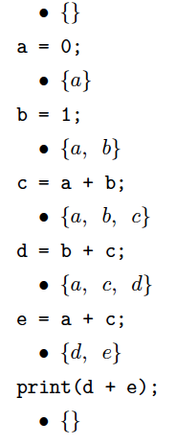
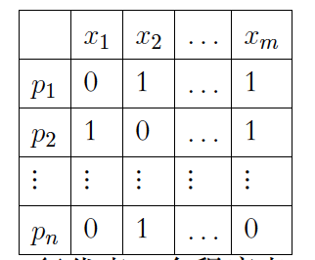

ILP Allocation
Integer Linear Programming (ILP):
NP hard, in theory
Efficient algorithms and practical solvers, in practice
Typical architecture for ILP allocation:
RA model: the most difficult part
r, m, l, s : a variable is in one of reg/mem/load/store
Generate constraints:
Each variable just takes one state
RA
model
program
solver
Solution

Slide 23
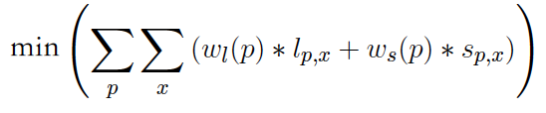
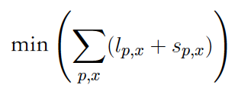
ILP Allocation, Cont’
Integer Linear Programming:
NP hard, in theory
Efficient algorithms and practical solvers, in practice
Typical architecture for ILP allocation:
RA model: the most difficult part
The objective function:
RA
model
program
solver
Solution

Slide 24
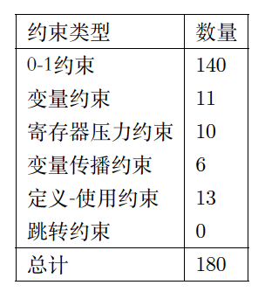
ILP Allocation, Cont’
The number of constraints are normally large
For a program with S statements and V variables: O(S * V)
Suppose S=1000, and V=100
#constraints = 100,000
The solver:
RA
model
program
solver
Return
normally
Solution
Return Abnormally
Problematic for RA!
Timeout

Slide 25
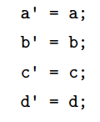

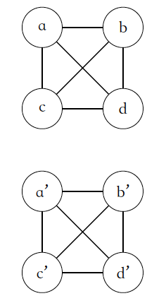

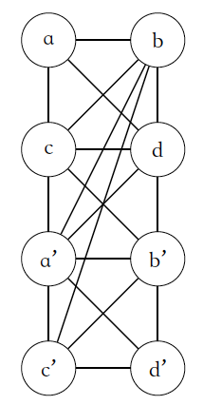
ILP Allocation, Cont’
Register assignment
Register pressure reduction
For each program point, introduce parallel assignments for live variables:
Register assignment:
Kempe algorithm
Complexity:
Phase | Color | Spill | Coalesce
Complexity | O(V+E) | NP hard | NP hard

Slide 26
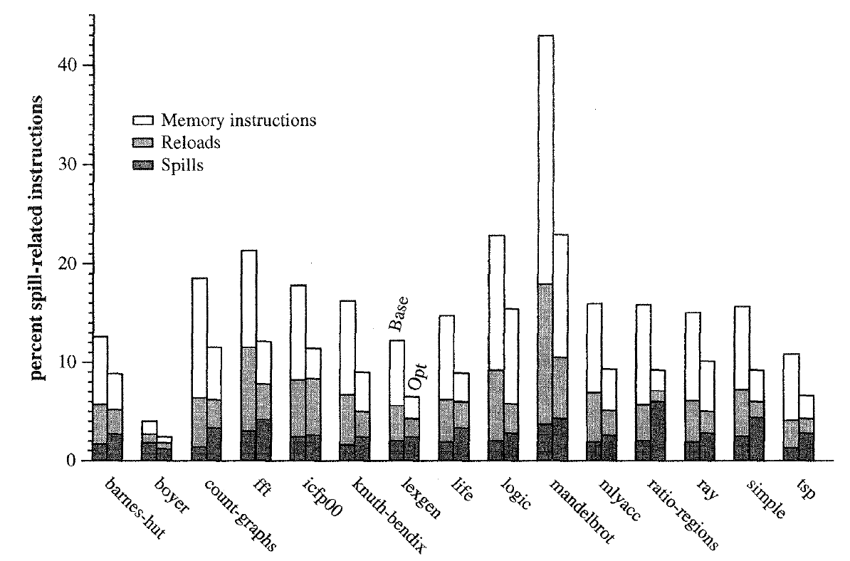
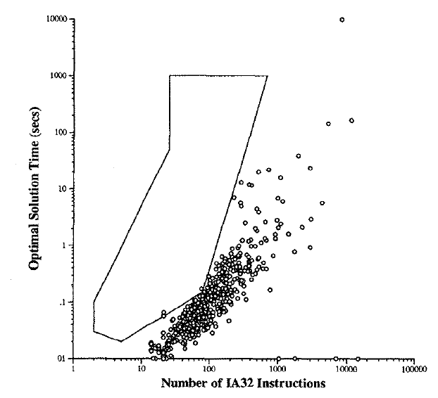
ILP Allocation Performance
Compare with graph coloring:
Solver time
Running time

Slide 27
Content
Register Allocation: the Problem
Graph coloring
Linear Scan
Chordal graph
SSA allocation
Constraint-based allocation
Conclusion

Slide 28
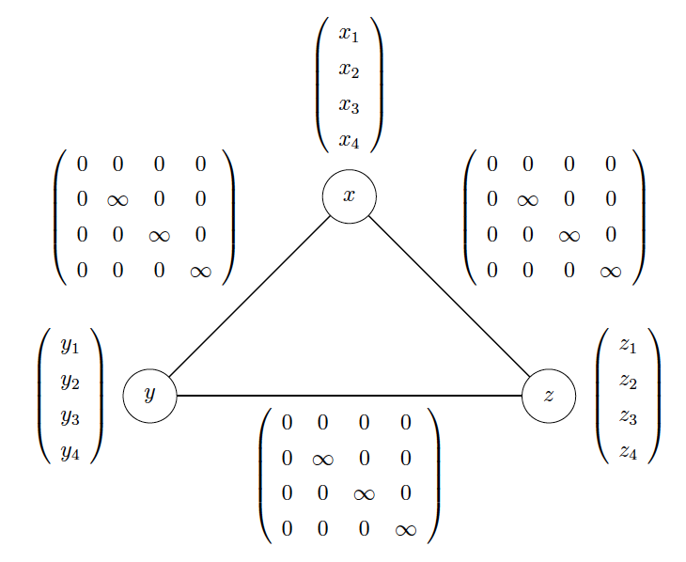
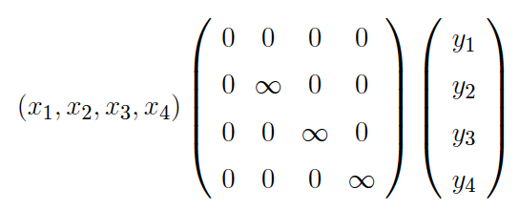
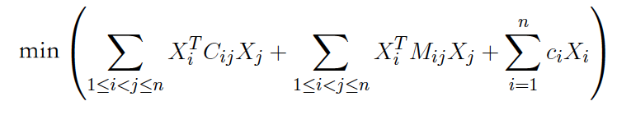
PBQP Allocation
Partitioned Boolean Quadratic Problem (PBQP):
Another NP hard problem from OR
Efficient algorithms and practical solvers, in practice
Typical architecture for ILP allocation:
RA model:
Cost model: the cost matrix
Constraints + objective functions
RA
model
program
solver
Solution

Slide 29
Content
Register Allocation: the Problem
Graph coloring
Linear Scan
Chordal graph
SSA allocation
Constraint-based allocation
Conclusion

Slide 30
Conclusion
Register allocation is the most important optimization in compilers
Long history, fruitful results,
Reflect most beautiful aspect of compilers: amazing solutions to challenging problems
Hard in theory
NP hard, not only for allocation, but also spilling and coalesce
Deep connection with other fields like graph theory, operational research, etc.
Many practical heuristics are developed
Different allocation algorithms for different scenarios
Different algorithms even in one compiler
For example, 4 in the LLVM compiler
Still active today, not only for scalar machines, but also for vector or heterogenous machines

Slide 31
Thanks!

