Slide 1
Concurrent Garbage Collection
Hao Tang
2021.2.4

Slide 2
Motivation
Pauseless GCs in Java
ZGC, Shenandoah GC: Production-ready (JDK15), not finished yet
Next goal: generational (throughput)
How to achieve concurrency?
Challenge: Mutator (application threads) vs. Collector
Concurrent vs. Stop-the-world

Slide 3

Motivation
Aleksey Shipilёv (Shenandoah GC leader)
“Many GCs appear super-innovative, but in fact they reuse (or reinvent) ideas from the GC Handbook"
“Combinations of those ideas give rise to many concrete GCs”

Slide 4
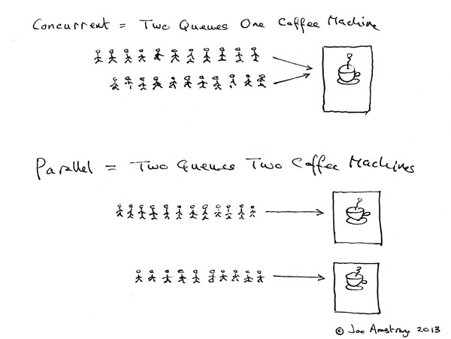
Concurrent GC
Concurrent vs. Parallel?
Java Options
ParallelGCThreads (STW)
ConcGCThreads (Concurrent)

Slide 5
Concurrent GC: Concepts
Incremental
Parallelized
Mostly-concurrent
On-the-fly

Slide 6
Incremental collection
First, on a Uniprocessor
Time
Notes:
Uniprocessor
The important thing is that the collection cycle is no longer atomic

Slide 7
Incremental collection
On a Multiprocessor:
Can also be parallelized:
Notes:
Multiprocessor

Slide 8
Mostly concurrent collection
Can also be incremental:
Notes:
Stop the world at the beginning, for instance to obtain roots.
Also helps to synchronize all mutators that a new collection cycle has begun.

Slide 9
Concurrent (on-the-fly) collection
Can also be incremental:
Notes:
Each mutator may have to synchronize with the collector prior to starting the collection cycle

Slide 10
Concurrent GC: Correctness
Safety
Retains at least all reachable objects
May leave “floating garbage”
Liveness
Collector must eventually complete its collection cycle (termination)

Slide 11
The tricolor abstraction
White objects
Have not (yet) been reached by the collector
Considered garbage at the end
Grey objects
Have been reached but not yet fully processed (may still point to white objects)
Black objects
Have been fully processed (don’t point to white objects immediately after the scan)

Slide 12
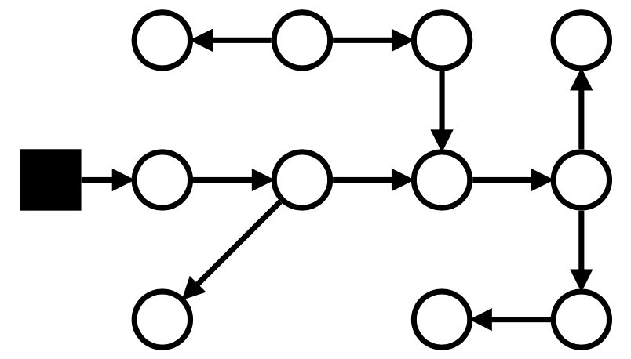
The tricolor abstraction

Slide 13
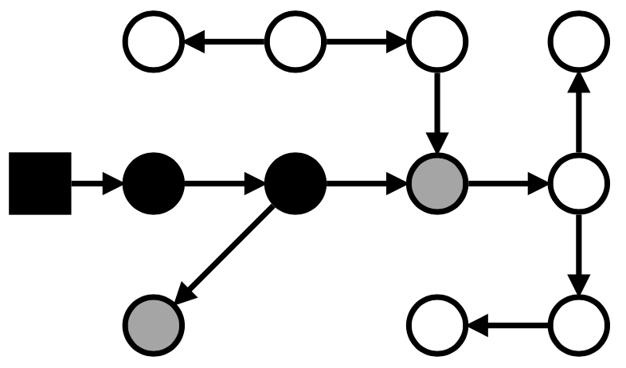
The tricolor abstraction
Grey wavefront

Slide 14
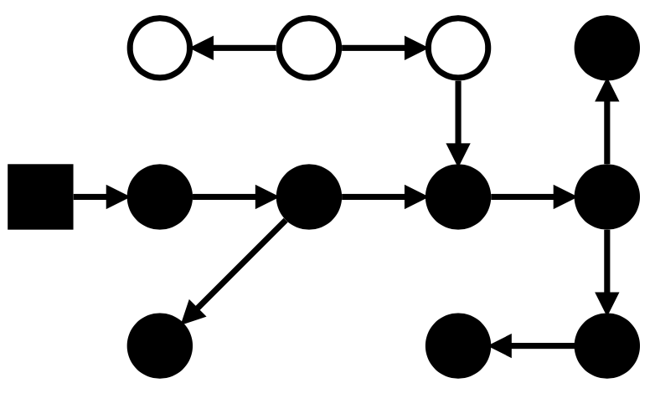
The tricolor abstraction

Slide 15
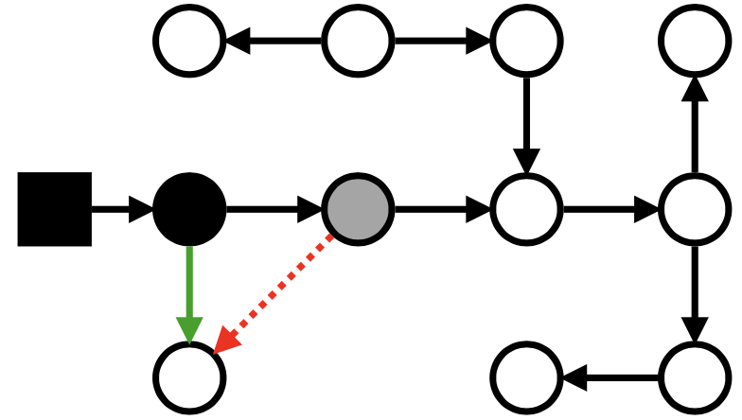
Challenge: the lost object problem
Mutator can insert an object behind the wavefront

Slide 16
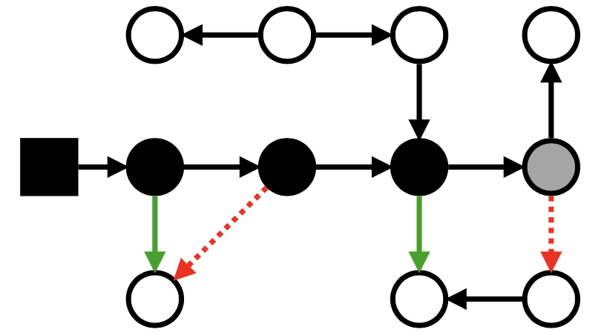
Challenge: the lost object problem
Mutator can insert an object behind the wavefront

Slide 17

Losing objects
Wilson [1994] states that an object can be lost only if the following two conditions hold:
Mutator stores a pointer to a white object into a black object, and
All paths from grey objects to that white object are destroyed
invalidate (at least) one of the conditions

Slide 18
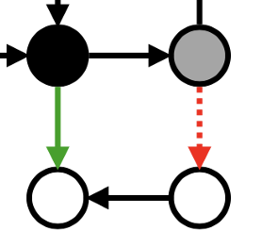
Not losing any objects
Must ensure that both conditions don’t hold simultaneously
Weak tricolor invariant:
All white objects pointed to by black objects are “grey protected”
(reachable from some grey object, directly or through a white chain)
This invalidates the second condition
Strong tricolor invariant:
There are no pointers from black objects to white objects
This invalidates both conditions

Slide 19
Tradeoffs
Solution properties
Precision: amount of “floating garbage”
Efficiency: throughput
Atomicity: degree of concurrency
Example:
A stop-the-world collector obtains:
Maximal precision
No concurrency with the mutator
Finer grained atomicity increases concurrency, at the expense of possibly accuracy and/or overhead of atomic operations

Slide 20
Mutator color
Consider the mutator itself an object
Grey mutator
Has not yet been scanned by the collector, or
Roots have been scanned but have to be rescanned
Black Mutator
Scanned by the collector; roots won’t be rescanned
Under strong invariant: roots don’t point to white objects
Under weak invariant: can hold white objects IF “grey protected”

Slide 21
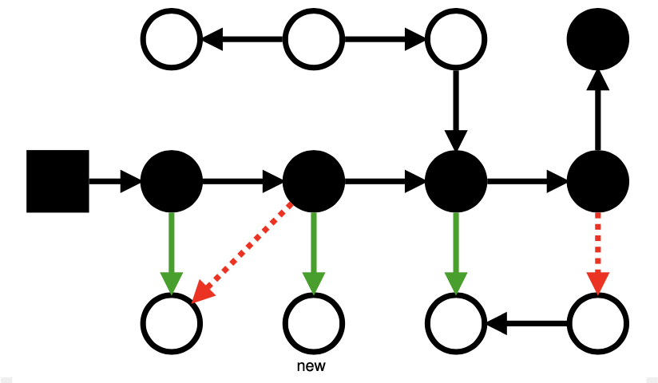
Allocation color
Mutator color influences color of allocated memory
Must satisfy the invariant that applies given the mutator color
Grey mutator can allocate white objects
Black mutator can not allocate white objects
Unless it knows that the reference will be stored ahead of wavefront
Allocating black objects is always safe

Slide 22
Short recap
Tricolor invariant types
Weak invariant
Every white object pointed by a black object, is “grey protected”
Strong invariant
No pointers from black objects to white objects
Mutator color
Grey mutator
Some of the roots haven’t been scanned yet
Black mutator
All roots scanned

Slide 23
Incremental Update Approach
Insertion (adding a white pointer to a black object)
Increase (increment) the set of objects known to be live
Use write barrier to re-color source/destination to prevent black to white pointers
Thus, preserve the strong invariant

Slide 24
Snapshot-at-the-beginning Approach
SATB
Deletion (deletion of a white pointer from a white/grey object)
Conservatively treat any white object ahead of the wavefront as alive
Use a write barrier to protect against deletion
Must snapshot the mutator and operate only with black mutator
Maintain the weak invariant
No way to delete all paths from grey objects to any object that was alive at the beginning of the collection cycle

Slide 25

Barrier

Slide 26
Barrier techniques for concurrent GC
To maintain one of the two invariants, the following actions can be taken at barriers:
Add to the wavefront by shading a white object grey
Advance the wavefront by scanning an object (to black)
Retreat the wavefront by reverting a black object to grey
Any other action would break the invariants:
revert to white / color black without scanning

Slide 27
Complete enumeration of barriers
Grey mutator techniques
Steele [1975, 1976]
Boehm et al. [1991]
Dijkstra et al. [1976]
Black mutator techniques
Baker [1977]
Appel [1988]
Abraham and Patel [1987], Yuasa [1990]
Pirinen [1998] claims that this is the complete list
Insertion (incremental update) barriers
Deletion (SATB) barriers

Slide 28
Grey mutator incremental update (v1)
Steele [1975, 1976]
atomic Write(src, i, ref): src[i] ← ref if isBlack(src) if isWhite(ref) revert(src)
Maintains the strong invariant
No black to white pointers exist
Most precise barrier, at the cost of progress
Notes:
Most precise as it only retreats the wavefront, which might cost in progress (rescan)
Which invariant? strong

Slide 29
Grey mutator incremental update (v2)
Boehm et al [1991]
atomic Write(src, i, ref): src[i] ← ref if isBlack(src) revert(src)
Less precise
Notes:
Same as before, just without the extra check. Was useful because they used virtual memory dirty bits to indicate mutator updates, to save the actual barrier code (rescan occurred only during stop-the-world phases), so could save some overhead

Slide 30
Grey mutator incremental update (v3)
Dijkstra et al [1976, 1978]
atomic Write(src, i, ref): src[i] ← ref if isBlack(src) shade(ref)
Notes:
Less precise, because the new pointer is shaded (although it might be soon removed), but aids progress (no rescan/wavefront retreat)

Slide 31
Black mutator incremental update (v1)
Baker [1978]
atomic Read(src, i): ref ← src[i] if isGrey(src) ref ← shade(ref) return ref
Maintains the strong invariant (after snapshotting mutator)
No pointers from black to white
Supports a copying-collector
Notes:
Note that the mutator is snapshotted at the beginning, so everything reachable directly from it is black or grey
Strong invariant, as it prevents the mutator from ever obtaining a white pointer
Designed for copying collection

Slide 32
Black mutator incremental update (v2)
Appel et al [1988]
atomic Read(src, i): if isGrey(src) scan(src) return src[i]
Less precise (more coarse-grained) than before
Notes:
Originally used virtual memory page protection primitives to trap the access and initiate scans
Can also be used with copying collector

Slide 33
Black mutator snapshot-at-the-beginning
Abraham and Patel [1987] and Yuasa [1990]
atomic Write(src, i, ref): if isGrey(src) || isWhite(src) shade(src[i]) src[i] ← ref
Maintains the weak invariant
White objects that were alive at the beginning are grey protected
Less precise of all
Initially wasn’t conditioned (used virtual memory COW)

Slide 34
Java GC Barriers
CMS: revert black objects
G1, Shenandoah GC: SATB
ZGC: Backer‘s read barrier

