Slide 1
Processor Architecture I: ISA & Design
侯太格 1600012897

Slide 2
CISC | Early RISC
Variable-size encodings | Fixed-length encodings
Arithmetic and logical operations can be applied to both memory and registers | Arithmetic and logical operations only use register operands
Condition codes | No condition codes
Many different combinations of base, displacement, index and scale for addressing | Simple addressing formats
Stack is used for procedure arguments and return addresses | Registers are used for procedure arguments and return addresses
A large number of instructions | Many fewer instructions
Some instructions with long execution times | No instruction with a long execution time

Slide 3
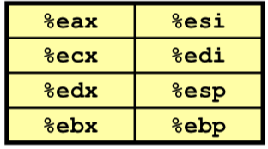

Y86 – One Instruction Set Architecture
Programmer Visible State
Registers
Condition Codes
PC
Stat: Program Status
Memory
AOK: Normal operation
HLT: halt instruction encountered
ADR: Invalid address encountered
INS: Invalid instruction encountered
If encountered any exceptions, Y86 would stop
ZF: Zero
SF: Signed-Negative
OF: Overflow

Slide 4
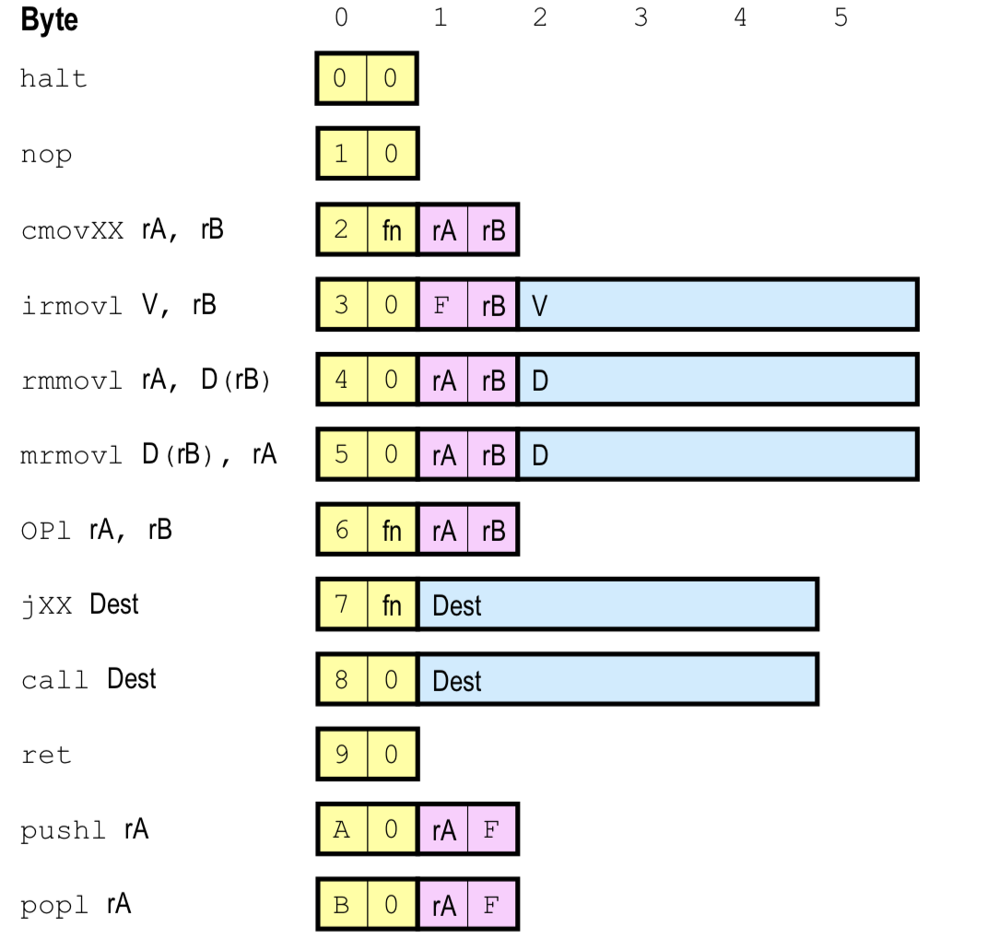
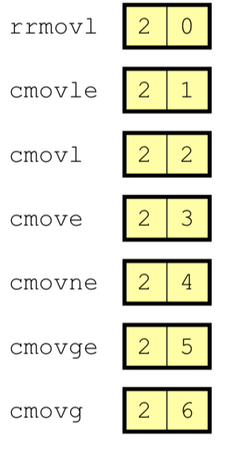
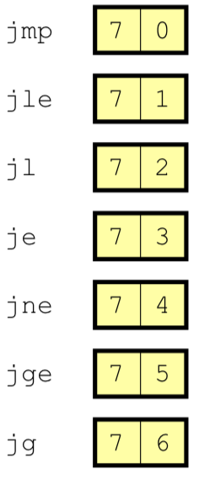
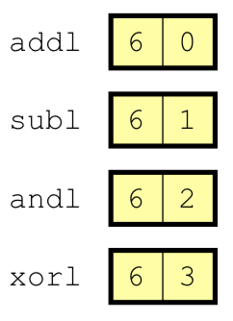
2. Y86 instructions
Compare with x86
Moving instant to memory is now forbidden
Only a simple base and displacement format for memory references
OP codes operate only on register data
Fixed-length encodings
prefix-free codes

Slide 5
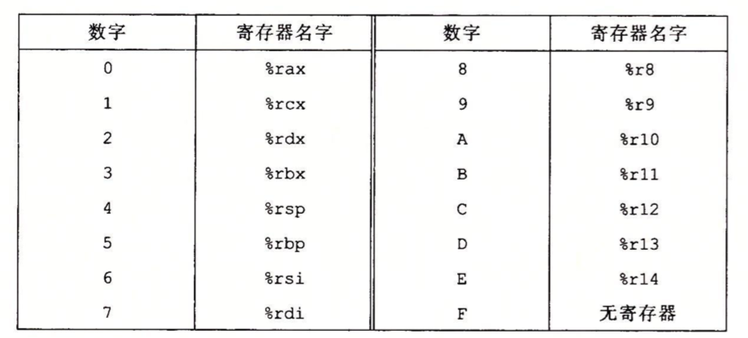
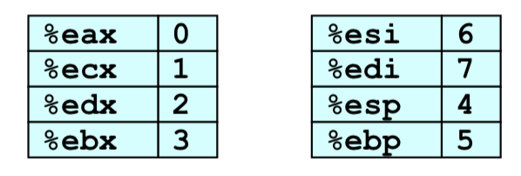
3. encoding registers
Y86 registers
Y86-64 registers
register ID 0xF means no registers
like
A0 0F pushl %eax
B0 0F popl %eax

Slide 6
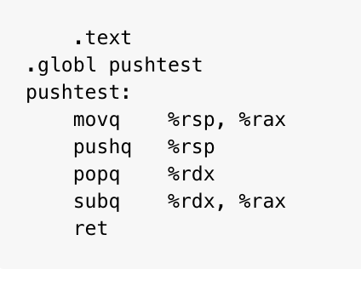
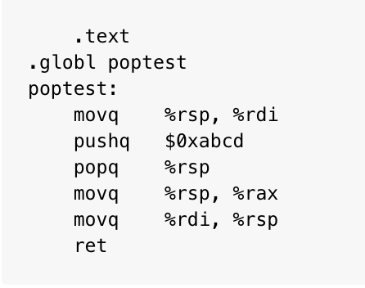
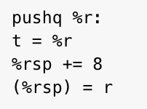
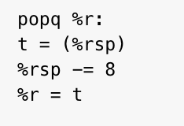
4. pushq and popq
pushtest returns 0
poptest returns 0xabcd

Slide 7
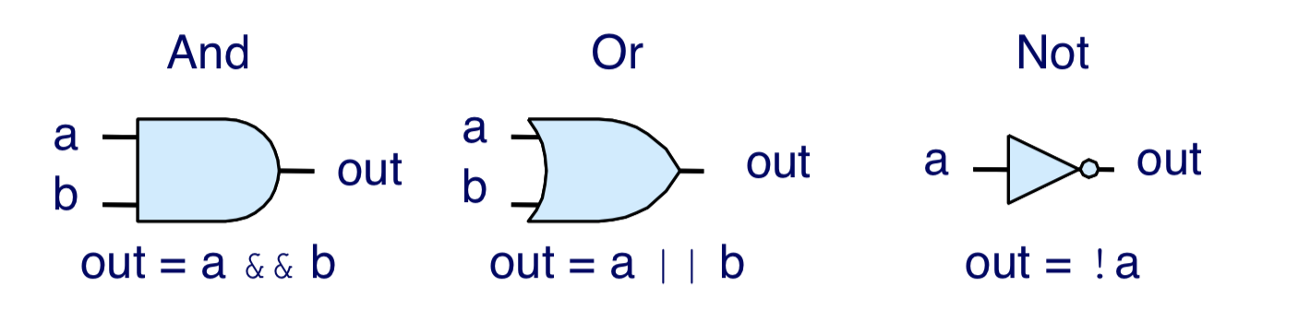
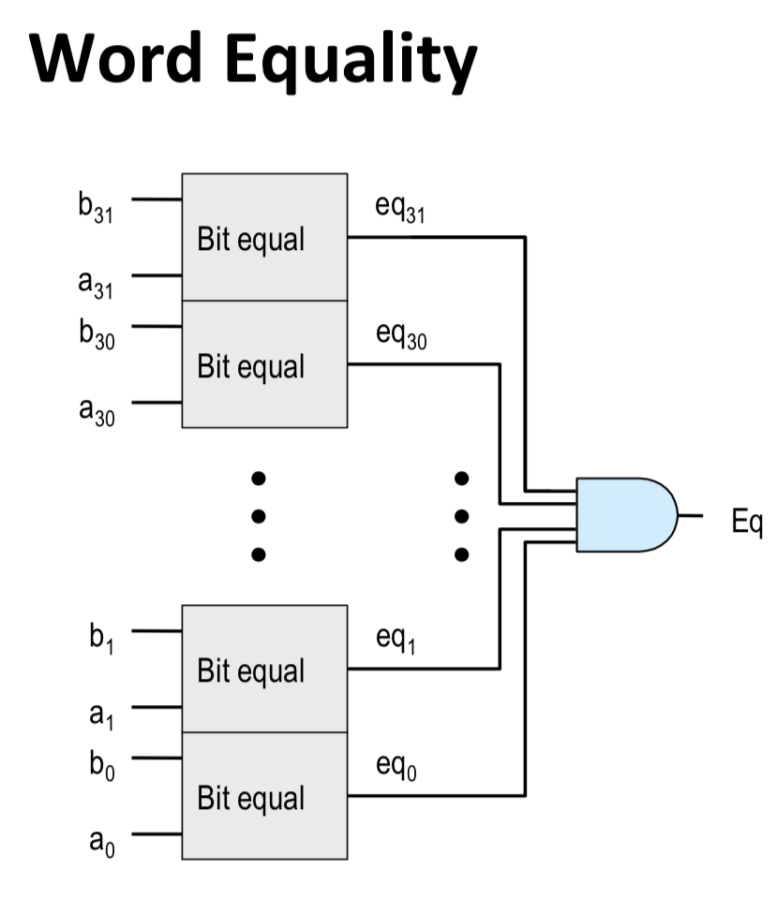
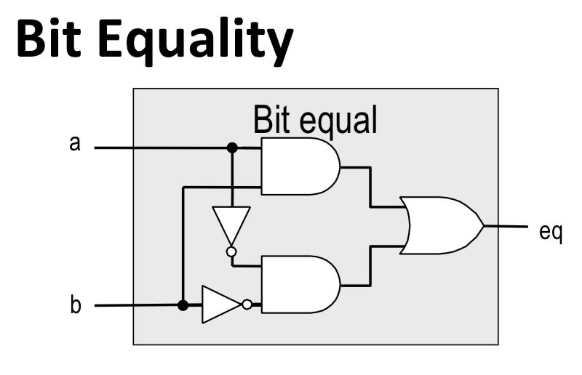
1. Logic Gates

Slide 8
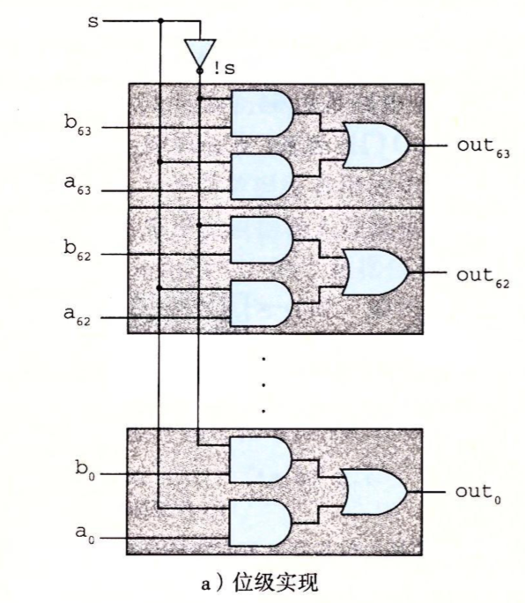
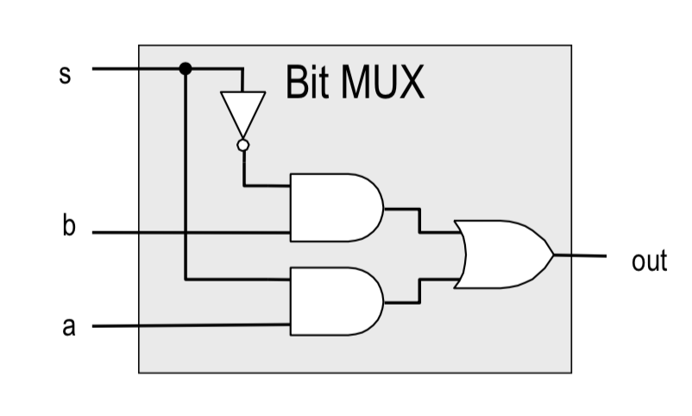
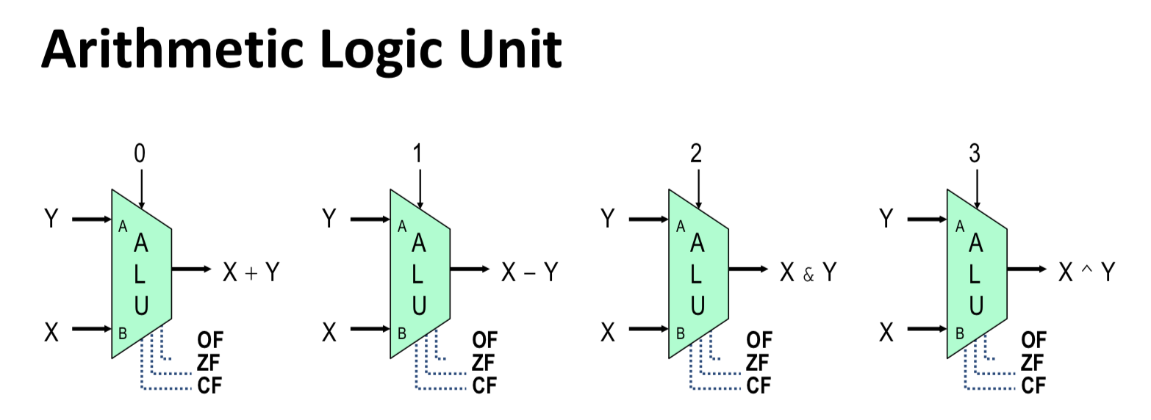
2. Multiplexor
bit level
word level

Slide 9
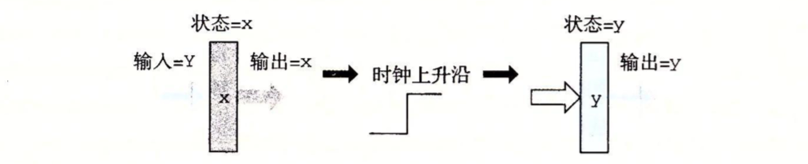
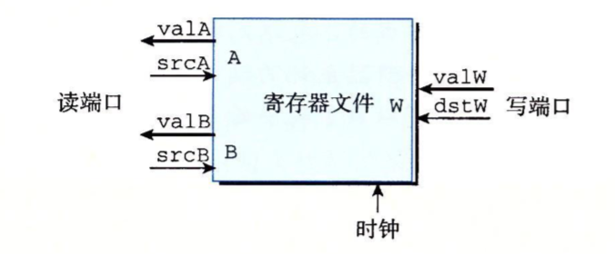
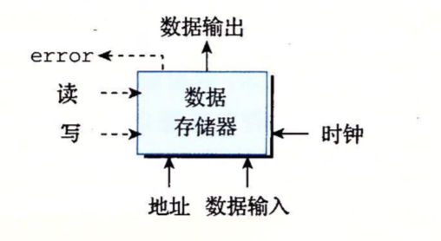
3. Memory and blocking
Read: address, write = 0
Write: address, write = 1
For illegal address, error = 1

