Slide 1
Machine-Level Programming I: Basics
李琬其 1700017813

Slide 2
History of Intel processors and architectures
Intel x86 Processors
C, assembly, machine code
Assembly Basics: Registers, operands, move
Arithmetic & logical operations

Slide 3
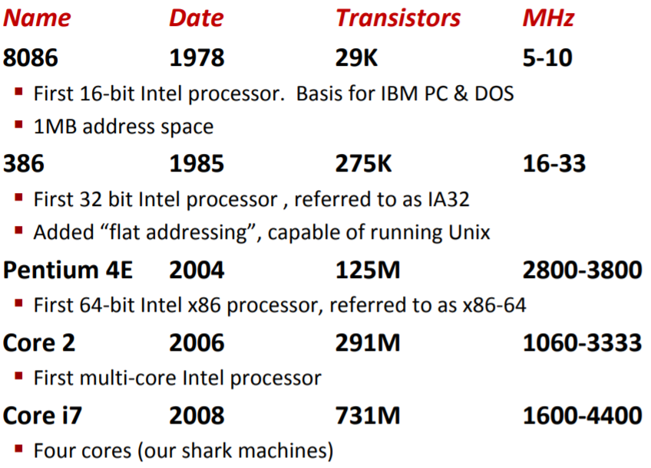
Intel x86 Processors
P111
multimedia operations
more efficient conditional operations
32→64
More cores

Slide 4
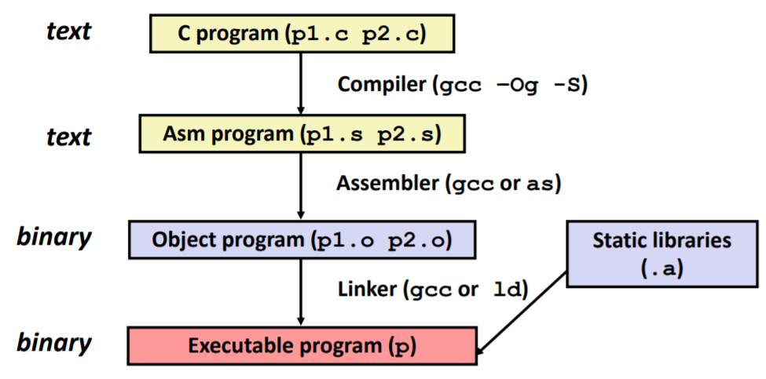
C → object code
gcc –Og –c
Disassembler
objdump –d

Slide 5
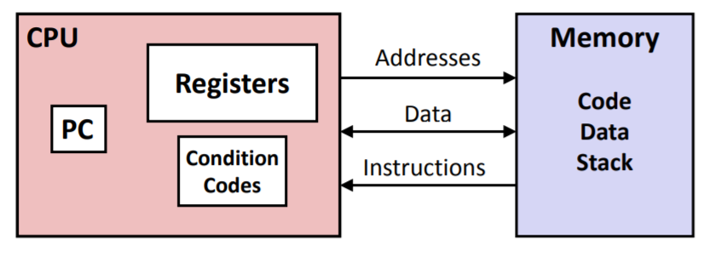
Programmer-Visible State

Slide 6
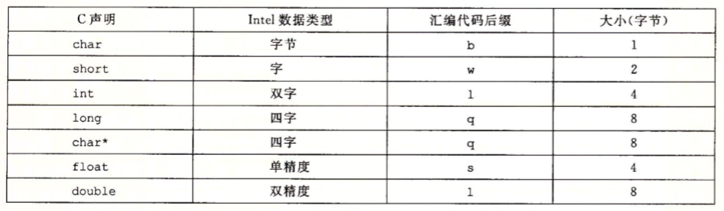
Data types
“Integer” data of 1, 2, 4, or 8 bytes
Floating point data of 4, 8, or 10 bytes
Code
p119

Slide 7
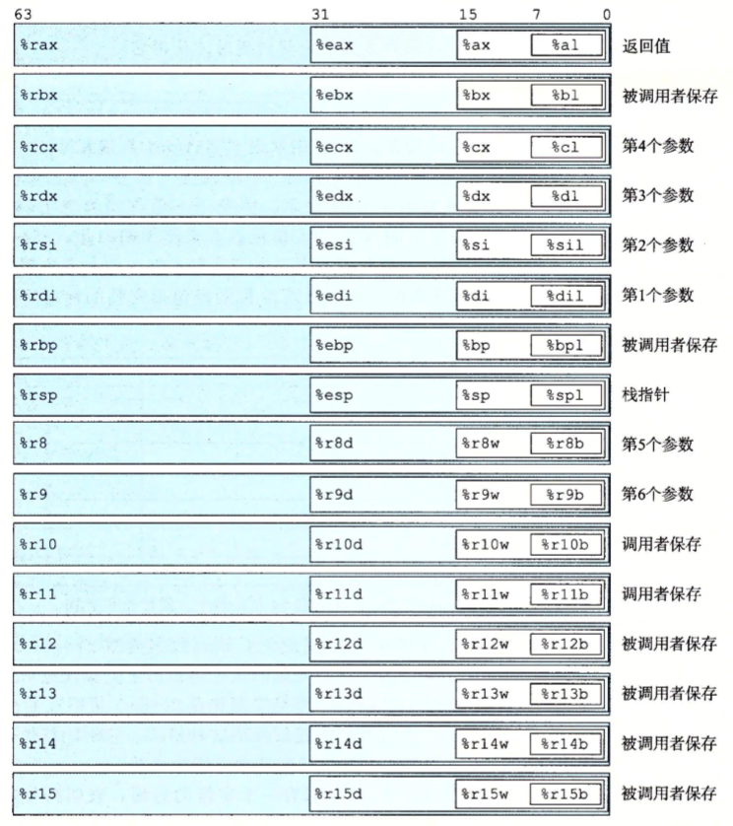
x86-64 Integer Registers
%rsp stack pointer

Slide 8
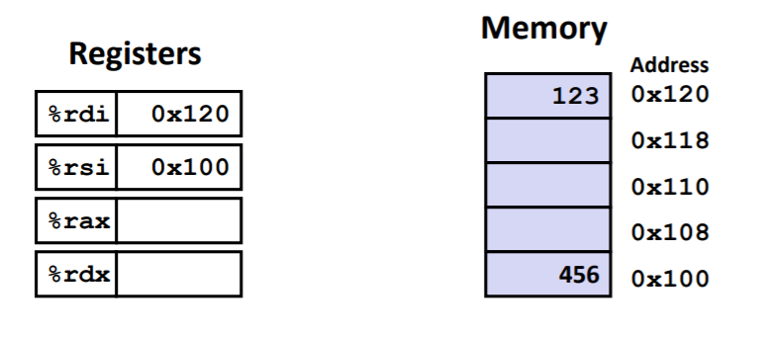
Operand Types
Immediate: ‘$’
Register: One of 16 integer registers
Memory: 8 consecutive bytes of memory at address given by register
(%rax)

Slide 9
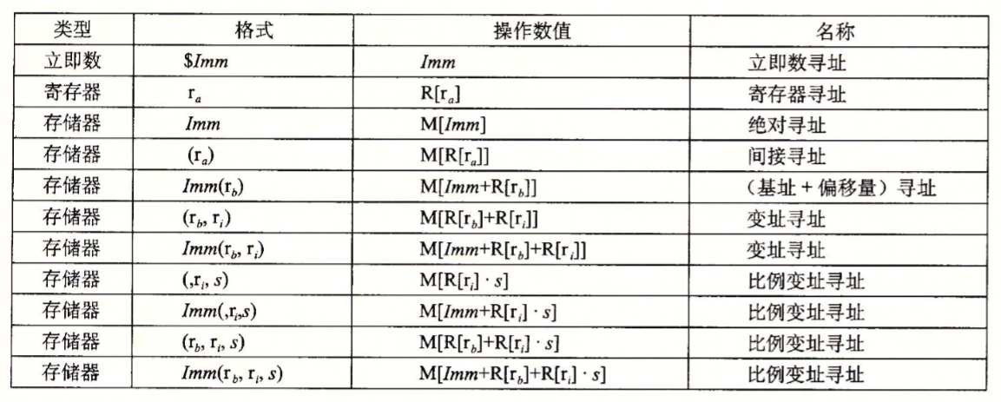
Addressing Modes
p121

Slide 10
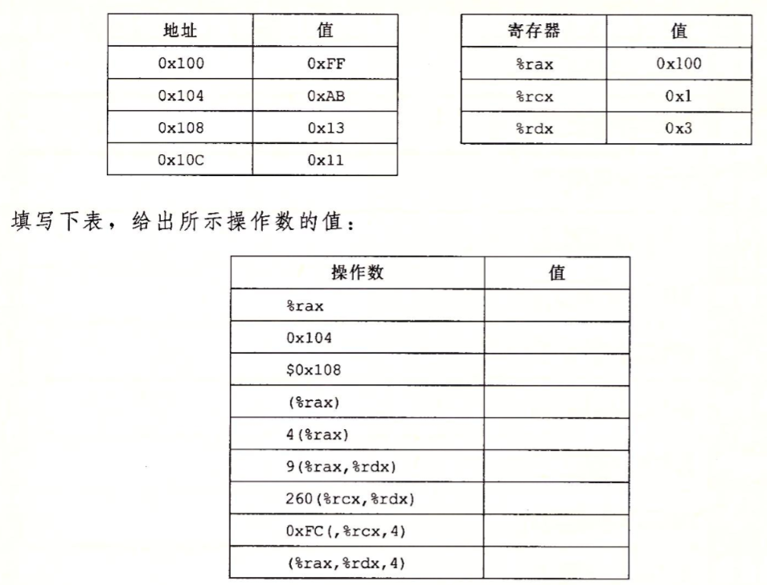
习题3.1

Slide 11

movq
%rax | a
%rdx | b
 | source | dest | c
movq $0x4,%rax | imm | reg | a=0x4;
movq $-147,(%rax) | imm | mem | *a=-147;
movq %rax,%rdx | reg | reg | a=b;
movq %rax,(%rdx) | reg | mem | *b=a;
movq (%rax),%rdx | mem | reg | b=*a;

Slide 12

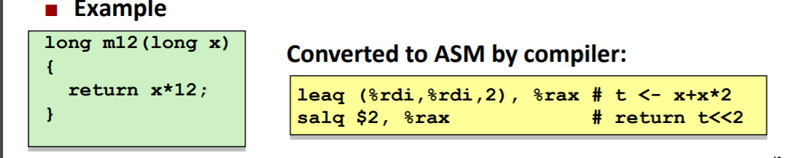
leaq
x + k*y k = 1, 2, 4, or 8

Slide 13
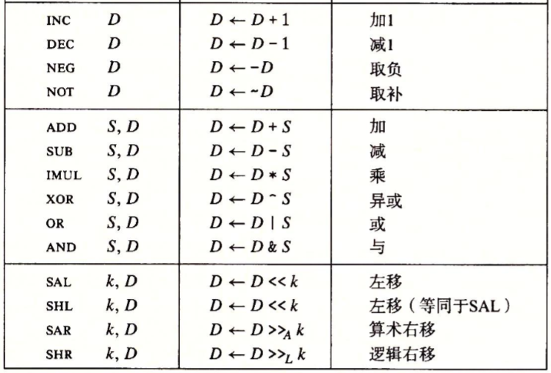
Some Arithmetic Operations
p129

Slide 14
Thx~

