Slide 1
Web SERVER
By：赵旭峰

Slide 2
OVERVIEW
Web and HTTP
Tiny web server
Proxy

Slide 3
Part One: Web Server Basic and HTTP

Slide 4
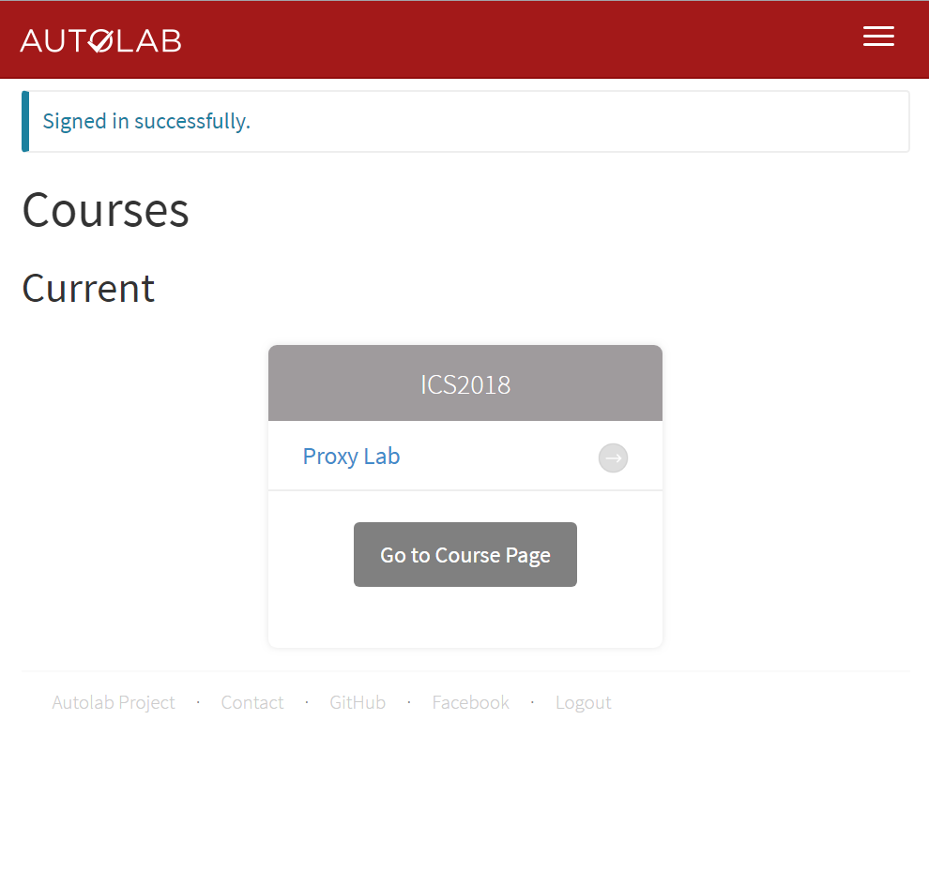
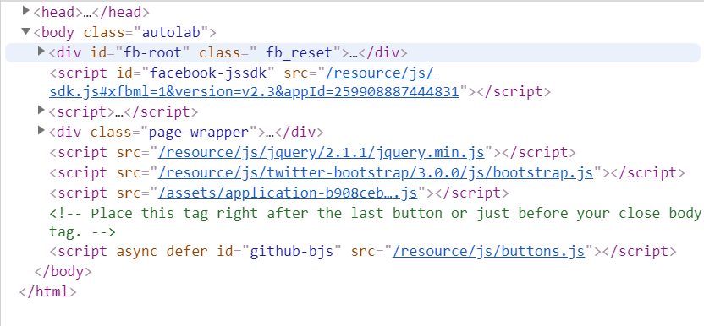
HTTP
全称：the HyperText Transfer Protocol
层次：应用层
特征：HTML(Hypertext Markup Language) 语言

Slide 5
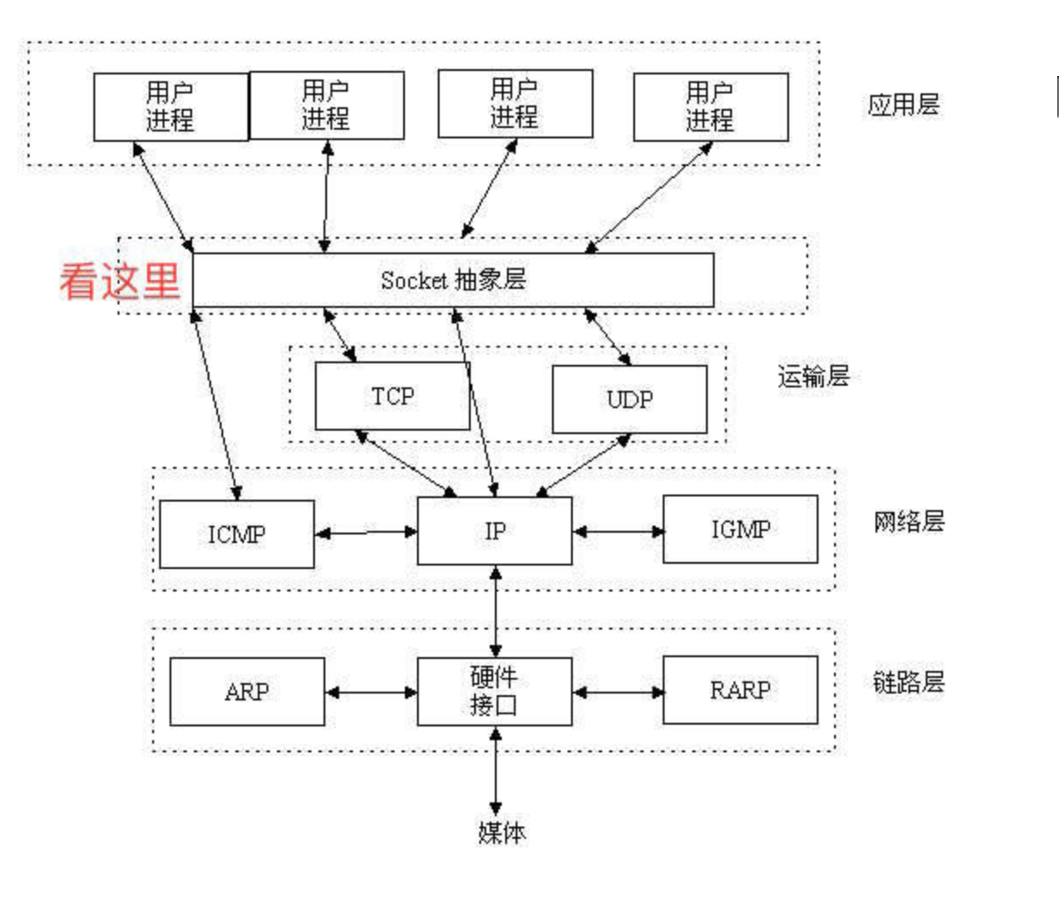
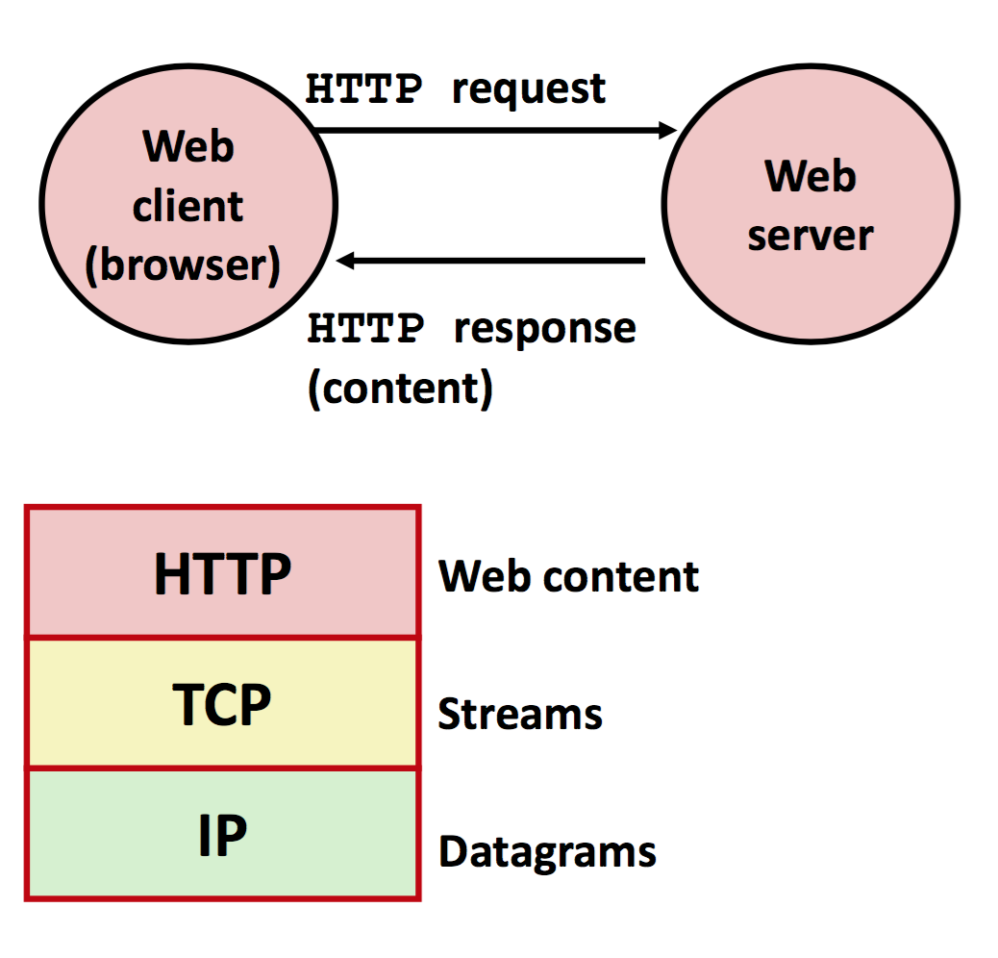

Slide 6
HTTPS
HTTP协议传输的数据都是未加密的，也就是明文的，因此使用HTTP协议传输隐私信息非常不安全，为了保证这些隐私数据能加密传输，于是网景公司设计了SSL（Secure Sockets Layer）协议用于对HTTP协议传输的数据进行加密，从而就诞生了HTTPS。简单来说，HTTPS协议是由SSL+HTTP协议构建的可进行加密传输、身份认证的网络协议，要比http协议安全。
1、https协议需要到ca申请证书，一般免费证书较少，因而需要一定费用。
2、安全性的ssl加密传输协议。
3、用的端口也不一样，前者是80，后者是443。
4、http的连接很简单，是无状态的；HTTPS协议是由SSL+HTTP协议构建的可进行加密传输、身份认证的网络协议，比http协议安全。

Slide 7
内容
类型(MIME) text/html HTML document
text/plain Unformatted text
image/gif Binary image encoded in GIF format
image/png Binar image encoded in PNG format
image/jpeg Binary image encoded in JPEG format
分类 静态内容、动态内容
文件标识 URL(Universal Resource Locator)

Slide 8
URLs
http://www.cs.cmu.edu:8000/cgi-bin/proc?15000&213
http://www.cs.cmu.edu:80/index.html
端口号：默认80，可选
/表示请求内容类型的主目录，若无后缀默认为/，补全为某个默认主页
参数中不能有空格，用%20替代
静态和动态的判断：没有固定方法

Slide 9
HTTP请求
Request line: <method> <uri> <version>
<method> is one of GET, POST, OPTIONS, HEAD, PUT, DELETE, or TRACE
<uri> is typically URL for proxies, URL suffix for servers
<version> is HTTP version of request (HTTP/1.0 or HTTP/1.1)
whaleshark> telnet www.cmu.edu 80 Client: open connection to server
Trying 128.2.42.52... Telnet prints 3 lines to terminal
Connected to WWW-CMU-PROD-VIP.ANDREW.cmu.edu.
Escape character is '^]'.
GET / HTTP/1.1 Client: request line
Host: www.cmu.edu Client: required HTTP/1.1 header
Client: empty line terminates headers

Slide 10
Method
GET 请求指定的页面信息，并返回实体主体。
HEAD 类似于get请求，只不过返回的响应中没有具体的内容，用于获取报头
POST 向指定资源提交数据进行处理请求（例如提交表单或者上传文件）。数据被 包含在请求体中。POST请求可能会导致新的资源的建立和/或已有资源的修改。
PUT 从客户端向服务器传送的数据取代指定的文档的内容。
DELETE 请求服务器删除指定的页面。
CONNECT HTTP/1.1协议中预留给能够将连接改为管道方式的代理服务器。
OPTIONS 允许客户端查看服务器的性能。
TRACE 回显服务器收到的请求，主要用于测试或诊断

Slide 11
HTTP响应
HTTP/1.1 200 OK Server: response line
Date: Wed, 05 Nov 2014 17:37:26 GMT Server: followed by 4 response headers
Server: Apache/1.3.42 (Unix)
Transfer-Encoding: chunked
Content-Type: text/html; charset=...
Server: empty line terminates headers
1000 Server: begin response body
<html ..> Server: first line of HTML content
…
</html>
0 Server: end response body
Connection closed by foreign host. Server: close connection
Response line: <version> <status code> <status msg>
<version> is HTTP version of the response
<status code> is numeric status
<status msg> is corresponding English text

Slide 12
HTTP响应
HTTP/1.1 200 OK Server: response line
Date: Wed, 05 Nov 2014 17:37:26 GMT Server: followed by 5 response headers
Server: Apache/1.3.42 (Unix)
Transfer-Encoding: standard
Content-Type: text/html
Content-Length: ...
Server: empty line terminates headers
1000 Server: begin response body
<html ..> Server: first line of HTML content
…
</html>
0 Server: end response body
Connection closed by foreign host. Server: close connection
Response headers: <header name>: <header data>
Provide additional information about response
Content-Type: MIME type of content in response body
Content-Length: Length of content in response body

Slide 13
HTTP/1.1新特性
persistent connections
（1.1默认Keep-Alive，除非启用Connection: close ）
HOST header
Host: www.cmu.edu
Makes it possible to host multiple websites at single Internet host
chunked encoding
Break data into blocks. Prefix each block with number of bytes (Hex coded)
additional support for caching
两者仍然兼容!

Slide 14
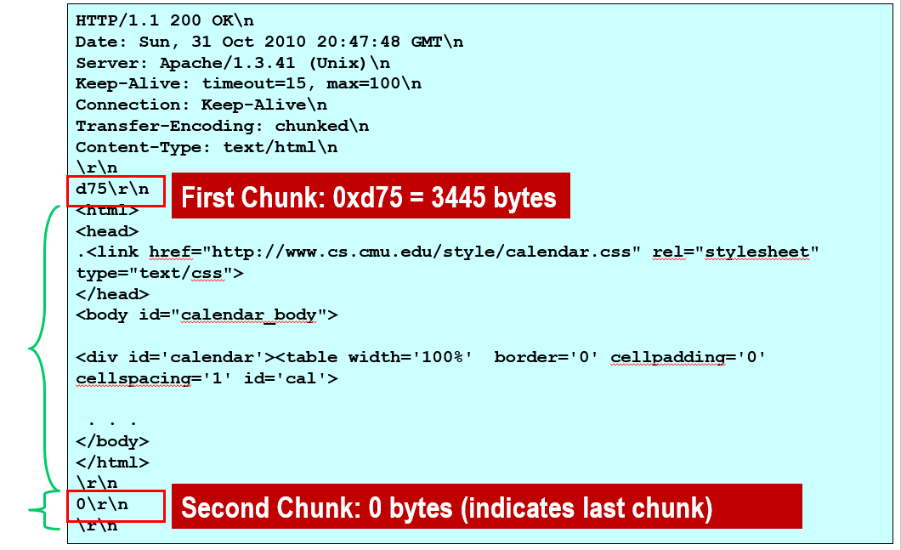

Slide 15
Part Two: TINY Web Server

Slide 16
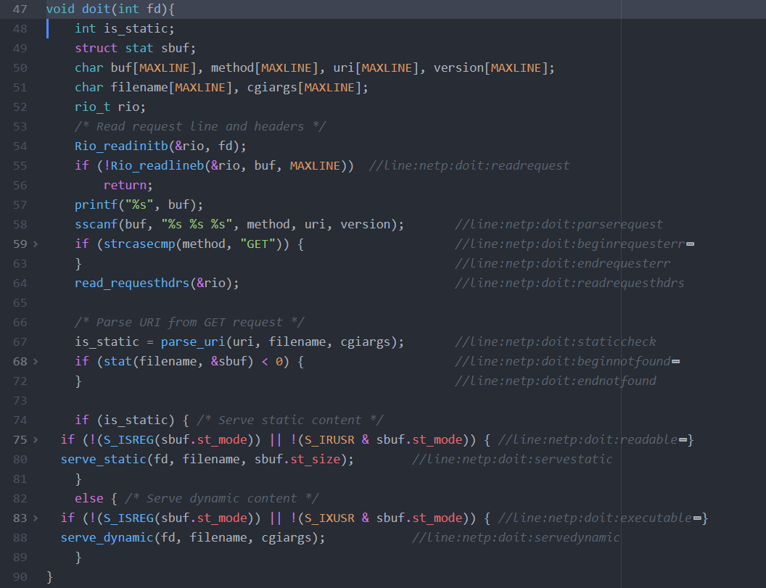

Slide 17
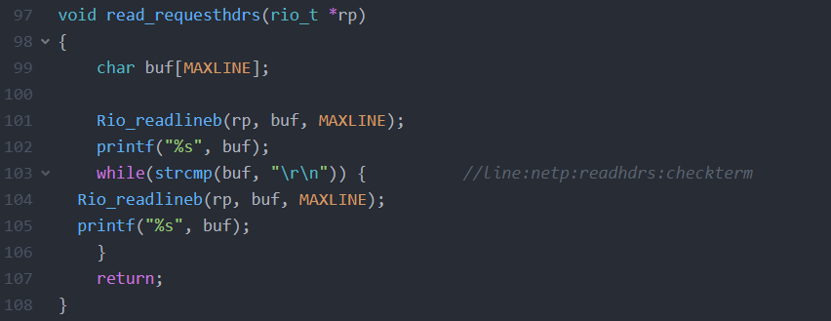

Slide 18
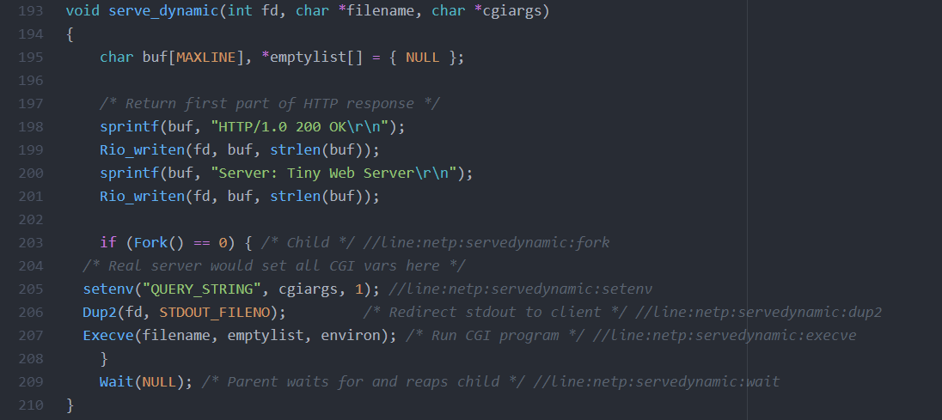

Slide 19
Part Three: Proxies

Slide 20
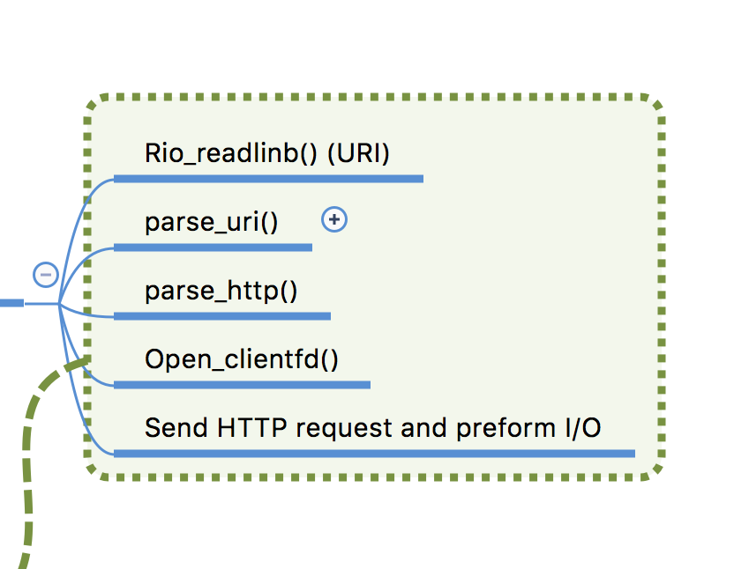
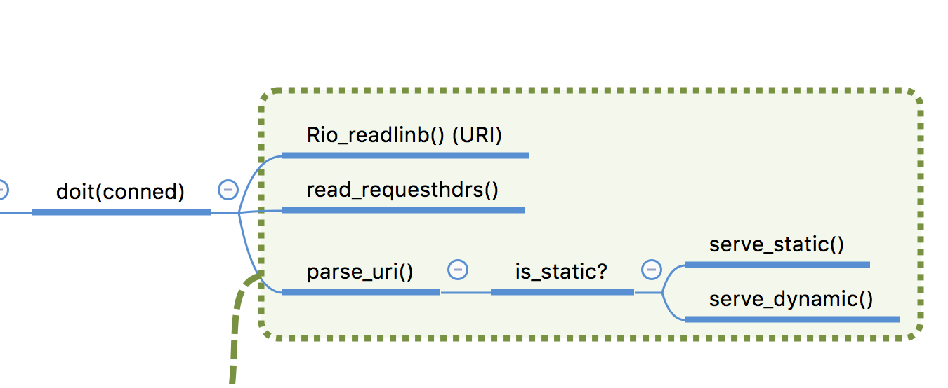

Slide 21
Why proxy?
Caching
Anonymization
By stripping requests of all identifying information, a proxy can make the browser anonymous to web servers.
Logging
Proxies can be installed in order to eavesdrop upon the data-flow between the client machine and the web. A conntent-filtering web proxy server provides administrative control over the content that may be relayed in one or both directions through the proxy.
Transloation
A translation proxy is a proxy server that is used to localize a website experience for different markets.

Slide 22
Two types of web proxy
Explicit (browser-known) proxies
Used by configuring browser to send requests to proxy
Each request specifies entire URL
allowing proxy to know target server
Transparent proxies
Browser/client behaves as though there is no proxy
Proxy runs on network component in route between client and server
intercepting and interposing on web requests

Slide 23
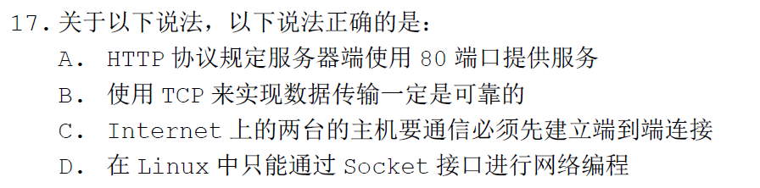
Notes:
答案：B
A错误，80是默认端口而非必须；C错误，IP协议本身不基于连接，传输层中的UDP协议便不基于连接；D错误，可以通过网卡驱动接口直接收发数据。

Slide 24
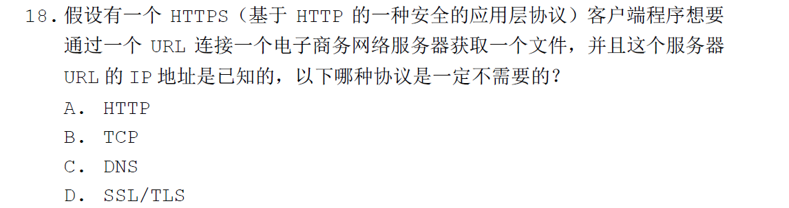
Notes:
C

Slide 25
13、关于web service，以下说法是不正确的是：
A. HTTP/1.0 和HTTP/1.1 都支持persistent connections。
B. 代理（proxy）的使用和设置对用户来说是透明的。
C. 北大主页的布局是左侧是校园风光图片，中间是新闻通告，右侧是图文热点，上下分别为菜单链接。所以说北大主页只包含动态内容。
D. URI是URL 的一个子集。

Slide 26
HTTP协议中，哪个命令可以用来获取动态内容？
HEAD
GET
POST
PUT
Notes:
BC

Slide 27
4.关于Tiny Server 程序，请回答下列问题。
a.（1分）下面这段服务器代码用来生成内容的文件是哪个参数？
b.（1分）所生成的内容是静态还是动态？请简述原因。
c.（1分）如果支持多个客户端请求，下面程序需要添加一个什么功能？
/* Return first part of HTTP response */
sprintf(buf, "HTTP/1.0 200 OK\r\n");
Rio_writen(fd, buf, strlen(buf));
sprintf(buf, "Server: Tiny Web Server\r\n");
Rio_writen(fd, buf, strlen(buf));
setenv(“QUERY_STRING”, cgiargs, 1);
Dup2(fd, STDOUT_FILENO）;
Execve(filename, emptylist, environ);
Notes:
答案
a. filename
b. 动态，因为调用了exec 函数启动新的程序（execve 执行文件），而非静态
file name
c. 可以通过多进程、多线程或IO 多路复用进行更改

