Slide 1
Virtual Memory: Systems Introduction to Computer Systems

Slide 2
Today
Virtual memory questions and answers
Simple memory system example
Case study: Core i7/Linux memory system
Memory mapping

Slide 3
Virtual memory reminder/review
Programmer’s view of virtual memory
Each process has its own private linear address space
Cannot be corrupted by other processes
System view of virtual memory
Uses memory efficiently by caching virtual memory pages
Efficient only because of locality
Simplifies memory management and programming
Simplifies protection by providing a convenient interpositioning point to check permissions

Slide 4
Recall: Virtual Memory & Physical Memory
Physical memory
(DRAM)
Physical page
number or
disk address
Virtual address
Valid
VP 1
PP 0
PTE 0
0
null
VP 2
1
VP 7
VP 4
PP 3
1
0
1
0
null
Virtual memory
(disk)
0
PTE 7
1
VP 1
Memory resident
page table
(DRAM)
VP 2
VP 3
VP 4
VP 6
VP 7
A page table contains page table entries (PTEs) that map virtual pages to physical pages.

Slide 5
Recall: Address Translation With a Page Table
Virtual address
Page table base register
(PTBR)
n-1
p
p-1
0
Virtual page number (VPN)
Virtual page offset (VPO)
Page table address
for process
Page table
Valid
Physical page number (PPN)
Valid bit = 0:
page not in memory
(page fault)
m-1
p
p-1
0
Physical page number (PPN)
Physical page offset (PPO)
Physical address

Slide 6
Recall: Address Translation: Page Hit
CPU Chip
2
Cache/
Memory
MMU
PTEA
1
PTE
CPU
VA
3
PA
4
Data
5
1) Processor sends virtual address to MMU
2-3) MMU fetches PTE from page table in memory
4) MMU sends physical address to cache/memory
5) Cache/memory sends data word to processor

Slide 7
Question #1
Are the PTEs cached like other memory accesses?
Yes (and no: see next question)

Slide 8
Page tables in memory, like other data
PTE
CPU Chip
PTE
MMU
PTEA
hit
Memory
PTEA
PTEA
miss
PTEA
CPU
VA
PA
PA
PA
miss
PA
hit
Data
L1
cache
Data
VA: virtual address, PA: physical address, PTE: page table entry, PTEA = PTE address

Slide 9
Question #2
Isn’t it slow to have to go to memory twice every time?
Yes, it would be… so, real MMUs don’t

Slide 10
Speeding up Translation with a TLB
Page table entries (PTEs) are cached in L1 like any other memory word
PTEs may be evicted by other data references
PTE hit still requires a small L1 delay
Solution: Translation Lookaside Buffer (TLB)
Small, dedicated, super-fast hardware cache of PTEs in MMU
Contains complete page table entries for small number of pages

Slide 11
TLB Hit
CPU Chip
TLB
2
PTE
VPN
3
Cache/
Memory
1
MMU
CPU
VA
PA
4
Data
5
A TLB hit eliminates a memory access

Slide 12
TLB Miss
CPU Chip
TLB
4
2
PTE
VPN
Cache/
Memory
1
MMU
3
CPU
VA
PTEA
PA
5
Data
6
A TLB miss incurs an additional memory access (the PTE) Fortunately, TLB misses are rare. Why?

Slide 13
Question #3
Isn’t the page table huge? How can it be stored in RAM?
Yes, it would be… so, real page tables aren’t simple arrays

Slide 14
Multi-Level Page Tables
Suppose:
4KB (2¹²) page size, 64-bit address space, 8-byte PTE
Problem:
Would need a 32,000 TB page table!
2⁶⁴ * 2⁻¹² * 2³ = 2⁵⁵ bytes
Common solution:
Multi-level page tables
Example: 2-level page table
Level 1 table: each PTE points to a page table (always memory resident)
Level 2 table: each PTE points to a page (paged in and out like any other data)
Level 2
Tables
Level 1
Table
...
...

Slide 15
A Two-Level Page Table Hierarchy
Level 1
page table
Level 2
page tables
Virtual
memory
0
VP 0
PTE 0
...
PTE 0
...
VP 1023
2K allocated VM pages
for code and data
PTE 1
PTE 1023
VP 1024
PTE 2 (null)
...
PTE 3 (null)
VP 2047
PTE 4 (null)
PTE 0
Gap
PTE 5 (null)
...
PTE 6 (null)
PTE 1023
PTE 7 (null)
6K unallocated VM pages
PTE 8
1023 null
PTEs
(1K - 9)
null PTEs
PTE 1023
1023
unallocated
pages
1023 unallocated pages
VP 9215
1 allocated VM page
for the stack
32 bit addresses, 4KB pages, 4-byte PTEs
...

Slide 16
Translating with a k-level Page Table
Having multiple levels greatly reduces page table size
Page table base register
(part of the process’ context)
n-1
VIRTUAL ADDRESS
p-1
0
VPN 1
VPN 2
...
VPN k
VPO
the Level 1
page table
a Level 2
page table
a Level k
page table
...
...
PPN
m-1
p-1
0
PPN
PPO
PHYSICAL ADDRESS

Slide 17
Question #4
Aren’t the TLB contents wrong after a context switch?
Yes, they would be, so something must be done..
Option 1: flush TLB on context switch
Option 2: associate a process ID with each TLB entry

Slide 18
Today
Virtual memory questions and answers
Simple memory system example
Case study: Core i7/Linux memory system
Memory mapping

Slide 19
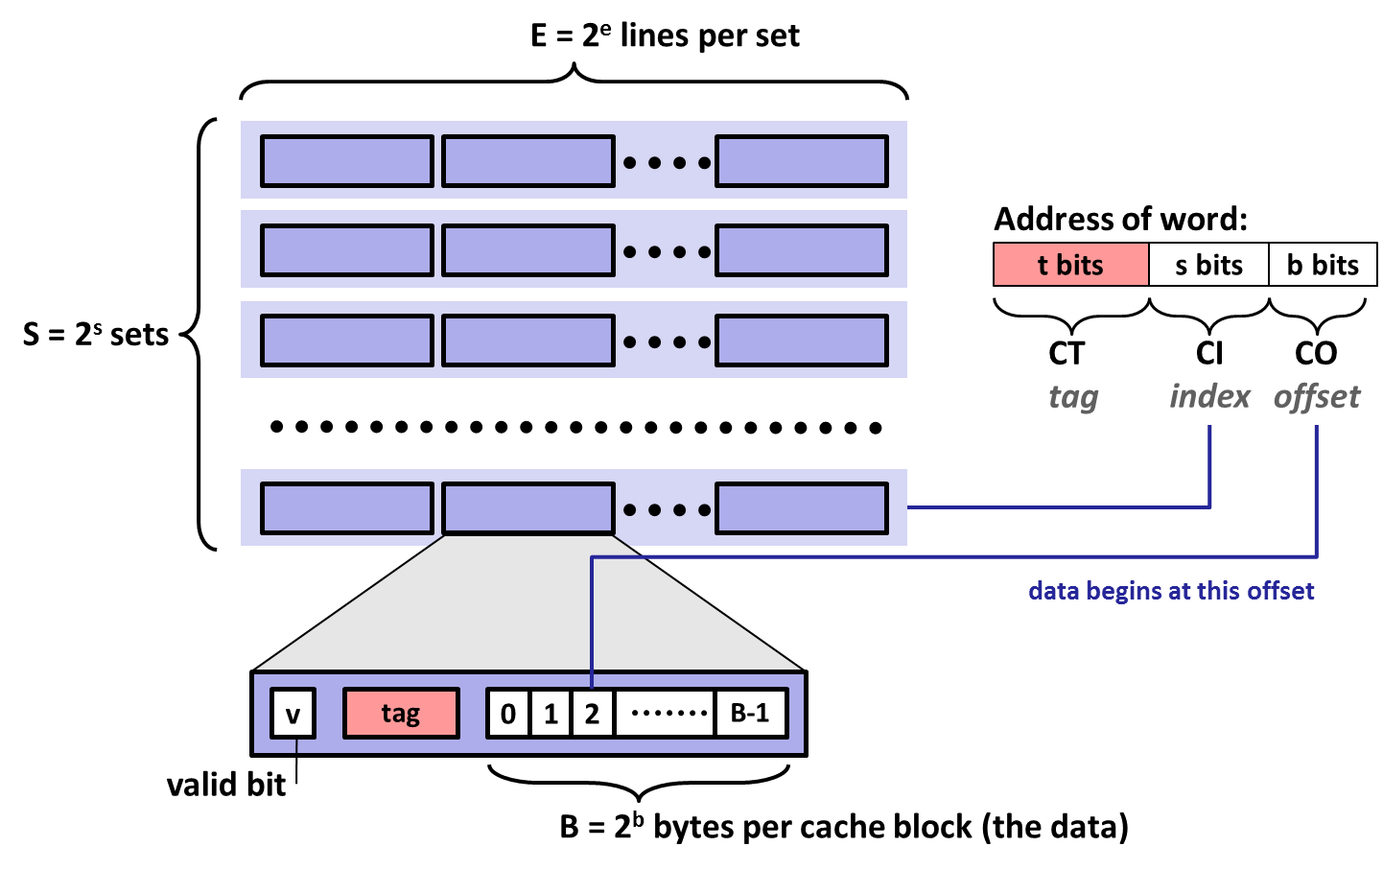
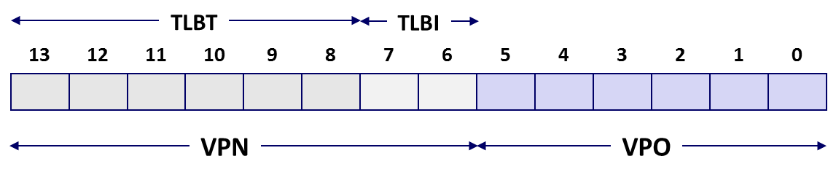
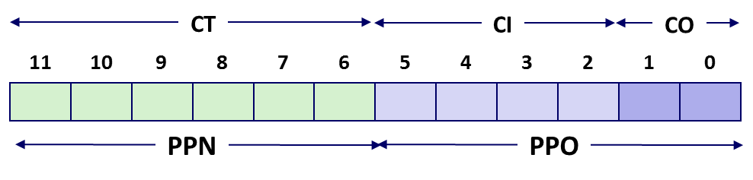

Review of Symbols
Basic Parameters
N = 2^{n} : Number of addresses in virtual address space
M = 2^{m} : Number of addresses in physical address space
P = 2^{p} : Page size (bytes)
Components of the virtual address (VA)
TLBI: TLB index
TLBT: TLB tag
VPO: Virtual page offset
VPN: Virtual page number
Components of the physical address (PA)
PPO: Physical page offset (same as VPO)
PPN: Physical page number
CO: Byte offset within cache line
CI: Cache index
CT: Cache tag
(bits per field for our simple example)

Slide 20
Simple Memory System Example
Addressing
14-bit virtual addresses
12-bit physical address
Page size = 64 bytes
13
12
11
10
9
8
7
6
5
4
3
2
1
0
VPN
VPO
Virtual Page Number
Virtual Page Offset
11
10
9
8
7
6
5
4
3
2
1
0
PPN
PPO
Physical Page Number
Physical Page Offset

Slide 21
Simple Memory System TLB
16 entries
4-way associative
TLBT
TLBI
13
12
11
10
9
8
7
6
5
4
3
2
1
0
0
0
0
0
1
1
0
1
VPN
VPO
VPN = 0b1101 = 0x0D
Translation Lookaside Buffer (TLB)
Set
Tag
PPN
Valid
Tag
PPN
Valid
Tag
PPN
Valid
Tag
PPN
Valid
Set
Tag
PPN
Valid
Tag
PPN
Valid
Tag
PPN
Valid
Tag
PPN
Valid
0
03
–
0
09
0D
1
00
–
0
07
02
1
0
03
–
0
09
0D
1
00
–
0
07
02
1
1
03
2D
1
02
–
0
04
–
0
0A
–
0
1
03
2D
1
02
–
0
04
–
0
0A
–
0
2
02
–
0
08
–
0
06
–
0
03
–
0
2
02
–
0
08
–
0
06
–
0
03
–
0
3
07
–
0
03
0D
1
0A
34
1
02
–
0
3
07
–
0
03
0D
1
0A
34
1
02
–
0

Slide 22
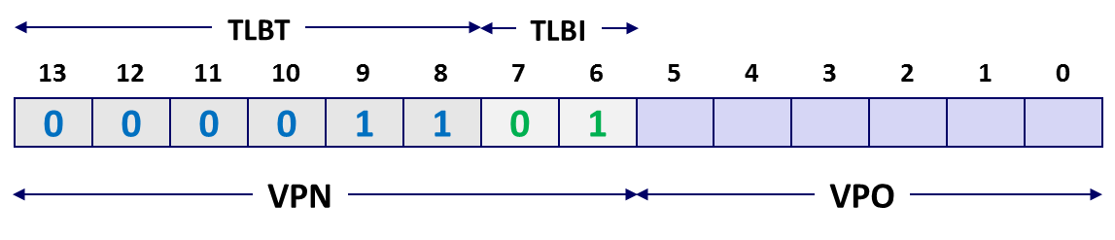
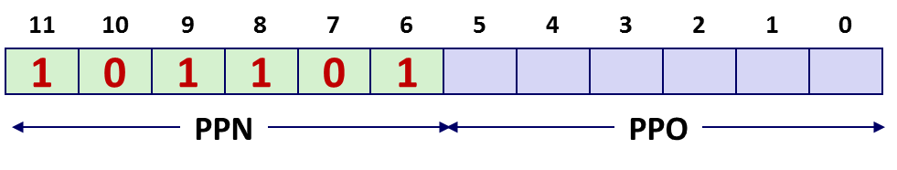
Simple Memory System Page Table
Only showing the first 16 entries (out of 256)
VPN
PPN
Valid
VPN
PPN
Valid
00
28
1
08
13
1
01
–
0
09
17
1
02
33
1
0A
09
1
03
02
1
0B
–
0
04
–
0
0C
–
0
05
16
1
0D
2D
1
0x0D → 0x2D
06
–
0
0E
11
1
07
–
0
0F
0D
1

Slide 23
Simple Memory System Cache
16 lines, 4-byte block size
Physically addressed
Direct mapped
V[0b00001101101001] = V[0x369]
P[0b101101101001] = P[0xB69] = 0x15
CT
CI
CO
11
10
9
8
7
6
5
4
3
2
1
0
1
0
1
1
0
1
1
0
1
0
0
1
PPN
PPO
Idx
Idx
Tag
Tag
Valid
Valid
B0
B0
B1
B1
B2
B2
B3
B3
Idx
Idx
Tag
Tag
Valid
Valid
B0
B0
B1
B1
B2
B2
B3
B3
0
0
19
19
1
1
99
99
11
11
23
23
11
11
8
8
24
24
1
1
3A
3A
00
00
51
51
89
89
1
1
15
15
0
0
–
–
–
–
–
–
–
–
9
9
2D
2D
0
0
–
–
–
–
–
–
–
–
2
2
1B
1B
1
1
00
00
02
02
04
04
08
08
A
A
2D
2D
1
1
93
93
15
15
DA
DA
3B
3B
3
3
36
36
0
0
–
–
–
–
–
–
–
–
B
B
0B
0B
0
0
–
–
–
–
–
–
–
–
4
4
32
32
1
1
43
43
6D
6D
8F
8F
09
09
C
C
12
12
0
0
–
–
–
–
–
–
–
–
5
5
0D
0D
1
1
36
36
72
72
F0
F0
1D
1D
D
D
16
16
1
1
04
04
96
96
34
34
15
15
6
6
31
31
0
0
–
–
–
–
–
–
–
–
E
E
13
13
1
1
83
83
77
77
1B
1B
D3
D3
7
7
16
16
1
1
11
11
C2
C2
DF
DF
03
03
F
F
14
14
0
0
–
–
–
–
–
–
–
–

Slide 24
Address Translation Example: TLB/Cache Hit
Virtual Address: 0x03D4
VPN ___ TLBI ___ TLBT ____ TLB Hit? __ Page Fault? __ PPN: ____
Physical Address
TLBT
TLBI
13
12
11
10
9
8
7
6
5
4
3
2
1
0
0
0
0
0
1
1
1
1
0
1
0
1
0
0
VPN
VPO
0x0F
0x3
0x03
Y
N
0x0D
TLB
Set
Tag
PPN
Valid
Tag
PPN
Valid
Tag
PPN
Valid
Tag
PPN
Valid
0
03
–
0
09
0D
1
00
–
0
07
02
1
1
03
2D
1
02
–
0
04
–
0
0A
–
0
2
02
–
0
08
–
0
06
–
0
03
–
0
3
07
–
0
03
0D
1
0A
34
1
02
–
0
11
10
9
8
7
6
5
4
3
2
1
0
0
0
1
1
0
1
0
1
0
1
0
0
PPN
PPO

Slide 25
Address Translation Example: TLB/Cache Hit
Physical Address
CO ___ CI___ CT ____ Hit? __ Byte: ____
CT
CI
CO
11
10
9
8
7
6
5
4
3
2
1
0
0
0
1
1
0
1
0
1
0
1
0
0
PPN
PPO
0
0x5
0x0D
Y
0x36
Cache
Idx
Tag
Valid
B0
B1
B2
B3
Idx
Tag
Valid
B0
B1
B2
B3
0
19
1
99
11
23
11
8
24
1
3A
00
51
89
1
15
0
–
–
–
–
9
2D
0
–
–
–
–
2
1B
1
00
02
04
08
A
2D
1
93
15
DA
3B
3
36
0
–
–
–
–
B
0B
0
–
–
–
–
4
32
1
43
6D
8F
09
C
12
0
–
–
–
–
5
0D
1
36
72
F0
1D
D
16
1
04
96
34
15
6
31
0
–
–
–
–
E
13
1
83
77
1B
D3
7
16
1
11
C2
DF
03
F
14
0
–
–
–
–

Slide 26
Address Translation Example: TLB/Cache Miss
Virtual Address: 0x0020
VPN ___ TLBI ___ TLBT ____ TLB Hit? __ Page Fault? __ PPN: ____
Physical Address
CO___ CI___ CT ____ Hit? __ Byte: ____
TLBT
TLBI
13
12
11
10
9
8
7
6
5
4
3
2
1
0
0
0
0
0
0
0
0
0
1
0
0
0
0
0
VPN
VPO
0x00
0
0x00
N
N
0x28
Page table
VPN
PPN
Valid
CT
CI
CO
00
28
1
11
10
9
8
7
6
5
4
3
2
1
0
01
–
0
1
0
1
0
0
0
1
0
0
0
0
0
02
33
1
03
02
1
PPN
PPO
04
–
0
0
0x8
0x28
05
16
1
06
–
0
07
–
0

Slide 27
Address Translation Example: TLB/Cache Miss
Cache
Physical Address
CO___ CI___ CT ____ Hit? __ Byte: ____
Idx
Tag
Valid
B0
B1
B2
B3
Idx
Tag
Valid
B0
B1
B2
B3
0
19
1
99
11
23
11
8
24
1
3A
00
51
89
1
15
0
–
–
–
–
9
2D
0
–
–
–
–
2
1B
1
00
02
04
08
A
2D
1
93
15
DA
3B
3
36
0
–
–
–
–
B
0B
0
–
–
–
–
4
32
1
43
6D
8F
09
C
12
0
–
–
–
–
5
0D
1
36
72
F0
1D
D
16
1
04
96
34
15
6
31
0
–
–
–
–
E
13
1
83
77
1B
D3
7
16
1
11
C2
DF
03
F
14
0
–
–
–
–
CT
CI
CO
11
10
9
8
7
6
5
4
3
2
1
0
1
0
1
0
0
0
1
0
0
0
0
0
PPN
PPO
0
0x8
0x28
N
Mem

Slide 28
Address Translation Example: Page Fault
Virtual Address: 0x018F
VPN ___ TLBI ___ TLBT ____ TLB Hit? __ Page Fault? __ PPN: ____
Physical Address
CO___ CI___ CT ____ Hit? __ Byte: ____
TLBT
TLBI
13
12
11
10
9
8
7
6
5
4
3
2
1
0
0
0
0
0
0
1
1
0
0
0
1
1
1
1
VPN
VPO
0x06
0x2
0x01
N
Y
TBD
Page table
VPN
PPN
Valid
CT
CI
CO
00
28
1
11
10
9
8
7
6
5
4
3
2
1
0
01
–
0
02
33
1
03
02
1
PPN
PPO
04
–
0
05
16
1
06
–
0
07
–
0

Slide 29
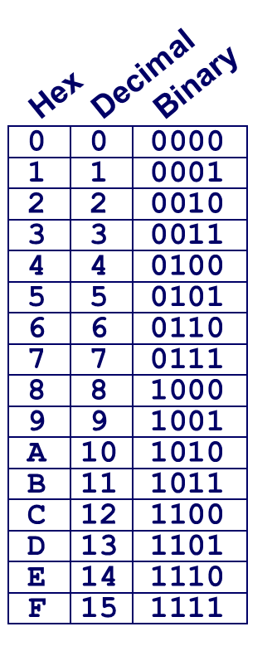
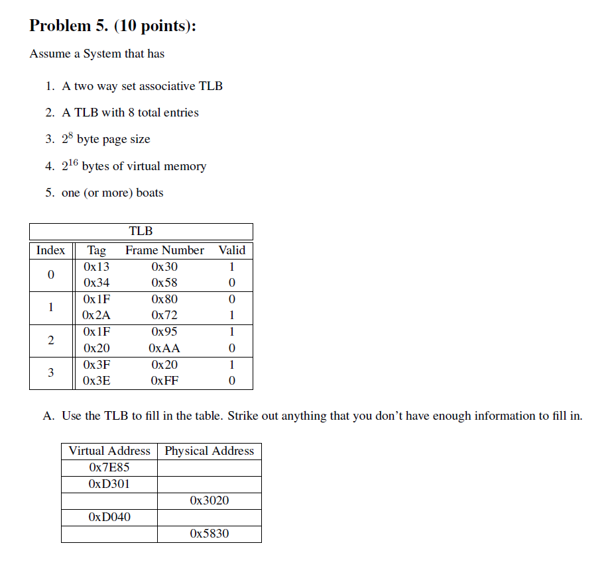
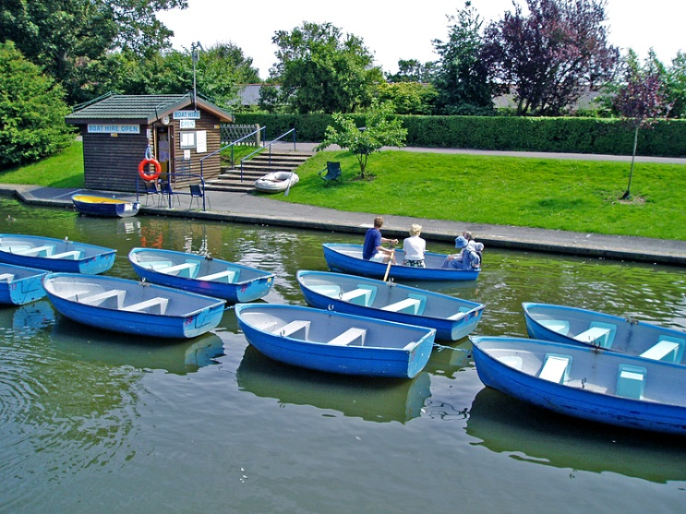
Virtual Memory Exam Question
PPN
TLBT
TLBI
15
14
13
12
11
10
9
8
7
6
5
4
3
2
1
0
0
1
1
1
1
1
1
0
1
0
0
0
0
1
0
1
0x7E85
0x9585
TLBI = 0x2
------
0x7E85
= 0x0111111010000101
0x4C20
TLBT = 0x1F
------
------
Exam: http://www.cs.cmu.edu/~213/oldexams/exam2b-s11.pdf (solution)
0x7E85 → 0x9585

Slide 30
Today
Virtual memory questions and answers
Simple memory system example
Case study: Core i7/Linux memory system
Memory mapping

Slide 31
Intel Core i7 Memory System
Processor package
Core x4
Registers
Instruction
fetch
MMU
(addr translation)
L1 d-cache
32 KB, 8-way
L1 i-cache
32 KB, 8-way
L1 d-TLB
64 entries, 4-way
L1 i-TLB
128 entries, 4-way
L2 unified cache
256 KB, 8-way
L2 unified TLB
512 entries, 4-way
To other
cores
QuickPath interconnect
4 links @ 25.6 GB/s each
To I/O
bridge
L3 unified cache
8 MB, 16-way
(shared by all cores)
DDR3 Memory controller
3 x 64 bit @ 10.66 GB/s
32 GB/s total (shared by all cores)
Main memory

Slide 32
End-to-end Core i7 Address Translation
CPU
32/64
L2, L3, and
main memory
Result
Virtual address (VA)
36
12
VPN
VPO
L1
hit
L1
miss
32
4
TLBT
TLBI
L1 d-cache
(64 sets, 8 lines/set)
TLB
hit
TLB
miss
...
...
L1 TLB (16 sets, 4 entries/set)
9
9
9
9
40
12
40
6
6
VPN1
VPN2
VPN3
VPN4
PPN
PPO
CT
CI
CO
Physical
address
(PA)
CR3
PTE
PTE
PTE
PTE
Page tables

Slide 33
Core i7 Level 1-3 Page Table Entries
63
62
52
51
12
11
9
8
7
6
5
4
3
2
1
0
XD
Unused
Page table physical base address
Unused
G
PS
A
CD
WT
U/S
R/W
P=1
Available for OS (page table location on disk)
P=0
Each entry references a 4K child page table. Significant fields:
P: Child page table present in physical memory (1) or not (0).
R/W: Read-only or read-write access access permission for all reachable pages.
U/S: user or supervisor (kernel) mode access permission for all reachable pages.
WT: Write-through or write-back cache policy for the child page table.
A: Reference bit (set by MMU on reads and writes, cleared by software).
PS: Page size either 4 KB or 4 MB (defined for Level 3 PTEs only).
Page table physical base address: 40 most significant bits of physical page table address (forces page tables to be 4KB aligned)
XD: Disable or enable instruction fetches from all pages reachable from this PTE.

Slide 34
Core i7 Level 4 Page Table Entries
63
62
52
51
12
11
9
8
7
6
5
4
3
2
1
0
XD
Unused
Page physical base address
Unused
G
D
A
CD
WT
U/S
R/W
P=1
Available for OS (page location on disk)
P=0
Each entry references a 4K child page. Significant fields:
P: Child page is present in memory (1) or not (0)
R/W: Read-only or read-write access permission for child page
U/S: User or supervisor mode access
WT: Write-through or write-back cache policy for this page
A: Reference bit (set by MMU on reads and writes, cleared by software)
D: Dirty bit (set by MMU on writes, cleared by software)
Page physical base address: 40 most significant bits of physical page address (forces pages to be 4KB aligned)
XD: Disable or enable instruction fetches from this page.

Slide 35
Core i7 Page Table Translation
9
9
9
9
12
Virtual
address
VPN 1
VPN 2
VPN 3
VPN 4
VPO
L1 PT
Page global
directory
L2 PT
Page upper
directory
L3 PT
Page middle
directory
L4 PT
Page
table
40
40
40
40
CR3
/
/
/
/
Physical
address
of L1 PT
Offset into
physical and
virtual page
/
12
L1 PTE
L2 PTE
L3 PTE
L4 PTE
Physical
address
of page
512 GB
region
per entry
1 GB
region
per entry
2 MB
region
per entry
4 KB
region
per entry
40
/
40
12
Physical
address
PPN
PPO

Slide 36
Cute Trick for Speeding Up L1 Access
CT
Tag Check
40
6
6
Physical
address
(PA)
CT
CI
CO
PPN
PPO
Address
Translation
No
Change
Virtual
address
(VA)
CI
VPN
VPO
L1 Cache
36
12
Observation
Bits that determine CI identical in virtual and physical address
Can index into cache while address translation taking place
Generally we hit in TLB, so PPN bits (CT bits) available next
“Virtually indexed, physically tagged”
Cache carefully sized to make this possible

Slide 37
Virtual Address Space of a Linux Process
Process-specific data
structs (ptables,
task and mm structs, kernel stack)
Different for each process
Kernel
virtual
memory
Identical for each process
Physical memory
Kernel code and data
%rsp
User stack
Memory mapped region
for shared libraries
Process
virtual
memory
brk
Runtime heap (malloc)
Uninitialized data (.bss)
Initialized data (.data)
0x00400000
Program text (.text)
0

Slide 38
Linux Organizes VM as Collection of “Areas”
Process virtual memory
vm_area_struct
task_struct
mm_struct
vm_end
mm
pgd
vm_start
vm_prot
mmap
vm_flags
Shared libraries
vm_next
vm_end
pgd:
Page global directory address
Points to L1 page table
vm_prot:
Read/write permissions for this area
vm_flags
Pages shared with other processes or private to this process
vm_start
Data
vm_prot
vm_flags
vm_next
Text
vm_end
vm_start
vm_prot
vm_flags
vm_next
0
Each process has own task_struct, etc

Slide 39
Linux Page Fault Handling
vm_area_struct
Process virtual memory
vm_end
vm_start
vm_prot
vm_flags
shared libraries
vm_next
1
Segmentation fault:
accessing a non-existing page
read
vm_end
vm_start
data
3
vm_prot
read
Normal page fault
vm_flags
vm_next
text
2
Protection exception:
e.g., violating permission by writing to a read-only page (Linux reports as Segmentation fault)
write
vm_end
vm_start
vm_prot
vm_flags
vm_next

Slide 40
Today
Virtual memory questions and answers
Simple memory system example
Case study: Core i7/Linux memory system
Memory mapping

Slide 41
Memory Mapping
VM areas initialized by associating them with disk objects.
Process is known as memory mapping.
Area can be backed by (i.e., get its initial values from) :
Regular file on disk (e.g., an executable object file)
Initial page bytes come from a section of a file
Anonymous file (e.g., nothing)
First fault will allocate a physical page full of 0's (demand-zero page)
Once the page is written to (dirtied), it is like any other page
Dirty pages are copied back and forth between memory and a special swap file.

Slide 42
Review: Memory Management & Protection
Code and data can be isolated or shared among processes
0
Address
translation
0
Virtual Address Space for Process 1:
Physical
Address
Space (DRAM)
VP 1
VP 2
PP 2
...
N-1
PP 6
(e.g., read-only
library code)
Virtual Address Space for Process 2:
0
PP 8
VP 1
VP 2
...
...
N-1
M-1

Slide 43
Sharing Revisited: Shared Objects
Process 1
virtual memory
Physical
memory
Process 2
virtual memory
Process 1 maps the shared object (on disk).
Shared
object

Slide 44
Sharing Revisited: Shared Objects
Process 1
virtual memory
Physical
memory
Process 2
virtual memory
Process 2 maps the same shared object.
Notice how the virtual addresses can be different.
But, difference must be multiple of page size
Shared
object

Slide 45
Sharing Revisited: Private Copy-on-write (COW) Objects
Process 1
virtual memory
Physical
memory
Process 2
virtual memory
Two processes mapping a private copy-on-write (COW) object.
Area flagged as private copy-on-write
PTEs in private areas are flagged as read-only
Private
copy-on-write
area
Private
copy-on-write object

Slide 46
Sharing Revisited: Private Copy-on-write (COW) Objects
Process 1
virtual memory
Physical
memory
Process 2
virtual memory
Instruction writing to private page triggers protection fault.
Handler creates new R/W page.
Instruction restarts upon handler return.
Copying deferred as long as possible!
Copy-on-write
Write to private
copy-on-write
page
Private
copy-on-write object

Slide 47
The fork Function Revisited
VM and memory mapping explain how fork provides private address space for each process.
Perfect approach for common case of fork() followed by exec()
To create virtual address for new new process
Create exact copies of current mm_struct, vm_area_struct, and page tables.
Flag each page in both processes as read-only
Flag each vm_area_struct in both processes as private COW
On return, each process has exact copy of virtual memory
Subsequent writes create new pages using COW mechanism

Slide 48
The execve Function Revisited
User stack
Private, demand-zero
To load and run a new program a.out in the current process using execve:
Free vm_area_struct’s and page tables for old areas
Create vm_area_struct’s and page tables for new areas
Programs and initialized data backed by object files.
.bss and stack backed by anonymous files .
Set PC to entry point in .text
Linux will fault in code and data pages as needed.
libc.so
.data
Memory mapped region
for shared libraries
Shared, file-backed
.text
Runtime heap (via malloc)
Private, demand-zero
Uninitialized data (.bss)
Private, demand-zero
a.out
Initialized data (.data)
.data
Private, file-backed
.text
Program text (.text)
0

Slide 49
Finding More Shareable Pages
Easy places to identify shareable pages
Child create via fork
Processes loading the same binary file
E.g., bash or python interpreters, web browsers, ...
Processes loading the same library file
What about others?
Kernel Same-Page Merging
OS scans through all of physical memory, looking for duplicate pages
When found, merge into single copy, marked as copy-on-write
Implemented in Linux kernel in 2009
Limited to pages marked as likely candidates
Especially useful when processor running many virtual machines

Slide 50
User-Level Memory Mapping
void *mmap(void *start, int len,
int prot, int flags, int fd, int offset)
Map len bytes starting at offset offset of the file specified by file description fd, preferably at address start
start: may be 0 for “pick an address”
prot: PROT_READ, PROT_WRITE, ...
flags: MAP_ANON, MAP_PRIVATE, MAP_SHARED, ...
Return a pointer to start of mapped area (may not be start)

Slide 51
User-Level Memory Mapping
void *mmap(void *start, int len,
int prot, int flags, int fd, int offset)
len bytes
start
(or address
chosen by kernel)
len bytes
offset
(bytes)
0
0
Disk file specified by
file descriptor fd
Process virtual memory

Slide 52
Example: Using mmap to Copy Files
Copying a file to stdout without transferring data to user space
#include "csapp.h"
void mmapcopy(int fd, int size)
{
/* Ptr to memory mapped area */
char *bufp;
bufp = Mmap(NULL, size,
PROT_READ,
MAP_PRIVATE,
fd, 0);
Write(1, bufp, size);
return;
}
/* mmapcopy driver */
int main(int argc, char **argv)
{
struct stat stat;
int fd;
/* Check for required cmd line arg */
if (argc != 2) {
printf("usage: %s <filename>\n",
argv[0]);
exit(0);
}
/* Copy input file to stdout */
fd = Open(argv[1], O_RDONLY, 0);
Fstat(fd, &stat);
mmapcopy(fd, stat.st_size);
exit(0);
}
mmapcopy.c
mmapcopy.c

Slide 53
Some Uses of mmap
Reading big files
Uses paging mechanism to bring files into memory
Shared data structures
When call with MAP_SHARED flag
Multiple processes have access to same region of memory
Risky!
File-based data structures
E.g., database
Give prot argument PROT_READ | PROT_WRITE
When unmap region, file will be updated via write-back
Can implement load from file / update / write back to file

Slide 54
Summary
VM requires hardware support
Exception handling mechanism
TLB
Various control registers
VM requires OS support
Managing page tables
Implementing page replacement policies
Managing file system
VM enables many capabilities
Loading programs from memory
Forking processes
Providing memory protection

