Slide 1
Application Project
CS 643851-Cloud Computing
Group 1
Fang Cao

Slide 2
Motivation
Goal
To analyze the performance of each game of National Football League
from 2002 to 2012
List all the penalties in each game
List all the incomplete passes in each game
Motivation
Study the performance of each team within 10 year
Predict the trending of each team

Slide 3
Design
Linux cluster on AWS
One master node
multiple slave nodes
Data source
Play-by-Play Data
from: Advanced Football Analytics
advancedfootballanalytics.com
2002 to 2012
csv format

Slide 4
Implementation
Linux cluster on AWS
Hadoop
Input and output data are stored on HDFS
Hadoop streaming API
Both mapper and reducer are python scripts
Take stdin and output as stdout
Hadoop streaming API will take care the rest

Slide 5
Implementation
Map Reduce
Mapper
Read input data from HDFS
look for all penalties and incomplete passes
list as key value pares
Reducer
Sort by game date and count the occurrence

Slide 6
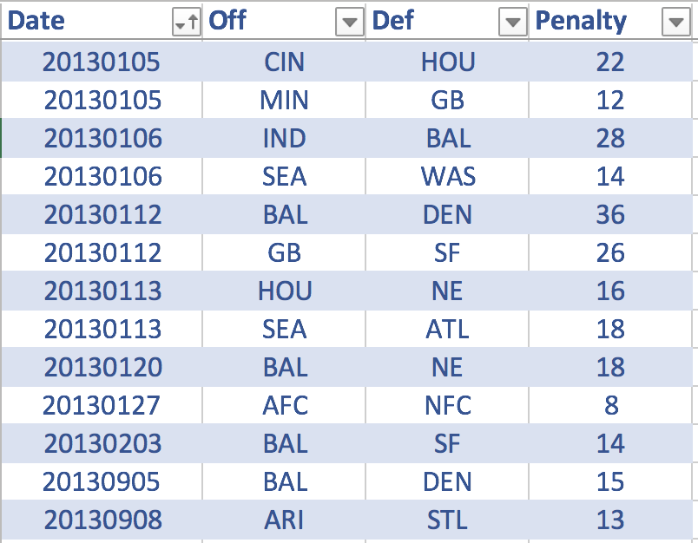
Evaluation
Sample Output - Number of penalty made per game

Slide 7
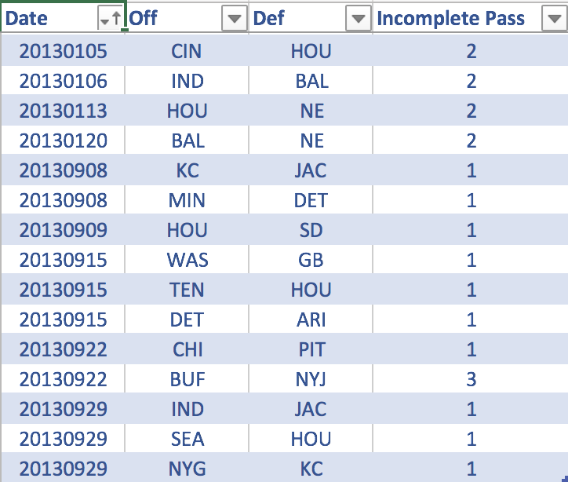
Evaluation
Sample Output - Number of Incomplete pass made per game

Slide 8
Evaluation
Cluster Performance
5 instances :
Elapsed Time: 56 sec
4 instances
Elapsed Time: 1 min
3 instances :
Elapsed Time: 5 min

