Slide 1
Cross-Language Code Search using Static and Dynamic Analyses

Slide 2

Cross-Language Code-to-Code Search
Code-to-code search describes the task of using a code query to search for similar code in a repository.
This task is particularly challenging when the query and results belong to different languages due to syntactic and semantic differences between the languages.
This task is involved in identifying code clones, finding translations of code in a different language, program repair, and supporting students in learning a new programming language

Slide 3
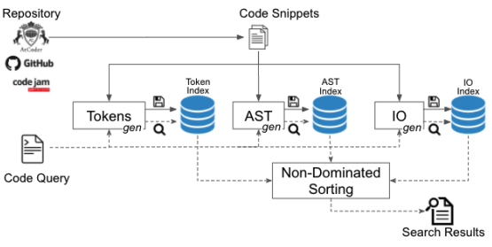
CODE-TO-CODE SEARCH ACROSS LANGUAGES ( COSAL)
Token-Based Search
AST-Based Search
Input-Output Based Search
Non-Dominated Sorting for extracting results

Slide 4
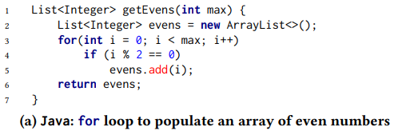
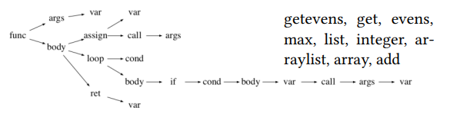
Token-Based Search
Remove language-specific keywords based on the documentation
Remove frequently-used words used in a language based on common coding conventions.
Remove common stopwords from the English vocabulary.
Split tokens to address language-specific nomenclature.
Remove tokens of length less than MIN_TOK_LEN.
Convert all the tokens to lower case

Slide 5
AST-Based Search
Common control structures: Control structures are simplified and clustered.
Normalizing Variable: Variables are denoted as var nodes.
Normalizing Literals: Literals are denoted as lit nodes.
Normalizing Operators: Operators are denoted as op nodes.
Language specific features: If a feature is implemented in only one language, a custom node is created.

Slide 6

Input-Output Based Search
SLACC segments code into executable snippets of size greater than MIN_STMTS and executed on ARGS_MAX arguments generated using a grey-box strategy.
The executed functions are then clustered using a similarity measure (𝑠𝑖𝑚) based on the inputs and outputs of the functions.

Slide 7
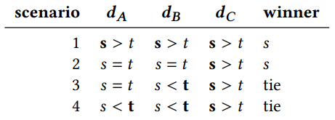
Non-dominated Ranking
A search result 𝑠 is said to dominate a search result 𝑡, if 𝑠 is no worse than 𝑡 in any objective and is better than 𝑡 in at least one objective. Otherwise, there is a tie.
To break ties, we compute distances between each search result and the optimal value for each similarity measure.

Slide 8
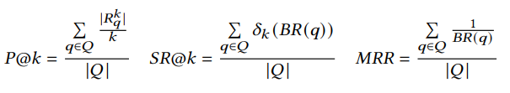
Metrics
Precision@k or P@k is the average percentage of relevant results in the top-k search results for a query.
SuccessRate@k or SR@k is the percentage of queries for which one or more relevant result exists among the top-k search results.
MRR is the Mean Reciprocal Rank of the relevant results for a query .

Slide 9
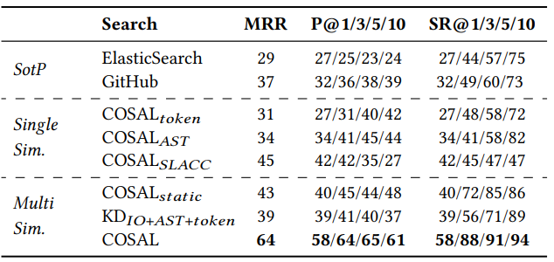
RQ1: Single vs Multiple Search Similarity Measures
Using non-dominated ranking with static and dynamic similarity measures improves the quality of results for code-to-code search compared to subsets or a weighted aggregation of measures

Slide 10
RQ2: State-of-the-Practice Cross-Language Code-to-Code Search
COSAL obtains better Precision@k, SuccessRate@k and MRR compared to GitHub Search and ElasticSearch.

Slide 11
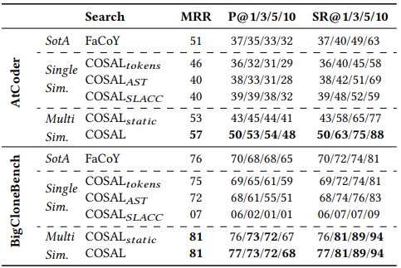
RQ3: State-of-the-Art Code-to-Code Search
Compared to state-of-the-art Java code-to-code search FaCoY, using dynamic information helps COSAL obtains better search results when executable code snippets are present. In the absence of dynamic information, a combination of AST and token-based similarity measures still yields better results than FaCoY.

Slide 12
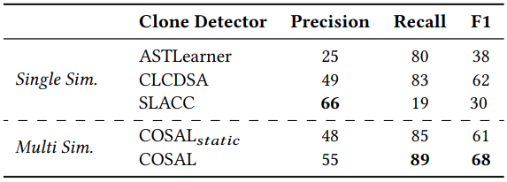
RQ4: Cross-Language Code Clone Detection
For code clone detection, COSAL obtains better precision, recall and F1 scores compared to ASTLearner and CLCDSA, without the need to build models. COSAL has lower precision to SLACC but much better recall and F1 score.

