Slide 1

Hongchen Cao
Research intern at Ant Group, working on LLM Infra
Under supervision of Prof. Jingzhu He from Oct. 2022 to Jul. 2026
  Bug and vulnerabilities detection in distributed system (NSDI’26, ASE-NIER’25)
  Resource management for microservice (IFIP Performance’23, ICWS’24)
Under supervision of Prof. Yutian Tang from Dec. 2020 to Sep. 2022
  Black-box adversarial attack to DL apps (JSEP’23)
  Empirical study of Jupyter bugs (EASE’25)
Teaching assistant
  CS132 Software Engineering, Fall 2021
  CS225 Advanced Distributed Systems Introduction, Fall 2024&2025
  CS130 Operating System, Spring 2026
Awards and Services
  Merit Student Award 2024 (Top 5%), Academic Scholarship 2023&2024&2025, IFIP Performance’23&NSDI’26 Student Grant
  OOPSLA’26 AE, ICWS ’26, ATC’26 AE, PACT’26 AE, EursoSys’27 AE, CGO’27 AE, POPL’27 AE, S&P’27 AE, …

Slide 2
Research
RSI for LLM Infra (now)
  TrainerAgent (RSI for LLM Training Framework) & TrainerChecker (Bit-wise Verifier for Distributed Training framework) (Main contributor)
Bug and Vulnerability Detection in Distributed System (2024-2025)
  Themis: Detecting Distributed Concurrency Bugs through RPC-Driven Race-Directed Test Generation and Fuzzing (First author, NSDI’26)
  STaint: Detecting Second-Order Vulnerabilities in PHP Applications with LLM-Assisted Bi-Directional Static Taint Analysis (Second author, ASE-NIER’25)
Microservice Resource Management (2023-2024)
  QueueFlower: Orchestrating Microservice Workflows via Dynamic Queue Balancing (Co-first, ICWS’24)
  POBO: Safe and optimal resource management for cloud microservices (Co-First, IFIP Performance’23)
Empirical Study (2020-2022)
  Characterising Bugs in Jupyter Platform (Second author, EASE’25)
Deep Learning Security (2020-2022)
  Cheating Your Apps: Black-box Adversarial Attacks on Deep Learning Apps (First author, JSEP’23)

Slide 4
Themis: Detecting Distributed Concurrency Bugs through RPC-Driven Race-Directed Test Generation and Fuzzing
Hongchen Cao, Jingzhu He, Ting Dai, GuoLiang Jin
ShanghaiTech University, InsightFinder AI, North Carolina State University
Notes:
Hello, everyone. Good Morning. My name is Hongchen Cao and I’m a student from Shanghaitech University.
My topic today is …

Slide 5
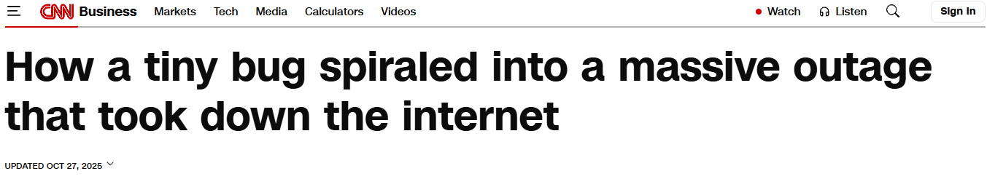

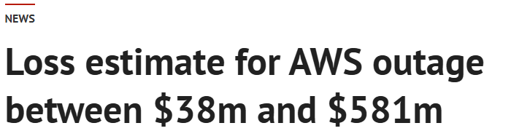
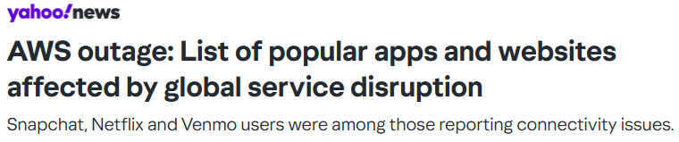
A Real-world Outage
Real-world impact of distributed concurrency bugs
  In October 2025, a distributed concurrency bug caused a 14-hours outage in Amazon DynamoDB.
  Affect more than 25 major AWS customers such as Netflix, Zoom, and T-Mobile.
  Result in estimated losses of $38–$581 million.
  The root cause was an unexpected interleaving of two remote requests on a worker node, in which an older request violated the atomicity of a newer one, causing all connection requests to fail.

Slide 6


Existing Top-Down Analysis With a Harness
Test Harness
MapReduce System
public class TestViolation1 {
public static void main(...) {
// Necessary call sequences
job = submitJob(...) ;
waitRunningJob(job, ...) ;
attempt = findActiveAttempt(...) ;
mr = createMR("mr-race" , ...) ;
// Invoke public APIs concurrently
tChild=() ->{ YarnChild.main(...) ;};
tKill=() ->{ mr.forceKillTask(tState,…) ;};
...
}
}
// mapred/TaskAttemptListenerImpl .java
77 public class TaskAttemptListenerImpl ... {
91 ConcurrentHashMap<…> jvmMap = ...;
503 public ... getTask(…) {
521 if (!jvmMap.containsKey(wJvmID)) {...}
524 else {
533 task = jvmMap.remove(wJvmID);
537 task.setEncryptedSpillKey(...) ;
539 }
542 }
568 public ... unregister(...) {
582 jvmMap.remove(jvmID);
588 }
721 }
YarnChild.main() {
umbilical.getTask(context);
}
MRClientService.forceKillTask()
KilledAfterSuccessTransition.
transition()
…

Slide 7
Static Race Detection for Open Systems
Problem: Static race detection for distributed concurrency bugs?
Challenge: Static analysis for open systems
Insight: Static RPC-driven race detection tailored for open systems
  Assumed concurrency model where any pair of public interfaces can be concurrent
  Variable-centric analysis focusing on RPC-reachable shared variables and their access site

Slide 8
Static RPC-Driven Race Detection Without a Harness
Test Harness
MapReduce System
RPC Client and Server Function Pair
// mapred/TaskAttemptListenerImpl .java
77 public class TaskAttemptListenerImpl ... {
91 ConcurrentHashMap<…> jvmMap = ...;
503 public ... getTask(…) {
521 if (!jvmMap.containsKey(wJvmID)) {...}
524 else {
533 task = jvmMap.remove(wJvmID);
537 task.setEncryptedSpillKey(...) ;
539 }
542 }
568 public ... unregister(...) {
582 jvmMap.remove(jvmID);
588 }
721 }
Shared Variable
YarnChild.main() {
umbilical.getTask(context);
}
Assuming Concurrent Execution of Each Pair of Public Interfaces
Test harness is unavailable
KilledAfterSuccessTransition.
transition()
Access Sites
MRClientService.forceKillTask()
…
Another Concurrent Call Chain

Slide 9
Constructing the Test Harness
Problem: Construct a test harness to validate the static analysis result?
Challenge: Combinatorial search space of call sequences and parameters
Insight: Decoupling call sequence synthesis and parameter exploration

Slide 10

Decoupling Call Sequence Synthesis and Parameter Exploration
LLM-Based Test Generation
Test Harness
MapReduce System
public class TestViolation1 {
public static void main(...) {
// Necessary call sequences
job = submitJob(...) ;
waitRunningJob(job, ...) ;
attempt = findActiveAttempt(...) ;
mr = createMR("mr-race" , ...) ;
// Invoke public APIs concurrently
tChild=() ->{ YarnChild.main(...) ;};
tKill=() ->{ mr.forceKillTask(tState,…);};
...
}
}
Diverse Call Sequence
// mapred/TaskAttemptListenerImpl .java
77 public class TaskAttemptListenerImpl ... {
91 ConcurrentHashMap<…> jvmMap = ...;
503 public ... getTask(…) {
521 if (!jvmMap.containsKey(wJvmID)) {...}
524 else {
533 task = jvmMap.remove(wJvmID);
537 task.setEncryptedSpillKey(...) ;
539 }
542 }
568 public ... unregister(...) {
582 jvmMap.remove(jvmID);
588 }
721 }
YarnChild.main() {
umbilical.getTask(context);
}
MRClientService.forceKillTask()
KilledAfterSuccessTransition.
transition()
Complex Input Parameter
…
Exploring Interleavings
Parameter Exploration

Slide 11
Towards Using LLMs
Problem: Handle LLMs’ hallucinations?
Challenge: Be careful of using LLMs
  The generated tests do not converge, missing target paths
  Hard to determine the correctness of generated tests
Insight: LLM + Guidance + Checking
  Guidance of static analysis results
  Checking by fuzzing to verify and refine the generated tests

Slide 12

Themis
Static RPC-Driven Race Detection
System Code
Candidate Shared Variables and Access Sites Extraction
Rule-Based Violation Identification
Error Pattern Matching
Staged Parameter Fuzzing and Interleaving Exploration
Bug Report
LLM-Based Holistic Test Generation
Symptom-Targeted Parameter Fuzzing
Interleaving Exploration
Race-Targeted Parameter Fuzzing

Slide 13
Evaluation Results
204 unique violations (198 new), corresponding to 58 bugs (52 new)
170 out of 204 detected violations (83.3%) exhibit implicit symptoms
192 new violations (49 new bugs) and 5 know bugs race on server instance variables
System | EO | EA | NP | OB | UR | MR | TO | Total
Alluxio | 0 | 0 | 0 | 0 | 2 | 0 | 0 | 2
Hadoop | 1 | 0 | 1 | 0 | 0 | 0 | 0 | 2
HBase | 5³ | 3¹ | 1 | 0 | 36 | 1 | 2 | 48⁴
HDFS | 3 | 0 | 0 | 0 | 1 | 3 | 1 | 8
Hive | 2 | 0 | 0 | 0 | 10 | 1 | 0 | 13
MapReduce | 7² | 3 | 3 | 2 | 19 | 3 | 2 | 39²
Tez | 1 | 0 | 0 | 0 | 2 | 0 | 0 | 3
Yarn | 9 | 0 | 4 | 0 | 71 | 2 | 3 | 89
Total | 28⁵ | 6¹ | 9 | 2 | 141 | 10 | 8 | 204⁶

Slide 14
STaint: Detecting Second-Order Vulnerabilities inPHP Applications with LLM-AssistedBi-Directional Static Taint Analysis
Yuchen Ji, Hongchen Cao, Jingzhu He
ShanghaiTech University

Slide 15
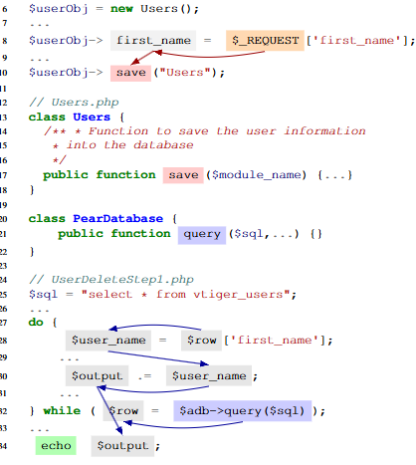
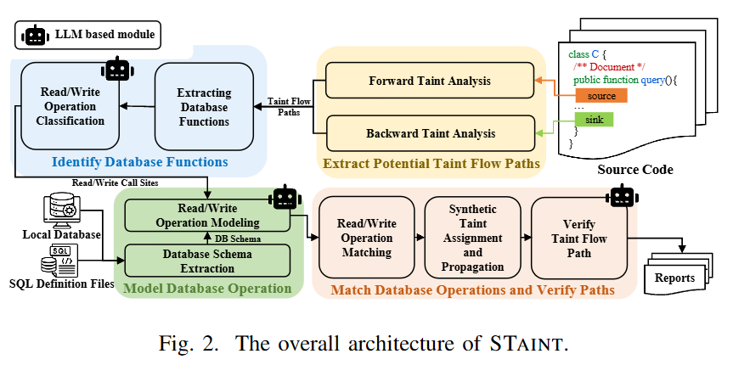
STaint

Slide 16
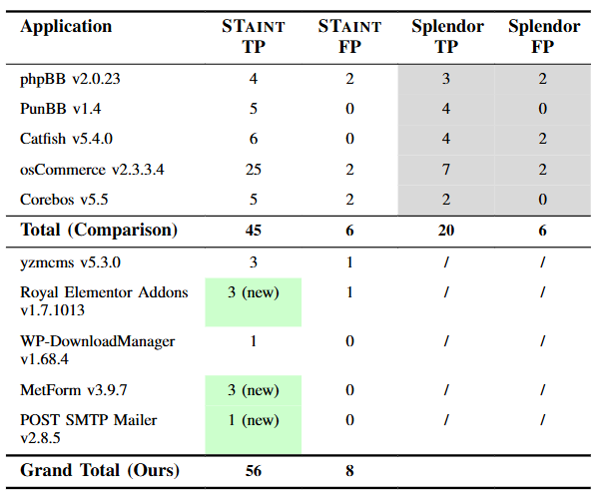
Staint

Slide 17
QueueFlower: Orchestrating Microservice Workflows via Dynamic Queue Balancing
Hongchen Cao¹, Xinrui Liu¹, Hengquan Guo, Jingzhu He∗, Xin Liu∗
Notes:
Hello, everyone. Good Morning. My name is Hongchen Cao and I’m a student from Shanghaitech University.
My topic today is …

Slide 18




Research Problem
Given a fixed number of total resources, how to allocate resources to each service can minimize the latency and service level agreement (SLA) violation rate.
XXX
Service node
Resources
rate
search
search
profile
geo
frontend
…
login
…
user
1

Slide 19
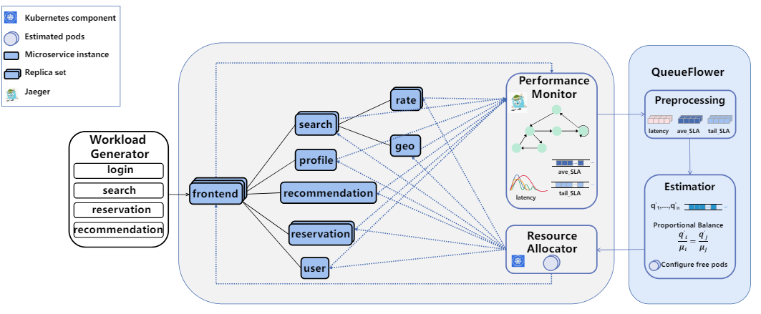
QueueFlower
5

Slide 20
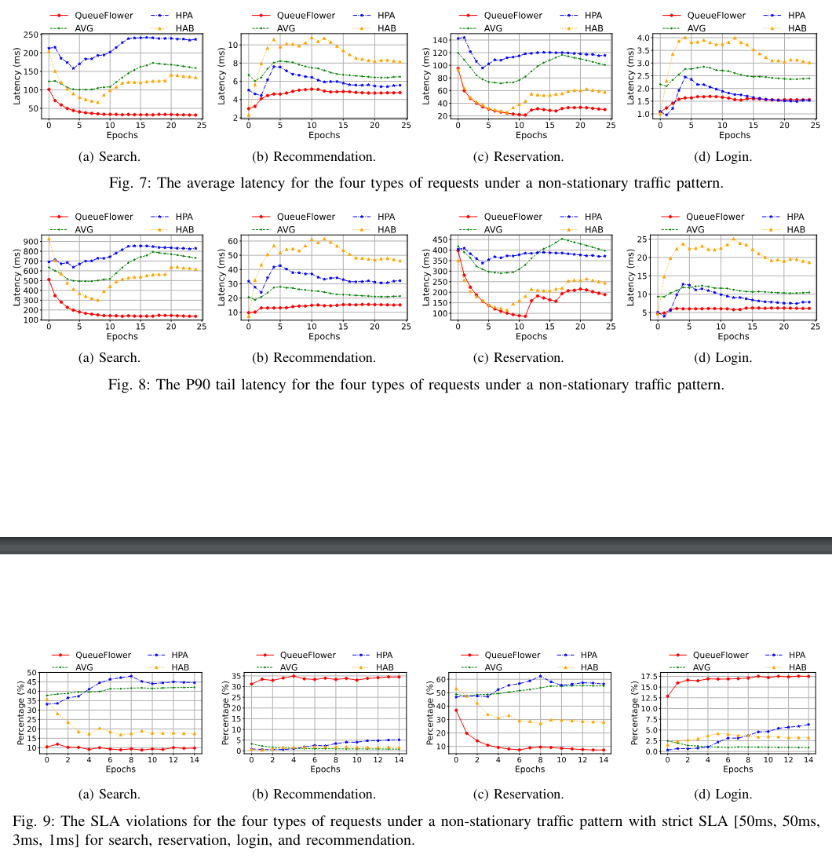
Results
A fixed arrival distribution with a varying number of arrivals:
QueueFlower can efficiently allocate available resources to guarantee low latencies and a percentage of SLA violations under the highly dynamic non-stationary workload.
19

Slide 21
Non-stationary Requests
A fixed arrival distribution with a varying number of arrivals:
QueueFlower can efficiently allocate available resources to guarantee low latencies and a percentage of SLA violations under the highly dynamic non-stationary workload.
QueueFlower can efficiently allocate available resources to guarantee low latencies and a percentage of SLA violations under the highly dynamic non-stationary workload.
20

Slide 22
Non-stationary Requests
A fixed arrival distribution with a varying number of arrivals:
QueueFlower can efficiently allocate available resources to guarantee low latencies and a percentage of SLA violations under the highly dynamic non-stationary workload.
QueueFlower can efficiently allocate available resources to guarantee low latencies and a percentage of SLA violations under the highly dynamic non-stationary workload.
21

Slide 23
POBO: Safe and optimal resource management for cloudmicroservices
Hengquan Guo¹, Hongchen Cao¹, Jingzhu He∗,
Xin Liu∗, YuanMing Shi
Notes:
Hello, everyone. Good Morning. My name is Hongchen Cao and I’m a student from Shanghaitech University.
My topic today is …

Slide 24
Research Problem
Given a fixed number of maximum resources, how to allocate resources to each service can minimize the latency, service level agreement (SLA) violation rate, and resource utlization .
XXX
Service node
Resources
rate
search
search
profile
geo
…
idle
frontend
login
…
user
1

Slide 25
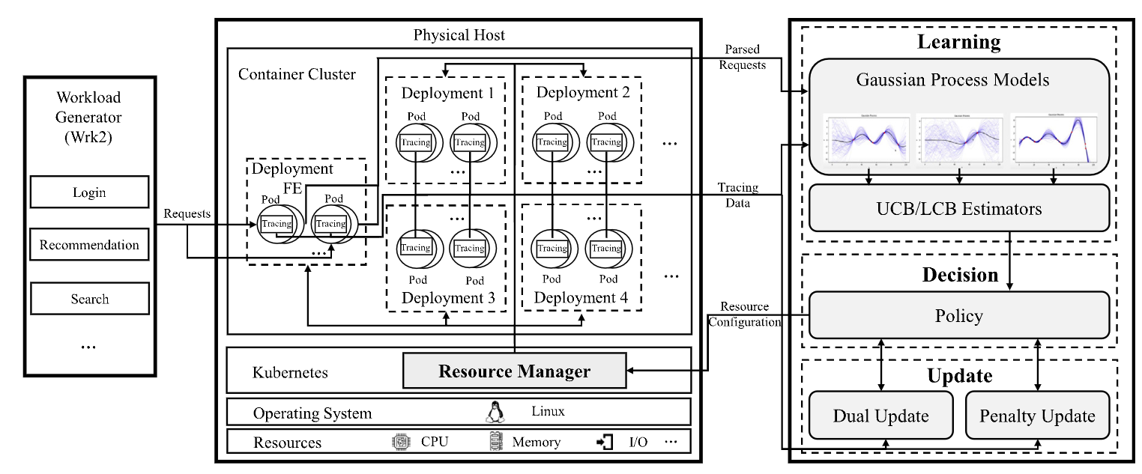
POBO
5

Slide 26
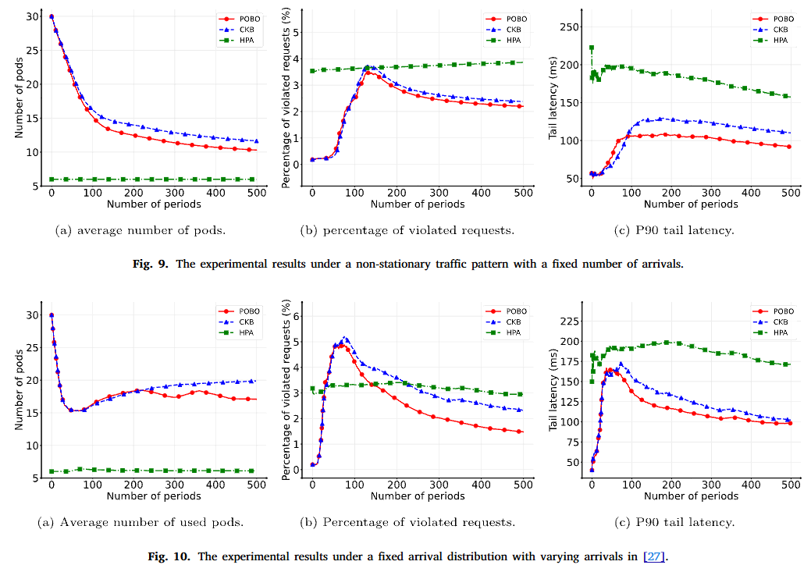
Results
A varyng distribution with a fixed number of arrivals:
POBO performs well under non-stationary arrival requests and is adaptive to the most effective policy
with minimal resource usage and SLA violations.
19

Slide 27
Results
A fixed arrival distribution with a varying number of arrivals:
QueueFlower can efficiently allocate available resources to guarantee low latencies and a percentage of SLA violations under the highly dynamic non-stationary workload.
POBO performs well under non-stationary arrival requests and is adaptive to the most effective policy
with minimal resource usage and SLA violations.
19

Slide 28
Characterising Bugs in Jupyter Platform
Yutian Tang∗, Hongchen Cao, Yuxi Chen, David Lo
Notes:
Hello, everyone. Good Morning. My name is Hongchen Cao and I’m a student from Shanghaitech University.
My topic today is …

Slide 29
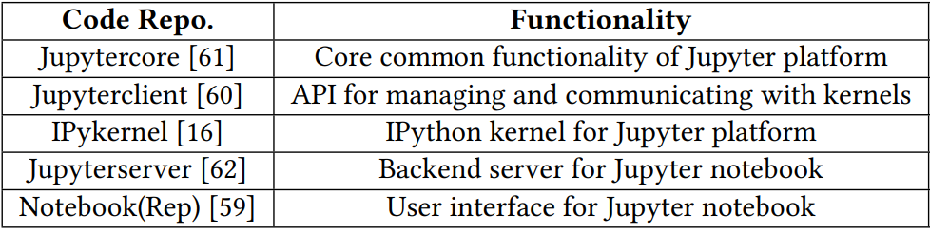
Research Problem
Popularity and diversity of Jupyter
  There are more than 2.5 million Jupyter notebook repositories, which are 10 times more than that in 2015.
  More languages are supported by the Jupyter platform, such as R, JavaScript, and C.
The nature of bugs in the Jupyter platform is not well understood
  Root causes and symptoms
  Bug localization and fixing
  The development of bug detection and testing tools

Slide 30
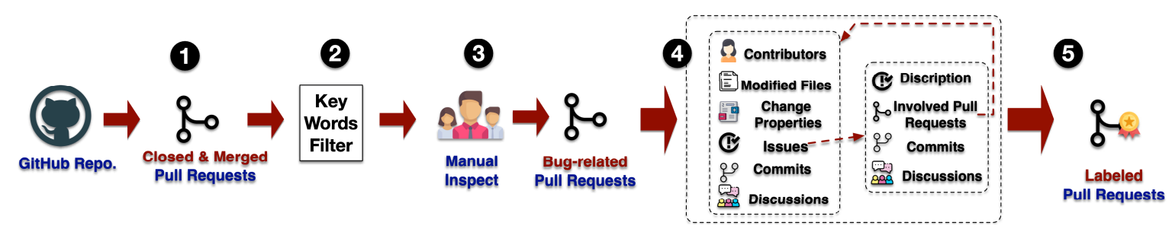
Method
We collect the closed and merged pull requests that fix bugs.
We reserve a list of words that have similar meanings to “bugs” and search each word in both tags and titles.
We manually inspect these 510 PRs and related Issues.
For each PR, we collect its contributors, modified files, change properties (e.g., how the files are modified), Issues linked to this PR, all related commits, and discussions under this PR.
Notes:
There are a lot of white-box attack methods to spoof a DL model.
However, recent studies show that developers are more likely to use encryption or hash code to protect their models.
It means that the knowledge of a model (i.e., structure and weights) inside the app is always unknown, which nullifies these white-box attacks.
We develop a practical pipeline that covers data preparation, student model learning, and adversarial examples generation to perform black-box adversarial attack to DL apps.
根据以往的研究，有很多白盒的攻击方法来欺骗一个深度学习模型。
然而，最近的研究表明，开发人员也逐渐开始使用加密或哈希码等方式来保护他们的模型。
这意味着应用程序内部的模型信息（即结构和权重）是不可篡改且未知的，这使白盒攻击无法被有效地使用。
在这项工作中，我们设计了一个pipeline，包括数据准备、学生模型学习和对抗性例子的生成三个主要部分，以对深度学习app进行黑盒对抗样本攻击。

Slide 31
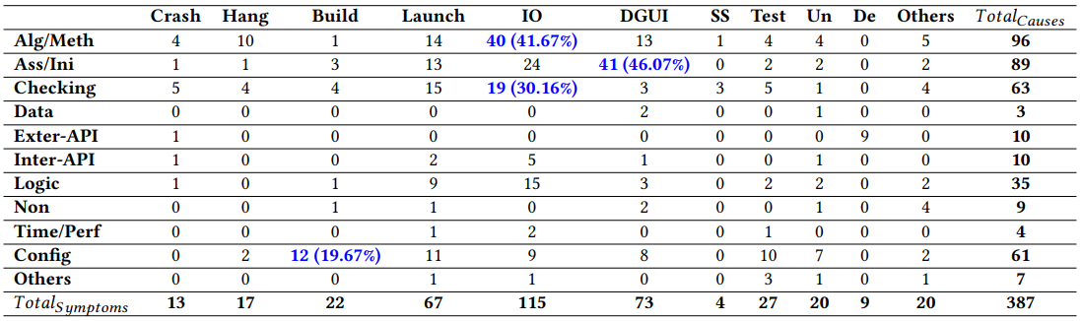
Results
Alg/Meth is the most frequent root cause, accounting for 24.81% of Jupyter platform bugs.
IO is the most frequently reported symptom, accounting for 115 out of 387.
For IO sympotoms, Alg/Meth and Checking can be the main root causes.
The bugs whose symptom is DGUI can be closely related to Ass/Ini.
Most bugs with symptoms reported as Build are related to improper configuration.
Notes:
We compare the performance among our approach, SOTA method ModelAttacker and blind attack on 10 apps.
Compared with the blind attack which is the common basic black-box attack method, our approach can attack all 10 apps successfully while the blind attack can only attack 5 of them.
Meanwhile, the attack success rate of our approach is at least 2.6 times higher than the blind attack.
Compared with ModelAttacker, we can reach a relatively high attack success rate of 66.60% on average, outperforming others by 27.63%.
Note that ModelAttacker have the knowledge of victim model’s structure and weights, which is unknown in our approach.
我们将我们的方法、SOTA的方法ModelAttacker以及blind攻击在10个app上的表现进行了比较。
ModelAttacker通过比较受害者模型与开源预训练模型的相似度找出最相近的模型，从而实现攻击
与最基本的黑盒攻击方法--blind攻击相比，我们的方法可以成功地攻击所有10个应用程序，而blind攻击只能成功攻击其中的5个。
同时，我们的方法的攻击成功率至少比blind攻击高2.6倍。
与ModelAttacker相比，我们可以达到相对较高的攻击成功率，平均为66.60%，高出27.63%。
值得注意的是，ModelAttacker知道受害者模型的结构和权重，而我们的方法则不知道。

Slide 32
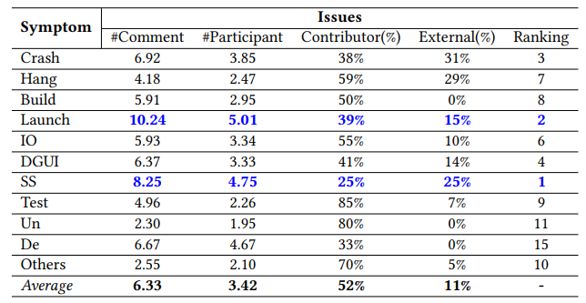
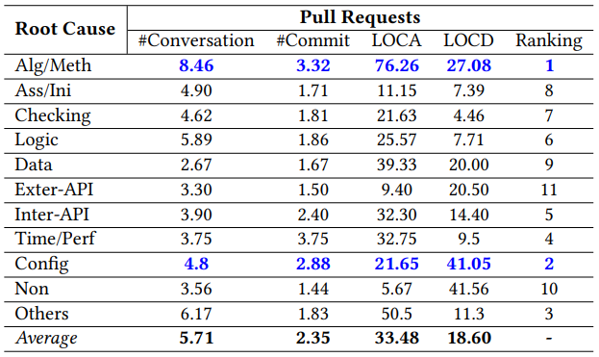
Results
SS(Safety&Security)-related bugs are challenging to detect.
  Reproducing and locating SS-related bugs based on abstract symptom descriptions is a challenge because there can be multiple solutions.
Alg/Meth is the most difficult category of bugs to fix in a mutimodule platform like Jupyter.
  Fixing one bug can interference the functionality of other relative modules. Some of them (i.e., extra bugs) cannot be captured with the regression test suite.
Config bugs are the second most difficult to fix
  The main challenge is identifying and resolving third-party dependency library conflicts.
Notes:
We compare the performance among our approach, SOTA method ModelAttacker and blind attack on 10 apps.
Compared with the blind attack which is the common basic black-box attack method, our approach can attack all 10 apps successfully while the blind attack can only attack 5 of them.
Meanwhile, the attack success rate of our approach is at least 2.6 times higher than the blind attack.
Compared with ModelAttacker, we can reach a relatively high attack success rate of 66.60% on average, outperforming others by 27.63%.
Note that ModelAttacker have the knowledge of victim model’s structure and weights, which is unknown in our approach.
我们将我们的方法、SOTA的方法ModelAttacker以及blind攻击在10个app上的表现进行了比较。
ModelAttacker通过比较受害者模型与开源预训练模型的相似度找出最相近的模型，从而实现攻击
与最基本的黑盒攻击方法--blind攻击相比，我们的方法可以成功地攻击所有10个应用程序，而blind攻击只能成功攻击其中的5个。
同时，我们的方法的攻击成功率至少比blind攻击高2.6倍。
与ModelAttacker相比，我们可以达到相对较高的攻击成功率，平均为66.60%，高出27.63%。
值得注意的是，ModelAttacker知道受害者模型的结构和权重，而我们的方法则不知道。

Slide 33
Cheating Your Apps: Black-box
Adversarial Attacks on Deep Learning Apps
Hongchen Cao, Shuai Li, Yuming Zhou, Ming Fan,
Xuejiao Zhao, Yutian Tang∗
Notes:
Hello, everyone. Good Morning. My name is Hongchen Cao and I’m a student from Shanghaitech University.
My topic today is …

Slide 34
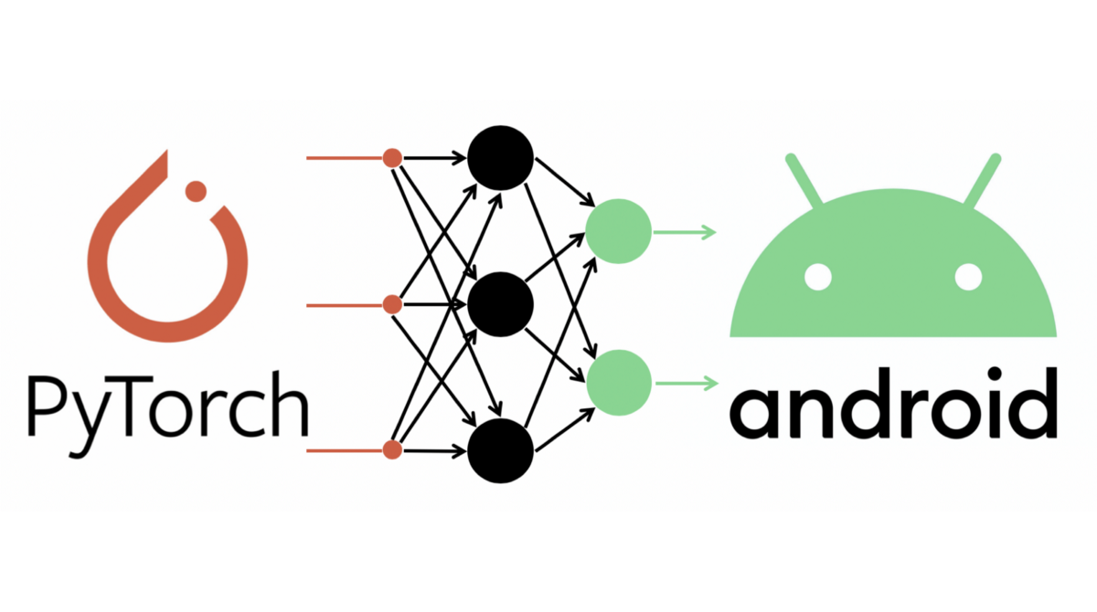


Research Problem
Popularity and diversity of DL apps
  The number of DL APPs and downloads are skyrocketing
  Widely used in apps for business, news, images, maps, social, shopping and health
On-device DL model deployment is better than on-cloud ones
  On cloud: Network quality, user privacy leakage
  On device: Faster, easy-to-use frameworks (TF Lite, Pytorch Mobile, …)
Recent studies for attacking mobile deep learning models are white box
  Need to know or even modify the structure and weights
  Developers use encryption or hash code to protect their models
Apple
CoreML

Slide 35
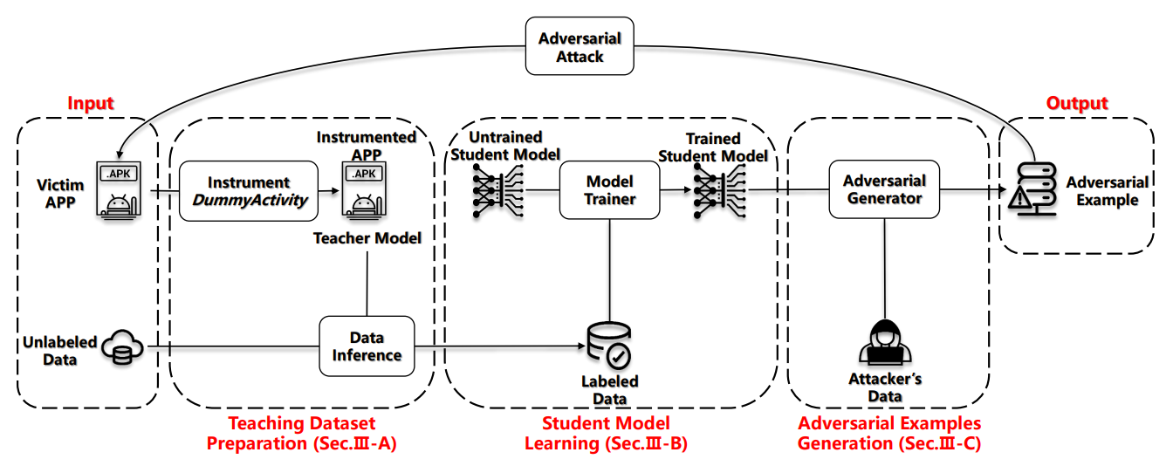
Method
The structure and weights of on-device DL models are hard to know
How to cheat a model only by querying the model and get its prediction?
  Three steps in our pipeline
  Determine the task type and data format
  Utilizing teacher-student training
  Generate adversarial examples to spoofy the app
Notes:
There are a lot of white-box attack methods to spoof a DL model.
However, recent studies show that developers are more likely to use encryption or hash code to protect their models.
It means that the knowledge of a model (i.e., structure and weights) inside the app is always unknown, which nullifies these white-box attacks.
We develop a practical pipeline that covers data preparation, student model learning, and adversarial examples generation to perform black-box adversarial attack to DL apps.
根据以往的研究，有很多白盒的攻击方法来欺骗一个深度学习模型。
然而，最近的研究表明，开发人员也逐渐开始使用加密或哈希码等方式来保护他们的模型。
这意味着应用程序内部的模型信息（即结构和权重）是不可篡改且未知的，这使白盒攻击无法被有效地使用。
在这项工作中，我们设计了一个pipeline，包括数据准备、学生模型学习和对抗性例子的生成三个主要部分，以对深度学习app进行黑盒对抗样本攻击。

Slide 36
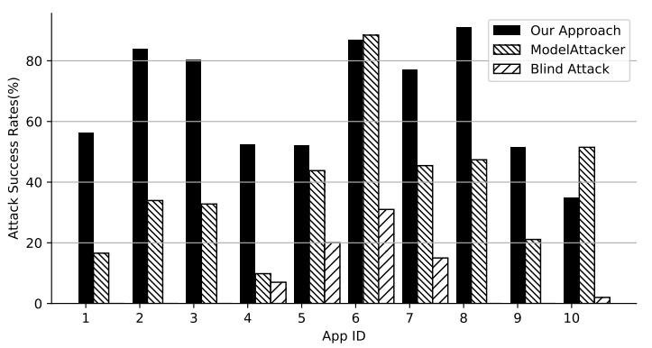
Results
Approach:
  Compared with Blind Attack and SOTA attack method ModelAttacker on 10 apps
Results:
  Our approach effectively attacks 10 DL apps, thus providing a new perspective and method for evaluating app reliability.
  Compared with existing methods, we reach a relatively high attack success rate of 66.60% on average, outperforming others by 27.63%.
Notes:
We compare the performance among our approach, SOTA method ModelAttacker and blind attack on 10 apps.
Compared with the blind attack which is the common basic black-box attack method, our approach can attack all 10 apps successfully while the blind attack can only attack 5 of them.
Meanwhile, the attack success rate of our approach is at least 2.6 times higher than the blind attack.
Compared with ModelAttacker, we can reach a relatively high attack success rate of 66.60% on average, outperforming others by 27.63%.
Note that ModelAttacker have the knowledge of victim model’s structure and weights, which is unknown in our approach.
我们将我们的方法、SOTA的方法ModelAttacker以及blind攻击在10个app上的表现进行了比较。
ModelAttacker通过比较受害者模型与开源预训练模型的相似度找出最相近的模型，从而实现攻击
与最基本的黑盒攻击方法--blind攻击相比，我们的方法可以成功地攻击所有10个应用程序，而blind攻击只能成功攻击其中的5个。
同时，我们的方法的攻击成功率至少比blind攻击高2.6倍。
与ModelAttacker相比，我们可以达到相对较高的攻击成功率，平均为66.60%，高出27.63%。
值得注意的是，ModelAttacker知道受害者模型的结构和权重，而我们的方法则不知道。

Slide 38
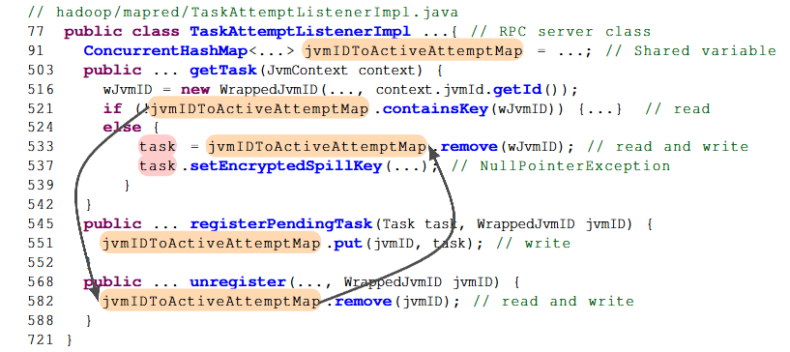
An Motivating Example
MapReduce-7507, a new bug detected by Themis.
Shared variable: jvmIDToActiveAttemptMap
Violation1:
  Line 582 happens between Line 521 and Line 533
Violation2:
  Execute getTask() twice
  E1-533 happens between E2-521 and E2-533
“Thanks for spotting this subtle concurrency issue!”
--- Hadoop developer

Slide 39
Challenges and Existing Methods
MapReduce-7507, a new bug detected by Themis.
Shared variable: jvmIDToActiveAttemptMap
Violation1:
  Line 582 happens between Line 521 and Line 533
Violation2:
  Execute getTask() twice
  E1-533 happens between E2-521 and E2-533
Existing Methods
  DCatch(ASPLOS’17), CloudRaid(FSE’18) …
  Dynamic approaches: assuming we already have a workload that can cover the buggy path, then identify races and trigger bugs
  Common-used workload and test suite have a low coverage for distributed concurrency bugs
“Thanks for spotting this subtle concurrency issue!”
--- Hadoop developer

Slide 40
Challenges and Existing Methods
MapReduce-7507, a new bug detected by Themis.
Shared variable: jvmIDToActiveAttemptMap
Violation1:
  Line 582 happens between Line 521 and Line 533
Violation2:
  Execute getTask() twice
  E1-533 happens between E2-521 and E2-533
Low coverage of workload? Use static analysis!
“Thanks for spotting this subtle concurrency issue!”
--- Hadoop developer

Slide 41
Challenges and Existing Methods
MapReduce-7507, a new bug detected by Themis.
Shared variable: jvmIDToActiveAttemptMap
Violation1:
  Line 582 happens between Line 521 and Line 533
Violation2:
  Execute getTask() twice
  E1-533 happens between E2-521 and E2-533
Low coverage of workload? Use static analysis!
High false positive of static analysis? Static pruning and dynamic triggering on real cluster!
“Thanks for spotting this subtle concurrency issue!”
--- Hadoop developer

Slide 42
Challenges and Existing Methods
MapReduce-7507, a new bug detected by Themis.
Shared variable: jvmIDToActiveAttemptMap
Violation1:
  Line 582 happens between Line 521 and Line 533
Violation2:
  Execute getTask() twice
  E1-533 happens between E2-521 and E2-533
Low coverage of workload? Use static analysis!
High false positive of static analysis? Static pruning and dynamic triggering on real cluster!
No existing workload for dynamic triggering? Generate a integration test by LLM based on static analysis result!
“Thanks for spotting this subtle concurrency issue!”
--- Hadoop developer

Slide 43
Challenges and Existing Methods
MapReduce-7507, a new bug detected by Themis.
Shared variable: jvmIDToActiveAttemptMap
Violation1:
  Line 582 happens between Line 521 and Line 533
Violation2:
  Execute getTask() twice
  E1-533 happens between E2-521 and E2-533
Low coverage of workload? Use static analysis!
High false positive of static analysis? Static pruning and dynamic triggering on real cluster!
No existing workload for dynamic triggering? Generate a integration test by LLM based on static analysis result!
LLM is insufficient for finding the parameter to trigger the bug? Use directed fuzzing to search!
“Thanks for spotting this subtle concurrency issue!”
--- Hadoop developer

Slide 44
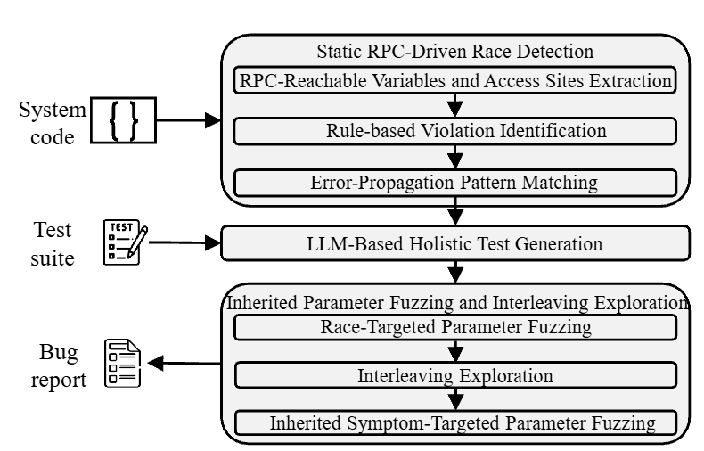
Themis
Themis: a novel approach that builds on static analysis and integrates three components to detect distributed concurrency bugs.
First, Themis performs RPC-driven rule-based static analysis to identify potential violations and further match them to error-propagation patterns.
Second, Themis leverages an LLM to generate integrated tests for each identified violation.
Third, Themis applies directed fuzzing to further refine input parameters and manipulates interleavings to expose distributed concurrency bugs.

Slide 45
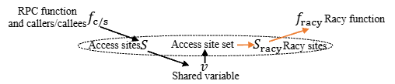
Themis: Static Analysis
RPC-Reachable Variables and Access Sites Extraction
  RPC Client–Server Pair Extraction
  Server & Client Side Reachable Variable Extraction
  Pointer Alias Analysis
  Reachable Variable and Access Site Mapping
  Read–Write Analysis

Slide 46
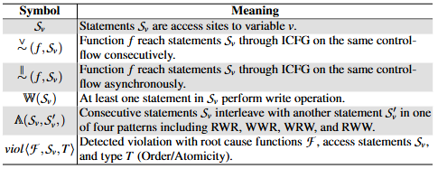
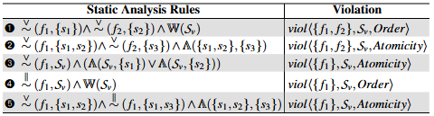
Themis: Static Analysis
RPC-Reachable Variables and Access Sites Extraction
Rule-Based Violation Identification
  Violation Identification
  Deduplication of Violation Tuples
  Escaping Violation Tuple Analysis
  Synchronization Analysis

Slide 47
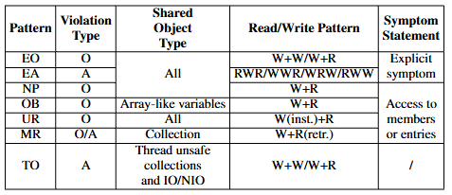
Themis: Static Analysis
RPC-Reachable Variables and Access Sites Extraction
Rule-Based Violation Identification
Error-Propagation Pattern Matching
  Explicit Symptom Detection
  Implicit Symptoms Detection

Slide 48
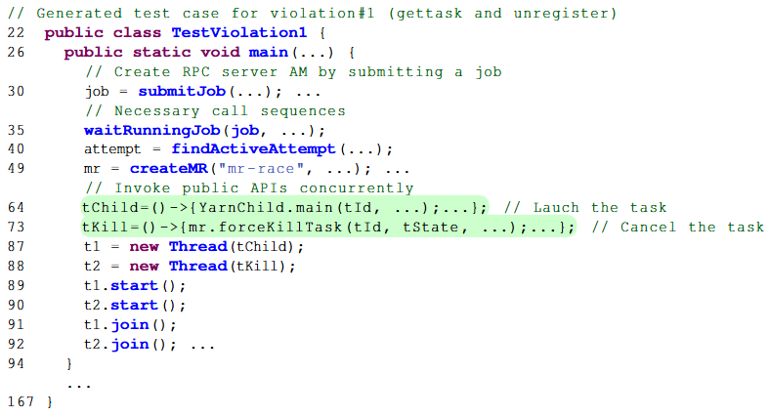
Themis: Test Generation
Generation-Repair Workflow
Generation Agent
  First, the identified RPC server must be properly set up so that it can be invoked by the client. The generation agent attempts to initialize it by instantiating the class that contains the RPC server function.
  Second, to ensure that execution flows through the target functions, the access statements, and the symptom statement, satisfying the path conditions, the test case must establish the correct system state by invoking application-specific call.
  Third, we require the LLM to output the test case where the public API(s) must be invoked concurrently, allowing the interleavings necessary for the concurrency bug to manifest.

Slide 49
Themis: Test Generation
Generation-Repair Workflow
Generation Agent
  First, the identified RPC server must be properly set up so that it can be invoked by the client. The generation agent attempts to initialize it by instantiating the class that contains the RPC server function.
  Second, to ensure that execution flows through the target functions, the access statements, and the symptom statement, satisfying the path conditions, the test case must establish the correct system state by invoking application-specific call.
  Third, we require the LLM to output the test case where the public API(s) must be invoked concurrently, allowing the interleavings necessary for the concurrency bug to manifest.

Slide 50
Themis: Test Generation
Generation-Repair Workflow
Generation Agent
  First, the identified RPC server must be properly set up so that it can be invoked by the client. The generation agent attempts to initialize it by instantiating the class that contains the RPC server function.
  Second, to ensure that execution flows through the target functions, the access statements, and the symptom statement, satisfying the path conditions, the test case must establish the correct system state by invoking application-specific call.
  Third, we require the LLM to output the test case where the public API(s) must be invoked concurrently, allowing the interleavings necessary for the concurrency bug to manifest.

Slide 51
Themis: Test Generation
Generation-Repair Workflow
Generation Agent
  First, the identified RPC server must be properly set up so that it can be invoked by the client. The generation agent attempts to initialize it by instantiating the class that contains the RPC server function.
  Second, to ensure that execution flows through the target functions, the access statements, and the symptom statement, satisfying the path conditions, the test case must establish the correct system state by invoking application-specific call.
  Third, we require the LLM to output the test case where the public API(s) must be invoked concurrently, allowing the interleavings necessary for the concurrency bug to manifest.
Repair Agent
  Given the generated test case and the error message, the repair agent leverages the corresponding function or class source code to fix execution errors.

Slide 52
Themis: Test Generation
Generation-Repair Workflow
Generation Agent
  First, the identified RPC server must be properly set up so that it can be invoked by the client. The generation agent attempts to initialize it by instantiating the class that contains the RPC server function.
  Second, to ensure that execution flows through the target functions, the access statements, and the symptom statement, satisfying the path conditions, the test case must establish the correct system state by invoking application-specific call.
  Third, we require the LLM to output the test case where the public API(s) must be invoked concurrently, allowing the interleavings necessary for the concurrency bug to manifest.
  Augmented generation agent with test suites.
Repair Agent
  Given the generated test case and the error message, the repair agent leverages the corresponding function or class source code to fix execution errors.

Slide 53
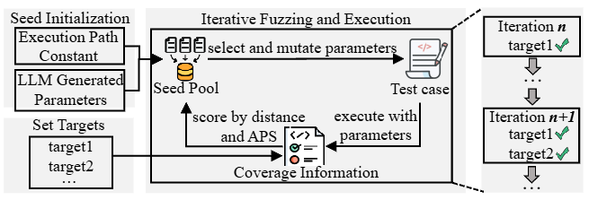
Themis: Bug Triggering
Directed Fuzzing Across Three Stages
Stage I: Race-Targeted Parameter Fuzzing
  Fuzzing Targets: the RCP call site and the entry points of the server functions, as well as the entry points of root cause functions and the access statements.
  Initial Seed Pool Construction: Constants and LLM generated parameters.
  False Positives Pruning: non-communicable RPC pairs and unsatisfiable path conditions from the public API to the accesses.

Slide 54
Themis: Bug Triggering
Directed Fuzzing Across Three Stages
Stage I: Race-Targeted Parameter Fuzzing
Stage II: Interleaving Exploration
  Signal and wait: control the execution order of access sites
  False Positives Pruning: the accesses are guarded by synchronization mechanisms not detected by static analysis.

Slide 55
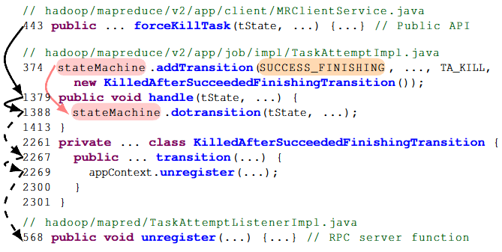
Themis: Bug Triggering
Directed Fuzzing Across Three Stages
Stage I: Race-Targeted Parameter Fuzzing
Stage II: Interleaving Exploration
Stage III: Inherited Symptom-Targeted Parameter Fuzzing
  Fuzzing Targets: Themis includes all fuzzing targets from Stage I as well as the identified symptom statements.
  False Positives Pruning: fail to satisfy the path conditions of error propagation. Such cases can reach the races but do not trigger any symptoms and are therefore classified as benign races.

Slide 56
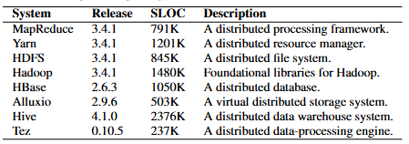
Evaluation
Implementation
  ~6K lines of Java code for static analysis and fuzzing, and ~700 lines of Python code for building the LLM agents
  The static analysis and fuzzing instrumentation are built on top of the Soot framework, and RPC extraction is implemented using RPCBridge. We adopt Claude-4 as the backbone LLM for test generation. We build the directed fuzzing engine by integrating the techniques of SelectFuzz into the Java fuzzing framework JQF.
Target systems
  We evaluate Themis on the latest releases of eight popular cloud system.
  These systems are representative of open-source distributed platforms and incorporate four RPC frameworks, i.e., Hadoop IPC, Netty, gRPC, and Thrift.
Metrics
  The primary measure of Themis as a detection tool is its ability to uncover new violations and bugs.

Slide 57
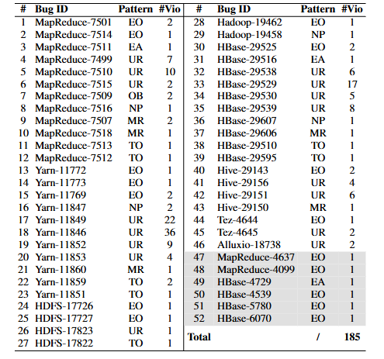
Evaluation
46 new bugs and 6 known bugs detected by Themis. ‘#Vio’ refers to the number of violations in this bug.

Slide 58
Conclusion
This paper presents Themis, a framework for detecting distributed concurrency bugs.
Themis combines static RPC-driven race detection, LLM-based test generation, and parameter fuzzing and interleaving exploration to expose bugs with both explicit and implicit symptoms.
We apply Themis on eight widely used distributed systems and detect 52 bugs, including 46 previously unknown ones.

