Slide 2

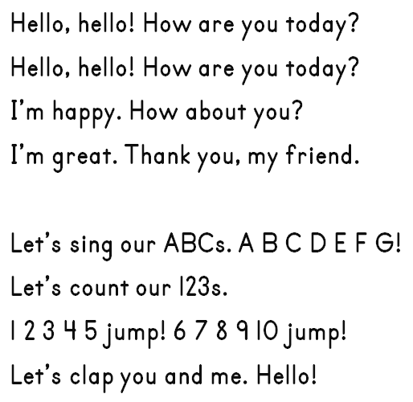







Slide 3









Slide 4




















Slide 5






Slide 6


Slide 7


Slide 8
















Slide 9







Copyright © 2018 iTutorGroup. All Rights Reserved.

Slide 10



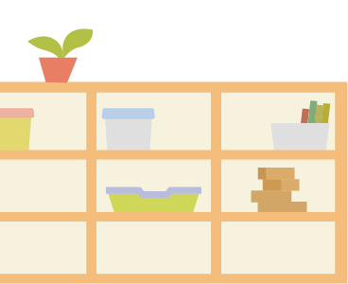







Copyright © 2018 iTutorGroup. All Rights Reserved.
Copyright © 2018 iTutorGroup. All Rights Reserved.

Slide 11











Start
Move on the game board one square at a time.
Begin on Start.
Get to Finish first.
Say the word and use in a sentence.
1
9
10
11
2
8
12
3
7
13
Move up
Move down
4
5
6
Finish

Slide 12




Slide 13

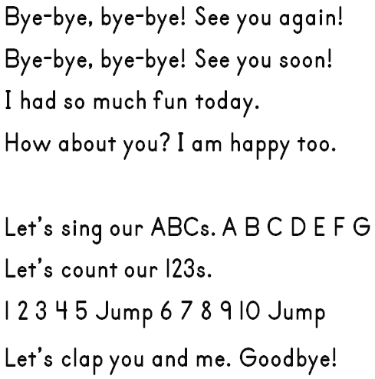


Slide 14



