Slide 1
CS 170 DIS 05

Slide 2
Agenda
Review of Greedy Algorithm
Introduce Dynamic Programming
Worksheet
Q1
Q4
Q5
Q3
Q2

Slide 3
Greedy algorithm
How to prove a greedy algorithm works?
Replacement argument!
Suppose you have a greedy solution and another optimal solution and they are the same until time t. Then, we need to argue that if the optimal solution picks greedy’s choice at time t, it generates another solution as good as itself.
Or justify by logic, like Horn Formula.
Or justify by explicitly writing out the cost function, like Huffman Encoding, Sum of Products on your last HW and Service scheduling in last section’s worksheet

Slide 4
Greedy algorithm
How to prove greedy algorithm doesn’t work?
Counterexamples
And think about worst case bound, namely the ration between cost of greedy solution with cost of optimal solution

Slide 5
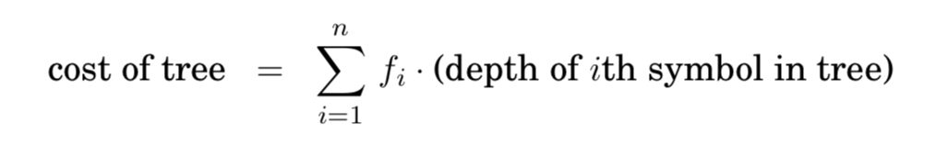
Huffman Encoding
The cost of a tree is the sum of the frequencies of all leaves and internal nodes, except the root.

Slide 6
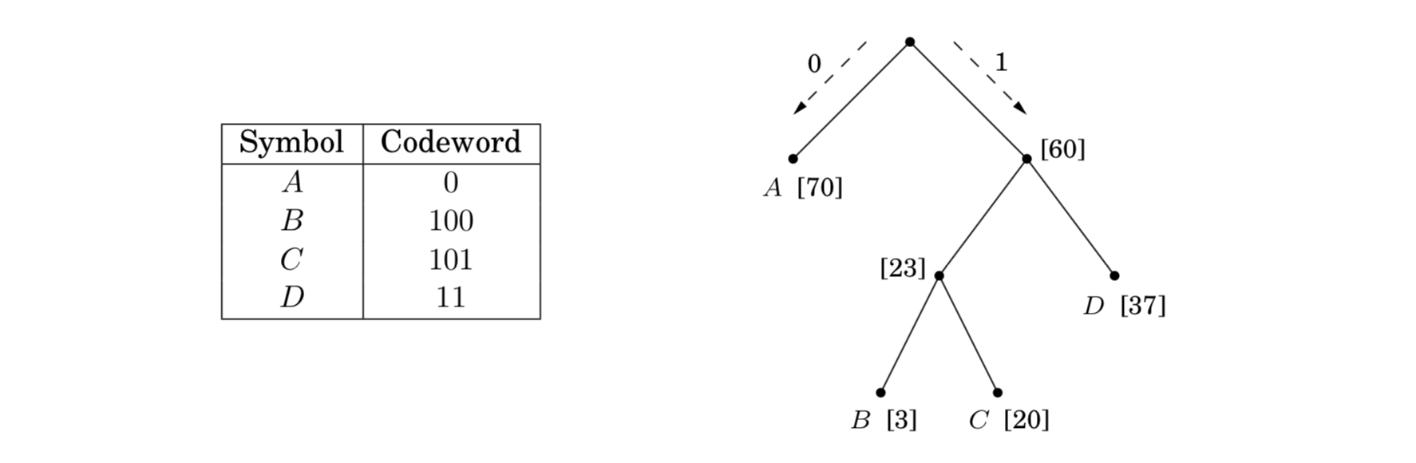

Slide 7
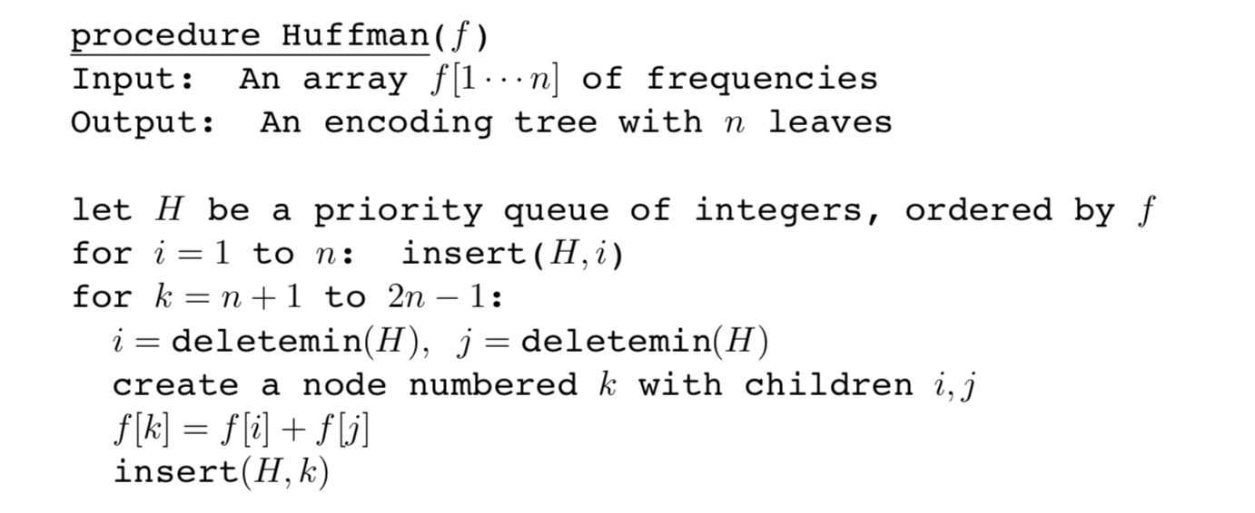
Huffman algorithm

Slide 8
Horn fORMULA
Implications, e.g. (z ∧ w) ⇒ u
Negative clauses
How to assign values to these variables?
Why is the algorithm greedy?
Main idea: We assign every variable to False at the beginning, which should satisfy all negative clauses. And only change a variable assignment whenever necessary for the sake of satisfying implications.

Slide 9
Set cover
Problem setting: A universe of elements and some sets. We want to find minimum number of sets that cover the universe.
Claim Suppose B contains n elements and that the optimal cover consists of k sets. Then the greedy algorithm will use at most k*ln(n) sets.

Slide 10
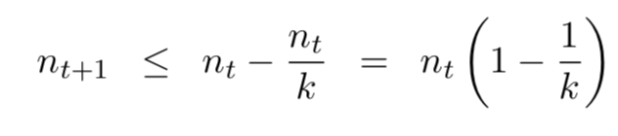
Focus on the elements (N(t) not being covered yet at time t by our greedy algorithm.
The optimal solution has k sets.
What can we say about those elements?
There must exist a set that contains more than N(t)/k of those elements. And our greedy algorithm will choose the set and covers more than N(t)/k of those elements.
Thus, we get a recurrence relationship:

Slide 11
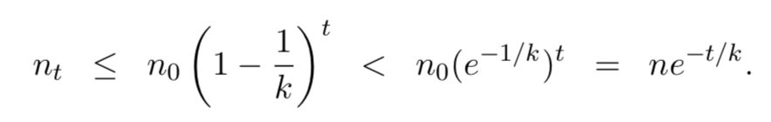
With some Math, we get
And, when t=k*ln(n), n_{t} is less than 1, which means we have covered the universe at time t.

Slide 12
Is this bound tight or not?
If it’s a tight bound, can you come up with examples such that the greedy algorithm will pick k*ln(n) sets to cover those n elements while optimal solution is k sets.
See Q4 on worksheet.

Slide 13
Dynamic Programming introduction
What are the main techniques we have learned so far in this course?
Divide & Conquer and Greedy Algorithm
What if they don’t work?
What is Dynamic Programming?
What’s the difference between Dynamic Programming and recursion or D&Q?

Slide 14
We have seen Dynamic Programming before in section…
But I avoided the term at that time

Slide 15
DAG Algorithms are almost all dynamic programming, meaning using previous stored information to help us solve later problems more efficiently.
So the most important thing in DP is to find an order to solve the problem and store relevant information, whether in an array or matrix or graph (tree).
Runtime is number of subproblems * the time to solve each subproblem

