Slide 1
1. divided into to part
1.1 attack
1.2 recorver
1.3 attack and recorver
2. Imporrtant point

Slide 2
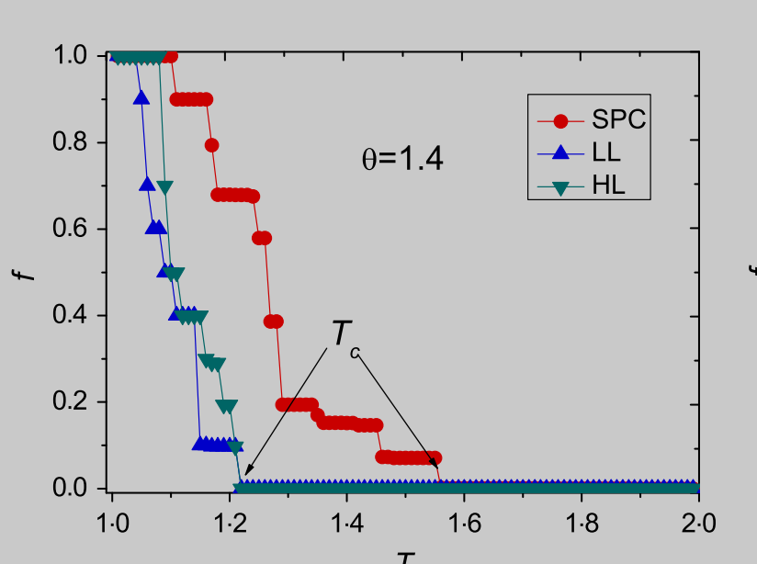
1.1 attack
This just show the final result of the simulation

Slide 3
1.1 attack
But, Asiteration. For our paper, we can show this iteration process. This this is the original point of us far as I know, the collapse simulation is a process of
Moreover, we can do the node attack and the edge attack perhaps( but do the edge attack first
node attack: generator, costume, 变电站

Slide 4
1.2 recorver
For the recorver, we can focus on how to slow down
the process of iteration. in the previous. the collase of each iteration will produce a graph. then for the recorver. the input is the collapse graph of each iteration, and output the recovererd graph.
recorvery can't start from the begin of attack
when start recorver

Slide 5
2. Imporrtant point
1. selltle down the data format between the recorver and attack model
2. finish the load model

