Slide 1
1. divided into to part
1.1 attack
1.2 recorver
1.3 attack and recorver
2. Imporrtant point

Slide 2
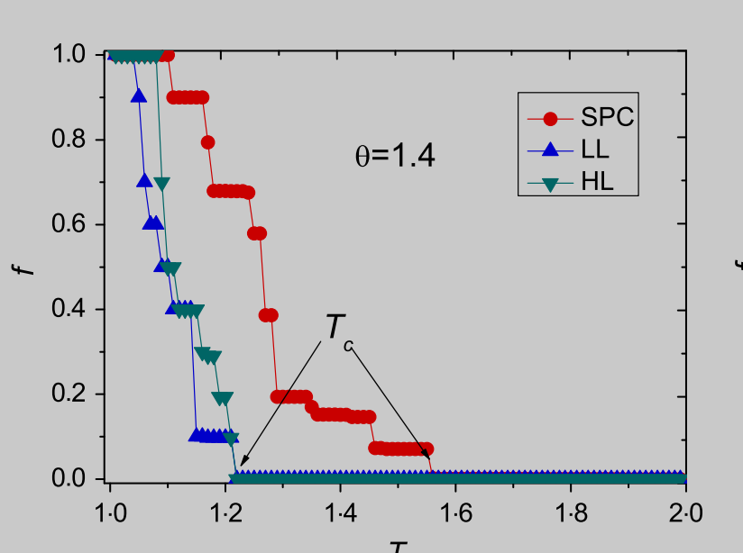
1.1 attack
This just show the final result of the simulation

Slide 3
1.1 attack
But, As far as I know, the collapse simulation is a process of iteration. For our paper, we can show this iteration process. This this is the original point of us
Moreover, we can do the node attack and the edge attack perhaps( but do the edge attack first
node attack: generator, costume, 变电站

Slide 4
1.2 recorver
For the recorver, we can focus on how to slow down
the process of iteration. in the previous. the collase of each iteration will produce a graph. then for the recorver. the input is the collapse graph of each iteration, and output the recovererd graph.
recorvery can't start from the begin of attack
when start recorver

Slide 5
2. Imporrtant point
1. selltle down the data format between the recorver and attack model
2. finish the load model

