Slide 1


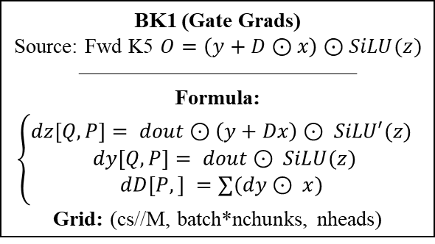


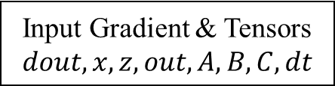
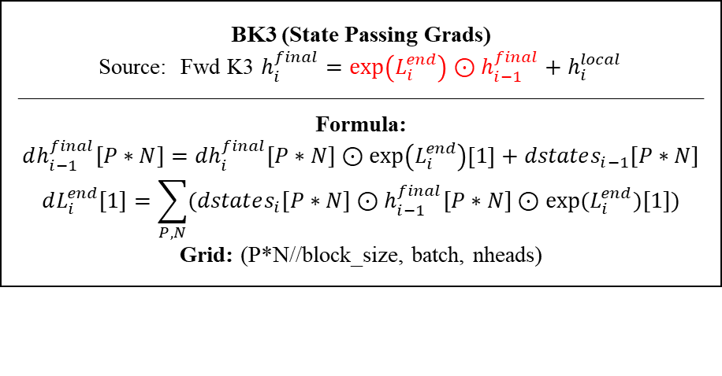

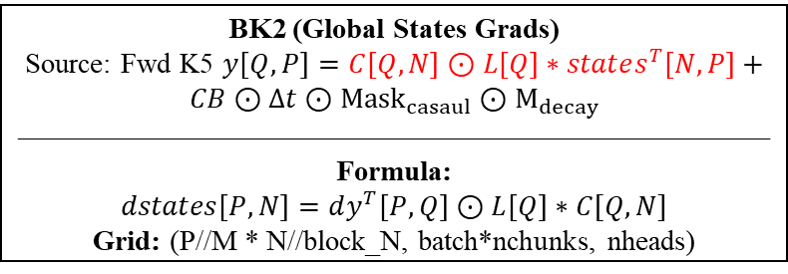



Input Gradient & Tensors
$$dout, x, z, out, A, B, C, dt$$
Forward Replay (To save memory)
Recompute:
L, dt
Shape: [batch, nchunks, nheads, cs]
Recompute:
states
Shape: [batch, nchunks, nheads, head_dim, d_state]
Recompute:
CB
Shape: [batch, nchunks, ngroups, cs, cs]
$$h_{i−1}^{final}$$
$$y_{i−1}$$
BK2 (Global States Grads)
Source: Fwd K5 $y\left[Q,P\right]=C\left[Q,N\right]⊙L\left[Q\right]∗states^{T}\left[N,P\right]+CB⊙Δt⊙{Mask}_{casaul}⊙M_{decay}$
——————————————————————————
Formula:
$$dstates\left[P,N\right]=dy^{T}\left[P,Q\right]⊙L\left[Q\right]∗C[Q,N]$$
Grid: (P//M * N//block_N, batch*nchunks, nheads)
BK1 (Gate Grads)
Source: Fwd K5 $O=\left(y+D⊙x\right)⊙SiLU(z)$
—————————————
Formula:
$$\left\{\begin{aligned}dz[Q,P]= dout⊙\left(y+Dx\right)⊙ SiLU′(z) \\ dy[Q,P]= dout⊙ SiLU(z) \\ dD[P,] =∑(dy⊙ x) \end{aligned}\right.$$
Grid: (cs//M, batch*nchunks, nheads)
$$dstates$$
$$dy$$
$$h_{i}^{final}$$
$$y_{i}$$
BK3 (State Passing Grads)
Source: Fwd K3 $h_{i}^{final}=\exp\left(L_{i}^{end}\right)⊙h_{i−1}^{final}+h_{i}^{local}$
——————————————————————————————
Formula:
$$dh_{i−1}^{final}[P∗N]={dh}_{i}^{final}[P∗N]⊙\exp\left(L_{i}^{end}\right)\left[1\right]+dstates_{i−1}[P∗N]$$
$$dL_{i}^{end}[1]=\sum_{P,N}{(dstates_{i}[P∗N]⊙h_{i−1}^{final}[P∗N]⊙exp⁡(L_{i}^{end})[1])}$$
Grid: (P*N//block_size, batch, nheads)
BK4 (Input Grads)
Source: Fwd K2 & K5
$$\left\{\begin{aligned}h_{i}^{final}[P,N]=\exp\left(L_{i}^{end}\right)⊙h_{i−1}^{final}+B_{i}[Q,N]⊙\exp\left(L_{i}^{end}−L_{i}\right)\left[Q,\right]∗U_{i}[Q,P] \\ y_{i}\left[Q,P\right]=C⊙L∗states^{T}+CB\left[Q,Q\right]⊙{Mask}_{casaul}⊙M_{decay}[Q,Q]∗U_{i} [Q,P]\end{aligned}\right.$$
$$\left\{\begin{aligned}U_{i}\left[Q,P\right]=Δt_{i}[Q,]⊙x_{i}[Q,D] \\ O=\left(y+D⊙x\right)⊙SiLU(z)\end{aligned}\right.$$
—————————————————————————————————————
Formula:
$$\left\{\begin{aligned}Part1:dU_{i}\left[Q,P\right]=B_{i}\left[Q,N\right]⊙\exp\left(L_{i}^{end}−L_{i}\right)\left[Q,\right]∗{\left(dh_{i}^{final}\right)}^{T}[N,P] \\ Part2:dU_{i}\left[Q,P\right]={\left(CB⊙{Mask}_{casaul}⊙M_{decay}\right)}^{T}\left[Q,Q\right]∗dy_{i}[Q,P]\end{aligned}\right.$$
$$dx_{i}\left[Q,P\right]=dU_{i}\left[Q,P\right]⊙Δt_{i}\left[Q,\right]+dy_{i}\left[Q,P\right]⊙D\left[1\right]$$
$$dD=∑\left(dy∗x\right)$$
$$dΔt_{i}\left[Q,\right]=\sum_{P}{dU_{i}\left[Q,P\right]⊙x_{i}[Q,P]}$$
Griid: (Q//M * P//N, batch*nchunks, nheads)
$$dh_{i}^{final}$$

