Slide 1

Introduction to ASP.NET Core
#02#
Design by: TEDU
Trainer: Bach Ngoc Toan
Website: www.tedu.com.vn
Facebook: fb.com/teduchannel
Please like videos and subscribe TEDU Channel to following the next video.

Slide 2
What is ASP.NET Core
ASP.NET Core is a collection of libraries that form a Framework for building web applications.
ASP.NET Core is not the next version of the ASP.NET. It is the brand new version written from scratch. It has a number of architectural changes that result in a much leaner and modular framework.
ASP.NET Core can run on both .NET Core or full .NET Framework.

Slide 3
What is .Net Core
The .NET Core is a runtime. It is a complete redesign of .NET Framework.
The main design goal of the .NET Core is to support developing cross-platform .NET applications.
It is supported on Windows, Mac OS & Linux.
.NET Core is an Open Source Framework maintained by Microsoft and the .NET community on GitHub
The .NET Core is a subset of Full .NET Framework. WebForms, Windows Forms, WPF are not part of the .NET Core
It implements .NET Standard specification.

Slide 4
What is .NET Standard
The .NET Standard is a formal specification of .NET APIs that are intended to be available on all .NET implementations.
It defines a uniform set of rules that need to be followed across all .NET implementations
You can read more about .NET Standard from here

Slide 5
Difference between .NET Core Vs .NET Framework
.NET Framework is older runtime which existed in windows for many years.
The .NET Core supports the subset of features supported by the .NET Framework. The features like WebForms, WindowsForms, WPF are unlikely to make into the .NET Core
.Net Framework Only runs on windows. .NET Core applications can run on any platform

Slide 6
ASP.NET Core
The Core word in ASP.NET core is very misleading
The name suggests that the ASP.NET Core applications can only be built on .NET Core, which is wrong.
ASP.NET Core web application can be developed using .NET Core or .NET Framework.
The ASP.NET Core application built using the .NET Core runtime can run on any OS, while those built using .NET Framework can run only in Windows

Slide 7
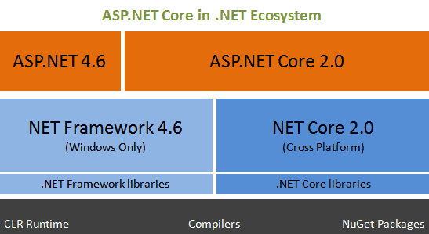
Ecosystem

Slide 8
Important Features of ASP.NET Core
You can build and run cross-platform ASP.NET apps on Windows, Mac and Linux (Open source and community focused
ASP.NET Core Unifies MVC & Web API.
Ability to host on IIS or self-host in your own process.
Built-in Dependency Injection.
Easy integration with client-side frameworks like Angular, Knockout etc.
An Environment based configuration system.
New light-weight and modular HTTP request pipeline.
Built on .NET Core, which supports true side-by-side app versioning.
Ships entirely as NuGet packages.

Slide 9
Important difference Between ASP.NET and ASP.NET Core
ASP.NET | ASP.NET CORE
Current Version 4.6 | Current Version 2.0
Legacy version | The complete redesigned version of ASP.NET
Runs on Dot Net Framework | Runs on both Dot Net Core/Dot Net Framework
Runs Only on Windows | Runs on all Platforms if you are using Dot Net Core
Stable version with Rich Features. | Not All the Features are not available. But it is expected to be added in the future releases
WebForms are supported | WebForms will not be supported
Bulky. System.web.dll | Smaller, leaner and Modular
Proprietary to Microsoft | ASP.NET Core is Open Source

