Slide 1
Lock-free red-black tree based CFS scheduler
2016 ECE/CS 5510 Multiprocessor Programming
Mincan Cao micao@vt.edu,
Ho-Ren Chuang horenc@vt.edu

Slide 2
Outline
Lock-free RB-tree
RB-tree based Linux-like CFS simulator
Conclusion

Slide 3
Outline
Lock-free RB-tree
RB-tree based Linux-like CFS simulator
Conclusion

Slide 4
Red-Black Tree
11
2
14
Red-Black Properties:
Every node is either red or black
Every leaf(NULL) is black
If a node is red, then both its children are black
Every simple path from a node to a descendant leaf contains the same number of black nodes
1
7
15
5
8
https://www.cs.auckland.ac.nz/software/AlgAnim/red_black.html

Slide 5
Red-Black Tree
Rotation Operation
Order of the nodes :
A -> x -> B -> y -> C
y
Right rotation
x
C
A
x
y
Left rotation
A
B
C
B
https://www.cs.auckland.ac.nz/software/AlgAnim/red_black.html

Slide 6
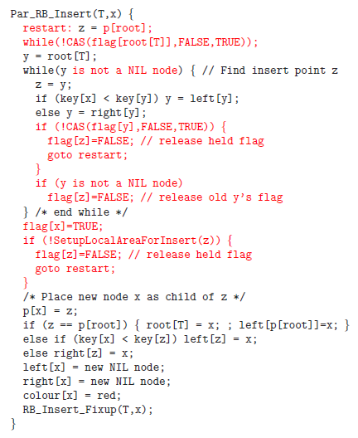
Red-Black Tree Lock-free insertion
We modified Kim’s method
Remove flag setup when searching insertion position
Set up Local area from bottom-up
Kim, Jong Ho, Helen Cameron, and Peter Graham. "Lock-free red-black trees using cas." Concurrency and Computation: Practice and Experience(2006): 1-40.

Slide 7
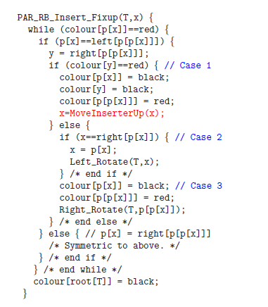
Red-Black Tree Lock-free insertion
x = MoveInsertUp(x) replaces x=x.parent.parent
Release all the flags at the end

Slide 8
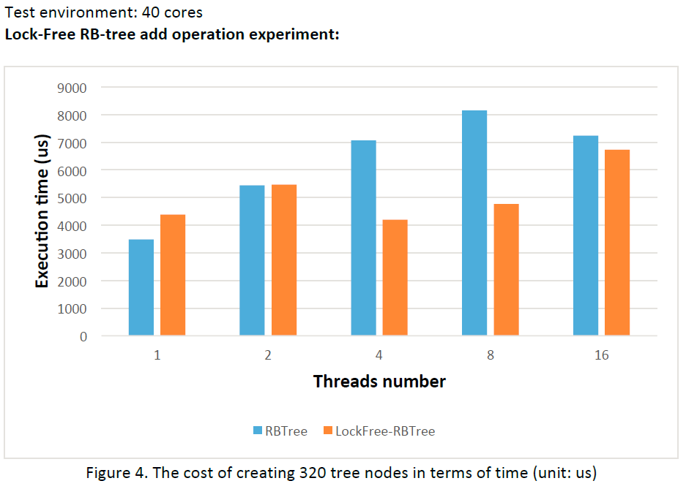
Experiment Result
Test environment: 40 cores machine

Slide 9
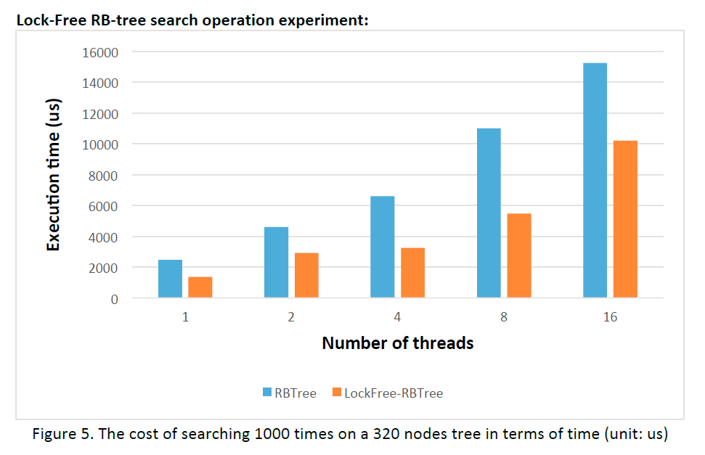
Experiment Result
Test environment: 40 cores machine

Slide 10
Outline
Lock-free RB-tree
RB-tree based Linux-like CFS simulator
Conclusion

Slide 11
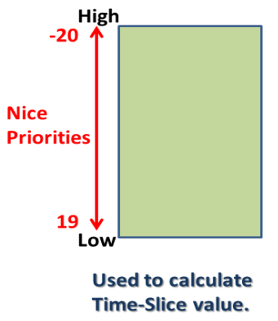
Complete Fairness Scheduler (CFS)
Scheduler
Allocate CPU resources to tasks
Problems?
Different types of tasks
Solutions
virtual runtime += time slice (changed by priority and nice value)
More problems?
Time slice granularity, group, new task, … and so on
More solutions
Min. granularity, per-process sched, least vruntime, ... and so on
Notes:
CFS->concurrent object queu
Time slice is not a fixed value, according to nice -> diff CPU proportion
Linux CFS vruntime formula
/* delta: how long process really runs, the time a process has the CPU resource to it release the resource */
/* weight: based on 10% rule, roughly equivalent to 1024 * (1.25)^(-nice)*/
vruntime += delta * (nice / weight);

Slide 12
Linux-like CFS scheduler simulator
Global runqueue
RB-tree / AVL-tree
CPU1
a task
check if time_slice is out
not out yet!
is out!
CPU2
time_slice
a task
CPU3
done
a task
CPU4
time
if start_time > global time
then enq() & re-sched()
1 thread (CPU4) keeps polling whether there is a external interrupt (e.g. new task comes)
Linux-like CFS simulator features:
Simulator features –
Timer interrupt: check if delta_exec > time_slice, enq() and then deq()
thread_exit(): when a thread finishes its jobs
thread_create() : start_time

Slide 13
Linux-like CFS scheduler simulator
Global runqueue
RB-tree / AVL-tree
CPU1
a task
check if time_slice is out
not out yet!
is out!
CPU2
time_slice
a task
CPU3
done
a task
CPU4
time
if start_time > global time
then enq() & re-sched()
1 thread (CPU4) keeps polling whether there is a external interrupt (e.g. new task comes)
Linux-like CFS simulator features:
CFS features –
Minimum granularity for a time slice
CPU resource limitation: RLIMIT_NICE
New task’s vrtime is not always 0
( Linux keeps recording a least number for each runqueue )

Slide 14
Linux-like CFS scheduler simulator
Global runqueue
RB-tree / AVL-tree
CPU1
a task
check if time_slice is out
not out yet!
is out!
CPU2
time_slice
a task
CPU3
done
a task
CPU4
time
if start_time > global time
then enq() & re-sched()
1 thread (CPU4) keeps polling whether there is a external interrupt (e.g. new task comes)
Other Linux CFS features we haven’t implemented yet:
Fork()
Group scheduling
External interrupt
Per-CPU runqueue
Real-time guarantee

Slide 15
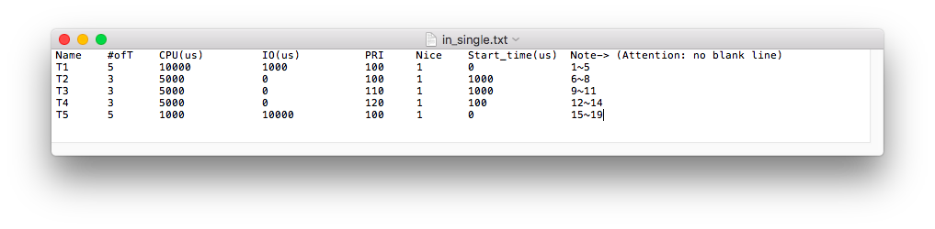
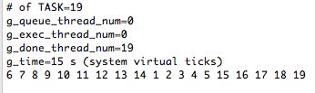
Single-threaded Linux-like CFS simulator
Test environment: 4 core laptop (hyper-threading)
User input:
CFS simulation result:
T2
high P & late
T4
low P & early
T1
CPU bound
T5
I/O bound
tasks finished order

Slide 16
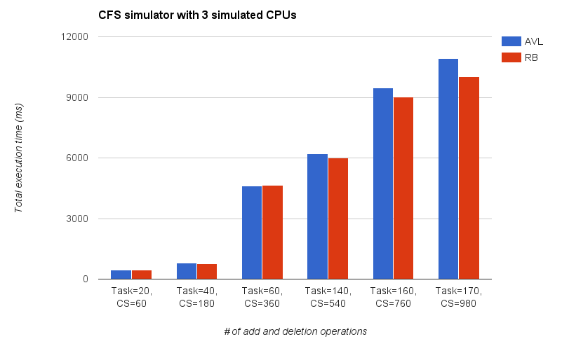
multi-threaded Linux-like CFS simulator
Test environment: 4 core laptop (hyper-threading)

Slide 17
Outline
Lock-free RB-tree
RB-tree based Linux-like CFS simulator
Conclusion

Slide 18
Conclusion
Our main contribution
Implementing/modifying AVL-tree & RB-tree
Implementing parts of lock-free RB-tree methods
(insertion - partially working, search - fully working)
Implementing Linux-like CFS simulators
(single-threaded and ideal version, multi-threaded and concurrent version)
Lessons we learn
Lock-free data structure is extremely hard to debug
What is fair from Linux point of view
Different concurrent data structures based CFS

Slide 19
Reference
[1] Molnar, Ingo. "Modular scheduler core and completely fair scheduler [cfs]."Linux-Kernel mailing list (2007).
[2] Kim, Jong Ho, Helen Cameron, and Peter Graham. "Lock-free red-black trees using cas." Concurrency and Computation: Practice and Experience(2006): 1-40.
[3] Love, Robert. Linux system programming: talking directly to the kernel and C library. " O'Reilly Media, Inc.", 2013.
[4] Jianwen Ma. Lock-Free Insertions on Red-Black Trees. MSc thesis, University of Manitoba, October,2003.
[5] Natarajan, Aravind, Lee H. Savoie, and Neeraj Mittal. "Concurrent wait-free red black trees." Symposium on Self-Stabilizing Systems. Springer International Publishing, 2013.
[6] The university of Auckland, Computer Science, Data Structures and Algorithms Course https://www.cs.auckland.ac.nz/software/AlgAnim/red_black.html

Slide 20
Q & A
Thanks for your attention

Slide 21
Linux-like CFS scheduler simulator
Global runqueue
RB-tree / AVL-tree
CPU1
a task
check if time_slice is out
not out yet!
is out!
CPU2
time_slice
a task
CPU3
done
a task
CPU4
time
if (start_time > global time)
then enq() & re-sched()
1 thread (CPU4) keeps polling whether there is a external interrupt (e.g. new task comes)
enqueue()
Picture for README.md

