Slide 1
文件-新建-源代码
运行-编译运行-保存文件（选择C source files*.c）
test.c

Slide 2

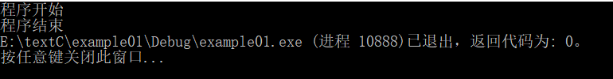
第一节课打印一些字
#include<stdio.h>
int main()
{
printf("程序开始");
printf("\n");
printf("程序结束");
getchar();
return 0;
}
#include<stdio.h>
int main()
{
printf("程序开始");
printf("\n");
printf("程序结束");
//getchar();
return 0;
}

Slide 3
变量的声明
#include<stdio.h>
int main()
{
int a;//%d
char b;//%c
float c;//%f
double d;//%f
a = 520;
b='F';
c=3.14;
d=3.1415926;
printf("变量a的值%d\n",a);
printf("变量b的值%c\n",b);
printf("变量c的值%.2f\n",c);
printf("变量d的值%11.8f\n",d);
return 0;
}
声明变量
int a
char b
float c
double d
#include <stdio.h>
int main()
{
printf("整形输入%d\n", 1 + 2.0);
printf("浮点型输出%f\n", 1.0 + 2.0);
return 0;
}
常用标识符：
%d 整型
%ld 长整型
%c 字符
%s 字符串
%f 浮点
%.2f 精度两位小数
%lf 长浮点
系统默认会把1+2.0转换成1.0+2.0
但是结果是3.0浮点类型，被转换成整型%d
所以会报错，就是0
解决方案：
printf("整形输入%d\n",1+(int)2.0);
Notes:
%d代表 十进制整形数据显示
%ld 十进制长整形
%c代表字符数据显示
%.2f精确到小数点后二位
%11f一共有11位包括.
%11.9f小数点后有9位
%s标识字符串
%f 浮点型
%i 则可以匹配八进制、十进制、十六进制表示的整数

Slide 4
布尔值
#include<stdio.h>
#include<stdbool.h>
int main()
{
int score = 588;
bool lieshizinv = true;
bool taiwan = false;
bool jianmeicao = true;
int add = 0;
if (lieshizinv) {
add += 20;
}
if (taiwan) {
add += 20;
}
printf("加分值 %d\n", add);
printf("退出程序");
getchar();
return 0;
}
#include<stdio.h>
#include<stdbool.h>
int main()
{
bool sex =true;//1,男，0女
bool is_late = false;//1,男，0女
printf("数值%d\n", sex);
printf("数值%d\n", is_late);
getchar();
return 0;
}

Slide 5
常量
#include<stdio.h>
#define TITLE "曹老师课堂"
#define YEAR 2020
#define MONTH 8
#define DAY 11
int main()
{
printf("大家好，欢迎来到%s,今天是%d年%d月%d日", TITLE, YEAR, MONTH, DAY);
getchar();
return 0;
}

Slide 6
打印各个变量的值及在内存中的大小
printf("size of int is %d\n", sizeof(int));
printf("size of char is %d\n", sizeof(char));
printf("size of float is %d\n", sizeof(double));
printf("size of float is %d\n", sizeof(float));
printf("\n");
printf("size of i is %d\n", sizeof(i));
printf("size of j is %d\n", sizeof(j));
printf("size of k is %d\n", sizeof(k));
printf("size of k is %d\n", sizeof(e));
printf("\n");
printf("i is %d\n", i);
printf("j is %c\n", j);
printf("k is %lf\n", k);
printf("e is %f\n", e);
printf("\n");
printf("k is %.9lf\n", k);
printf("e is %.9f\n", e);
getchar();
return 0;
#include<stdio.h>
int main()
{
int i;
char j;
double k;
float e;
i = 123;
j = 'C';
k = 3.1415926;
e = 3.1415926;
}

Slide 7
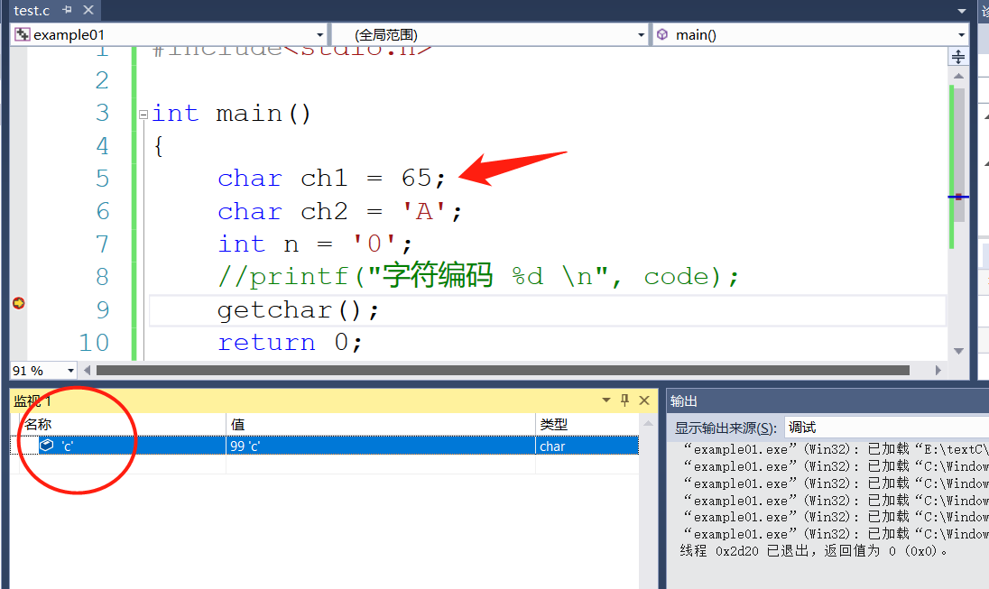
#include<stdio.h>
int main()
{
char ch1 = 'a';
char ch2 = 'A';
char ch3 = '0';
char ch4 = '*';
int code = (int)ch1;
printf("字符编码 %d \n", code);
getchar();
return 0;
}
字符与内存的关系，与整型的关系
Notes:
#include<stdio.h>
int main()
{
char ch1 = 'a';
char ch2 = 'A';
char ch3 = '0';
char ch4 = '*';
int code = (int)ch1;
printf("字符编码 %d \n", code);
getchar();
return 0;
}

Slide 8
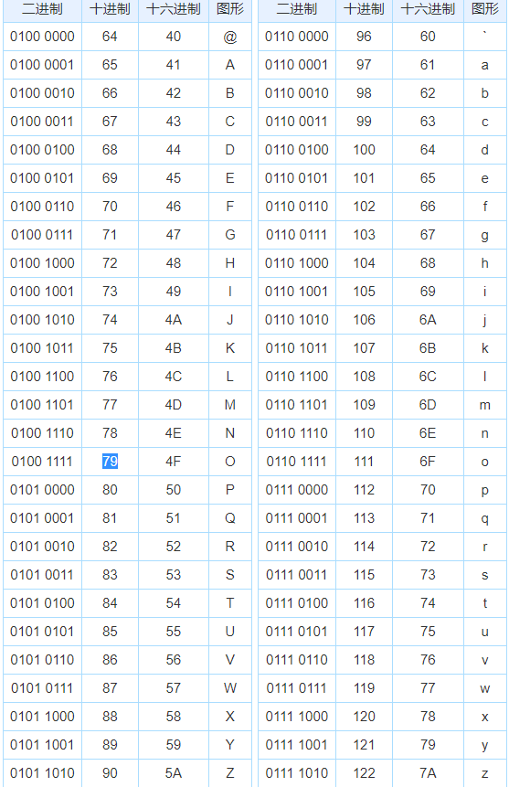
字符与内存的关系，与整型的关系
#include <stdio.h>
int main()
{
char a = 72, b = 69, c = 76, d = 76, e = 79;
printf("%c %c %c %c %c\n", a, b, c, d, e);
getchar();
return 0;
}

Slide 9
#include<stdio.h>
int main()
{
int score = 90;
if (score>90) {
printf("非常好");
}
else if (score>80) {
printf("还不错");
}
else if (score > 70) {
printf("加油~继续努力");
}
else if (score > 60) {
printf("刚好及格哦");
}
else {
printf("加油~马上就及格喽");
}
printf("\n退出程序");
getchar();
return 0;
}
#include<stdio.h>
int main()
{
int score = 90;
if (score>90) {
printf("非常好");
}
if (score>80 && score <= 70) {
printf("还不错");
}
if (score > 70 && score < 60) {
printf("加油~继续努力");
}
if (score == 60) {
printf("刚好及格哦");
}
if(score < 60)
{
printf("加油~马上就及格喽");
}
printf("%d\n", score);
printf("\n退出程序");
getchar(); return 0;
}
if判断
Notes:
#include<stdio.h>
int main()
{
int score = 90;
if (score>90) {
printf("非常好");
}
else if (score>80) {
printf("还不错");
}
else if (score > 70) {
printf("加油~继续努力");
}
else if (score > 60) {
printf("刚好及格哦");
}
else {
printf("加油~马上就及格喽");
}
printf("\n退出程序");
getchar();
return 0;
}
===========
#include<stdio.h>
int main()
{
int score = 90;
if (score>90) {
printf("非常好");
}
if (score>80 && score <= 70) {
printf("还不错");
}
if (score > 70 && score < 60) {
printf("加油~继续努力");
}
if (score == 60) {
printf("刚好及格哦");
}
if(score < 60)
{
printf("加油~马上就及格喽");
}
printf("%d\n", score);
printf("\n退出程序");
getchar();
return 0;
}

Slide 10
for循环
#include<stdio.h>
int main()
{
int result = 0;
int i;
for (i = 0; i <= 100;i++) {
result += i;
}
printf("%d\n", result);
getchar();
return 0;
}
#include<stdio.h>
int main()
{
for (int i = 0; i <= 100;i++) {
if (i%3==0) {
printf("%d\n", i);
}
}
getchar();
return 0;
}

Slide 11
#include<stdio.h>
int main()
{
for (int i = 0; i <= 100;i++) {
printf("%d\n", i);
if (i>=5) {
break;
}
}
getchar();
return 0;
}
break;continue;
#include<stdio.h>
int main()
{
for (int i = 0; i <= 20;i++) {
if (i%4==0) {
continue;
}
printf("%d\n", i);
}
getchar();
return 0;
}
Notes:
#include<stdio.h>
int main()
{
for (int i = 0; i <= 100;i++) {
printf("%d\n", i);
if (i>=5) {
break;
}
}
getchar();
return 0;
}

Slide 12
for 循环的多样性
#include<stdio.h>
int main()
{
int i = 1;
for (; i <= 10;i++) {
printf("%d\n", i);
}
getchar();
return 0;
}
#include<stdio.h>
int main()
{
int i = 1;
for (i=1;;i++) {
printf("%d\n", i);
if (i>=10) {
break;
}
}
getchar();
return 0;
}
#include<stdio.h>
int main()
{
for (int i = 1; i <= 10;i++) {
printf("%d\n", i);
}
getchar();
return 0;
}
#include<stdio.h>
int main()
{
int i = 1;
for (i=1;;) {
printf("%d\n", i);
if (i>=10) {
break;
}
i++;
}
getchar();
return 0;
}

Slide 13
#include<stdio.h>
int main()
{
int i = 1;
for (;;) {
printf("%d\n", i);
if (i>=10) {
break;
}
i++;
}
getchar();
return 0;
}

Slide 14
#include<stdio.h>
int main()
{
int i = 1;
while (i<=10) {
printf("%d\n",i);
i++;
}
getchar();
return 0;
}
while循环
#include<stdio.h>
int main()
{
int i = 1;
while (1==1) {
printf("%d\n",i);
if (i==10) {
break;
}
i++;
}
getchar();
return 0;
}
#include<stdio.h>
int main()
{
int i = 1;
while (1) {
printf("%d\n",i);
if (i==10) {
break;
}
i++;
}
getchar();
return 0;
}

Slide 15
#include<stdio.h>
int main()
{
int a[30];
int b[30] = { 0 };
int c[30] = { 98,99,100};
getchar();
return 0;
}
#include<stdio.h>
int main()
{
int a[4];//定义一个数组长度为4
a[0] = 90;//a数组的第0号位置的值为90
a[3] = 80;//a数组的第3号位置的值为80
printf("%d,%d", a[0], a[3]);
getchar();
return 0;
}
数组
#include<stdio.h>
int main()
{
int a[4] = { 5,12,9,8};
for (int i = 0; i < 4;i++) {
printf("result: %d\n", a[i]);
}
getchar();
return 0;
}
#include<stdio.h>
int main()
{
int a[4] = { 5,12,9,8};
int result = a[1] + a[2];
printf("result: %d\n", result);
getchar();
return 0;
}

Slide 16
#include<stdio.h>
int main()
{
int a[8] = { 5,12,9,8};
a[4] = a[3];
a[3] = a[2];
a[2] = a[1];
a[1] = 16;//把16插入数组第二位
for (int i = 0; i < 8;i++) {
printf("新数组为%d\n", a[i]);
}
getchar();
return 0;
}
#include<stdio.h>
int main()
{
int a[4] = { 5,12,9,8};
int temp = a[0];
a[0] = a[3];
a[3] = temp;
for (int i = 0; i < 4;i++) {
printf("新数组为%d\n", a[i]);
}
getchar();
return 0;
}

Slide 17
#include<stdio.h>
int main()
{
int count = 10;//声明一个整型变量count值为10，内存位置为 00AFFECC
int* ptr = &count;//声明一个指针整型变量ptr值为count内存位置名称，内存位置为 010FFB20
//%p 打印内存地址
printf("address: %p \n", &count);//打印count的内存位置名称
printf("address: %p \n", &ptr);//打印ptr的内存位置名称
printf("address: %p \n", ptr);//打印ptr指向的内存位置
printf("%d \n", *ptr);//打印ptr指向的内存位置的值
*ptr = 11;
printf("\n");
printf("address: %p \n", &count);//打印count的内存位置名称
printf("address: %p \n", &ptr);//打印ptr的内存位置名称
printf("address: %p \n", ptr);//打印ptr指向的内存位置
printf("%d \n", *ptr);//打印ptr指向的内存位置的值
printf("\n %d", count);
getchar();
return 0;
}
指针

Slide 18
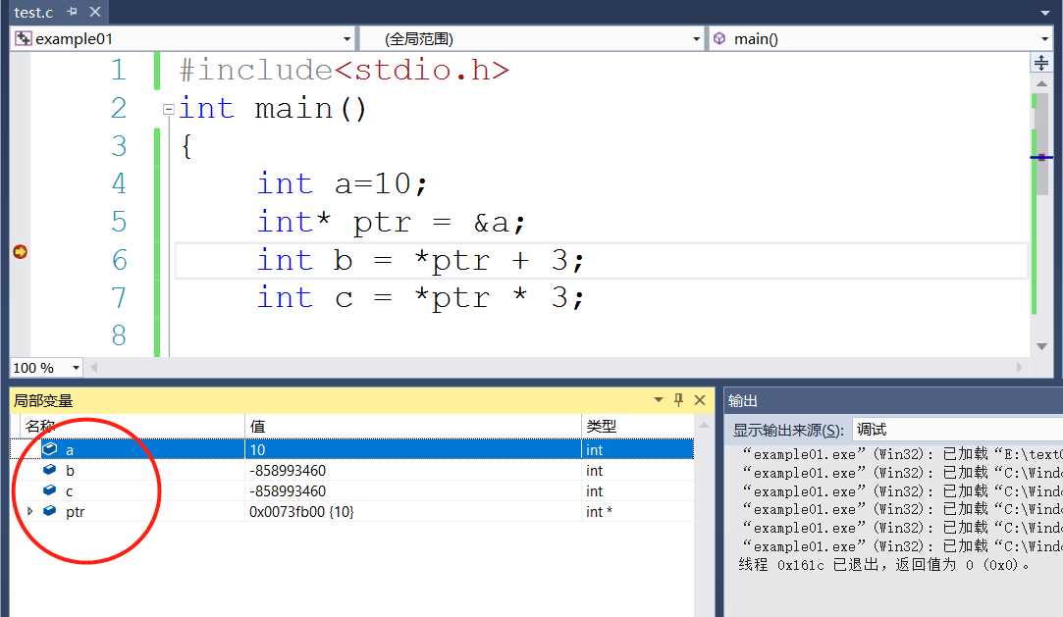
指针运算
#include<stdio.h>
int main()
{
int a = 10;
int* ptr = &a;
int b = *ptr + 3;
int c = *ptr * 3;
printf("%d,===,%d",b,c);
getchar();
return 0;
}

Slide 19
指针数组运算
#include<stdio.h>
int main()
{
int a[4] = { 12,9,32,8 };
int* ptr = a;//指针等于数组名相当于ptr就是数组a
ptr[0] = 14;//更方便使用ptr去修改数组中的元素
ptr[1] = 55;
for (int i =0;i<4;i++)
{
printf("%d\n",ptr[i]);
}
getchar();
return 0;
}
#include<stdio.h>
int main()
{
int a[4] = { 12,9,32,8 };
int* ptr = a+2;//指针等于数组名相当于ptr就是数组a
ptr[0] = 14;//更方便使用ptr去修改数组中的元素
ptr[1] = 55;
for (int i =0;i<4;i++)
{
printf("%d\n",ptr[i]);
}
getchar();
return 0;
}

Slide 20
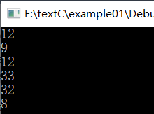
指针数组运算
#include<stdio.h>
int main()
{
int a[4] = { 12,9,32,8 };
int* p = &a[0];
printf("%d\n", *p);
p++;//向下移动，指向a[1]
printf("%d\n", *p);
*p = 33;
for (int i=0;i<4;i++)
{
printf("%d\n", a[i]);
}
getchar();
return 0;
}

Slide 21
#include<stdio.h>
int main()
{
int a[4] = { 12,9,32,8 };
int* p0 = &a[0];
int* p1 = &a[1];
#include<stdio.h>
int main()
{
int a[4] = { 12,9,32,8 };
int* p0 = &a[0];
int* p1 = &a[1];
int result = p1 - p0;//元素1-元素0=相差个数 结果为1
printf("%d\n", result);
getchar();
return 0;
} int result = p1 - p0;//元素1-元素0=相差个数 结果为1
printf("%d\n", result);
getchar();
return 0;
}
#include<stdio.h>
int main()
{
int a[4] = { 12,9,32,8 };
int* ptr = a + 2;
ptr[2] = 12;//a[4],越界
getchar();
return 0;
}

Slide 22
#include<stdio.h>
void report()
{
for (int i=1;i<=32;i++)
{
printf("%2d ",i);
//%2d就是将数字按照宽度为2 采用右对齐方
式输出，若数据位数不到2位，则左边补空格
if (i%10==0) {
printf("\n");
}
}
}
int main()
{
printf("报数\n");
report();
printf("再报一遍\n");
report();
getchar();
return 0;
}
void函数方法
#include<stdio.h>
void report(int N)
{
for (int i=1;i<=N;i++)
{
printf("%2d ",i);
if (i%10==0) {
printf("\n");
}
}
}
int main()
{
printf("1班报数\n");
report(32);
printf("2班报数\n");
report(46);
getchar();
return 0;
}
Notes:
#include<stdio.h>
void report()
{
for (int i=1;i<=32;i++)
{
printf("%2d ",i);
//%2d就是将数字按照宽度为2 采用右对齐方式输出，若数据位数不到2位，则左边补空格
if (i%10==0) {
printf("\n");
}
}
}
int main()
{
printf("报数\n");
report();
printf("再报一遍\n");
report();
getchar();
return 0;
}

Slide 23
方法返回值
参数
#include<stdio.h>
void test(int a,int b)//void为无返回值
{
int restult = a * a + b * b;
printf("res: %d \n", restult);
}
int main()
{
test(3, 5);
getchar();
return 0;
}
#include<stdio.h>
int test(int a,int b)
{
int restult = a * a + b * b;
return restult;
}
int main()
{
int v=test(3, 5);
printf("%d \n",v);
getchar();
return 0;
}
void triangle()
{
return;//代表直接退出函数
}

Slide 24
#include<stdio.h>
int find_max(int* arr,int size)
{
int max = arr[0];
for (int i=0;i<size;i++)
{
if (arr[i]>max)
{
max = arr[i];
}
}
return max;
}
int main()
{
int a[] = { 12,39,99,-18 };
int max = find_max(a, 4);
printf("a[]最大值为%d \n", max);
getchar();
return 0;
}
数组参数
#include<stdio.h>
int sum(int* arr, int size)
{
int result = 0;
for (int i = 0; i < size;i++) {
result += arr[i];
}
return result;
}
int main()
{
int a[] = {23,99,8,44,10,72,90,12 };
int v1 = sum(a, 3);
int v2 = sum(a+5, 3);
printf("前三项之和%d，后三项之和%d",v1,v2);
getchar();
return 0;
}
Notes:
#include<stdio.h>
int find_max(int* arr,int size)
{
int max = arr[0];
for (int i=0;i<size;i++)
{
if (arr[i]>max)
{
max = arr[i];
}
}
return max;
}
int main()
{
int a[] = { 12,39,99,-18 };
int max = find_max(a, 4);
printf("a[]最大值为%d \n", max);
getchar();
return 0;
}

Slide 25
函数声明顺序
#include<stdio.h>
double power(double a, int n);
int main()
{
double a = 2.0;
double total = a + power(a, 2) + power(a, 3);
printf("%lf\n", total);
getchar();
return 0;
}
double power(double a, int n)
{
double result = 1.0;
for (int i = 0; i < n; i++)
{
result *= a;
}
return result;
}
#include<stdio.h>
double power(double a,int n)
{
double result = 1.0;
for (int i=0;i<n;i++)
{
result *= a;
}
return result;
}
int main()
{
double a = 2.0;
double total = a + power(a, 2) + power(a, 3);
printf("%lf\n", total);
getchar();
return 0;
}
Notes:
#include<stdio.h>
double power(double a,int n)
{
double result = 1.0;
for (int i=0;i<n;i++)
{
result *= a;
}
return result;
}
int main()
{
double a = 2.0;
double total = a + power(a, 2) + power(a, 3);
printf("%lf\n", total);
getchar();
return 0;
}

Slide 26
#include<stdio.h>
int main()
{
char ch1 = 'a';
char ch2 = 'A';
char ch3 = '0';
char ch4 = '*';
int code = (int)ch1;
printf("字符编码 %d \n", code);
getchar();
return 0;
}
字符编码
#include<stdio.h>
int main()
{
char ch1 = 'a';
printf("%d", ch1);
printf("\n");
int code = (int)ch1;
printf("%d", code);
getchar();
return 0;
}
Notes:
#include<stdio.h>
int main()
{
char ch1 = 'a';
char ch2 = 'A';
char ch3 = '0';
char ch4 = '*';
int code = (int)ch1;
printf("字符编码 %d \n", code);
getchar();
return 0;
}

Slide 27
转意字符
#include<stdio.h>
int main()
{
char ch = '\'';//希望打出来一个单引号
printf("%c",ch);
getchar();
return 0;
}
#include<stdio.h>
int main()
{
char ch = ' ';//中间有个空格
getchar();
return 0;
}
#include<stdio.h>
int main()
{
printf("hello \n world!\n");
printf("书名\"c语言学习智能\" ");
getchar();
return 0;
}

Slide 28
字符串
‘a’ 在内存里就是一个字符
“a”在内存里是一个字符'a'和一个字符‘\0’
putchar() 一次只能输出一个字符
putchar()对应的是ascll码
putchar('a');
printf();输出一个字符串不能使其他
解释为什么不能像pytohn一样 直接输出变量
printf(“%d”,a);就可以了

Slide 29
字符串
#include<stdio.h>
int main()
{
char name1[32] = { 'h','e','l','l','o' };
char name2[32] = "hello";
for (int i=0;i<5;i++)
{
printf("%c", name1[i]);
}
printf("\n%s",name2);
getchar();
return 0;
}
#include<stdio.h>
int main()
{
char name[32] = { 'h','e','l','l','o' };
char name[3] = { 'h','e','l','l','o' };
getchar();
return 0;
}

Slide 30
#include<stdio.h>
int main()
{
char name[32] = "hello";
printf("内容为 %s \n", name);//s代表string
getchar();
return 0;
}
#include<stdio.h>
#include<string.h>
int main()
{
char name[32] = "hello";
strcpy_s(name, 32, "nihao");
printf("内容为 %s \n", name);//s代表string
getchar();
return 0;
}
#include<stdio.h>
#include<string.h>
int main()
{
char name[32] = "hello";
name[3]=0;//由于系统看到0判断结束导致数据丢失
printf("内容为 %s \n", name);//内容为 hel
getchar();
return 0;
}

Slide 31
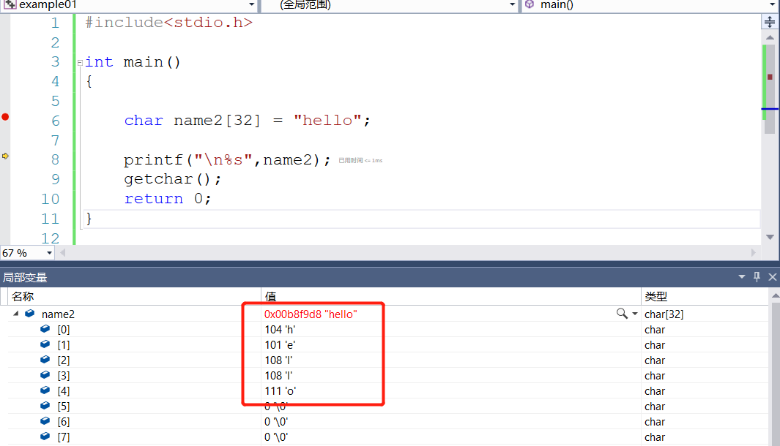
#include<stdio.h>
int main()
{
char name2[32] = "hello";
printf("\n%s",name2);
getchar();
return 0;
}

Slide 32
#include<stdio.h>
#include<string.h>
int main()
{
char name[100] = "hello";
printf("内容为 %s \n", name);
name[0] = 0;//清空字符串
printf("内容为 %s \n", name);
getchar();
return 0;
}
#include<stdio.h>
#include<string.h>
int main()
{
char name[5] = "hello";//由于没有结束符，导致系统乱码
printf("内容为 %s \n", name);
getchar();
return 0;
}
#include<stdio.h>
#include<string.h>
int main()
{
char name[100] = "hello\0nihao";//强制系统中断，结束符0
printf("内容为 %s \n", name);
getchar();
return 0;
}

Slide 33
字符串指针
#include<stdio.h>
int main()
{
char name[32] = "hello";//声明一个字符串数组
char* str = name;//声明一个字符指针
printf("%c", name[0]);//打印字符串数组第0位的值
printf("\n");
printf("%c", str[0]);//打印指针目标第0位的值
printf("\n");
printf("%c", *str);//打印指针目标数组第一位
printf("\n");
while (*str!=0)//指针数组第一位非=0
{
printf("%c", *str);//打印指针目标数组第一位
str++;//指针目标位数+1
}
getchar();
return 0;
}
#include<stdio.h>
int main()
{
char name[32] = "hello";//
char* str = name;
printf("%c", name[0]);
printf("\n");
printf("%c", str[0]);
printf("\n");
printf("%c", *str);
printf("\n");
for (int i = 0; i < 10;i++) {
printf("%c", *str);
str++;
}
getchar();
return 0;
}

Slide 37
#include<stdio.h>
#include<string.h>
int get_string_len(char* str)
{
int size = 0;
while (*str !=0)//检查是否为0
{
size++;
str++;
}
return size;
}
int get_string_len2(char* str)
{
int size = 0;
while (str[size]!=0)
{
size++;
}
return size;
}
int main()
{
char name[32] = "hello";
int len = get_string_len2(name);
printf("长度为 %d \n", len);
getchar();
return 0;
}

Slide 38
#include<stdio.h>
#include<string.h>
void copy_string(char* buffer,char* str)
{
while (*str!=0)
{
*buffer = *str;
buffer++;
str++;//偏移量使循环中的条件可以一一比对
}
*buffer = 0;//最后一个字符设为0
}
int main()
{
char name[32] = "hello";
copy_string(name, "nihao");
printf("内容为 %s \n", name);
getchar();
return 0;
}
标准C函数库提供了我们的函数
#include<string.h>
求字符串长度strlen()
求字符串拷贝srecopy_s()
求字符串拼接strcat_s()
求字符串比较strcmp()
求字符串是否包含
strster()

Slide 39
字符串输入
#include<stdio.h>
#include<string.h>
int main()
{
char buffer[1000];
gets_s(buffer, 1000);
printf("用户输入了%s \n", buffer);
getchar();
return 0;
}
#include<stdio.h>
#include<string.h>
#include<stdlib.h>
int main()
{
char buffer[1000];
gets_s(buffer, 1000);
int result = atoi(buffer);//需要引入头文件#include<stdlib.h>
//atoi 字符串转换int
printf("用户输入了整数%d \n", result);
printf("用户输入了%s \n", buffer);
getchar();
return 0;
}

Slide 40
#include<stdio.h>
#include<string.h>
#include<stdlib.h>
int main()
{
char buffer[1000];
gets_s(buffer, 1000);
int result = atoi(buffer);
double number = atof(buffer);
printf("用户输入了%s \n", buffer);
printf("用户输入了整数%d \n", result);
printf("用户输入了浮点%lf \n", number);
getchar();
return 0;
}
Notes:
#include<stdio.h>
#include<string.h>
#include<stdlib.h>
int main()
{
char buffer[1000];
gets_s(buffer, 1000);
int result = atoi(buffer);
double number = atof(buffer);
printf("用户输入了%s \n", buffer);
printf("用户输入了整数%d \n", result);
printf("用户输入了浮点%lf \n", number);
getchar();
return 0;
}

Slide 41
结构体
int main()
{
struct Student s;
s.id = 20008080;
strcpy_s(s.name,32, "张三");//不可这样写s.name = "张三";
strcpy_s(s.cellphone, 32, "13811111111");
s.sex = true;
printf("学号 %d\n",s.id);
printf("名字 %s\n", s.name);
printf("电话 %s\n", s.cellphone);
printf("性别 %d\n", s.sex);
getchar();
return 0;
}
#include<stdio.h>
#include<string.h>
#include<stdbool.h>
#include<stdlib.h>
struct Student//类
{
int id;
char name[32];
char cellphone[32];
bool sex;
};

Slide 42
int main()
{
struct Student s[30];
s[0].id = 20008080;
strcpy_s(s[0].name,32, "张三");
strcpy_s(s[0].cellphone, 32, "13811111111");
s[0].sex = true;
s[1].id = 19981220;
strcpy_s(s[1].name, 32, "澳门回归");
strcpy_s(s[1].cellphone, 32, "111111");
s[1].sex = true;
printf("学号 %d\n",s[0].id);
printf("名字 %s\n", s[0].name);
printf("电话 %s\n", s[0].cellphone);
printf("性别 %d\n", s[0].sex);
printf("学号 %d\n", s[1].id);
printf("名字 %s\n", s[1].name);
printf("电话 %s\n", s[1].cellphone);
printf("性别 %d\n", s[1].sex);
getchar();
return 0;
}
#include<stdio.h>
#include<string.h>
#include<stdbool.h>
#include<stdlib.h>
struct Student//类
{
int id;
char name[32];
char cellphone[32];
bool sex;
};
Notes:
#include<stdio.h>
#include<string.h>
#include<stdbool.h>
#include<stdlib.h>
struct Student//类
{
int id;
char name[32];
char cellphone[32];
bool sex;
};
int main()
{
struct Student s[30];
s[0].id = 20008080;
strcpy_s(s[0].name,32, "张三");
strcpy_s(s[0].cellphone, 32, "13811111111");
s[0].sex = true;
s[1].id = 19981220;
strcpy_s(s[1].name, 32, "澳门回归");
strcpy_s(s[1].cellphone, 32, "111111");
s[1].sex = true;
printf("学号 %d\n",s[0].id);
printf("名字 %s\n", s[0].name);
printf("电话 %s\n", s[0].cellphone);
printf("性别 %d\n", s[0].sex);
printf("学号 %d\n", s[1].id);
printf("名字 %s\n", s[1].name);
printf("电话 %s\n", s[1].cellphone);
printf("性别 %d\n", s[1].sex);
getchar();
return 0;
}

Slide 43
#include<stdio.h>
#include<stdbool.h>
#include<stdlib.h>
struct Student//类
{
int id;
char name[32];
char cellphone[32];
bool sex;
};
int main()
{
struct Student s;
struct Student* ps = &s;
(*ps).id = 20008080;
strcpy_s((*ps).name, 32, "张三");
strcpy_s((*ps).cellphone, 32, "13811111111");
(*ps).sex = true;
printf("学号 %d\n", (*ps).id);
printf("名字 %s\n", (*ps).name);
printf("电话 %s\n", (*ps).cellphone);
printf("性别 %d\n", (*ps).sex);
getchar();
return 0;
}
#include<stdio.h>
#include<stdbool.h>
#include<stdlib.h>
struct Student//类
{
int id;
char name[32];
char cellphone[32];
bool sex;
};
int main()
{
struct Student s;
struct Student* ps = &s;
ps->id = 20008080;
strcpy_s(ps->name, 32, "张三");
strcpy_s(ps->cellphone, 32, "13811111111");
ps->sex = true;
printf("学号 %d\n", ps->id);
printf("名字 %s\n", ps->name);
printf("电话 %s\n", ps->cellphone);
printf("性别 %d\n", ps->sex);
getchar();
return 0;
}

Slide 44
#include<stdio.h>
struct Point
{
double x;
double y;
};
struct Line
{
struct Point start;
struct Point end;
};
int main()
{
struct Line l;
//起点
l.start.x = 0;
l.start.y = 12;
//终点
l.end.x = 16;
l.end.y = 0;
printf("%lf", l.start.y);
getchar();
return 0;
}
Notes:
#include<stdio.h>
struct Point
{
double x;
double y;
};
struct Line
{
struct Point start;
struct Point end;
};
double get_line_length(struct Line* pl) {
}
int main()
{
struct Line l;
//起点
l.start.x = 0;
l.start.y = 12;
//终点
l.end.x = 16;
l.end.y = 0;
printf("%lf", l.start.y);
getchar();
return 0;
}

Slide 45
作用域
#include<stdio.h>
struct Circle
{
int x;
int y;
int radius;//半径
};
void move_to(struct Circle b,int x,int y)
{
b.x = x;
b.y = y;
}
int main()
{
struct Circle c;
c.x = 0;
c.y = 0;
c.radius = 1;
move_to(c, 12, 12);
getchar();
return 0;
}
#include<stdio.h>
void increase(int b) {
b += 1;
}
int main()
{
int a = 10;
increase(a);
printf("%d\n",a);
getchar();
return 0;
}

Slide 46
多文件组合
把项目拷贝到同目录下
源文件-添加-现有项目-ok
输入整数
Notes:
#include<stdio.h>
#include<stdbool.h>
#include<stdlib.h>
#include <string.h>
struct Student
{
int id;
char name[40];
char phone[40];
bool sex;
};
int DB_SIZE = 40;
struct Student database[40];
void db_init()
{
for (int i = 0; i < DB_SIZE; i++)
{
database[i].id = 0;
}
}
// 添加一条记录
void db_add(struct Student stu)
{
for (int i = 0; i < DB_SIZE; i++)
{
if (database[i].id == 0)
{
database[i] = stu;
break;
}
}
}
/*
struct Student get_input_student()
{
struct Student ps;
printf("学号: ");
ps.id = 2008;
char name[40];
gets_s(name, 40);
printf("名称: ");
strcpy_s(ps.name, 40, name);
char phone[40];
gets_s(phone, 40);
printf("电话: ");
strcpy_s(ps.phone, 40, phone);
printf("性别f/m: ");
char sexe[40];
gets_s(sexe, 40);
if (strcmp(sexe, "f") == 0)
{
ps.sex=true;
}
else
{
ps.sex = false;
}
return ps;
}
*/
// 查看所有记录
void db_list()
{
int count = 0;
for (int i = 0; i < DB_SIZE; i++)
{
if (database[i].id > 0)
{
count++;
struct Student* ps = &database[i];
printf("[%04d] %08d , %12s , %14s , %08d\n",
i,
ps->id,
ps->name,
ps->phone,
ps->sex);
// 注：这里 ? : 的语法叫"条件表达式" 或 "三目表达式",相当于简写的if语句
}
}
printf("共 %d 记录 \n", count);
}
int main()
{
db_init();
printf("学生管理系统");
while(1)
{
printf("\n>");
char tep[40];
gets_s(tep,40);
if (strcmp(tep,"add")==0)
{
printf("进入添加模块\n");
//struct Student stu = get_input_student();
struct Student ps;
printf("学号: ");
char id[40];
gets_s(id, 40);
ps.id = atoi(id);
printf("名称: ");
char name[40];
gets_s(name, 40);
strcpy_s(ps.name, 40, name);
printf("电话: ");
char phone[40];
gets_s(phone, 40);
strcpy_s(ps.phone, 40, phone);
printf("性别f/m: ");
char sexe[40];
gets_s(sexe, 40);
if (strcmp(sexe, "f") == 0)
{
ps.sex = true;
}
else
{
ps.sex = false;
}
db_add(ps);
}
else if (strcmp(tep, "list") == 0)
{
printf("进入查看模块\n");
db_list();
}
else if (strcmp(tep, "find") == 0)
{
printf("进入查找模块\n");
}
else if (strcmp(tep, "quit") == 0)
{
printf("退出系统\n");
break;
}
else
{
printf("输入错误请从新输入\n");
}
}
getchar();
return 0;
}

Slide 54
#include<stdio.h>
int main()
{
int a=55;
printf("16进制 ：%08x \n",a);
int b = 022;//0开头是八进制
printf("");
getchar();
return 0;
}
#include<stdio.h>
int main()
{
int a=0x2A;
int b = 42;//十六进制
printf("a=%d,b=%d\n",a,b);
getchar();
return 0;
}

Slide 55
#include<stdio.h>
int main()
{
int count=10;
int*ptr = &count;//&count取得变量的内存地址
//int*表示 int型变量的地址
//%p 打印地址
printf("address: %p \n", &count);
printf("address: %p \n",ptr);
getchar();
return 0;
}
#include<stdio.h>
int main()
{
int a=10;
int* p = &a;
printf("address: %p \n", p);
a = 0x12345678;
a = 0x55555555;
getchar();
return 0;
}
Notes:
#include<stdio.h>
int main()
{
int count=10;
int*ptr = &count;//&count取得变量的内存地址
//int*表示 int型变量的地址
//%p 打印地址
printf("address: %p \n", &count);
printf("address: %p \n",ptr);
getchar();
return 0;
}

Slide 56
指针，标识变量地址的类型
#include<stdio.h>
int main()
{
int count=10;
int* ptr = &count;
*ptr = 11;//*标识修改 修改ptr的目标 ptr的目标就是count
getchar();
return 0;
}
#include<stdio.h>
int main()
{
int count=10;
int* ptr = &count;//&count取得变量的内存地址
*ptr = 11; //内存地址010FFD88指向目标修改为11
count = 88;
getchar();
return 0;
}

Slide 57
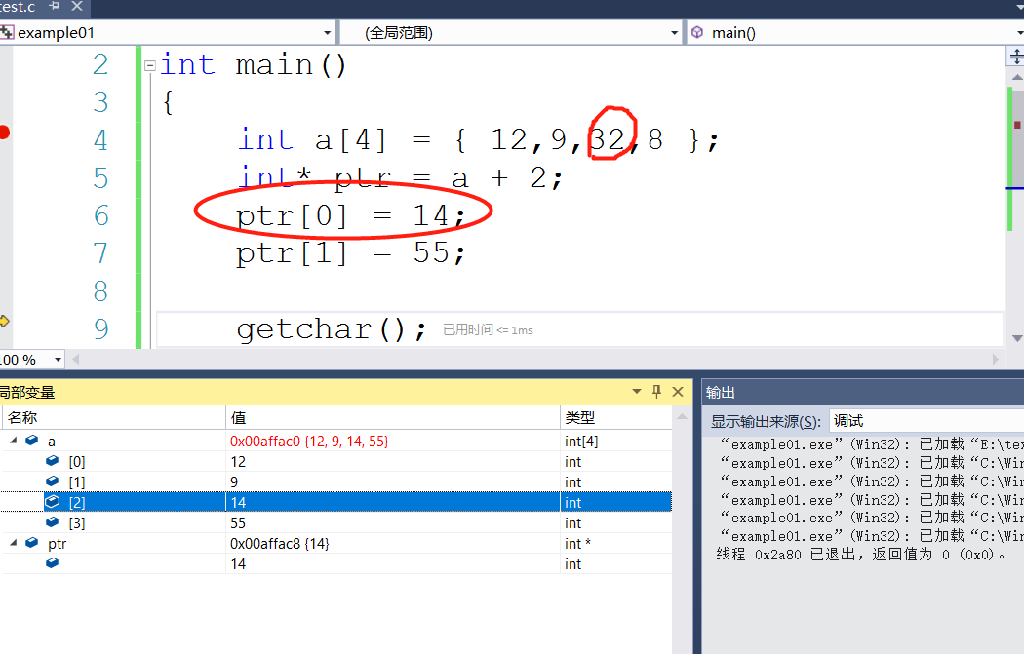
#include<stdio.h>
int main()
{
int a[4] = { 12,9,32,8 };
int* p0 = &a[0];
int* p1 = &a[1];
int result = p1 - p0;
printf("%d\n", result);
getchar();
return 0;
}
#include<stdio.h>
int main()
{
int a[4] = { 12,9,32,8 };
int* ptr = a + 2;
ptr[0] = 14;
ptr[1] = 55;
getchar();
return 0;
}

