Slide 1
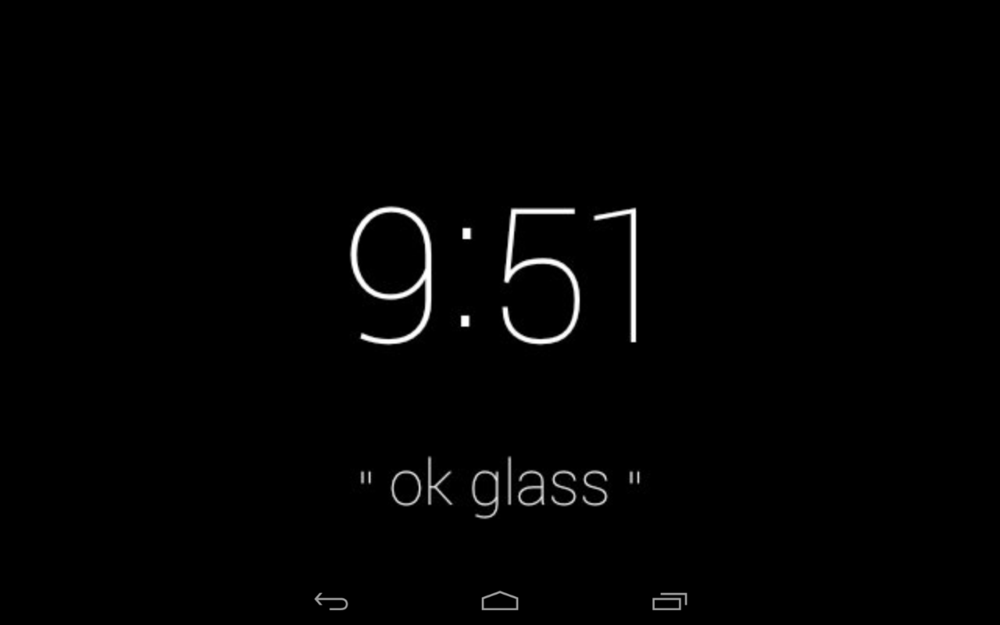
Main Screen
Single Tap

Slide 2
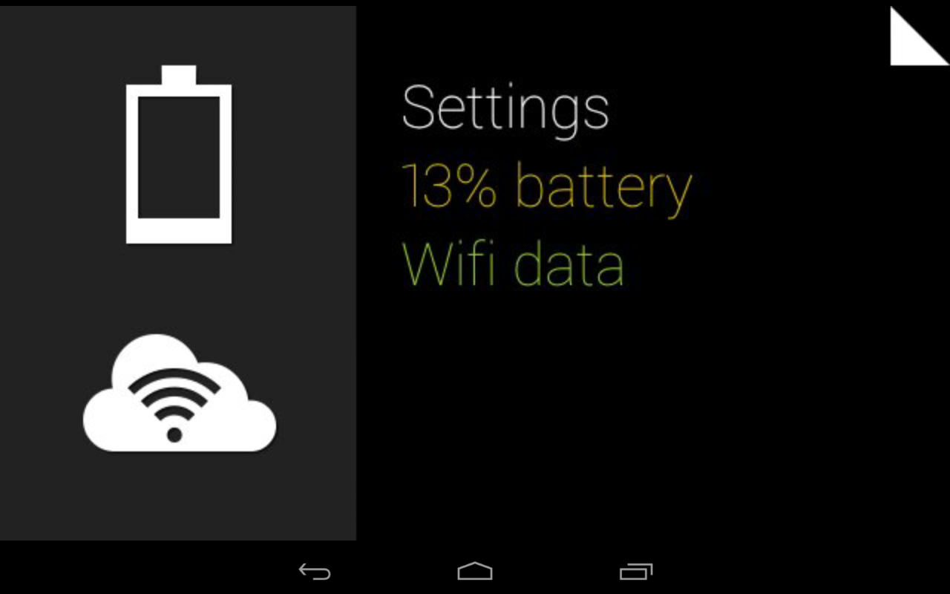
Basic Operations
Swipe
Backward
Swipe
Backward
Swipe
Forward

Slide 3

Basic Operations
Single
Click
Swipe
Backward
Swipe
Down

Slide 4

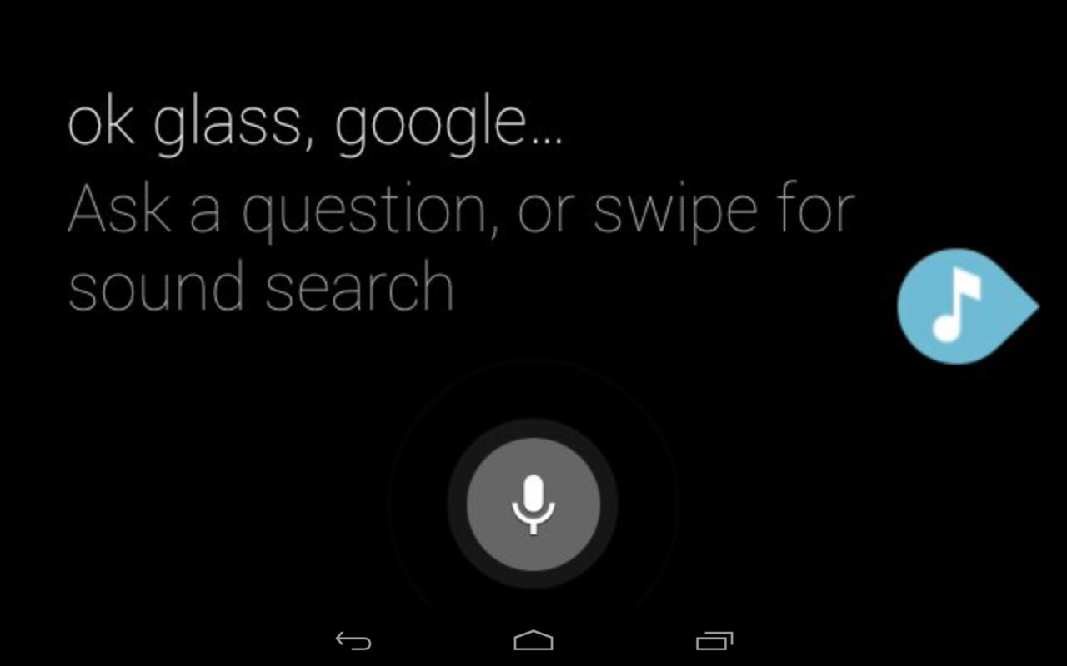
Basic Operations
Long
Hold
Swipe
Backward
Swipe
Down

Slide 5
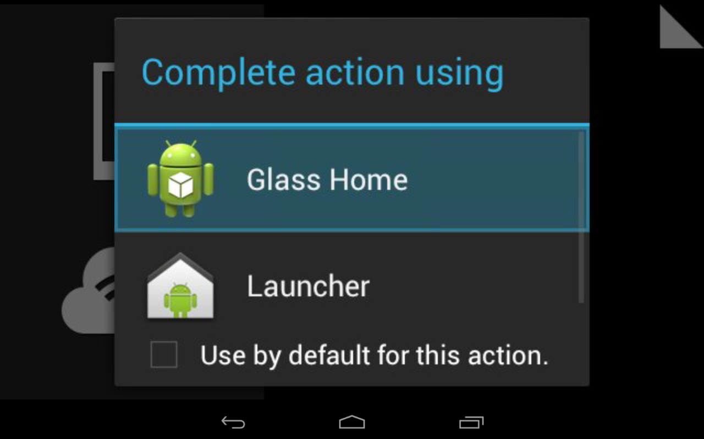
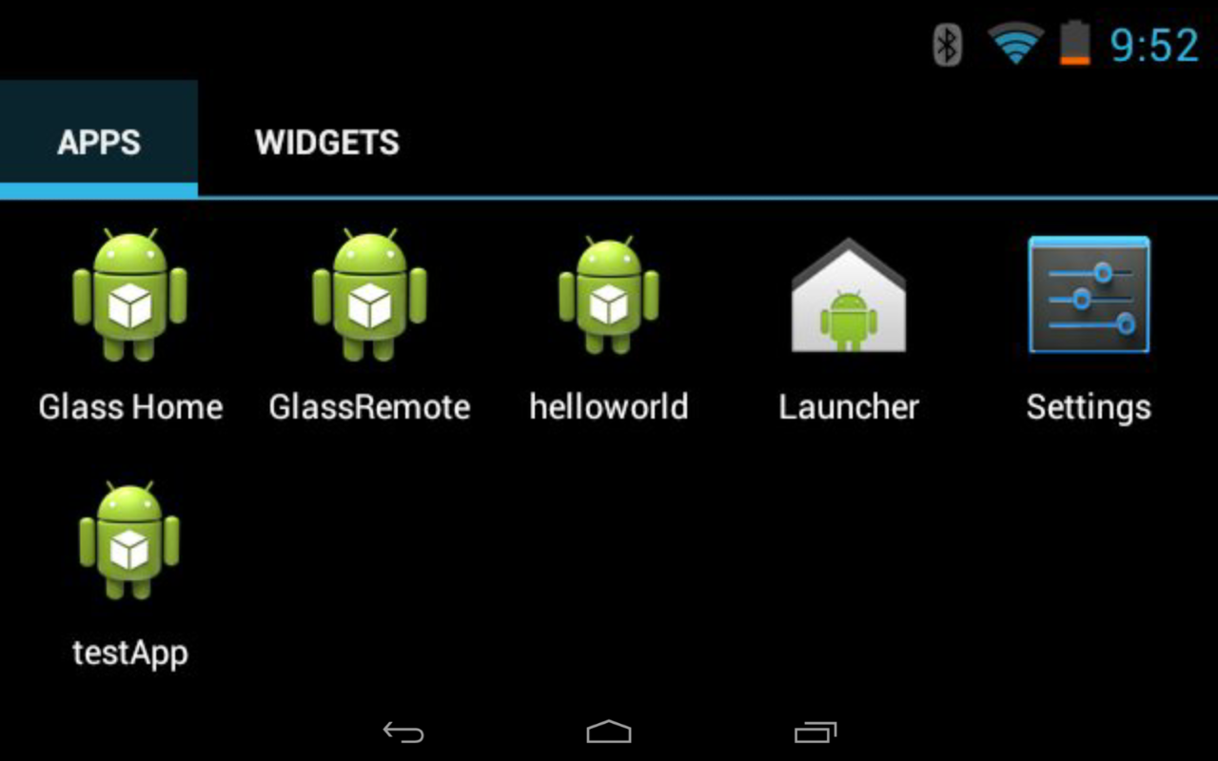

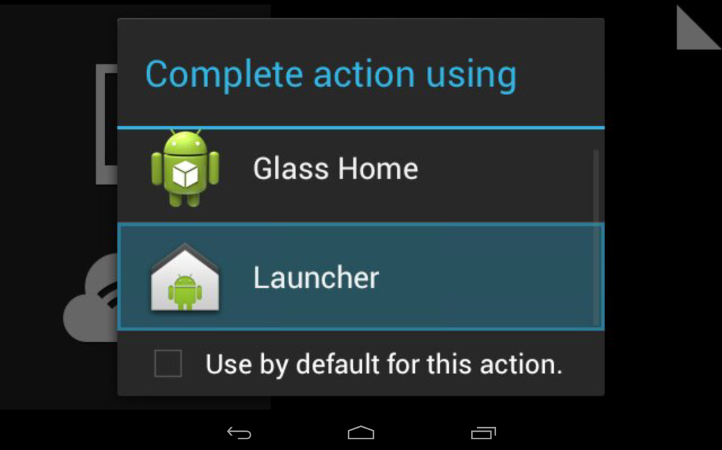
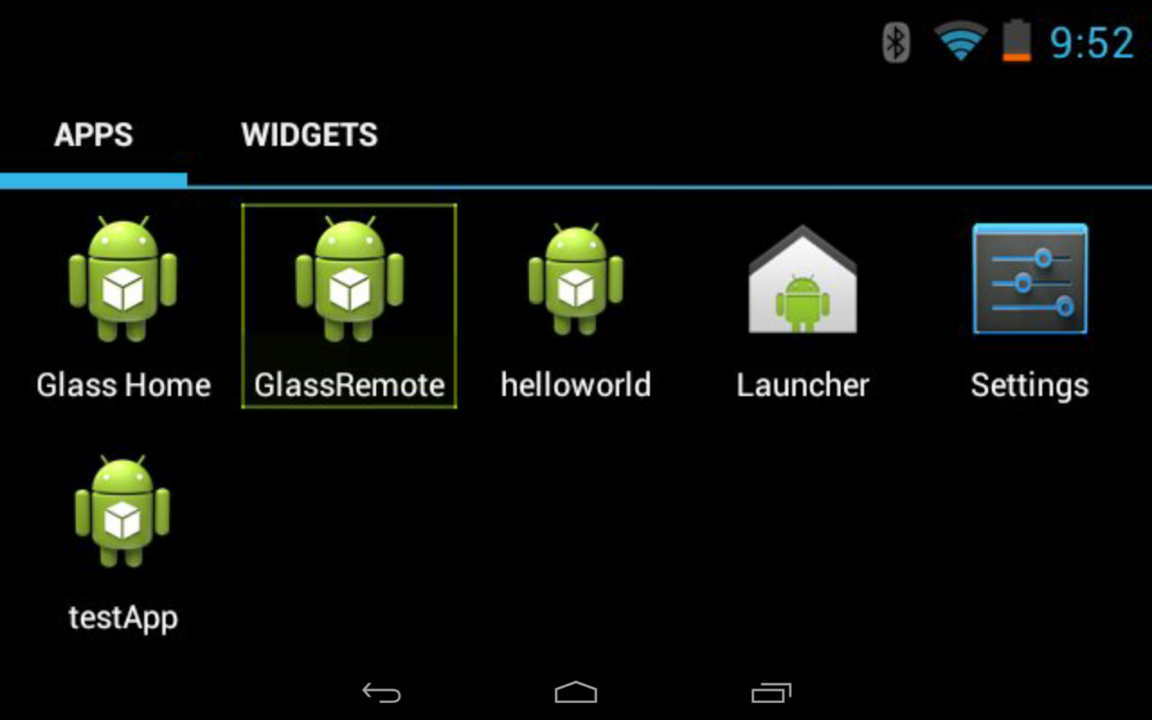
swipe
tap
swipe
tap
tap
swipe

Slide 6
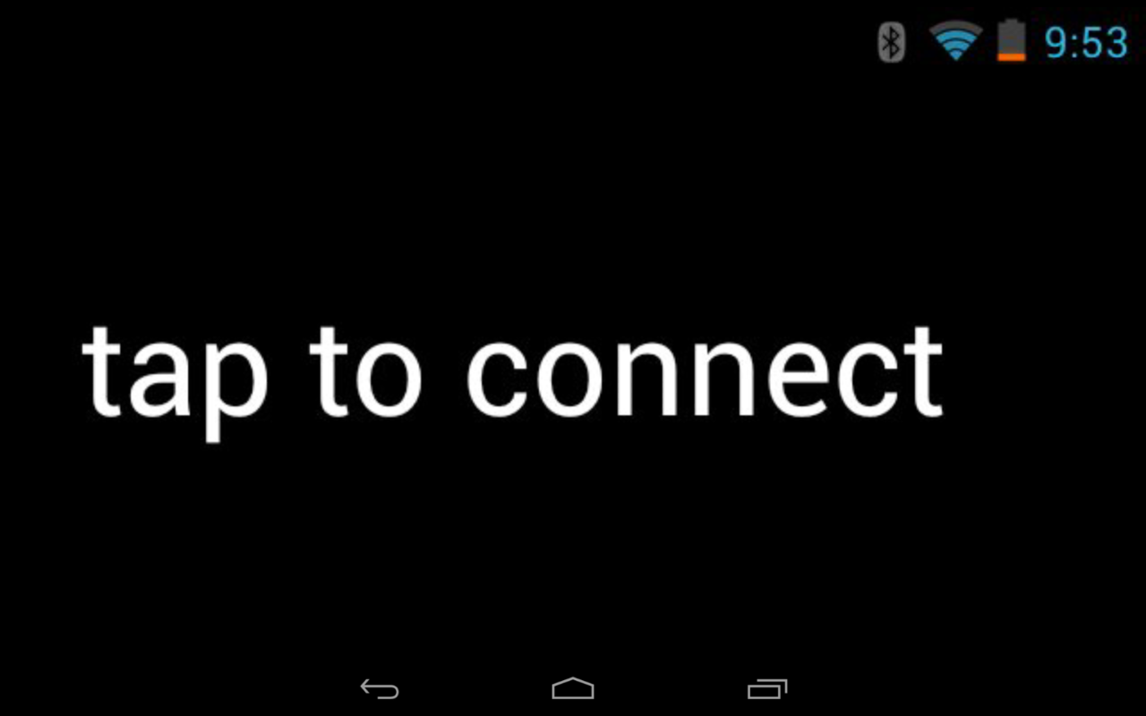
App Screen
Main Page

Slide 7
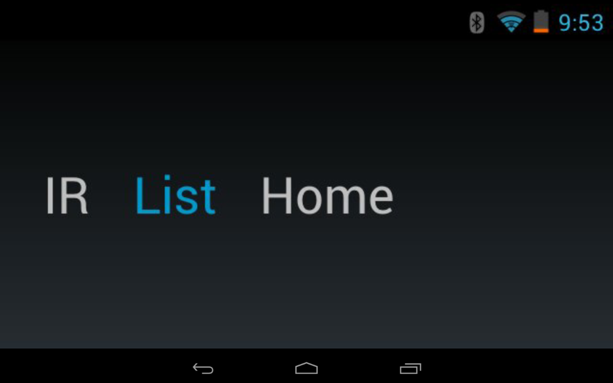
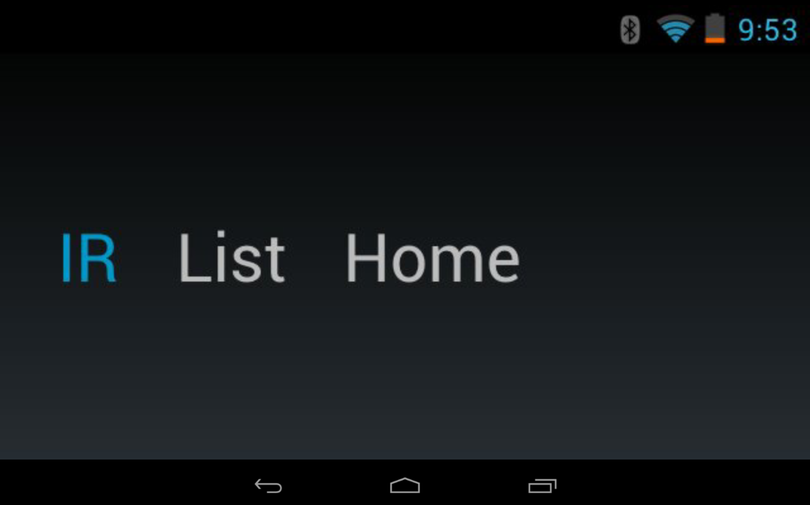
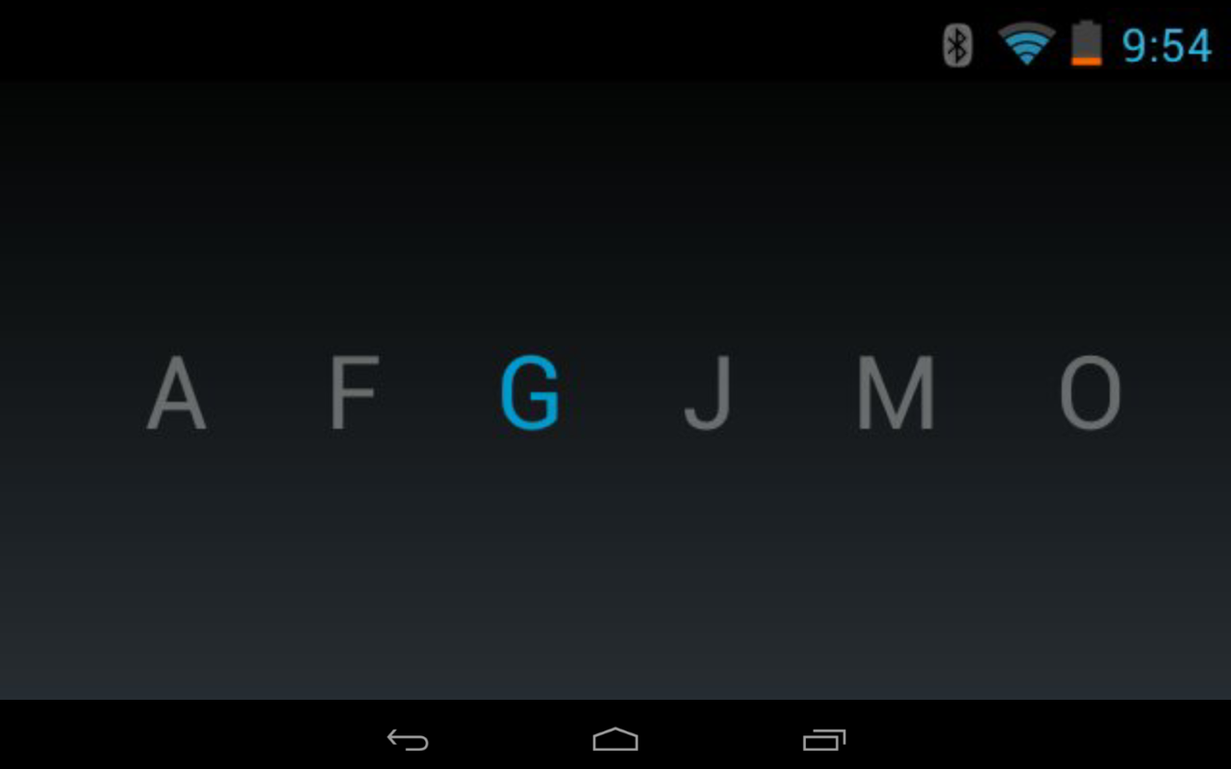
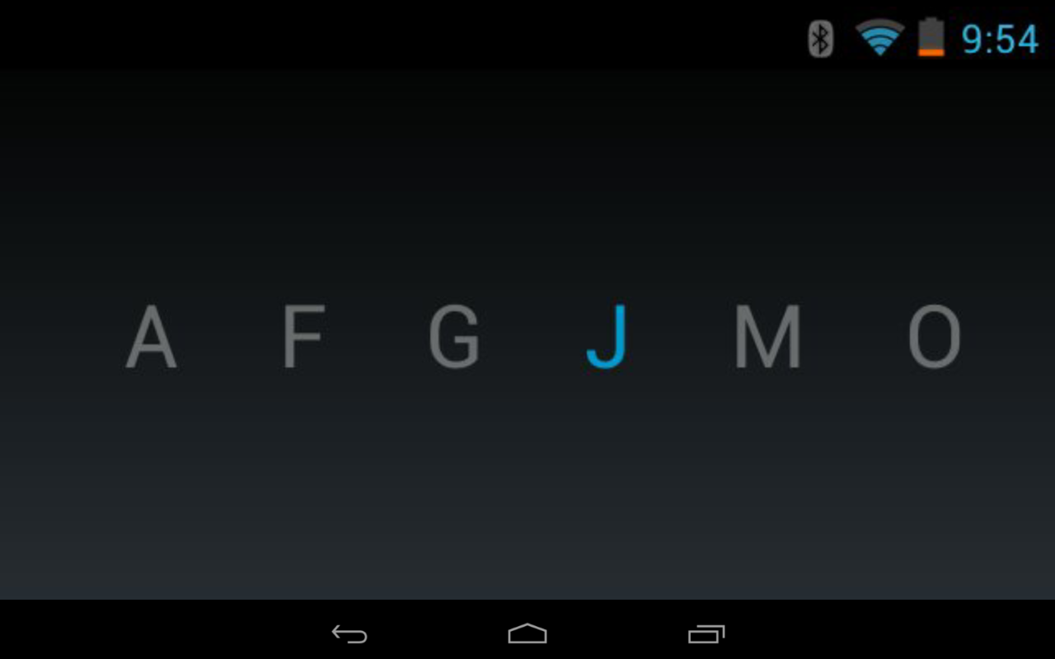
Frequent Screen
swipe
swipe

