Slide 1
libplayer introduction

Slide 2
Agenda
FFMPEG
Android MediaPlayer
libplayer

Slide 3
libplayer architecture
ISubtitle
player
FFMPEG
Platform
Android
IOS
Cygwin
NativeWindow
Audiotrack
Osles
Ogles 1.1 2.0 3.0
Open AL
Ogles 2.0
SDL audio/video

Slide 4
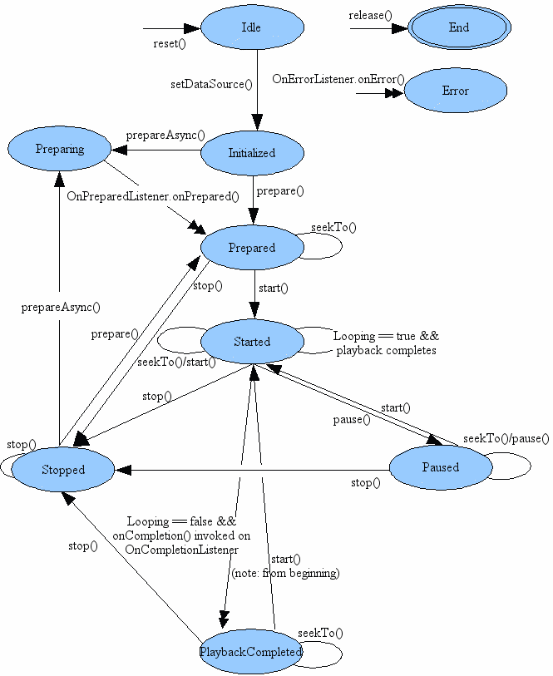
Android MediaPlayer

Slide 5
Java and JNI architecture
Java side
C side
PPPlayer.cpp
SystemMediaPlayer.java
PPPlayer.cpp
A14
PPPlayer.cpp
A16
MediaPlayer.java
NuMediaPlayer2.java
android_media_MediaPlayer.cpp
DefaultMediaPlayer.java

Slide 6
libplayer known issue
一定几率播放器退出时，会crash(线程处理，退出有bug)
HEVC解码播放性能有待提高

Slide 7
libplayer enhancement
NativeWindow render
Opensl es to replace audiotrack
RGB565 to replace RGBX8888

Slide 8
Q and A

