Slide 1
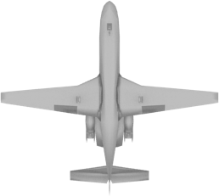
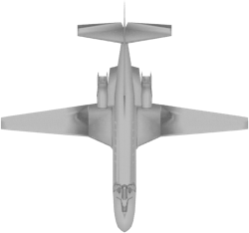
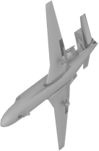
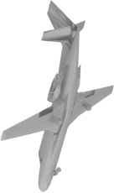
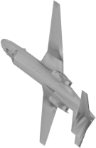

SoftmaxLoss
(Category)
SoftmaxLoss
(Sub-category)
SoftmaxLoss
(Category)
SoftmaxLoss
(Sub-category)
Fully Connected Layers
Fully Connected Layers
View Feature Pooling
View Feature Concatenation
…
…
Convolutional Layers
Convolutional Layers
…
…

