Slide 1
Kinesiological control of teleoperated robot manipulators
Danny Rakita, Alper Sarikaya, Christopher Bodden Department of Computer Sciences
University of Wisconsin–Madison
CS/Psych-770 Human-Computer Interaction

Slide 2

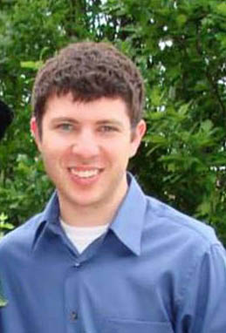

Alper Sarikaya
Data visualization, graphics
Danny Rakita
Animation, robotics
Christopher Bodden Robotics, animation

Slide 3
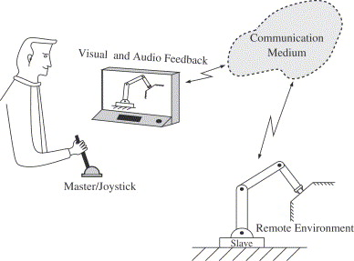
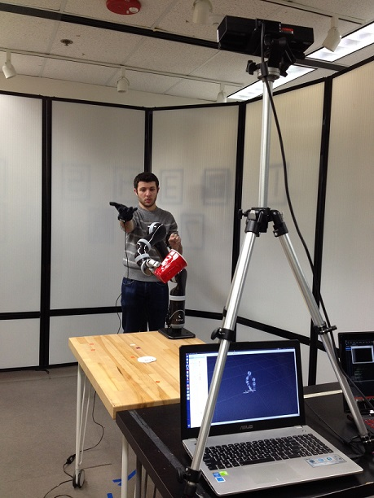
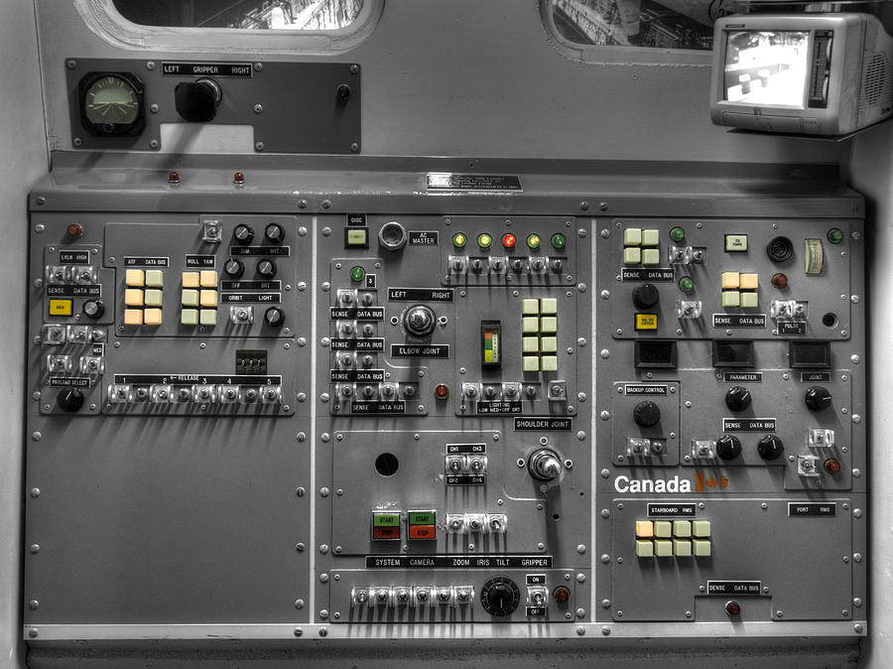
Motivation
As telepresence becomes more pervasive, it would be advantageous to allow physical interaction with the environment. But what is the best control method? Traditionally robot arms are operated via joysticks and knobs.
Joystick / Knobs + Direct control
Kinesiological control + Retargeting

Slide 4
Prior Works
Teleoperated robot implementations:
Hokayem & Spong [6] summarize 50 years on teleoperated robotic theory in their survey paper. The history ranges from mechanically controlled teleoperation to retargeting.
Work On Retargeting Implementations:
In Animation: Gleicher [5] worked on adapting motion from one character to another.
In Robotics: Dragan et al. [1], Yang et al. [2], and Park et al. [3] have explored implementations of retargeting human arm motion to robots using various sensors (Kinect, data gloves, etc.).
Studies of interfaces for novice users:
Labonte et al. [4] have studied the effects of different display modalities on teleoperation performance for novice users.

Slide 5
Research Question
What is the effect of kinesiological robot arm control on novice user task performance and perception for tasks with/without 1-to-1 mappings?
Hypothesis
(H1) Task Performance – We hypothesize kinesiological robot arm control will have better task performance on tasks with 1-to-1 mappings, while joystick control will have better performance on tasks without 1-to-1 mappings. A combined control method will perform as well or better as kinesiological control for tasks with 1-to-1 mappings. Likewise, combined control will perform as well or better as joystick control for tasks without 1-to-1 mappings.
(H2) User Perception – We hypothesize the same relationships will be found as H1 for perceptions of Ease of Use, Usefulness, and Enjoyment.

Slide 6
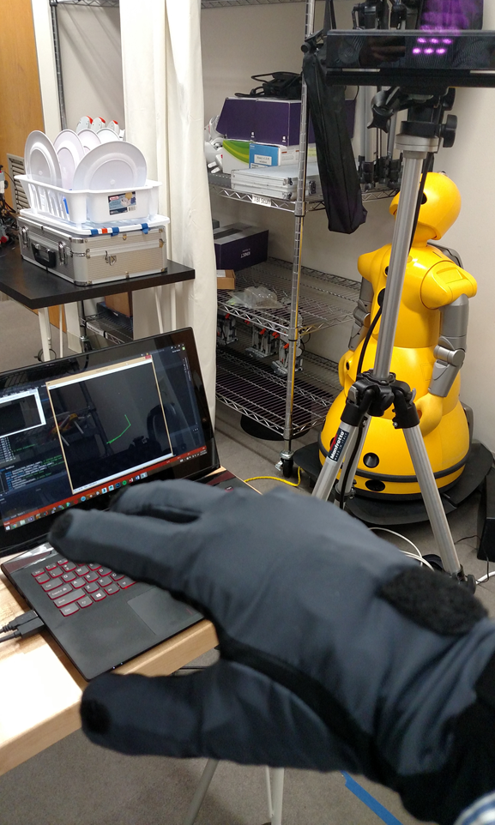
System Design
We implemented a kinesiological control method using a VML motion capture glove and a Microsoft Kinect.
Position data was collected with the Kinect and hand orientation data was collected by the motion capture glove.
Position and orientation were combined into a target pose for the end effector of a robot arm.
The target pose was sent to the robot arm using Robot Operating System (ROS)

Slide 7
Experimental Design
We designed a 3x2 mixed-methods study to test our hypothesis (control type – between-participants, task type – within-participants):
Independent Variables:
control type ϵ {kinesiological, joystick, kinesiological+}
task type ϵ {1-to-1 mapping, no mapping}
Dependent Variables:
task completion time, usefulness, ease of use, enjoyment

Slide 8
Participants, & Procedure
We used a Kinova Mico arm in the HCI lab to perform our study. Positions were captured with a Microsoft Kinect and hand orientation using a VML data glove.
Participants performed a movement (1-to-1 mapping) and a rotation (no mapping) task using 1 control type.
Participants were given an instruction sheet and unlimited practice time.
10 males and 2 females aged 19-40 (M: 27.1, SD: 5.45) were recruited by convenience sampling. Robot familiarity was moderate (M: 4.25, SD: 1.86).

Slide 9
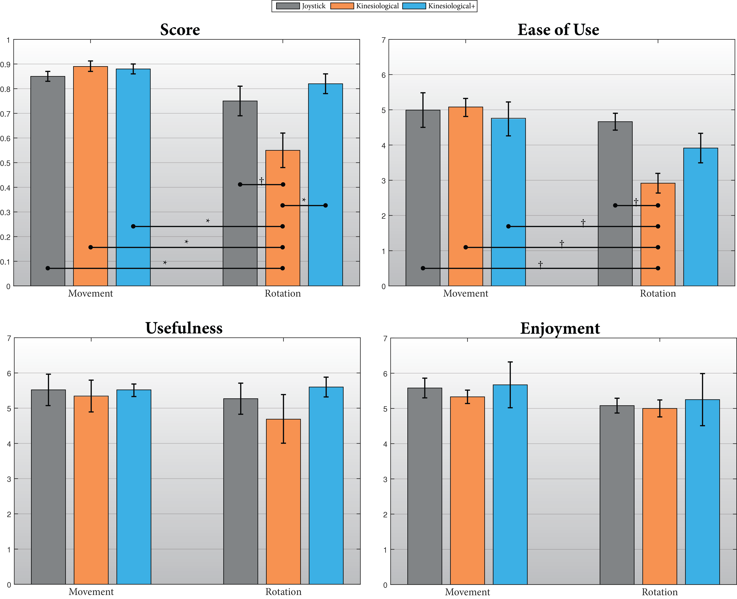
Results

Slide 10
Discussion
We were able to provide some support for H1 and limited support for H2.
We learned that participants can use combined kinesiological + special function control and perceive it as well as joystick control.
We learned that pure kinesiological control is not effective for tasks that robot actuators afford improved ability.
Designers of retargeted control methods need to keep these additional capabilities in mind and provide them.

Slide 11
Questions?
Thanks for listening!
Danny Rakita, Alper Sarikaya, Christopher Bodden Department of Computer Sciences
University of Wisconsin–Madison
CS/Psych-770 Human-Computer Interaction

