Slide 1

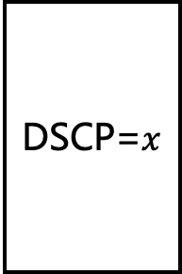
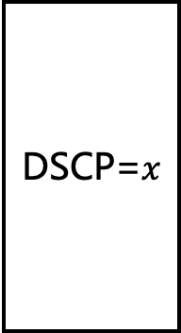



Multiple Flow Table (MFT) Pipeline
Rate(Mbps)
Group
Table
DSCP=$x$
Meter Table
DSCP
Remark
Threshold $p$
>$p$
DSCP=$y$
Go through indirect (2-hop) path
DSCP=$x$
Flows
$$p$$
Go through direct path
汇聚层交换机需支持openflow1.3的多级流表以及meter表dscp标记功能
设置Meter表，对于超过限速的流量进行DSCP Remark标记
让流量进入下一级流表
将没有被DSCP Remark的流量导到直连路径（借助group表分流）
将被DSCP Remark的流量分配到其他路径（借助group表分流）

Slide 2
Multiple Flow Table (MFT) Pipeline
Rate(Mbps)
Group
Table
DSCP=$x$
Meter Table
DSCP
Remark
Threshold $p$
>$p$
DSCP=$y$
If exceed threshold, go through indirect (2-hop) path randomly.
DSCP=$x$
Compare with WCMP
Reduce max link utilization about 15%
Reduce average link utilization about 30%
Reduce flow completion time about 30%
Flows
$$p$$
Go through direct path

