Slide 1



LessFlow size $s$
Flow size in AI workload is large
…
…
$k$ flows
…
…
$m$ QPs
…
…
RNIC
LessFLow Design

Slide 2


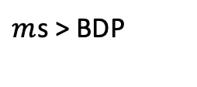

$k$ flows
…
LessFlow size $s$
RNIC
…
$m$ QPs
$m$s > BDP

