Slide 1
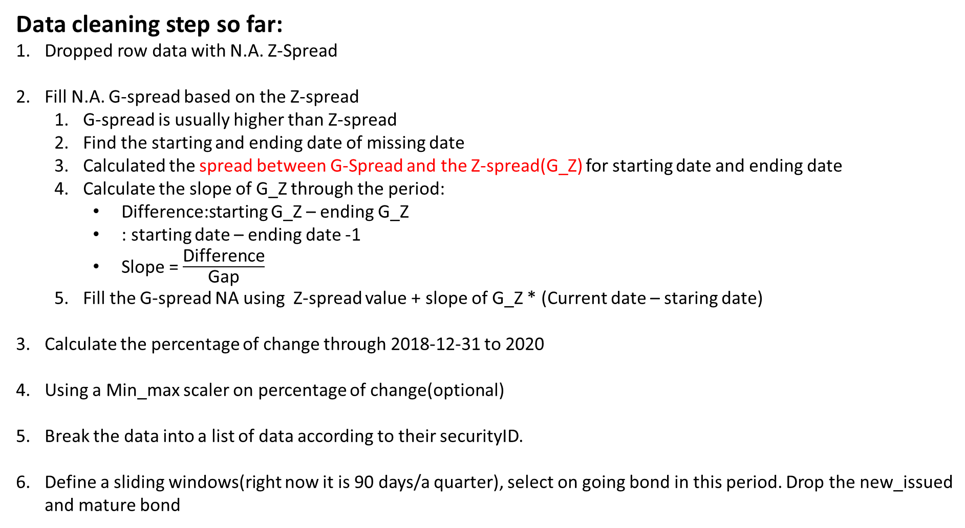
Data cleaning step so far:
Dropped row data with N.A. Z-Spread
Fill N.A. G-spread based on the Z-spread
G-spread is usually higher than Z-spread
Find the starting and ending date of missing date
Calculated the spread between G-Spread and the Z-spread(G_Z) for starting date and ending date
Calculate the slope of G_Z through the period:
Difference:starting G_Z – ending G_Z
: starting date – ending date -1
Slope = $\frac{\text{Difference}}{\text{Gap}}$
Fill the G-spread NA using Z-spread value + slope of G_Z * (Current date – staring date)
Calculate the percentage of change through 2018-12-31 to 2020
Using a Min_max scaler on percentage of change(optional)
Break the data into a list of data according to their securityID.
Define a sliding windows(right now it is 90 days/a quarter), select on going bond in this period. Drop the new_issued and mature bond

Slide 2
Conduct clustering
Data Manipulation:
(Include Dimension reduction)
SVD/Wavelet Transform
Seasonal Decomposition
Auto Encoder
Discrete Fast Fourier Transform
Distance Metric:
DTW
Cosine
EUCLIDEAN
Distance correlation
DBSCN
K++ Mean
C Mean
SOM
Self Organizing Maps
Clustering Method:
Hierarchical

Slide 3
Package: pyclustering, sklearn, statsmodels, scipy

