Slide 1
Homework 1
Reported by CAO QIQI

Slide 2
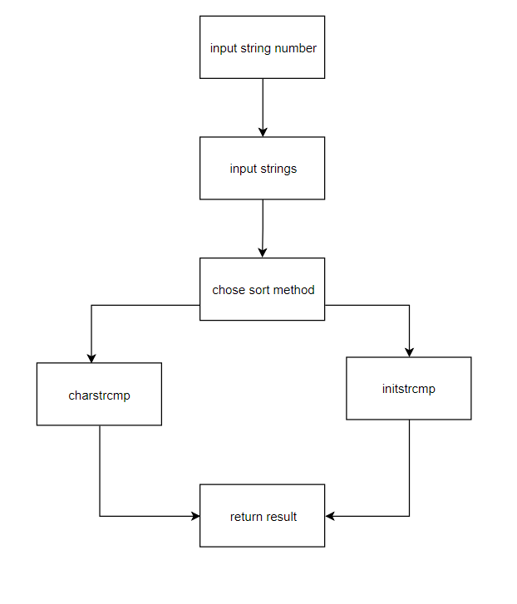
Flow chart of main()

Slide 3
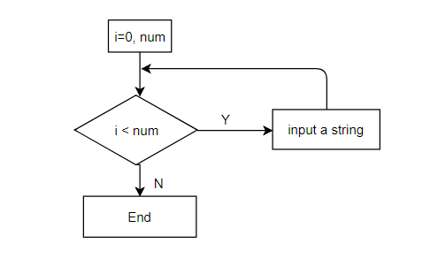
Flow chart of get_input()

Slide 4
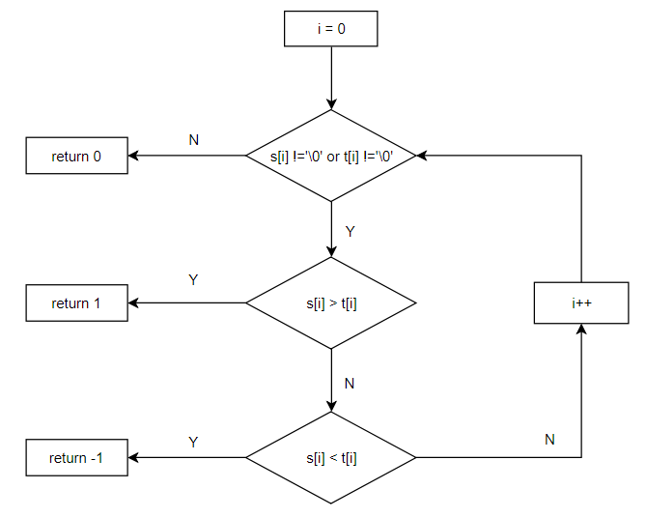
Flow chart of charstrcmp()

Slide 5
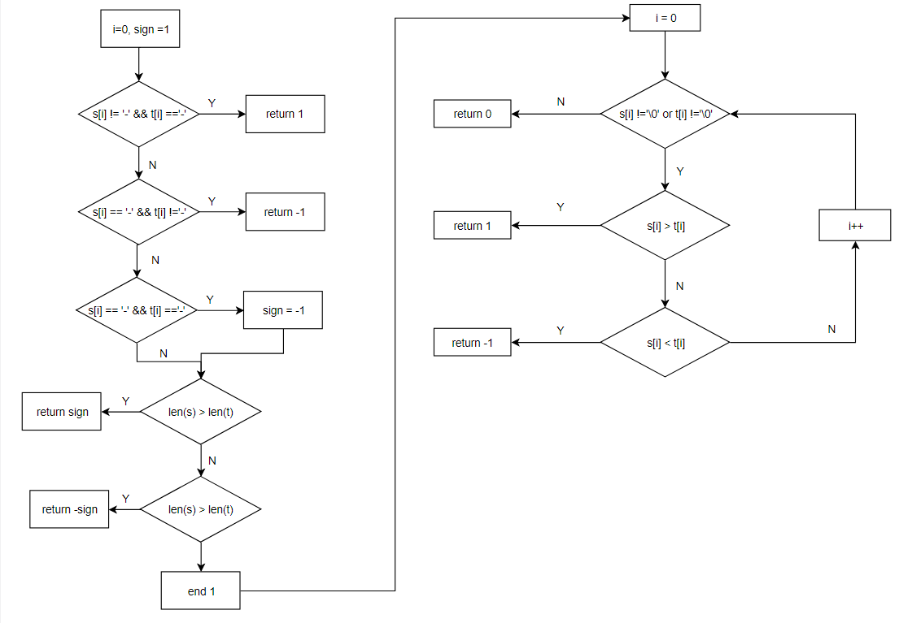
Flow chart of initstrcmp()

Slide 6
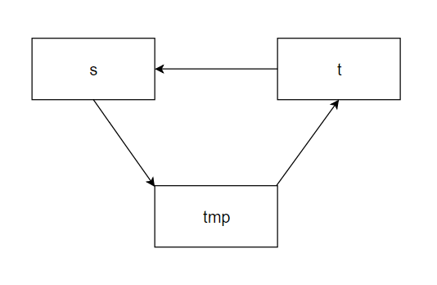
Function swap()

Slide 7
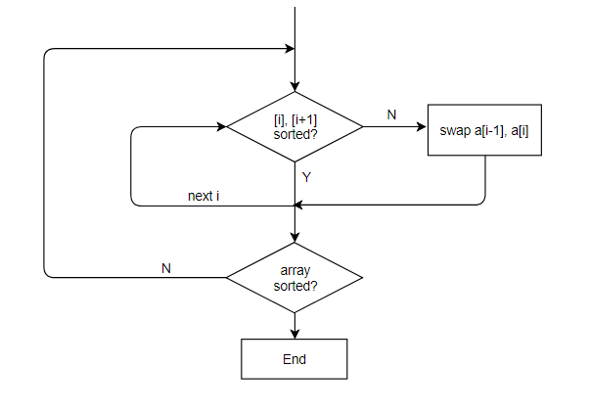
Flow chart of bubble_sort()

