Slide 1



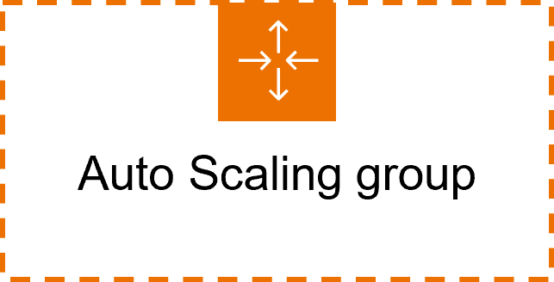







Application Load Balancer
Elastic Load Balancing
Amazon EC2 Auto Scaling
Group AutoScalingGroup
Amazon Elastic Compute Cloud Amazon EC2
Instance
Amazon Relational Database Service Amazon RDS
Database
Amazon ElastiCache
ElastiCache for Redis
Cache node

