Slide 1
Crazy Taxi
NYC Green Taxi Fare Prediction

Slide 2
Outline
Overview
Goal
Exploratory Analysis
Feature Engineering
Key interpretations with visualizations
Data Modeling
Results

Slide 3
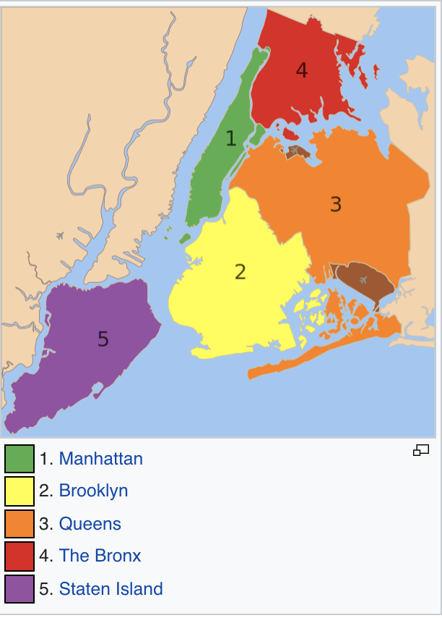
Background – NYC Green Taxi
Also known as the “Boro Taxi” – Five Borough Taxi Plan (Bronx, Brooklyn, Queens, Manhattan, Staten Island)
Drop anywhere but pickup only from above zones!
Can be street hail or Dispatch

Slide 4
Goal

Slide 5


Exploratory Analysis (Data Cleaning, Visualizations & Feature Engineering)
About the dataset : 11.7 M rows, 19 columns
We used pickle file in the source data to reduce the loading time from 8 minutes to < 1 min
We also got an opportunity to explore AWS Machine learning module and S3 data storage
Notes:
Dataset source : https://data.cityofnewyork.us/Transportation/2017-Green-Taxi-Trip-Data/5gj9-2kzx

Slide 6
Hypothesis (Factors affecting taxi fare)
Trip distance
Time of travel
Day of travel (Weekday vs Weekend)
Weather conditions
Airport/Non-airport trip
Pickup/Drop-off location

Slide 7
Data Preprocessing
Dropped rows
- Negative fares << Add Plot>>
Drop off time before the pickup time
Negative trip distance
Passenger count < 0
Toll amount > $500
Custom total < $0 or > $1000

Slide 8
Feature Engineering
Trip Duration (in minutes)
Day/Month/Hour of pickup
Custom Total (as the total was calculated incorrectly in few cases)
Weekend Flag (0 –weekday, 1- weekend)
Airport Flag (0- Non-airport, 1 – Airport

Slide 9
Exploring Dataset with Visualizations
Average price per mile for different distances for different trip type
Month wise fare plot
Day wise fare plot
Month wise trip count
Day wise trip count
Top 10 zones based on trip count
Borough wise trip count

Slide 10
Interpretations from Visualizations
Plot | Conclusion
Month wise fare distribution | Highest: March 17 | Lowest: December 17
Day wise fare distribution | Highest: Friday | Lowest : Sunday
Month wise trip count | Highest: March | Lowest: November
Day wise trip count | Highest: Friday | Lowest: Sunday
Top 10 zones based on trip count | Highest : East Harlem North, Manhattan
Borough wise trip count | Highest: Brooklyn | Lowest : Staten Island

