Slide 1
EECS 731 – Data Science
Regression

Slide 2
Pre-Regression
Clean Data
Remove Outliers
Feature Selection using ‘fregressor’
Shuffle Data
Normalize Features
Combination of Different features to feed into regressors

Slide 3
Feature Selection
‘sklearn.feature_selection’ module used for feature selection to improve estimators accuracy scores
The correlation between each regressor and target is computed
‘SelectKBest’ selects features according to the k highest scores
It can be seen as a preprocessing step to an estimator
target is ‘fare_amount’, other features are regressors

Slide 4
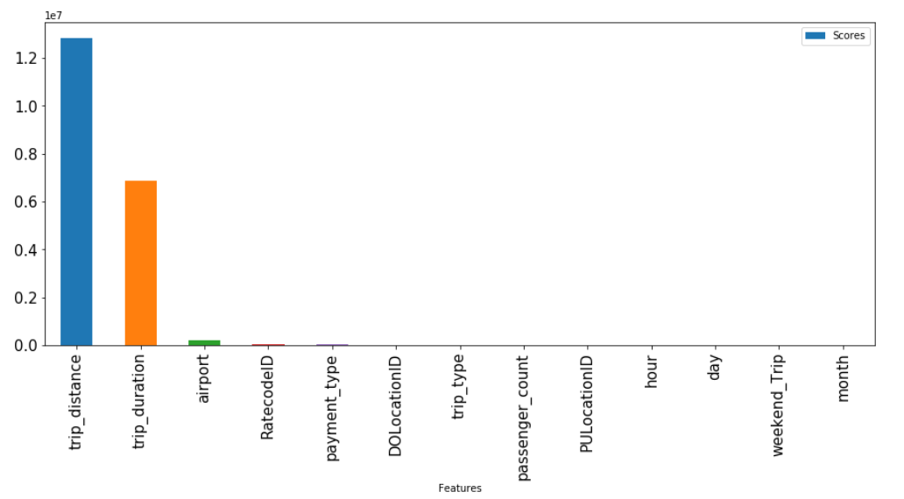
...Feature Selection

Slide 5
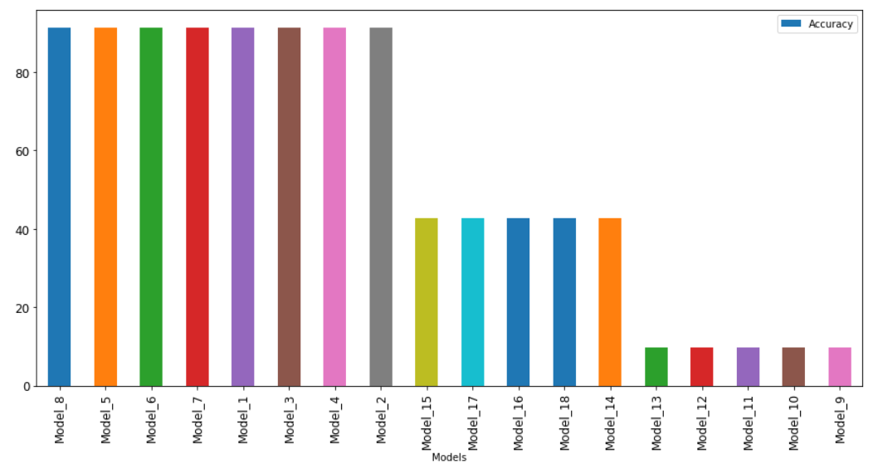
The Beginning – Elastic Net

Slide 6
Takeaways
Top 3 features made the most impact!
Features with lower scores does not add much to accuracy
Features with very low scores sometimes reduces accuracy of the regressor!
Training so many models breaks your computer

Slide 7
Regression
3 Major Models for fare_amount prediction:
M1: Regression with Feature Engineering
M2: Regression without Feature Engineering
M3: Hybrid Model
Model_1 = {'trip_distance','trip_duration','airport’}
Model_2 = {'RatecodeID','payment_type','DOLocationID','trip_type','passenger_count','PULocationID','hour','day','weekend_Trip','month’}
Model_3 = {'trip_distance','airport','RatecodeID','payment_type','DOLocationID','trip_type','passenger_count','PULocationID','hour','day’}

Slide 8


Scoring the Model
Problem: Classifying a prediction as Accurate or Inaccurate
Calculating Accuracy:
$$\frac{result[result['difference'] < 1].shape[0]}{result.shape[0]}×100$$
Training Set ≈ 2 M
Testing Set ≈ 22k

Slide 9
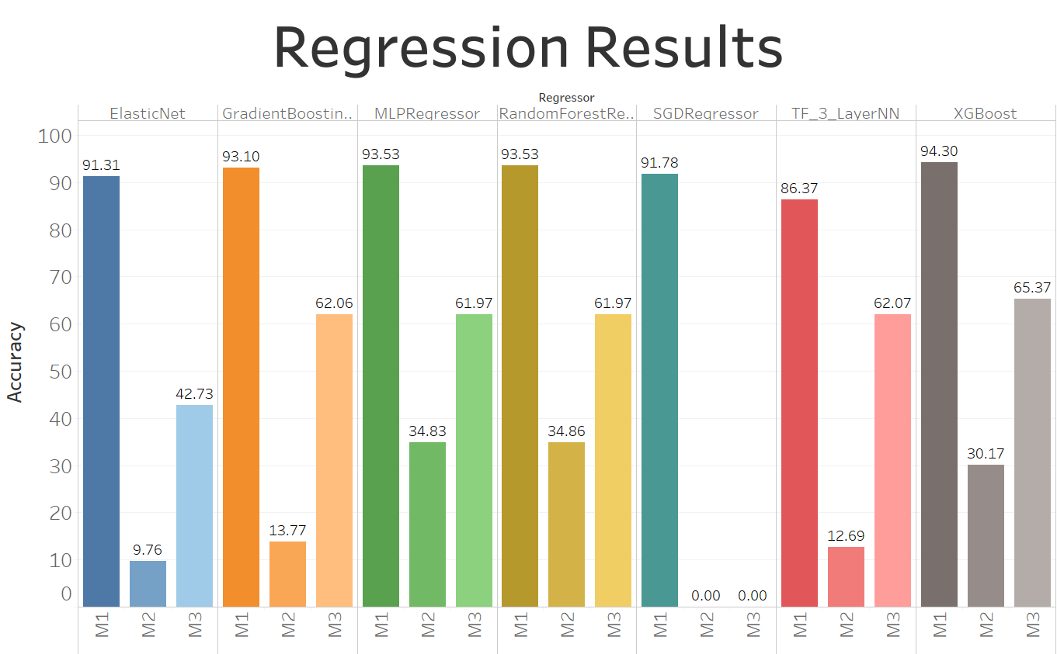

Slide 10
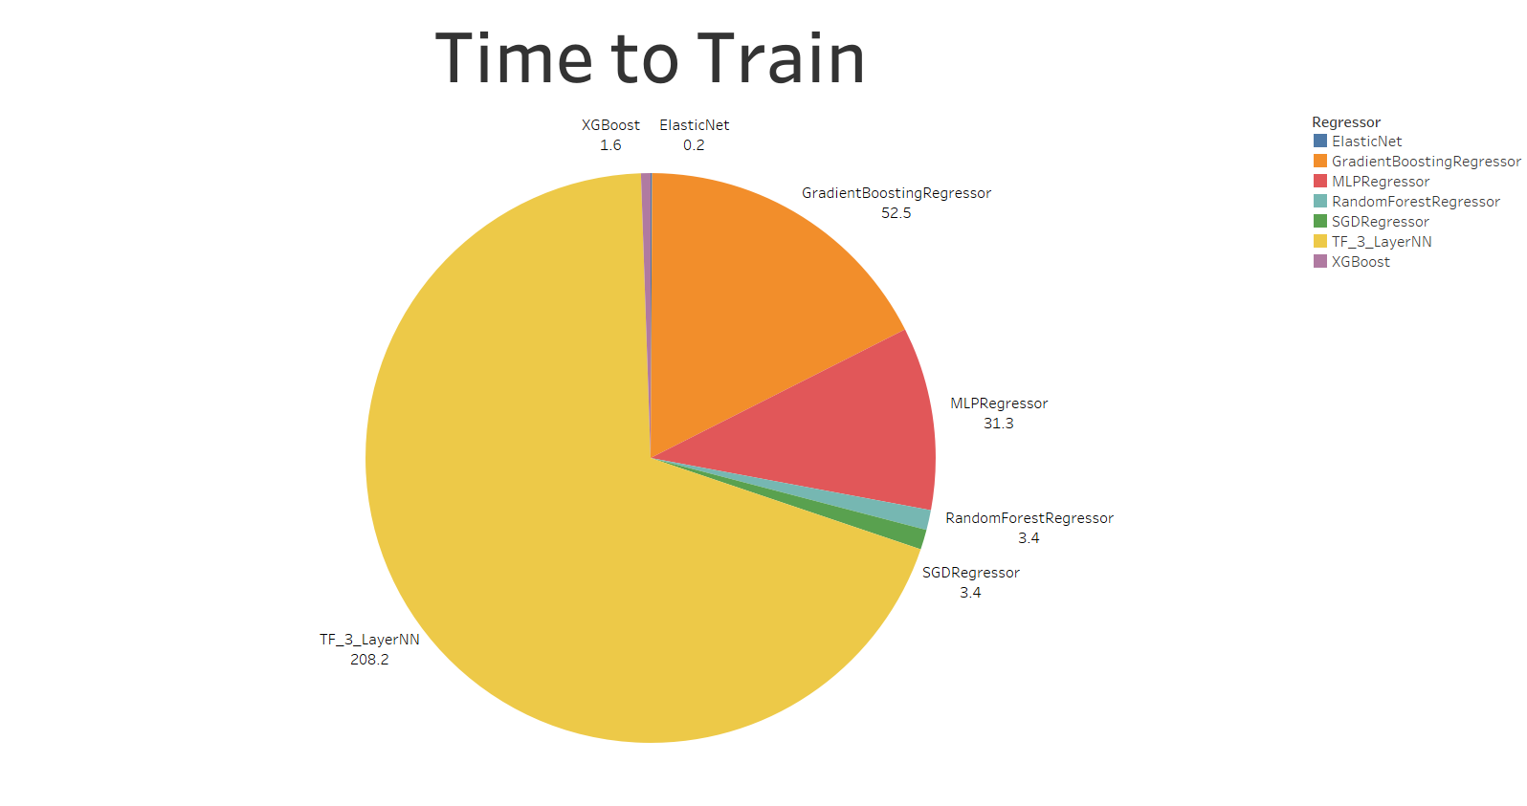

Slide 11
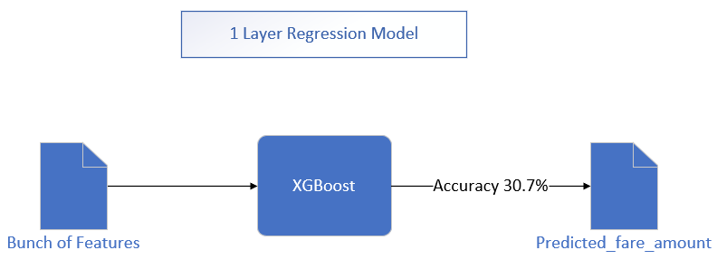
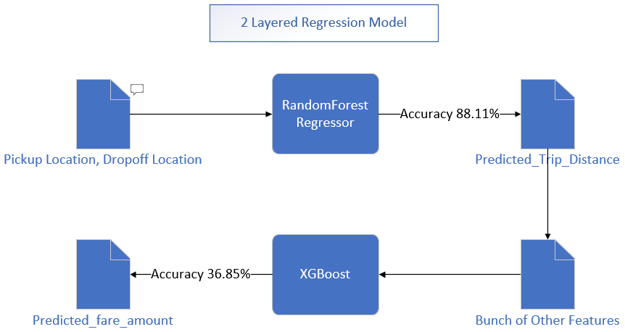

Slide 12
Conclusion
XGBoost gave highest accuracy on Models with Feature Engineering
Random Forests gave highest accuracy on Models without Feature Engineering
Roadblocks : Memory error/Runs forever
mutual_info_regression
Support Vector Regression
Kernal Ridge Regression
Gaussian Process Regression
Future Work:
Experimenting more with Neural Networks
Improving Accuracy on two layer regression model

