Slide 1
EECS 731 – Data Science
Regression

Slide 2
Pre-Regression
Clean Data
Remove Outliers
Feature Selection using fregressor
Shuffle Data
Normalize Features
Combination of Different features

Slide 3
Feature Selection
sklearn.feature_selection module used for feature selection to improve estimators accuracy scores
The correlation between each regressor and target is computed
SelectKBest selects features according to the k highest scores
It can be seen as a preprocessing step to an estimator
target is ‘fare_amount’, other features are regressors

Slide 4
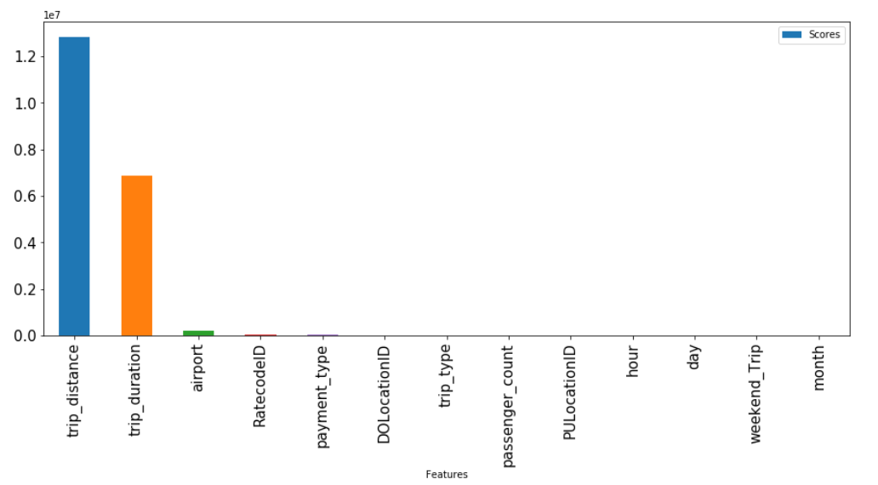
...Feature Selection

Slide 5
Regression
3 Major Models for fare prediction:
M1: Regression with Feature Engineering
M2: Regression without Feature Engineering
M3: Hybrid Model
Model_1 = {'trip_distance','trip_duration','airport’}
Model_2 = {'RatecodeID','payment_type','DOLocationID','trip_type','passenger_count','PULocationID','hour','day','weekend_Trip','month’}
Model_3 = {'trip_distance','airport','RatecodeID','payment_type','DOLocationID','trip_type','passenger_count','PULocationID','hour','day','fare_amount'}

Slide 6
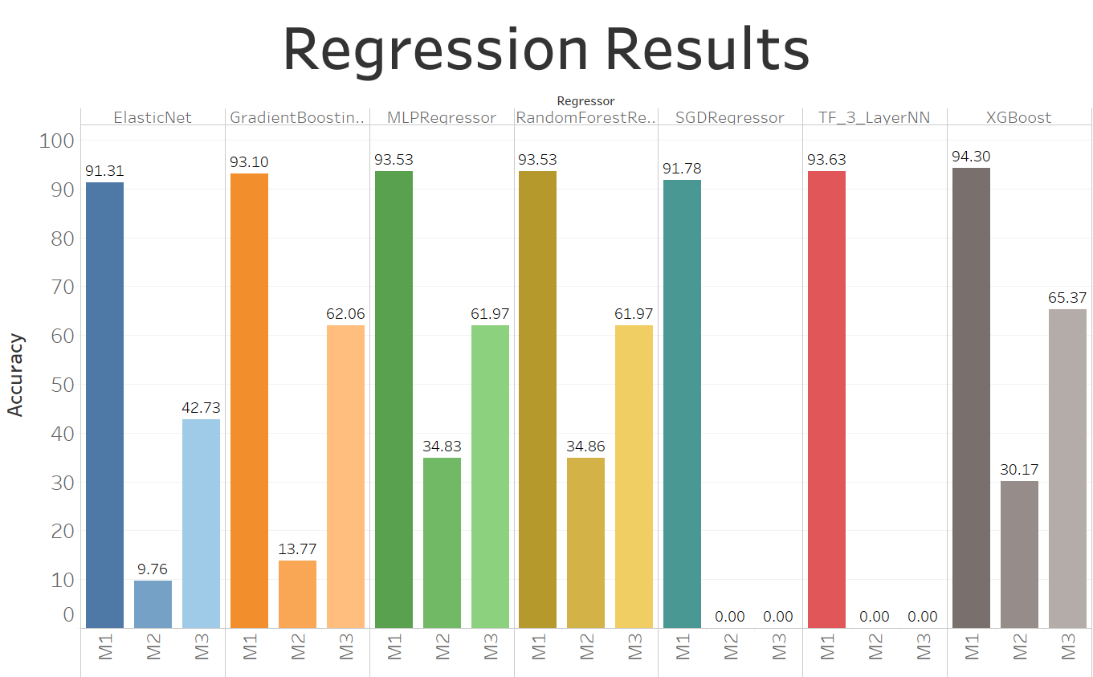

Slide 7
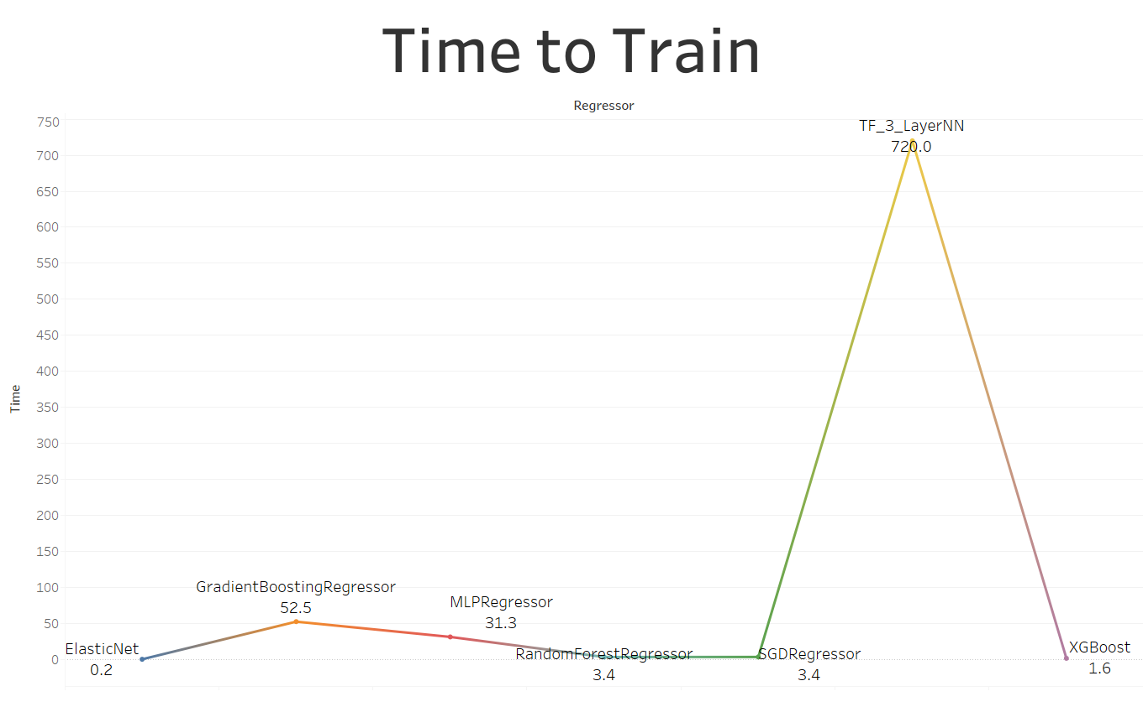

Slide 8
Conclusion
XGBoost gave highest accuracy on Models with Feature Engineering
Random Forests gave highest accuracy on Models without Feature Engineering
Roadblocks : Memory error/Runs forever
mutual_info_regression
Support Vector Regression
Kernal Ridge Regression
Gaussian Process Regression
Future Work:
Experimenting more with Neural Networks
Build a two later prediction model
predict trip_distance and trip_duration, use them to predict fare_amount

