Slide 1

APACHE KAFKA
Presentation prepared by: cAO Tat Cuong

Slide 2
Main content
Introduction
Kafka architecture
Demo

Slide 3
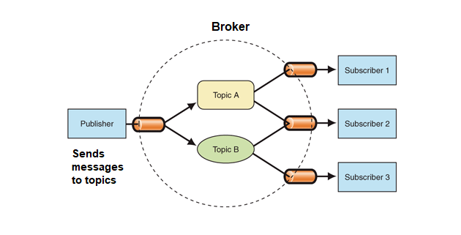
Introduction
What is Apache Kafka?
Apache Kafka is a distributed event store and stream-processing platform.
Kafka is in general publish-subscribe based messaging system.
The Main Functions of Kafka
Features of Kafka

Slide 4
Introduction
What is Apache Kafka?.
The Main Functions of Kafka
Kafka provides three main functions to its users:
Publish and subscribe to streams of records
Effectively store streams of records in the order in which records were generated
Process streams of records in real time
Features of Kafka

Slide 5
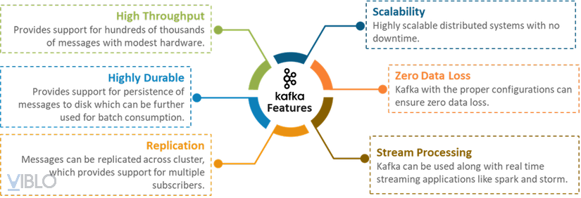
Introduction
What is Apache Kafka?.
The Main Functions of Kafka
Features of Kafka

Slide 6
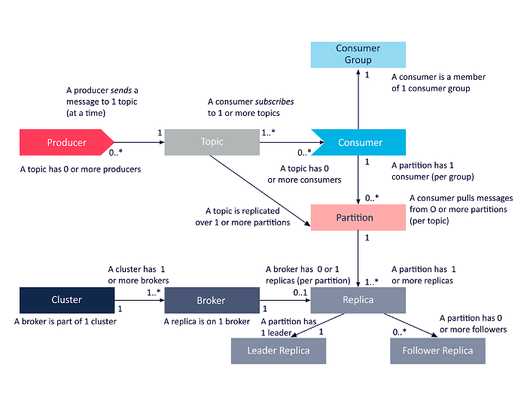
Kafka architecture
The main Kafka components:
Producer
Message
Topic & Partition
Consumer
Broker & Cluster
Replication
Zookeeper

Slide 7
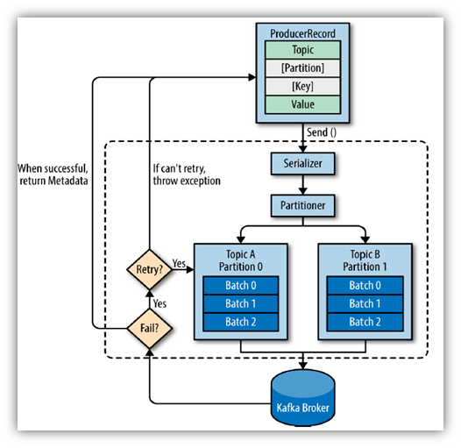
Kafka architecture
1. Kafka Producer
Event is published as ProducerRecord to the topic which resides in and managed by broker. Step like:
Create the ProducerRecord
Serialization
Partitioning
Success and failed scenarios

Slide 8
Kafka architecture
2. Kafka Message
The Kafka Message is the ProducerRecord input, which is simply an array of bytes. Messages are organized in batches to increase efficiency.
There are three main ways to send messages:
Fire-and-forget: don’t care if it was successfully received or not .
Synchronous: wait for a response from Kafka before sending the next message.
Asynchronous: send a message and provide a call back function to receive acknowledgment.

Slide 9
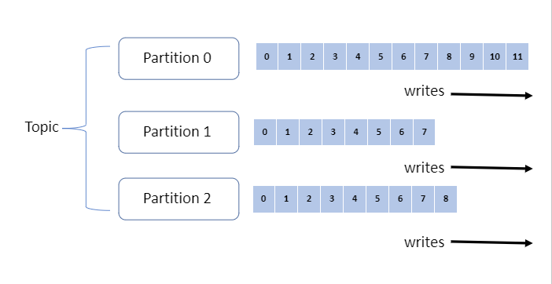
Kafka architecture
3. Kafka Topic & Partition
Messages in Kafka will be categorized into topics.
Kafka’s topics are divided into several partitions.
Each partition is a single log file where records are written to it in an append-only fashion.

Slide 10
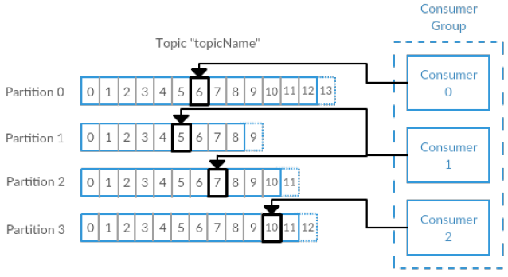
Kafka architecture
4. Kafka Consumer
Kafka consumers are typically part of a consumer group. When multiple consumers are subscribed to a topic and belong to the same consumer group, each consumer in the group will receive messages from a different subset of the partitions in the topic.

Slide 11
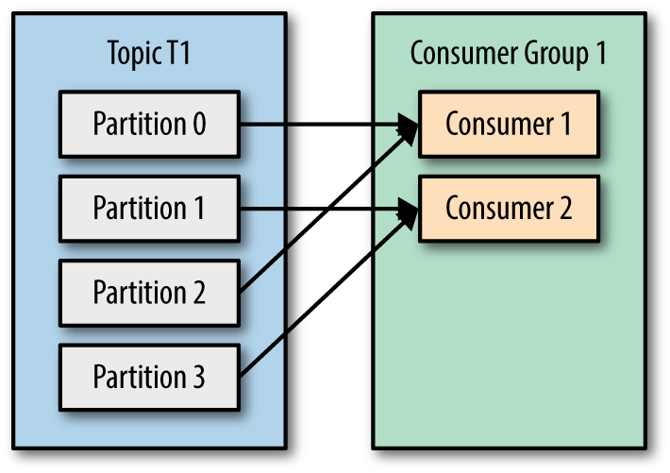
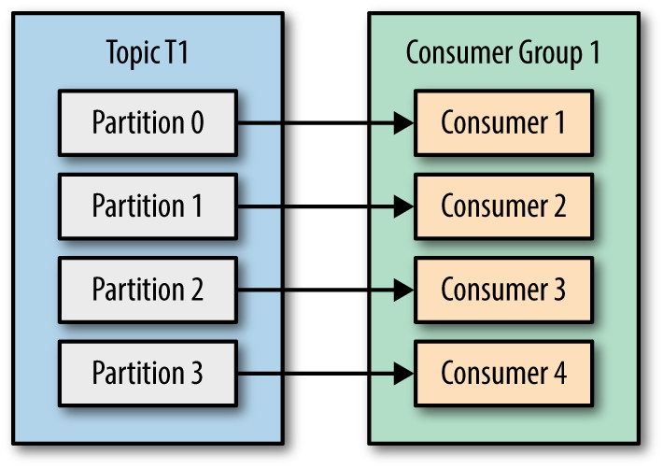
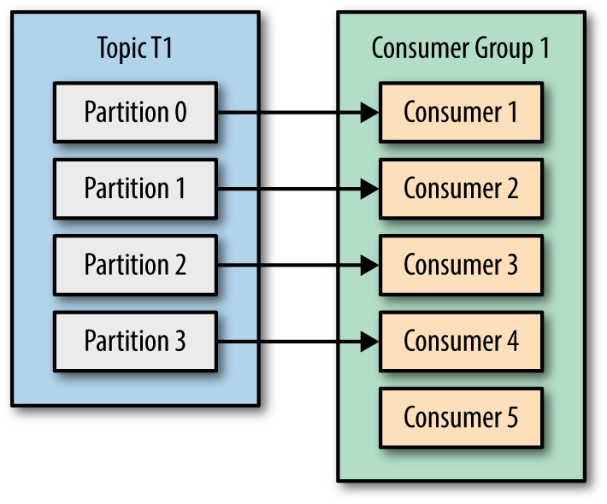
Kafka architecture
4. Kafka Consumer

Slide 12
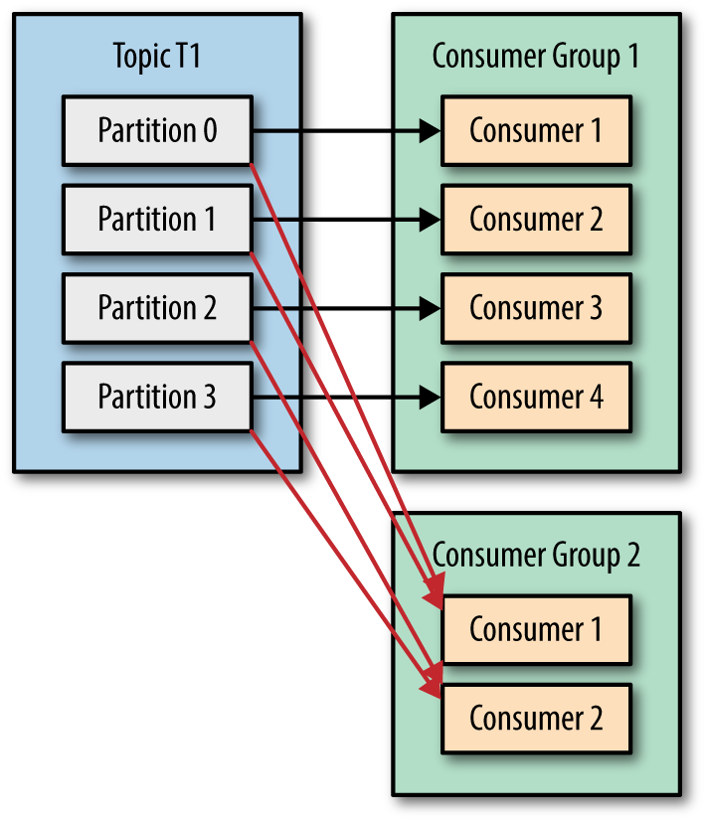
Kafka architecture
4. Kafka Consumer

Slide 13
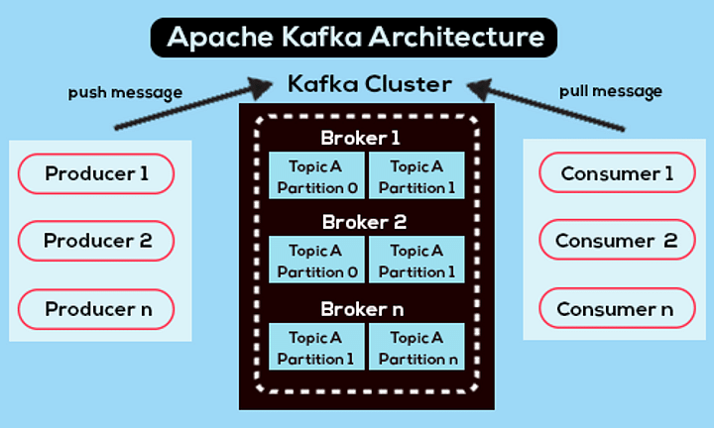
Kafka architecture
5. Kafka Broker & Cluster
Brokers are the heart of Kafka Cluster and its connector to the outer words such as consumer, producer, confluent connector. Kafka Topic consists of multiple partitions distributed across Brokers.
A Kafka cluster consists of one or more servers (Kafka brokers) running Kafka

Slide 14
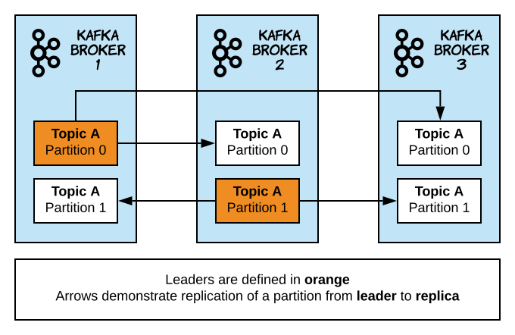
Kafka architecture
6. Kafka Replication
Kafka Replication means having multiple replicas of the data, spread across multiple servers/brokers. This helps in maintaining high availability in case one of the brokers goes down and is unavailable to serve the requests.
Each partition can have many replicas. These replicas are stored across brokers up to hundreds or thousands of copies.
There are two types of replicas:
Leader replica: each partition has a unique replica designated as leader. All requests go through the leader to ensure consistency
Follower replica: all replicas that are not leaders are called followers. Followers only back up messages from the leader, and take over the leader position if the leader fails

Slide 15
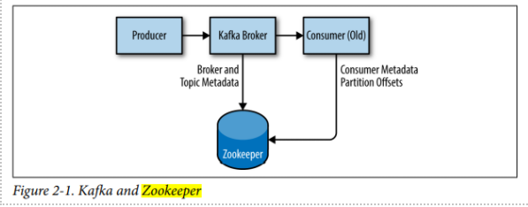
Kafka architecture
7. Zookeeper
Zookeeper is used in distributed systems for service synchronization and as a naming registry.
In Kafka, Zookeeper is primarily used to track the status of brokers in the Kafka cluster and notify Producers and Consumers of the presence of brokers in the cluster
Zookeeper is also responsible for choosing a new leader for each partition, in case of an error in the broker containing leader replica.

