Slide 1
Chapter 9:
Pointers

Slide 2
9.1
Getting the Address of a Variable

Slide 3
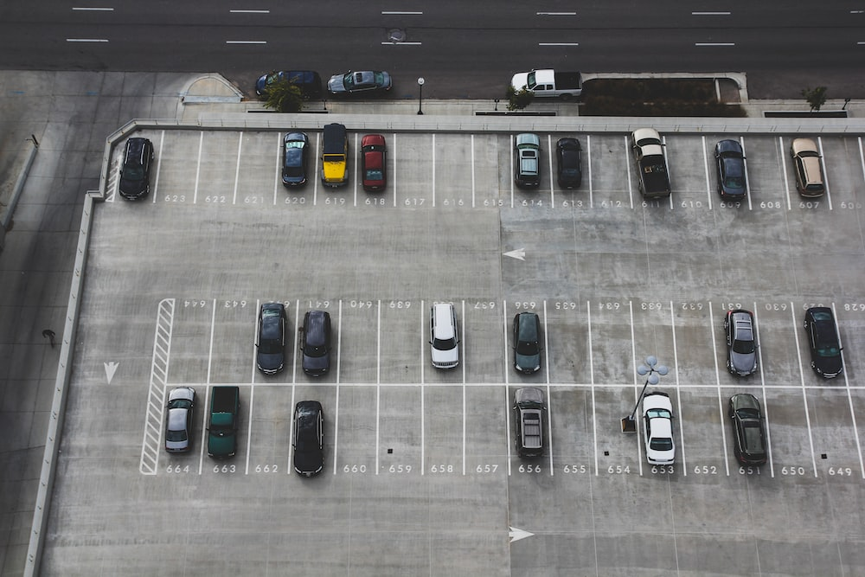

What are pointers?
Pointers are variables that contain the address of memory location.
My car is at 653
Each spot has an address.
And the address are sequential

Slide 4
Pointer Variables
Pointer variable : Often just called a pointer, it's a variable that holds an address
Because a pointer variable holds the address of another piece of data, it "points" to the data

Slide 5
Pointer Variables
Pointer variables are yet another way using a memory address to work with a piece of data.
Pointers are more "low-level" than arrays and reference variables.
This means you are responsible for finding the address you want to store in the pointer and correctly using it.

Slide 6
Pointer Variables
Definition:
  int *intptr;
Read as:
“intptr can hold the address of an int”
Spacing in definition does not matter:
  int * intptr; // same as above
  int* intptr; // same as above

Slide 7
Pointer Variables
Assigning an address to a pointer variable:
  int *intptr;
  intptr = &num;
Memory layout:
num
intptr
25
0x4a00
address of num: 0x4a00

Slide 8
Pointer Variables
Initialize pointer variables with the special value nullptr.
In C++ 11, the nullptr key word was introduced to represent the address 0.
Here is an example of how you define a pointer variable and initialize it with the value nullptr:
int *ptr = nullptr;

Slide 9
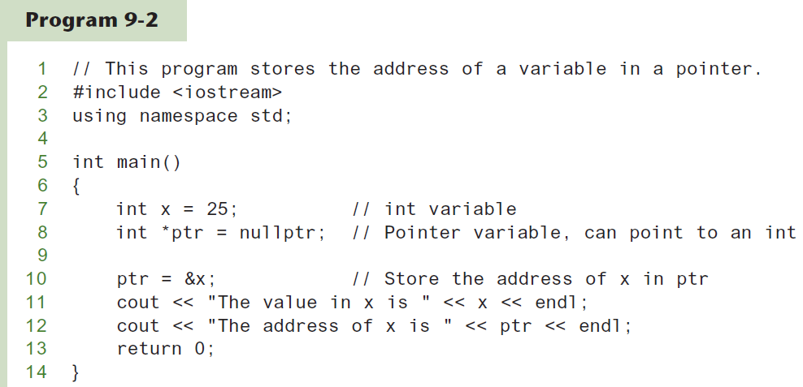
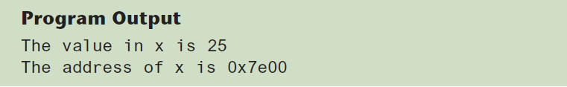
A Pointer Variable in Program 9-2

Slide 10
The Indirection Operator
The indirection operator (*) dereferences a pointer.
It allows you to access the item that the pointer points to.
int x = 25;
int *intptr = &x;
cout << *intptr << endl;
This prints 25.

Slide 11
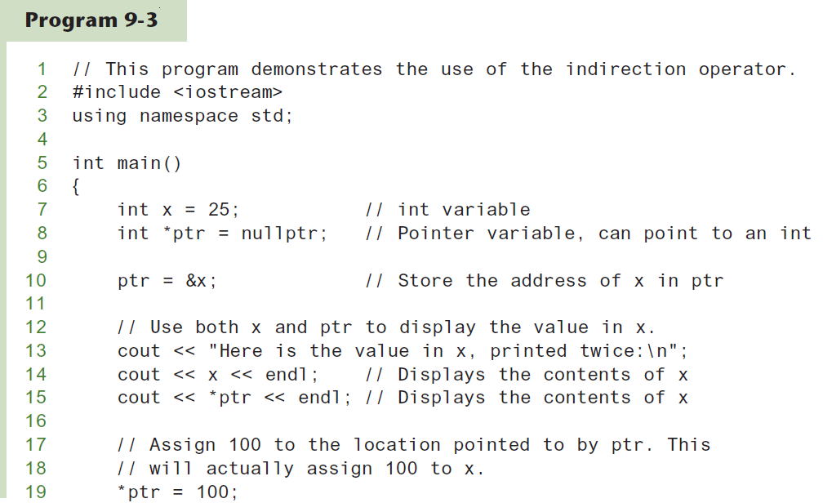
The Indirection Operator in Program 9-3

Slide 12
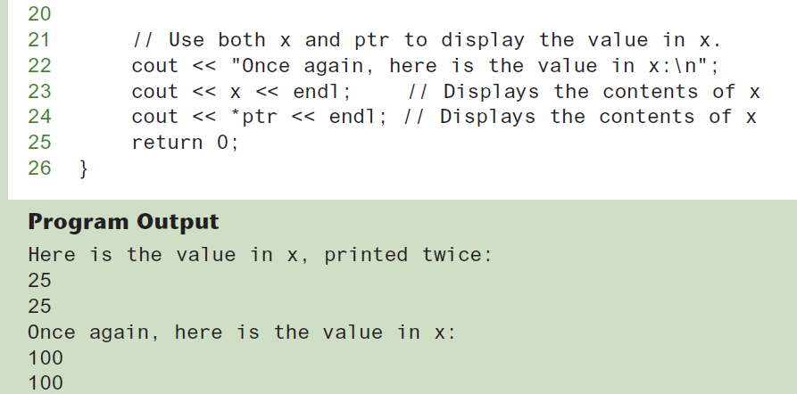
The Indirection Operator in Program 9-3

Slide 13
Getting the Address of a Variable
Each variable in program is stored at a unique address
Use address operator & to get address of a variable:
  int num = -99;
  cout << &num; // prints address
  // in hexadecimal

Slide 14
Pointer variables
When you create a variable, compiler will create an entry in symbol table with name and the address in memory. For example,
int i = 10;
Same way, you can define a pointer variable as follows.
int *p; → p is a pointer variable that stores the address of an integer location.
To set the value for p to address of i (variable created above), use the & operator.
p = &i;
Trying to access the pointer location that is not initialized causes program exception (error). So good practice to always initialize pointers.
int* pUnassigned;
std::cout << “pUnassigned is pointing to “ << *pUnassigned ← Program will fail here
0x200
0x204
0x208
0x20b
10
200
0
Symbol table
Name | Location
i | 0x200
p | 0x204
pUnassigned | 0x208

Slide 15
Why pointers?
Pointer notations work faster when working with arrays.
  Accessing next/prev element in array can be achieved by incrementing/decrementing.
Pointers allow functions to access large blocks of data.
  Functions can accept pointers as parameters and any change to the data that the pointer is pointing to would reflect in the calling function.
Pointers allow dynamic memory allocation.
  Building data structures like linked lists, trees, graphs etc

Slide 16
Few more points regarding pointers..
Addresses are in hexadecimal notation e.g: 0x01AC4D.
Addresses to change from execution to execution.
Datatype of the pointer should be the same as the datatype of the variable.
  Cannot store pointer to a double variable to address of int.
Different data types take up different amount of memory.
Data type | Memory allocated
char, bool | 1 byte
short | 2 bytes
int, long, float | 4 bytes
double | 8 bytes
Pointer to variable | 4 bytes

Slide 17
Something Like Pointers: Arrays
We have already worked with something similar to pointers, when we learned to pass arrays as arguments to functions.
For example, suppose we use this statement to pass the array numbers to the showValues function:
showValues(numbers, SIZE);

Slide 18
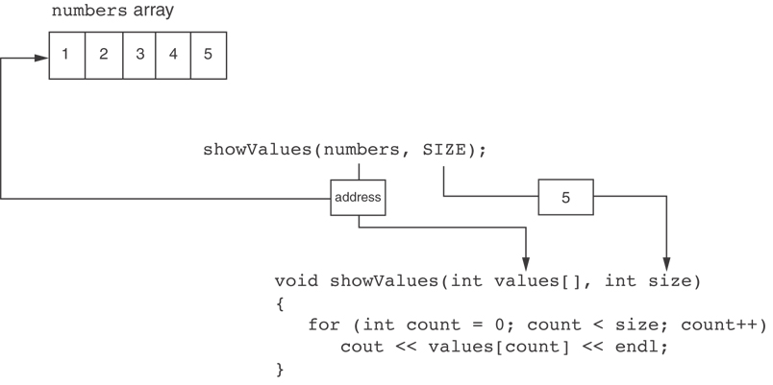
Something Like Pointers : Arrays
The values parameter, in the showValues function, points to the numbers array.
C++ automatically stores the address of numbers in the values parameter.

Slide 19
Something Like Pointers: Reference Variables
We have also worked with something like pointers when we learned to use reference variables. Suppose we have this function:
void getOrder(int &donuts)
{
cout << "How many doughnuts do you want? ";
cin >> donuts;
}
And we call it with this code:
int jellyDonuts;
getOrder(jellyDonuts);

Slide 20
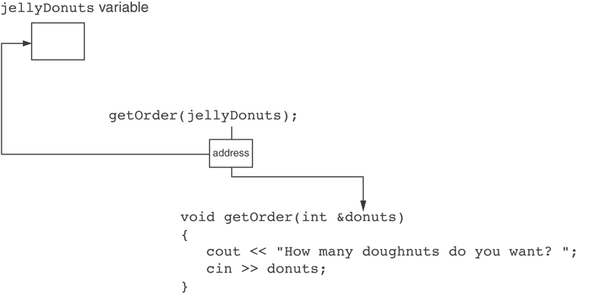
Something Like Pointers: Reference Variables
The donuts parameter, in the getOrder function, points to the jellyDonuts variable.
C++ automatically stores the address of jellyDonuts in the donuts parameter.

Slide 21
9.3
The Relationship Between Arrays and Pointers

Slide 22
The Relationship Between Arrays and Pointers
Array name is starting address of array
  int vals[] = {4, 7, 11};
  cout << vals; // displays
  // 0x4a00
  cout << vals[0]; // displays 4
4 | 7 | 11
starting address of vals: 0x4a00

Slide 23
The Relationship Between Arrays and Pointers
Array name can be used as a pointer constant:
  int vals[] = {4, 7, 11};
  cout << *vals; // displays 4
Pointer can be used as an array name:
  int *valptr = vals;
  cout << valptr[1]; // displays 7

Slide 24
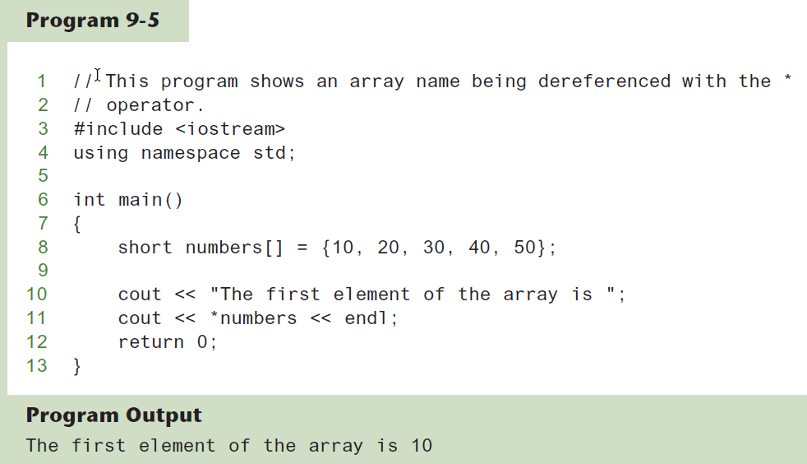
The Array Name Being Dereferenced in Program 9-5

Slide 25
Pointers in Expressions
Given:
  int vals[]={4,7,11}, *valptr;
  valptr = vals;
What is valptr + 1? It means (address in valptr) + (1 * size of an int)
  cout << *(valptr+1); //displays 7
  cout << *(valptr+2); //displays 11
Must use ( ) as shown in the expressions

Slide 26
Array Access
Array elements can be accessed in many ways:
Array access method | Example
array name and [] | vals[2] = 17;
pointer to array and [] | valptr[2] = 17;
array name and subscript arithmetic | *(vals + 2) = 17;
pointer to array and subscript arithmetic | *(valptr + 2) = 17;

Slide 27
Array Access
Conversion: vals[i] is equivalent to *(vals + i)
No bounds checking performed on array access, whether using array name or a pointer

Slide 28
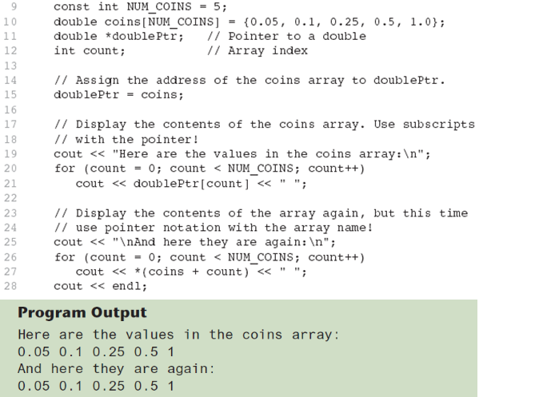
From Program 9-7

Slide 29
9.4
Pointer Arithmetic

Slide 30
Pointer Arithmetic
Operations on pointer variables:
Operation | Example int vals[]={4,7,11}; int *valptr = vals;
++, -- | valptr++; // points at 7 valptr--; // now points at 4
+, - (pointer and int) | cout << *(valptr + 2); // 11
+=, -= (pointer and int) | valptr = vals; // points at 4 valptr += 2; // points at 11
- (pointer from pointer) | cout << valptr–val; // difference //(number of ints) between valptr // and val

Slide 31
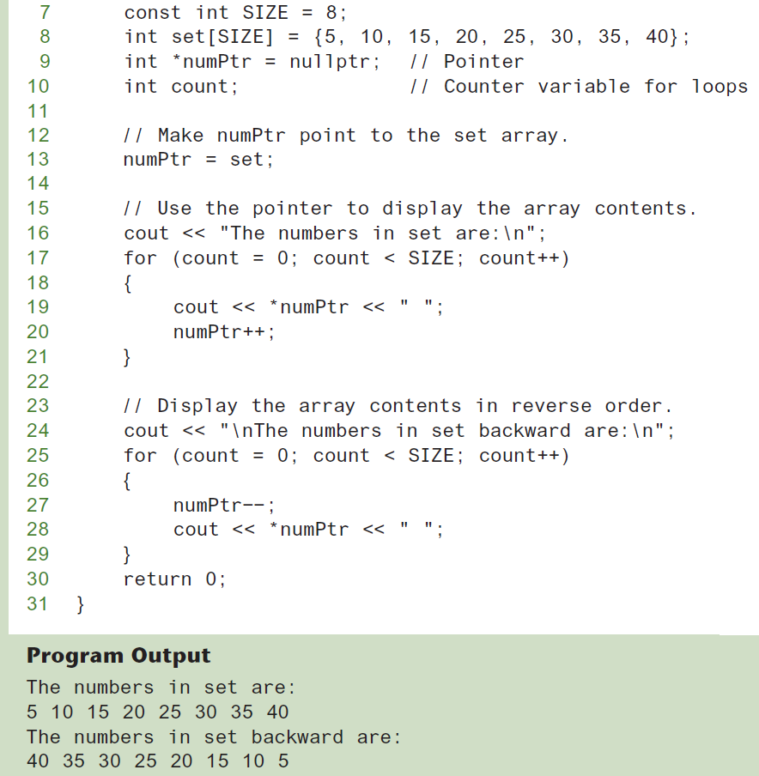
From Program 9-9

Slide 32
9.8
Dynamic Memory Allocation

Slide 33
Dynamic Memory Allocation
Can allocate storage for a variable while program is running
Computer returns address of newly allocated variable
Uses new operator to allocate memory:
  double *dptr = nullptr;
  dptr = new double;
new returns address of memory location

Slide 34
Dynamic Memory Allocation
Can also use new to allocate array:
const int SIZE = 25;
arrayPtr = new double[SIZE];
Can then use [] or pointer arithmetic to access array:
  for(i = 0; i < SIZE; i++)
  *arrayptr[i] = i * i;
  or
  for(i = 0; i < SIZE; i++)
  *(arrayptr + i) = i * i;
Program will terminate if not enough memory available to allocate

Slide 35
Releasing Dynamic Memory
Use delete to free dynamic memory:
  delete fptr;
Use [] to free dynamic array:
  delete [] arrayptr;
Only use delete with dynamic memory!

Slide 36
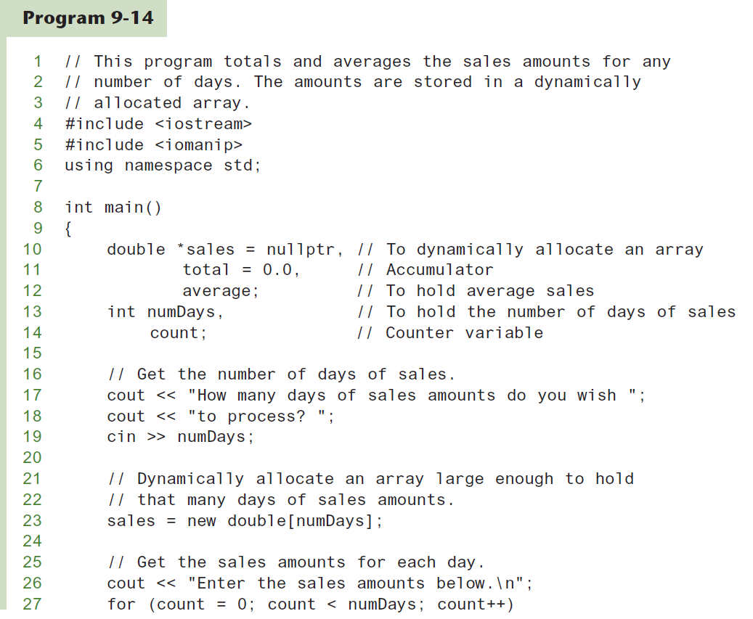
Dynamic Memory Allocation in Program 9-14

Slide 37
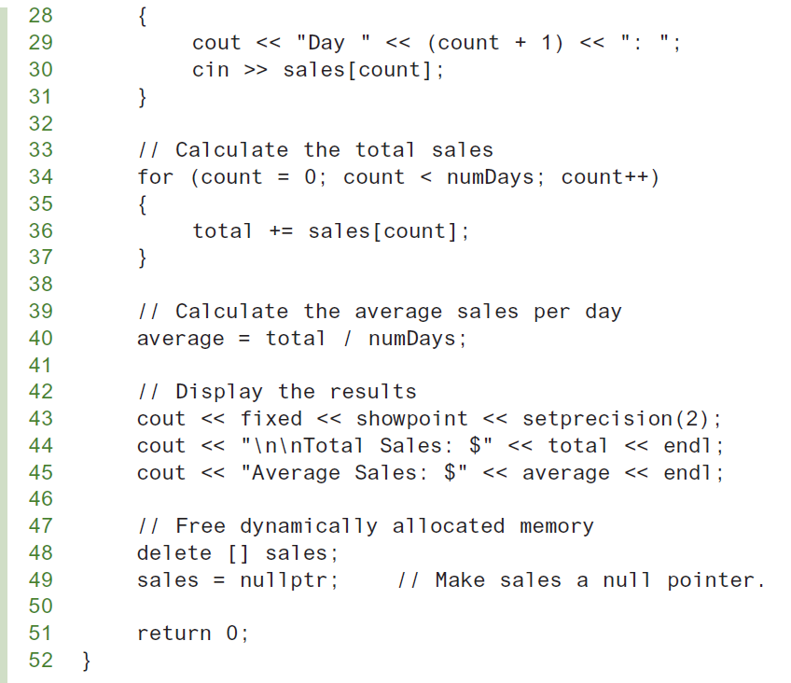
Dynamic Memory Allocation in Program 9-14
Program 9-14 (Continued)

Slide 38
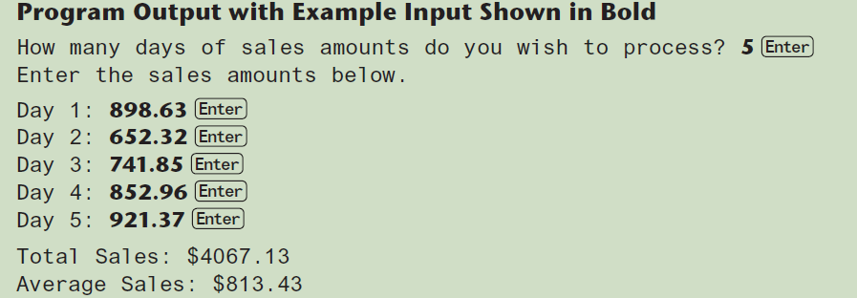
Dynamic Memory Allocation in Program 9-14
Program 9-14 (Continued)
Notice that in line 49 nullptr is assigned to the sales pointer. The delete operator is designed to have no effect when used on a null pointer.

