Slide 1
Lecture 06
CS 4: Introduction to Artificial Intelligence

Slide 2


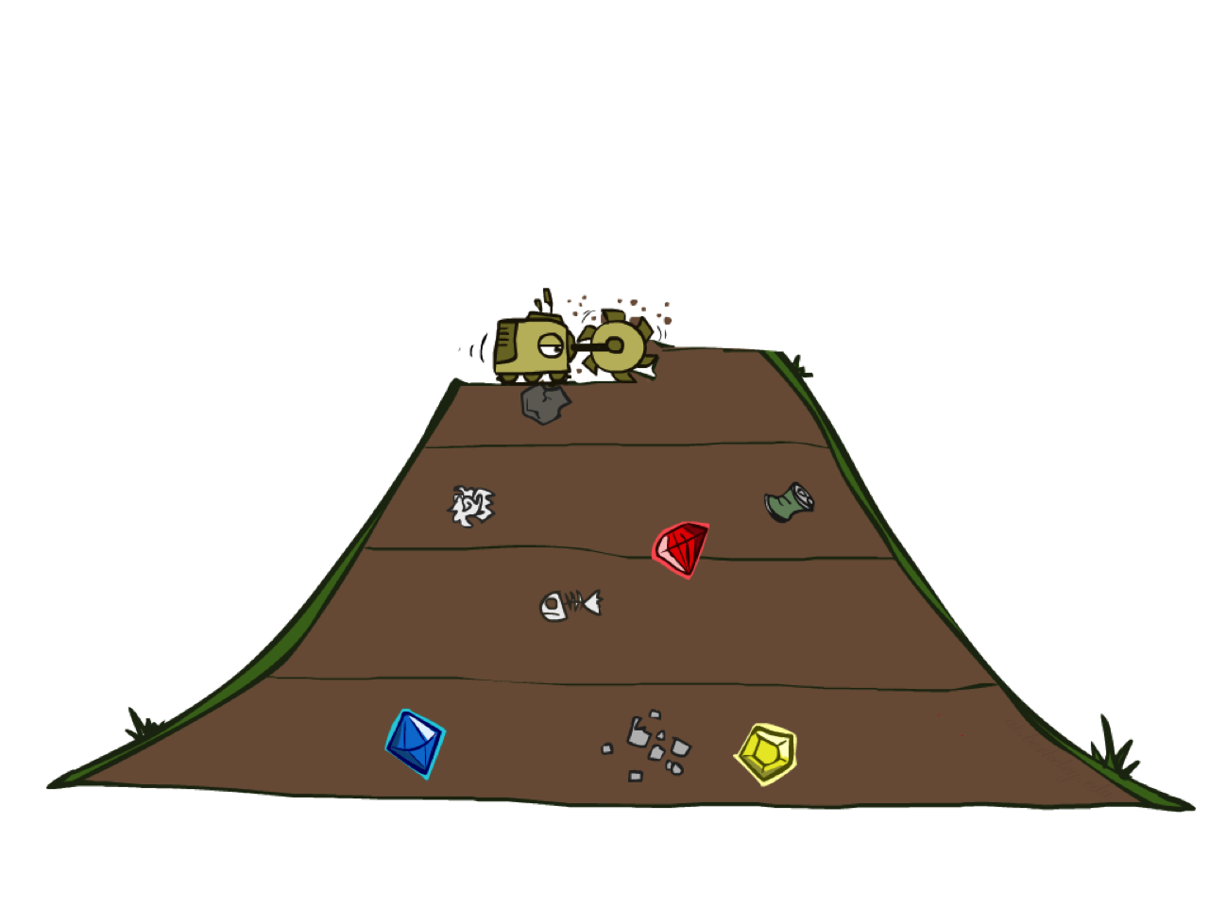
Uninformed Graph Algorithms: Breadth-First Search
Start at the initial state for the problem
Expand this node to find the successor states
For those successors, expand them and find their successors
Repeat this process until a goal state is found
Breadth-first search will search the state space in waves of uniform depth

Slide 3
a
G
b
c
e
d
f
S
h
p
r
q

Slide 4
a
G
b
c
e
d
f
S
h
p
r
q

Slide 5
a
G
b
c
e
d
f
S
h
p
r
q

Slide 6
a
G
b
c
e
d
f
S
h
p
r
q

Slide 7
a
G
b
c
e
d
f
S
h
p
r
q

Slide 8
S
d
e
p
b
c
e
h
r
q
a
a
h
r
p
q
f
p
q
f
q
c
G
q
c
a
G
a

Slide 9
S
d
e
p
b
c
e
h
r
q
Search
Tiers
a
a
h
r
p
q
f
p
q
f
q
c
G
q
c
a
G
a

Slide 10

Video of Demo Maze Water

Slide 11
Inefficient!
function BREADTH-FIRST-BFS(problem) returns a solution node or failure
return BEST-FIRST-SEARCH(problem, depth)

Slide 12
function BREADTH-FIRST-SEARCH(problem) returns a solution node or failure
node ← NODE(problem.initial)
if problem.IS-GOAL(node.state) then
return node
frontier ← a queue with node as an element
reached ← {problem.initial}
while not IS-EMPTY(frontier) do
node ← POP(frontier)
for each child in EXPAND(problem, node) do
s ← child.state
if problem.IS-GOAL(s) then
return child
if s is not in reached then
add s to reached
add child to frontier
return failure

Slide 13





Uninformed Graph Algorithms: Breadth-First Search
Works when all actions have the same cost
If a solution exists, breath-first search will find it
The solution will also be cost-optimal
Problem: memory requirements
1 node
$$b$$
$b$ nodes
$d$ tiers
$b^{2}$ nodes
$b^{d}$ nodes

Slide 14
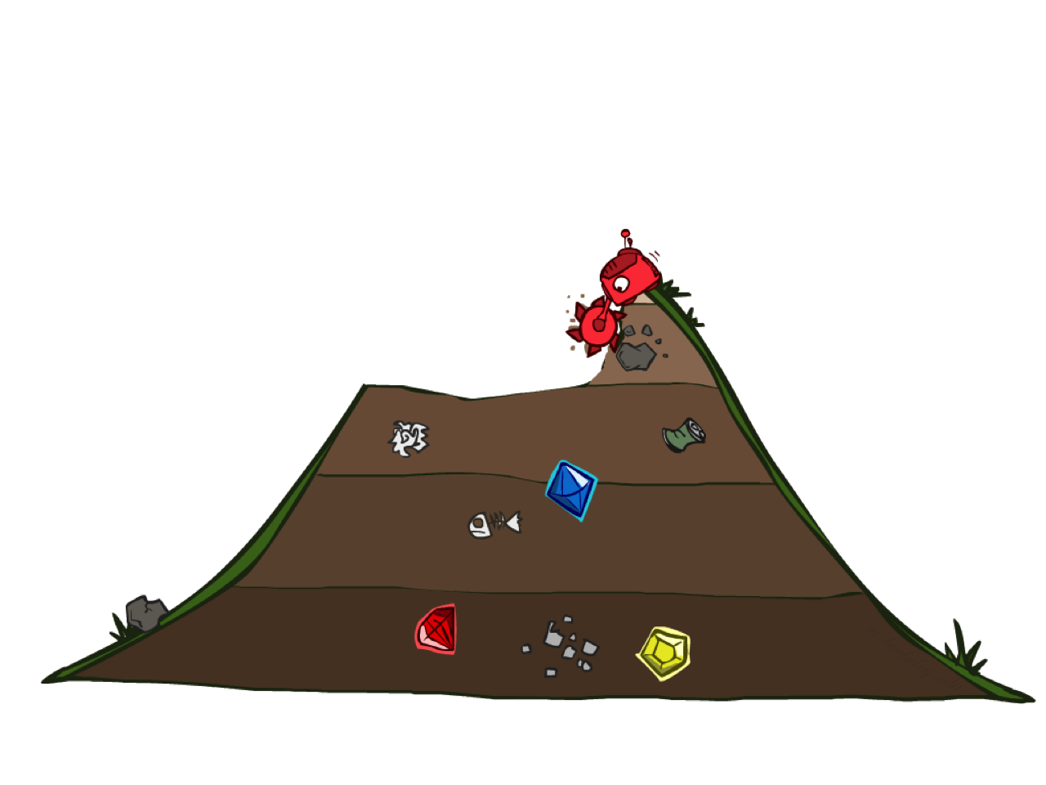
Uninformed Graph Algorithms: Uniform-Cost Search
When actions have different costs, a simple idea is to expand the cheapest node first according to its path-cost
This is called uniform-cost search
AKA, Dijkstra’s algorithm

Slide 15
a
G
2
4
b
c
6
1
8
2
e
2
d
3
f
S
8
2
h
9
7
1
1
p
r
q
10
15

Slide 16
S
0
d
e
p
3
9
1
b
c
e
h
r
q
4
11
5
17
11
16
a
a
h
r
p
q
12
f
6
15
13
7
24
27
p
q
f
q
c
G
20
23
8
39
18
14
q
c
a
G
22
35
14
10
a
18

Slide 17
function UNIFORM-COST-SEARCH(problem) returns a solution node or failure
return BEST-FIRST-SEARCH(problem, path-cost)

Slide 18





Uninformed Graph Algorithms: Uniform-Cost Search
Uniform-cost search will search the state space in waves of uniform path-cost
If a solution exists, uniform-cost search will find it
The solution will also be cost-optimal
Problem: memory requirements
$$b$$
$$c≤1$$
${C^{∗}}/ε$ contours
$$c≤2$$
Even worse than breadth-first search!
$$c≤3$$

Slide 19
Video of Demo Contours UCS Pacman Small Maze

Slide 20
Video of Demo Empty UCS

