Slide 1

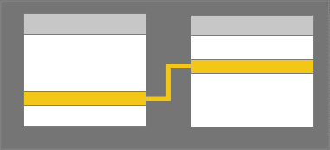




Capture at ☑80%
☑
☑
Mod 2, Unit 2
1. Create relationships between your data sources
Model View
Publish
Browser & mobile apps
Create reports
Publish reports
Power BI Desktop
Power BI service

Slide 2
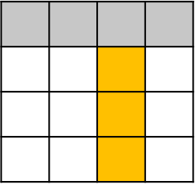
Capture at ☑80%
☑
☑
Mod 2, Unit 3
2. Create a new field with calculated columns
Publish
Browser & mobile apps
Create reports
Publish reports
Power BI Desktop
Power BI service

Slide 3
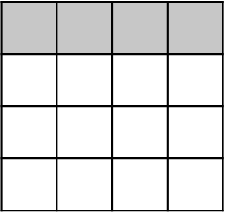
Capture at ☑80%
☑
☑
Mod 2, Unit 4
3. Optimize data by hiding fields and sorting visualization data
Publish
Browser & mobile apps
Create reports
Publish reports
Power BI Desktop
Power BI service

Slide 4

Capture at ☑80%
☑
☑
Mod 2, Unit 4b
4. Create a measure to perform calculations on your data
input field
transformed data
Publish
Browser & mobile apps
Create reports
Publish reports
Power BI Desktop
Power BI service

Slide 5

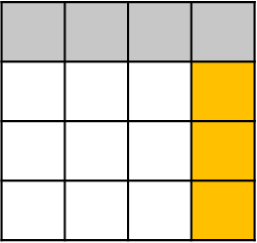
Capture at ☑80%
☑
☑
Mod 2, Unit 5
5. Use a calculated table to create a relationship between two tables
Publish
Browser & mobile apps
Create reports
Publish reports
Power BI Desktop
Power BI service

Slide 6
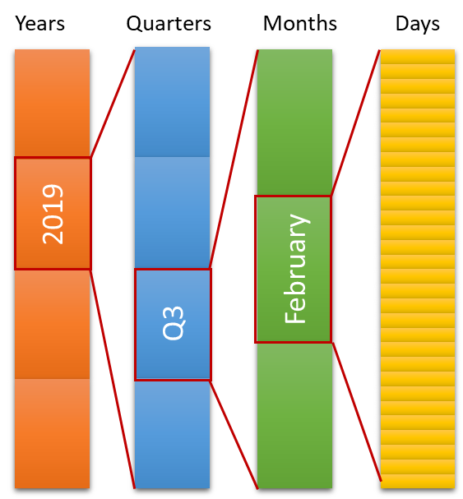
Capture at ☑80%
☑
☑
Mod 2, Unit 6
6. Format time-based data so that you can drill down for more details
Publish
Browser & mobile apps
Create reports
Publish reports
Power BI Desktop
Power BI service

Slide 7
Capture at ☑80%
☑
☑
Mod 2, Unit 2
1. Create relationships between your data sources
Model View
Publish
Browser & mobile apps
Create reports
Publish reports
Power BI Desktop
Power BI service

